Slide 1

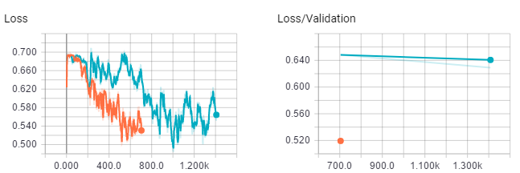
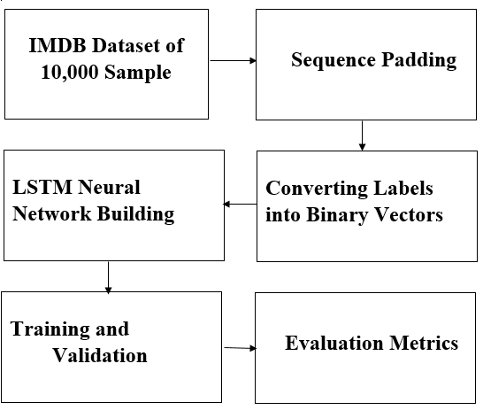
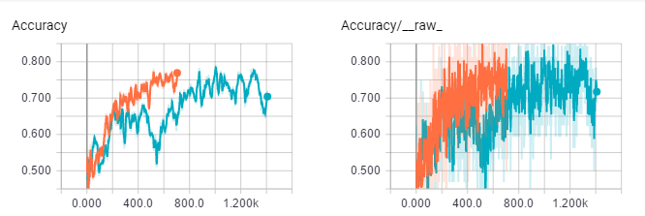
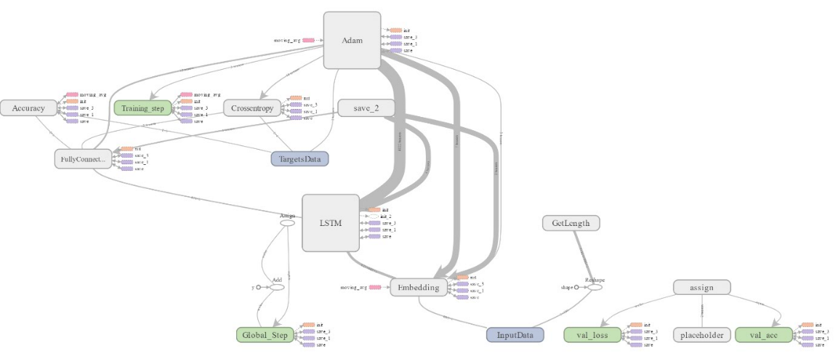
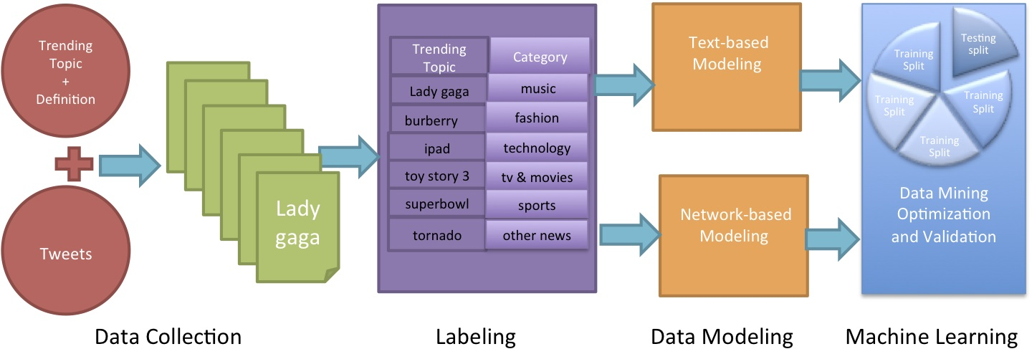
Sentiment Classification of IMDB dataset using Long-Short-Term-Memory (LSTM) neural networks
Lalitha Madhuri Putchala (1), Ravi Teja (2)
(1) lxp76310@ucmo.edu, University of Central Missouri, USA
(2) rxm85860@ucmo.edu, University of Central Missouri, USA
Abstract
Related Work
Design
Results – Variations of Loss and Accuracy during Training
With the advent of social media, the Sentiment Analysis or Emotion AI has become one of the major research areas in the recent times. This research primarily focusses on determine the attitude of the writer, speaker or the overall context of the content. The main applications of the sentiment analysis can be seen in Twitter’s sentiment classification, companies making decisions based on customer review ratings, movie review ratings and so on. Predominantly, researchers follow Lexicon Based approach or Machine Learning approach to perform the sentiment analysis experiments. The rapid pace of development of Machine Learning and Deep Learning sciences are obtained better results for Emotional AI when compared to traditional lexicon-based approach. Among the Machine Learning algorithms, the neural networks when used with deep learning concepts we believe would obtain better accuracy over large datasets.
In this research, we apply a deep learning approach on IMDB movie review dataset for classifying the reviews to positive and negative. We build a Long-Term-Short-Memory (LSTM) recurrent neural networks algorithm using Tensorflow Libraries in Python. Our experiment evaluations indicates that our proposed approach has obtained better accuracy than the existing methodologies.
A vast amount of research has been performed in Sentiment Analysis with various approaches. In the research paper by (Vinodhini G & Chandrasekaran R.M, 2012), the authors presented a brief survey on the Opinion Mining and Sentiment Analysis. (Pak A & Paroubek P, 2010) performed linguistic analysis on the Twitter data as a corpus to discover the phenomena and built a sentiment classifier based on the method TreeTagger for POS tagging. A broad overview of classification of Web forum opinions in multiple languages is addressed by (Abbasi, A Chen H & Salem A, 2008). The utility of the syntactic features and stylish features is measured for the sentiment classification of Arabic and English content. In the research paper by (Tang D, Qin B and Tang Liu, 2015), the authors addressed the application of deep learning algorithms on IMDB datasets. The accuracy results of LSTM network is only 45% which needs to be improved.
We have followed the traditional machine learning data flow. In the initial stages, we have downloaded the first 10,000 samples IMBD dataset and modified the data with respect to the algorithm. We performed the Sequence Padding and converted labels into binary vectors in the data pre-processing stage. We have designed the neural network using LSTM layers. The network design involved the building of the base layer, embedded layer, LSTM layer and fully connected layer. The design flow can be seen in Figure 2:
Figure 2
Figure 4
Motivation
Opinion Mining or Sentiment Analysis has a great impact on today’s world in framing marketing strategies, determining the behavior of the users, influencing the social problem and so on. The research in Sentiment Analysis needs to be extensive and accurate which will have a greater impact. Machine Learning and Deep Learning can become handful to obtain the optimum design and accuracy for Sentiment Classification. Among all the algorithms, the recurrent neural networks can learn from vast amount of data and from past experiences which would obtain satisfactory results. The available deep learning libraries like Keras, Pytorch,mxnet and Tensorflow made it easy for researchers to developers to build robust models. The application of tflearn library in building a sentiment classifier has been not explored. The wide range of functionalities provided by this high-level API of Tensorflow will be a great help in building a sentiment classifier model.
Figure 5
Summary & Future Work
Implementation
In this research. we have proposed a deep learning approach for Sentiment Analysis on IMDB movie dataset using LSTM recurrent neural network. The evaluation results show that our approach has outperformed all the existing methods with a classification accuracy of 98.3%.
The future research work would be applying on larger review datasets along with the gated recurrent neural networks for lightweight applications.
The algorithm is implemented in Python with the help of tflearn library. We have imported built-in functions of tflearn : “to_categorical” for converting the labels to binary vectors and “pad_sequneces” to perform the sequence padding up to the length “100”. We then built the base layer of the network with size “100” and then the following layers. It has to be noted that each layer’s output is provided as input to the following layer. We then trained the network with the help of “tf.learn
and “model.fit” functions with the corresponding parameters required for the network.
Introduction
Social-media has become a powerful communication tool among the people . The internet users share a millions of messages on daily basis in the microblogging websites like Facebook, Twitter and Tumbler. This publicly available data can be used efficiently for social studies or marketing. The influence of the 2016 US elections is one such prime example. Other than lexicon based methods for Opinion Mining, Machine Learning and Deep Learning sciences have a great influence on analyzing the datasets in different ways and can be applied to Sentiment Analysis. In a real-time, the end to end flow of the Sentiment Analysis can be seen in Figure 1:
Figure 1
References
Vinodhini, G., & Chandrasekaran, R. M. (2012). Sentiment analysis and opinion mining: a survey. International Journal, 2(6), 282-292 2) Pak, A., & Paroubek, P. (2010, May). Twitter as a Corpus for Sentiment Analysis and Opinion Mining. In LREc (Vol. 10, No. 2010). 3) Abbasi, A., Chen, H., & Salem, A. (2008). Sentiment analysis in multiple languages: Feature selection for opinion classification in web forums. ACM Transactions on Information Systems (TOIS), 26(3), 12 4) Tang, D., Qin, B., & Liu, T. (2015, September). Document Modeling with Gated Recurrent Neural Network for Sentiment Classification. In EMNLP (pp. 1422-1432).
Results – Graphical Interactions in the network
Research Questions
This research will answer the following hypothetical questions:
Whether a detailed analysis is performed on the current literature on Sentiment Analysis
Whether the proposed Deep Learning approach using LSTM has better accuracy than the existing methods.
Whether using Tensorflow and tflearn libraries has provided robust graphical results to interpret
Figure 3

