Slide 1
Sentiment Analysis using Long-Short-Term Memory (LSTM) Neural Networks: A Deep Learning Approach
Group 1:
Lalitha Madhuri Putchala (700657631)
Ravi teja(700658586)

Slide 2
Outline
Research Statement
Sentiment Analysis
Types of Sentiment Analysis
Methods in Sentiment Analysis
Machine Learning and Deep Learning for Sentiment classification
LSTM Concepts
Existing Literature
Motivation
Research Hypotheses
Design
Algorithm
Results
Summary
Future Work

Slide 3
Research Statement
With the advent of social media, the Sentiment Analysis or Emotion AI has become one of the major research areas in the recent times.
This research primarily focusses to determine the attitude of the writer, speaker or the overall context of the content.
In this research, we apply a deep learning approach on IMDB movie review dataset for classifying the reviews to positive and negative.
We built a Long-Term-Short-Memory (LSTM) recurrent neural networks algorithm using Tensor-flow Libraries in Python.

Slide 4
Sentiment Analysis
Sentiment => Attitudes, Opinions, Emotions or Feelings
Also known as Emotional AI or Opinion Mining
Dislike/Like, Against/For, Bad/good etc.,
Utilizes natural language processing, biometrics, computational linguistics and text analysis methods to perform sentiment classification
Sample Sentiment Analysis questions :
a) How the people are reacting to a new item in the market or a campaign based on their tweets?
b) Whether the customer satisfied with the product or not?
c) Whether the review of a product is positive or negative?

Slide 5
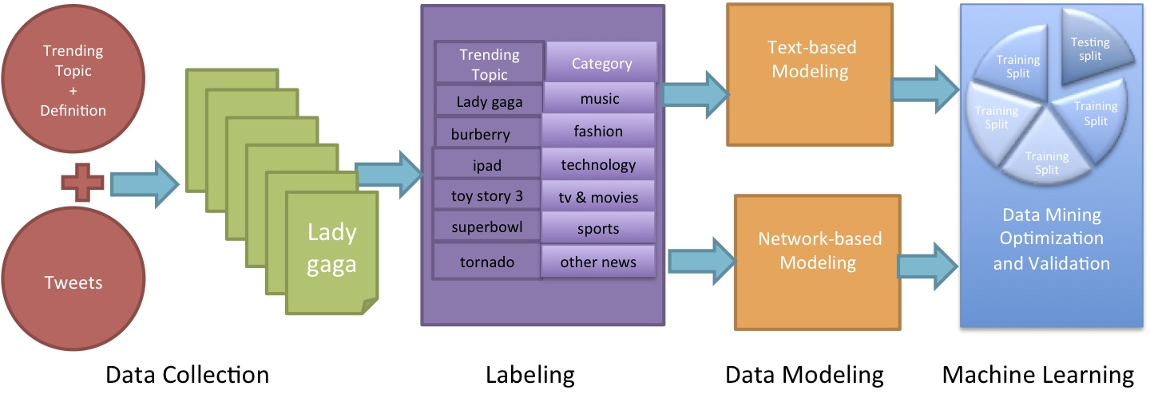
Sentiment Analysis data flow example

Slide 6
Types of Sentiment Analysis
1) Identification of Subjectivity or Objectivity:
Classification of text as either subjective or objective
Ex: People’s opinion in newspapers or blogs
2) Aspect based or Feature based:
Evaluating opinions based on the features of the entities like digital camera or mobile phone
Various features may generate diverse sentiment outputs.
Ex: A restaurant may be at a good location but may not provide tasty good food.

Slide 7
Methods in Sentiment Analysis
Knowledge Based:
Text classification is performed based on the key words such has sad, afraid, happy etc.,
Statistical:
Make use of the machine learning techniques like support vector machines, decision tress, latent semantic analysis etc.,
Hybrid:
Leverage both knowledge representations (semantics and ontologies) and traditional machine learning techniques

Slide 8
Deep Machine Learning for Opinion Mining
Unlike traditional linguistic methods, machine learning statistical techniques are easy to train and also produce better accuracy
Other than traditional machine learning techniques like Support Vector Machines (SVM), Decision trees – deep learning algorithms like recurrent neural networks are more efficient.
Recurrent Neural Networks(RNN) has capability to learn from past data.
RNN, LSTMS and GRUs are the commonly used recurrent neural networks
We chose LSTM which has proven capabilities compared to RNN and GRU.

Slide 9
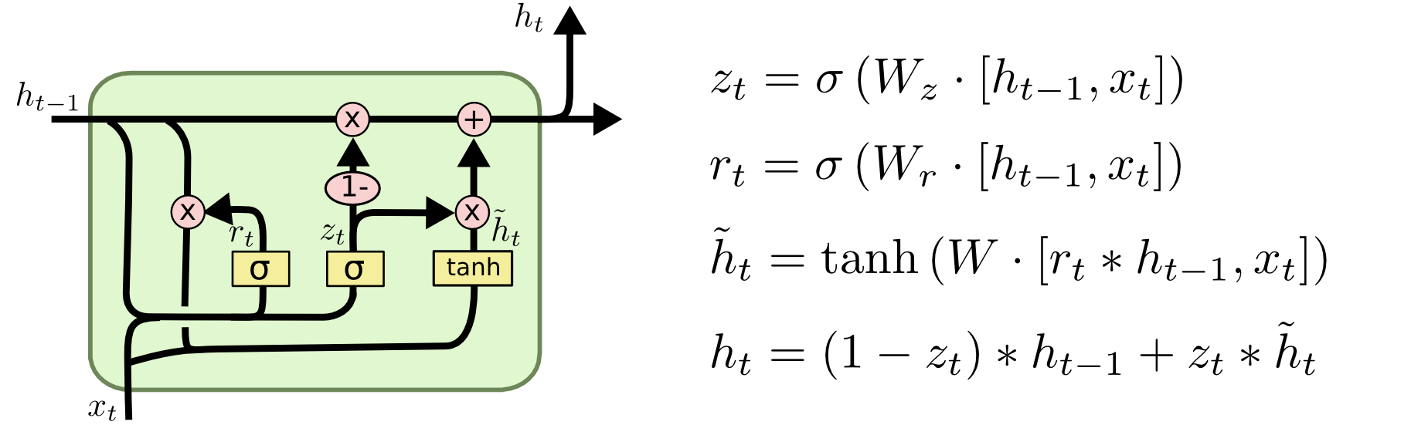
Long-Short Term Memory (LSTM)
Gated Mechanism : Contains Input gate, forget gate, output gate.
Forget Gate : r(t) = Sigmoid (W®.[h(t-1),x(t)])

Slide 10
Existing Literature on Sentiment Analysis
In the research paper by (Vinodhini G & Chandrasekaran R.M, 2012), the authors presented a brief survey on the Opinion Mining and Sentiment Analysis.
(Pak A & Paroubek P, 2010) performed linguistic analysis on the Twitter data as a corpus to discover the phenomena and built a sentiment classifier based on the method TreeTagger for POS tagging.
In the research paper by (Tang D, Qin B and Tang Liu, 2015), the authors addressed the application of deep learning algorithms on IMDB datasets. The accuracy results of LSTM network is only 45% which needs to be improved.

Slide 11
Motivation
Opinion Mining or Sentiment Analysis has a great impact on today’s world in framing marketing strategies, determining the behavior of the users, influencing the social problem and so on.
The research in Sentiment Analysis needs to be extensive and accurate which will have a greater impact. Machine Learning and Deep Learning can become handful to obtain the optimum design and accuracy for Sentiment Classification.
Among all the algorithms, the recurrent neural networks can learn from vast amount of data and from past experiences which would obtain satisfactory results.

Slide 12
Research Hypotheses
This research will answer the following hypothetical questions:
Whether a detailed analysis is performed on the current literature on Sentiment Analysis
Whether the proposed Deep Learning approach using LSTM has better accuracy than the existing methods.
Whether using Tensorflow and tflearn libraries has provided robust graphical results to interpret

Slide 13
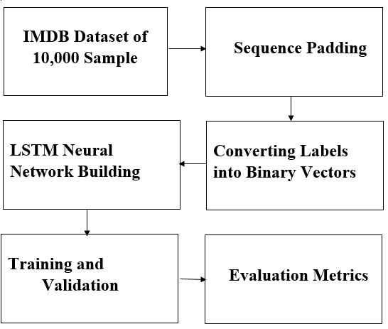
Design
Selected 10,000 samples from IMBD dataset for sentiment classification task.
Sequence Padding is required to restrict the size of the input.
Building the network with LSTM layer. (Base Layer + Embedded Layer + LSTM layer and Full connected layer)
Labels which are in categorical form needs to be converted to binary vectors

Slide 14
Implementation
The whole code is scripted in Python
Libraries used: pandas, numpy, tflearn and tensorflow
Training time for 10,000 samples = 30 minutes approximately
More the number of the training steps the better the accuracy
Trade-off is required for the values of hyper-parameters to avoid over-fitting

Slide 15
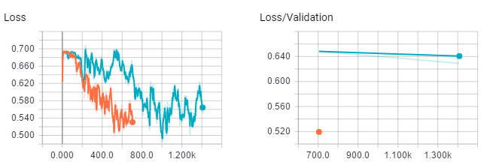
Results - 1
Variation of Training Loss with respect to number of training steps

Slide 16
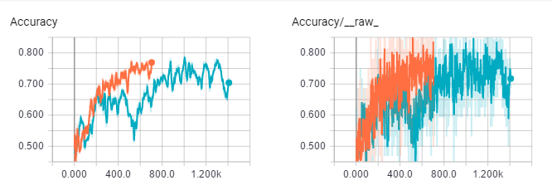
Results – 2
Variation of Training Accuracy with respect to number of training steps

Slide 17
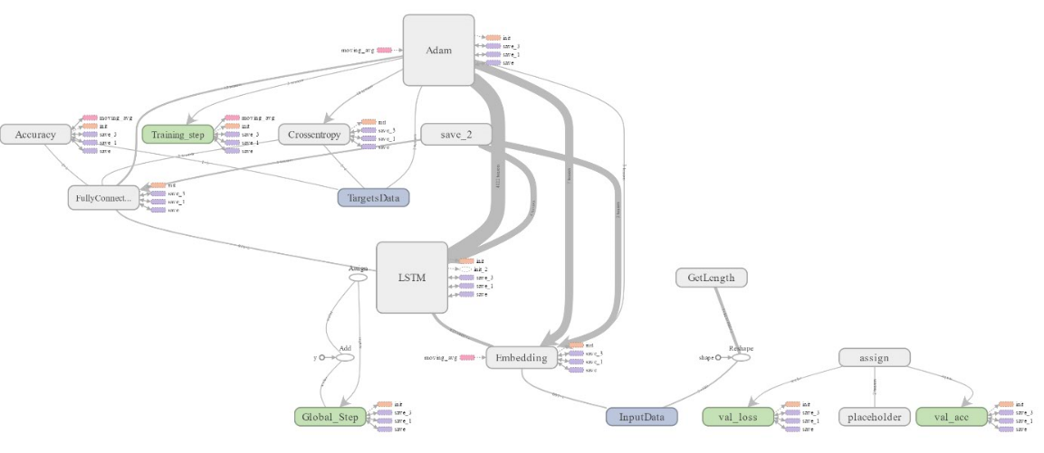
Interactions in network

Slide 18
Summary
In this research. we have proposed a deep learning approach for Sentiment Analysis on IMDB movie dataset using LSTM recurrent neural network.
The evaluation results show that our approach has outperformed all the existing methods with a classification accuracy of 98.3%.

Slide 19
Future Work
The future research work would be applying on larger review datasets along with the Gated Recurrent Unit neural networks (GRU) for lightweight applications.

Slide 20
Thank you

