Slide 1
Design Reuse Through Frameworks and Patterns
Presented By
Lalitha Madhuri Putchala (700657631)

Slide 2
Overview
Introduction
Frameworks and Sedimentation
Intensive Design Reuse
Design Patterns
The Tool – Material Pattern
The Role Pattern
Application Adaptability
Style Guides : Catalogs of well – tried solutions
Criteria for Reuse
Usage Models
Human – Computer Interaction (HCI)
Conclusion

Slide 3
Need of Design Reuse :
There is an increasing trend where customers (users) of banks and other large service organizations demand individual workstation adaptions for specific use now-a-days.
Therefore, Banks and Insurance Companies require standard and flexible application software solutions for mutually exclusive standardization and flexibility requirements
Frameworks and Design Patterns are the perfect solution for these needs.
A real-time example:
A German Company RWG, used an application software Gebos which is based on these frameworks, in more than 17000 banks work places.
RWG was successful in providing the service for heterogeneous group of 400 banks for almost past 10 years.

Slide 4
Approach
Frameworks may also arise few problems and obstacles apart from numerous advantages
Usability problems can be detected and corrected in the early phases of the life cycle to avoid cost wastage.
Solution - Approach : Integrates frameworks and design patterns in to the requirements phase of the SDLC (early stages) where they have proven useful in improving user participation
This approach provides an idea which units are suitable for reuse

Slide 5
More about Frameworks
Objective of Framework : To reuse domain specific units – Ex: customer records, accounts or security accounts
In traditional approaches to software reuse, we create an application program using existing libraries for UI and database access.
Whereas, design reuse through frameworks means that we adapt a prefabricated, fully developed hull – by sub-classing for instance.
Therefore, in frameworks, the program logic is already present.

Slide 6
Sedimentation – creating layers
To design framework -> Focus on small and clearly structured business domain -> Task Analysis by developers -> Involvement of potential users in task analysis and development (user participation)
Multiple Frameworks created based on a criteria that “those chunks that require design again and again are implemented first”
Chunks are then extracted and represented as frameworks in the deeper of two layers – SEDIMENTATION

Slide 7
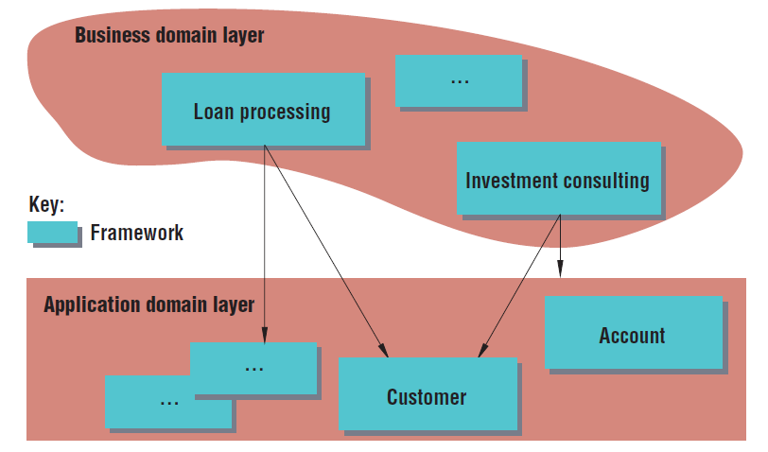
Framework Layers - Sedimentation
Developing stable and reusable frameworks through sedimentation. Implementation chunks in the business domain layer that are shared by at least two frameworks sediment into the application domain layer

Slide 8
Intensive Design Reuse
Direct access to the objects in ADL is not possible. We can obtain the sum of operations and attributes shared by all type of objects through sedimentation.
Similar procedure for frameworks containing user interface (UI)
During SDLC, the common functionalities of a task settle in to ADL. An example of this type is the development of an editor framework.
Other interactive frameworks like email mechanisms and electronic signatures also follow the sedimentation for the intensive design reuse

Slide 9
Design Patterns
Not easy task to document the details of all frameworks -> solution : Design Patterns
Design Patterns are metaphors that describe the behavior and structure of a single framework or the interplay between multiple frameworks – gives an idea conceptually how they work
They support user participation and provide pre-requisites for a highly useable system
Two types
The Tool – Material Pattern
The Role Pattern

Slide 10
Tool – Material Design Pattern
Describes the interplay between application domain objects (such as an account) and objects for interaction purposes (such as an editor), is derived from the tool-material metaphor.
The metaphor – namely, that materials can be worked on with these tools
User Interface changes will not affect the material frameworks contained in the business design layer or ADL
Can also be used for structuring the user interface
Tool Material Design is an excellent example of how we can get conceptual models to converge.

Slide 11
Role Pattern
Maintaining diverse but adaptable employee workstations presents technical challenges:
Fast system response time
Smooth sedimentation process
Solution for the above problem is “Role Pattern” where everyday business transactions serve as metaphors for structuring the software architecture.
Benefits user participation like tool – material pattern
If role changes, only that role’s framework is affected. The customer core framework in the application domain and the frameworks of other roles remain unaffected.

Slide 12
Role Pattern – Cont’d
This approach is applicable when developing frameworks for traditional industries such as banking or insurance, where the application domain has been stable for several years
However, it might be less worthwhile to try to initiate a sedimentation process in young fields of business.
In such cases, it takes some release cycles until business objects become stable; only then are they candidates for sedimentation

Slide 13
Application Adaptability
As individual frameworks all use the same customer core but operate independently, we can easily develop task-specific applications in an elegant way
Role pattern offers practical and elegant possibilities for tailoring an application to particular activities
The Tool – Material pattern provides adaptability features by making a set of tools and materials available, thus addressing the distinct requirements of different types of workplaces.

Slide 14
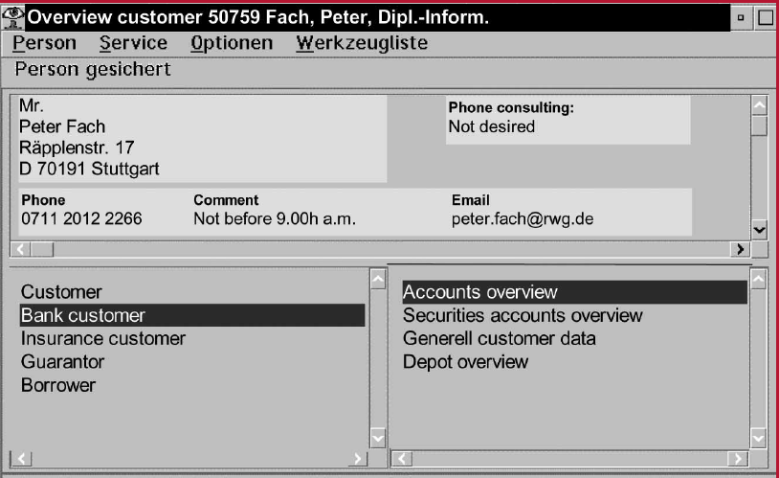
Correspondence between the software architecture and user interface. Workplace-specific roles appear in the lower left, and the materials available are listed on the lower right

Slide 15
Style guides: Catalogs of well-tried solutions
It is now possible to reuse entire tools, not just materials, single controls, and widgets – the common practice so far
For larger applications style guides became extremely important
Why style guides?
When developer uses Tool-Material pattern, -> as application system evolves -> reusing existing ones increases -> standardization work is mainly concentrated in early stages of the SDLC -> which means the small part of software team (base developers) who involve in initial part of the SDLC would only require to have the knowledge of style guides

Slide 16
Style guides – Cont’d
Style guides for framework development must take in to account these two issues:
Criteria for reuse
Usage Models
Criteria for reuse: It is important to preciously define the situations in which developers may use a particular tool. Otherwise, there is the danger that it might be used outside the intended context
Usage Models: It is the set of all metaphors that guide how to use an application.
Must be developed in the early stages of development process
Failing to do so leads to misuse of tools -> application modification -> slowing down

Slide 17
Human Computer Interaction (HCI)
HCI people must be involved very early in the framework development
They must have typical knowledge base as well as the technical design process of frameworks
Help develop suitable metaphors for design patterns
Ensure that these metaphors are realized consistently in the development process

Slide 18
Conclusion
Complete catalogs of technical solutions, documented as design patterns using metaphors are now available
These have potential to support the convergence of design models and conceptual models
Ex : Tool Material and Role Patterns
Therefore, with the help of frameworks and appropriate metaphors for design patterns, it should be possible to realize in software development that a pattern language would provide well-designed and successful solutions

Slide 19
Thank you

