Slide 1

Bike sharing DEMAND PREDICTION
Yulu Rental Bike Service

Slide 2
Contents
Executive Summary
Background
Core Team & Stakeholders
Scope & Objectives
Project Development Timeline
Development Strategy
Development Details
Results
Value & Next Steps
Socialization & Distribution

Slide 3
Executive Summary
Analyzed two years of rental bike data and corresponding weather variables.
Developed a predictive model for accurate hourly bike demand forecasts.
Enhanced bike availability and urban mobility through data-driven optimization.
Provided strategic insights for planning and operational efficiency in bike-sharing services.

Slide 4
Background on Urban Bike Rentals
Rental bikes enhance urban mobility and convenience.
Availability at the right times is key to reducing wait times.
Stable bike supply is crucial for city-wide service reliability.
Aim: Predict hourly bike demand using 2 years of rental data and weather conditions.

Slide 5
Core Team & Stakeholders
CORE TEAM:
Data Analyst1
Data Analyst2
Business Intelligence Analyst
Operations Coordinator
Inventory/Fleet Manager
STAKEHOLDERS:
Executive leadership
Operations team
Marketing team

Slide 6
SCOPE & OBJECTIVES
Scope of the Project:
Historical Data Analysis: Examine two years of bike rental data alongside weather conditions.
Predictive Modeling: Develop a statistical model to forecast bike rental demand.
Model Deployment: Implement the model into the operational framework for real-time demand prediction.
Objective of the Project:
Demand Prediction: To accurately predict the hourly demand for rental bikes, enabling effective inventory management and enhanced service reliability.

Slide 7
Project Development Timeline
- Exploratory Data Analysis – 1 day
- Data cleaning and pre-processing – 2 days
- Model building – 2 days
- Performance Evaluation – 1 day
- Model Comparison and selection – 1 day

Slide 8
Development strategy |Model Selection
Employed a comparative approach using four distinct predictive models.
Evaluated each model based on its performance metrics and computational efficiency.
Models tested include:
Linear Regression: For baseline performance.
Ridge Regression: To address potential multicollinearity.
Random Forest Regressor: For its ensemble learning capabilities.
XGBoost: For high performance on structured data.

Slide 9
Development details
Data Source – 2 years data collected of bike rentals count per each hour of the day.
Data Dictionary:
Field | Description
Date | year-month-day
Rented Bike count | Count of bikes rented at each hour
Hour | Hour of the Day
Temperature | Temperature in Celsius
Humidity | %
Windspeed | m/s
Visibility | 10m
Dew Point Temperature | Celsius
Solar radiation | MJ/m2
Rainfall | Mm
Snowfall | Cm
Seasons | Winter, Spring, Summer, Autumn
Holiday | Holiday/No Holiday
Functional Day | NoFunc(Non Functional Hours), Fun(Functional Hours)

Slide 10
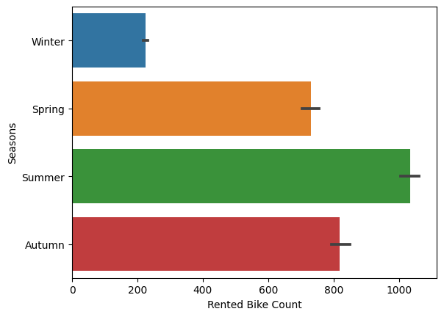
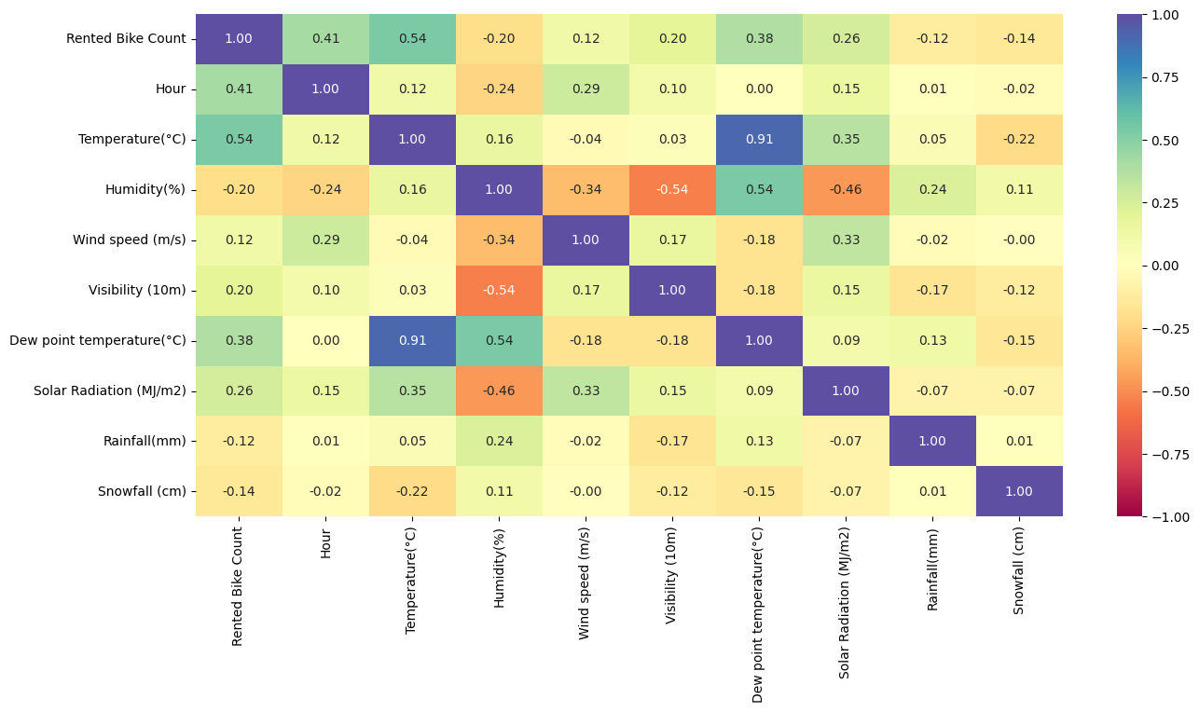
Development details | Data
Seasonal Ride share count
Correlation Matrix

Slide 11
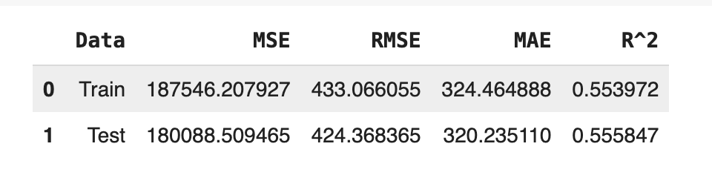
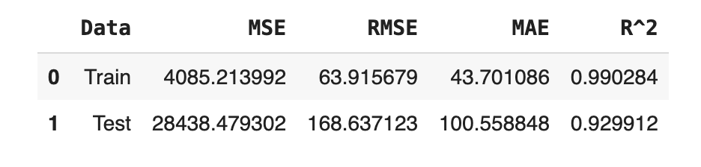
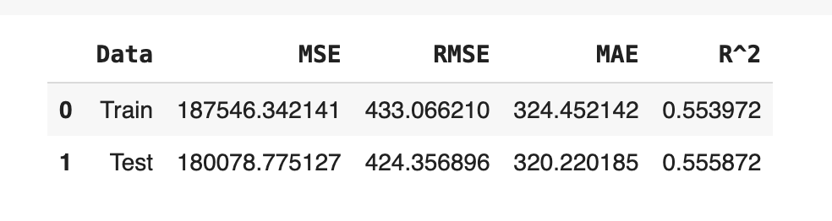
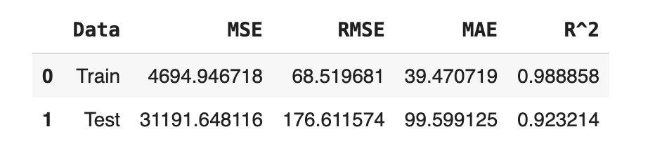
Development details
XGBoost
Linear Regression
Ridge Regression
Random Forest

Slide 12
Development details
Model Comparison
XGB Regression stands out as the most promising choice for the dataset dataset. It exhibits the lowest Mean Squared Error (MSE) at 28,438.48 and the highest R-squared value of 0.9299, indicating a strong predictive performance.
MODEL | MSE | RMSE | MAE | R2
Linear | 180,088 | 424 | 320 | 0.56
Ridge | 180,078 | 424 | 320 | 0.56
Random Forest | 30,925 | 176 | 98 | 0.92
XGBoost | 28,438 | 169 | 101 | 0.93

Slide 13
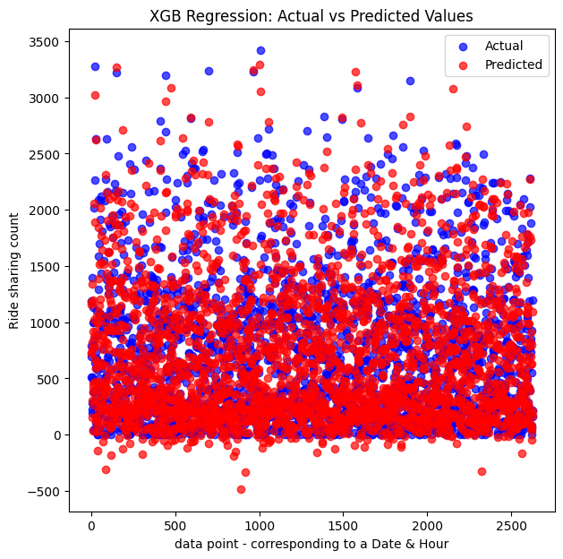
RESULTS

Slide 14
Value Provided
Enhanced Service Delivery
Operational Efficiency
Data-Driven Decisions
Market Responsiveness
Sustainability Impact
Competitive Advantage

Slide 15
NEXT STEPS
Model Deployment
Performance Monitoring
Feedback Loop
Ongoing Training
Expansion Planning
Technology Assessment
Stakeholder Engagement
Marketing Strategy

Slide 16
Scope CAN BE EXTENDED TO
Demand Forecasting
Inventory Optimization
Maintenance Planning
Technology Upgrade

Slide 17
Socialization & Distribution
Model Updating
Performance Updates
Dashboard Development

