Slide 1
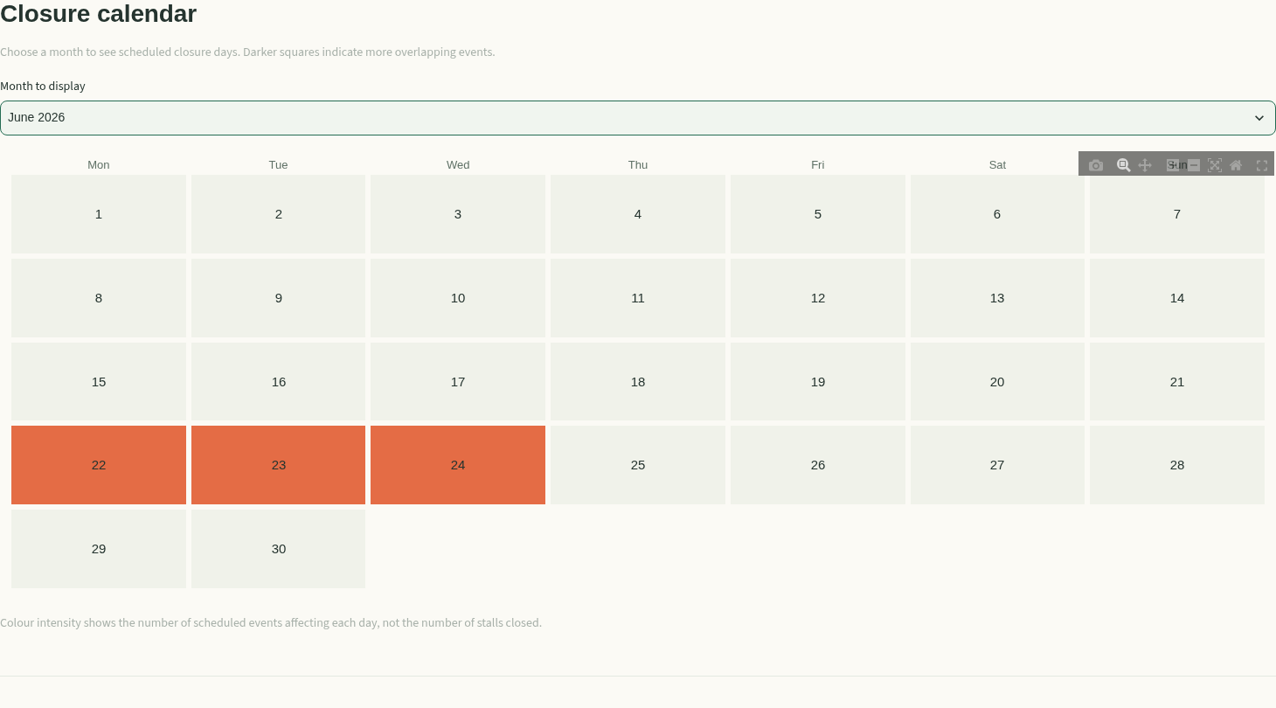
MOTIVATION &
OBJECTIVES
DATA SOURCES &
PREPARATION
APPROACH &
METHODOLOGY
DASHBOARD
CHALLENGES & LIMITATIONS
Discover Singapore,
one hawker at a time.
HAWKERGO
Plan with schedules.
Find a nearby alternative.
DS608 CLOUD COMPUTING
Madhurima Subramaniam Rudra (Madhu)
Nicolyne Tiana Lie · Enhui
DS608 / GROUP PROJECT 2026
01
Notes:
Opening | 40 seconds
A good hawker visit starts before we leave home. HawkerGO brings scheduled closures, nearby alternatives and stall information into one Streamlit dashboard. Our focus is practical: help a resident check a plan and find another option when a favourite centre is scheduled to close. This is a group project by Madhurima Subramaniam Rudra, known as Madhu, Nicolyne Tiana Lie and Enhui. Today we will follow five sections: motivation and objectives, data sources and preparation, approach and methodology, the dashboard, and challenges and limitations.

Slide 2
MOTIVATION &
OBJECTIVES
DATA SOURCES &
PREPARATION
APPROACH &
METHODOLOGY
DASHBOARD
CHALLENGES & LIMITATIONS
Good food shouldn't
be hard to plan for.
THE QUESTION
Can public
schedules
become a
better visit
decision?
01
A favourite may be closed.
Cleaning and other works affect visit plans.
02
The next option needs context.
Location, walking distance and scheduled status matter.
03
Centre size can mislead.
Food stalls and market stalls serve different needs.
A planning problem grounded in public schedules.
DS608 / GROUP PROJECT 2026
02
Notes:
The problem | 45 seconds
The problem is a decision, rather than a lack of restaurant recommendations. A resident may know where they want to eat but still need to know whether a scheduled cleaning period overlaps their visit. If it does, they need another centre nearby. A large centre is also not automatically the best choice for cooked food: total stalls combine food and market stalls. Our research question is how public closure data can be transformed into an interactive dashboard for visit planning. We do not estimate wasted journeys or claim measured time savings; those would require separate user research.

Slide 3
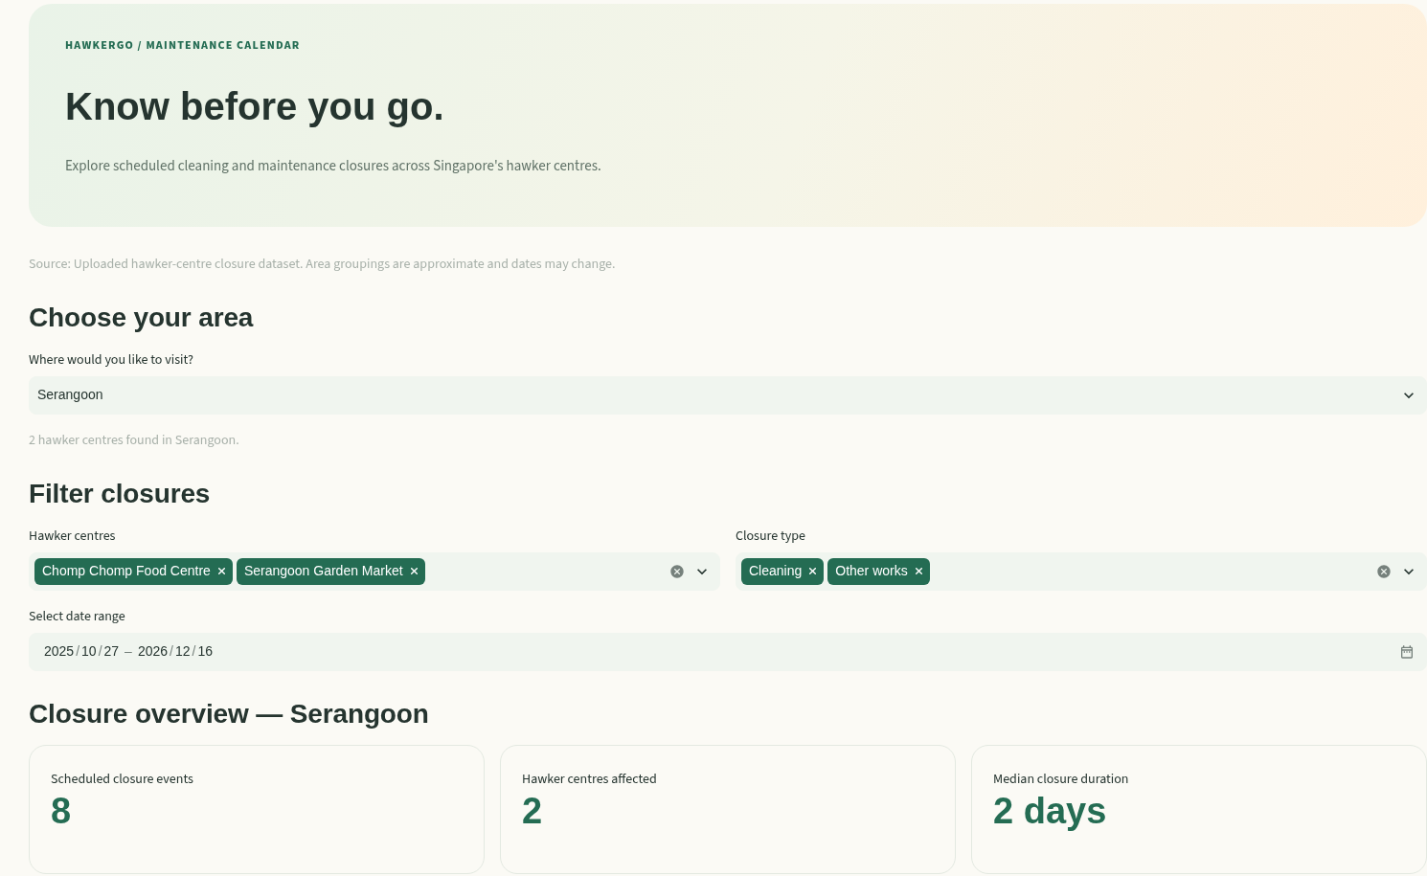
MOTIVATION &
OBJECTIVES
DATA SOURCES &
PREPARATION
APPROACH &
METHODOLOGY
DASHBOARD
CHALLENGES & LIMITATIONS
Our objective:
a better visit plan.
Three connected views.
One practical decision.
123
centres in the included dataset
3
interactive dashboard pages
DS608 / GROUP PROJECT 2026
03
Notes:
Meet HawkerGO | 45 seconds
HawkerGO combines three views of the same planning problem. Explore Hawkers supports date, MRT and status filtering, centre details and nearby alternatives. The Maintenance Calendar presents cleaning and other works over time. Stall Insights compares the distribution of food and market stalls. There are 123 centre records in the included processed dataset. These are dataset coverage figures, not a claim about complete current national coverage. The screenshot is captured from the working app. Its status labels are computed from uploaded schedules, so they must not be interpreted as a live operational feed.

Slide 4
MOTIVATION &
OBJECTIVES
DATA SOURCES &
PREPARATION
APPROACH &
METHODOLOGY
DASHBOARD
CHALLENGES & LIMITATIONS
Public records.
Decision-ready views.
INPUTS
PREPARATION
APPLICATION
Closure CSV
Event-level cleaning
Feature-ready tables
→
→
123 centre records
Dates, remarks, location, stalls
Parse quarterly date pairs
Classify valid and review records
Calendar events
Centre attributes + distance matrix
539
513
26
closure event records
valid dated events
records needing review
Local GeoJSON files cover hawker centres and MRT exits. Original source URLs, dates and licences still need verification.
DS608 / GROUP PROJECT 2026
04
Notes:
Data and preparation | 50 seconds
The repository includes a raw closure CSV with 123 centre records, plus hawker-centre and MRT-exit GeoJSON files. The closure loader in src/wrangle.py reshapes quarterly cleaning and other-works date pairs into 539 event records. Of these, 513 have valid date ranges and 26 require review. It parses day-month-year dates, computes inclusive duration and retains remarks. The Explore and Stall Insights pages read the processed centre CSV; the alternative finder also reads a 123-by-123 distance matrix. The complete lineage of those processed files is not documented. Original dataset URLs, publication dates and licences remain a verification task; we do not invent them here.

Slide 5
MOTIVATION &
OBJECTIVES
DATA SOURCES &
PREPARATION
APPROACH &
METHODOLOGY
DASHBOARD
CHALLENGES & LIMITATIONS
Turn dates into decisions.
Transparent rules connect every input to a visible result.
STEP | IMPLEMENTED METHOD | DECISION SUPPORTED
1 Structure | Reshape quarterly date pairs into events; parse dates and flag invalid ranges | Separate dated schedules from records needing review
2 Filter | Match area, centre and closure type; retain overlapping date ranges | See which scheduled closures affect a visit
3 Compare | Use the included walking-distance matrix; rank three centres without a recorded closure | Find a nearby alternative for the selected day
4 Interpret | Add food and market stalls; compare totals and composition | Understand what centre size represents
Rules are descriptive and schedule-based. No prediction model, live status feed or food-quality score is implemented.
DS608 / GROUP PROJECT 2026
05
Notes:
Approach and methodology | 55 seconds
Our methodology uses transparent rules rather than a prediction model. First, reshape each centre's quarterly cleaning dates and other works into event records. Parse valid date ranges, calculate inclusive duration and retain incomplete records for review. Second, filter by area, centre and closure type, keeping events whose date ranges overlap the selected visit period. Third, use the included walking-distance matrix to rank three alternative centres with no closure recorded on the chosen day. Finally, calculate total stalls and compare their food and market composition. These descriptive methods make the dashboard explainable. They do not predict food quality, popularity or real-time availability. The following architecture slide shows how those rules are implemented.

Slide 6
MOTIVATION &
OBJECTIVES
DATA SOURCES &
PREPARATION
APPROACH &
METHODOLOGY
DASHBOARD
CHALLENGES & LIMITATIONS
A small, transparent stack.
Streamlit / Python
Browser
Local CSV files
app.py → st.navigation
Explore · Calendar · Stall Insights
Pandas transforms + Plotly charts
st.cache_data for selected loaders
Controls, tables
and chart interactions
Centre attributes
Closure events
Walking-distance matrix
VERIFIED HERE / local Streamlit process + Python environment
No database, live ingestion API, autoscaler or production cloud endpoint is evidenced in the repository.
DS608 / GROUP PROJECT 2026
06
Notes:
Implemented technical architecture | 50 seconds
The browser communicates with one Streamlit application process. The entry point registers three pages through st.navigation. Python and Pandas handle the tabular data, and Plotly supplies the interactive charts. Selected loaders use Streamlit caching. Data storage is file based: local CSV files, not a managed database. There is no live ingestion API, authentication service or autoscaling configuration in the repository. We have verified this local process inside the development environment. That is different from publishing the application for end users. A running cloud development workspace does not establish a deployed product endpoint, an availability target or production scaling behavior.

Slide 7
MOTIVATION &
OBJECTIVES
DATA SOURCES &
PREPARATION
APPROACH &
METHODOLOGY
DASHBOARD
CHALLENGES & LIMITATIONS
From “is it closed?”
to “where next?”
01
02
03
CHECK
→
FILTER
→
DECIDE
Maintenance Calendar
Explore Hawkers
Alternative stall finder
Serangoon / June 2026
22 June / Lorong Chuan MRT
Serangoon Garden Market
22–24 June: Chomp Chomp cleaning
Chosen centre is scheduled closed
Listed distance: about 0.1 km
An illustrative journey using dates in the included schedule, not a current operating-status guarantee.
DS608 / GROUP PROJECT 2026
07
Notes:
The user journey | 40 seconds
Here is the journey demonstrated in the video. First, check the Maintenance Calendar for Serangoon in June 2026. It records a Chomp Chomp cleaning closure from the twenty-second to the twenty-fourth. Next, set the Explore page to the twenty-second of June and filter for Lorong Chuan MRT. The selected centre is marked closed according to that schedule. Finally, inspect the alternative finder: Serangoon Garden Market is listed about one tenth of a kilometre away. This is an illustrative historical scenario from the supplied data, rather than advice that either centre is open right now. Distances and walking times are estimates.

Slide 8
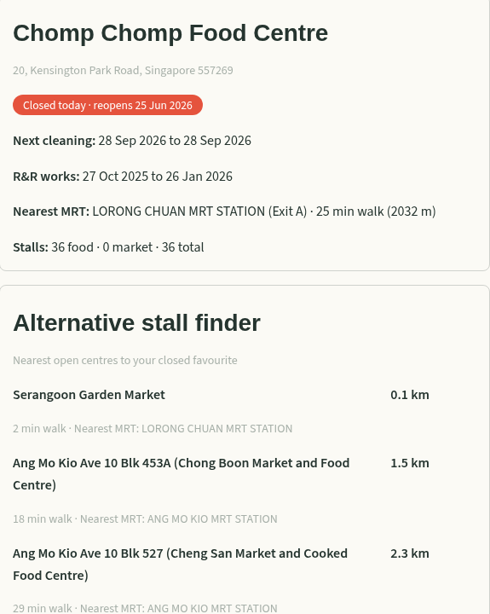
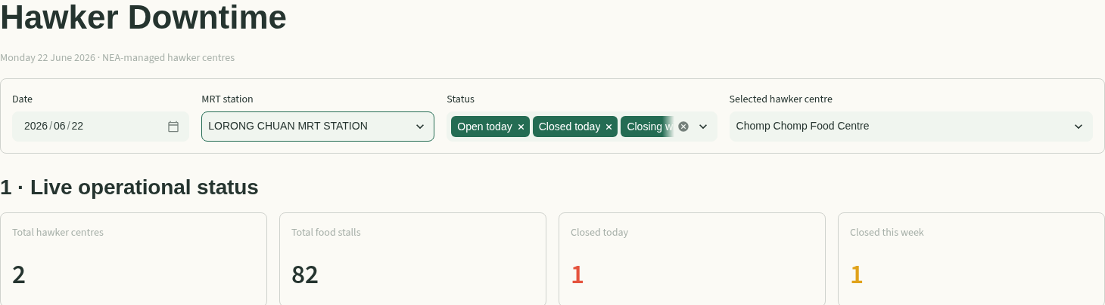
MOTIVATION &
OBJECTIVES
DATA SOURCES &
PREPARATION
APPROACH &
METHODOLOGY
DASHBOARD
CHALLENGES & LIMITATIONS
A closed favourite.
A nearby alternative.
DATE + MRT + STATUS
Filter the visit, read the centre details,
then compare the listed alternatives.
DS608 / GROUP PROJECT 2026
08
Notes:
Explore Hawkers | 50 seconds
Explore Hawkers begins with the visit date, an MRT station, a status filter and a selected centre. The summary cards update for the MRT-filtered group. The detail card shows address, scheduled status, future cleaning information, stall counts and an estimated walk from the nearest MRT. The alternative finder uses an included centre-to-centre distance matrix and ranks three centres that have no closure recorded for the selected day. The implementation does not ask a routing service for each visit. The map is implemented in Plotly, but external basemap requests are blocked in this recording environment, so the demonstration focuses on the working controls and detail cards.

Slide 9
MOTIVATION &
OBJECTIVES
DATA SOURCES &
PREPARATION
APPROACH &
METHODOLOGY
DASHBOARD
CHALLENGES & LIMITATIONS
A centre’s size is only
part of the story.
Chinatown Complex: 703 total stalls
226
food stalls
477
market stalls
Included dataset • top five by total stalls • counts are not quality or popularity measures.
DS608 / GROUP PROJECT 2026
09
Notes:
What stall counts reveal | 45 seconds
The Stall Insights page gives us a useful analytical distinction. In the included data, Chinatown Complex has the largest total count: 703 stalls. That comprises 226 food stalls and 477 market stalls. So ranking only by total size can obscure what a visitor wants to do. The stacked bars make the composition visible, while the app also provides a top-ten table and a scatter plot of food versus market stalls. These counts describe the dataset, not popularity, food quality or sales. In this slide the chart is a native editable PowerPoint chart with its underlying values, rather than an image of a chart.

Slide 10
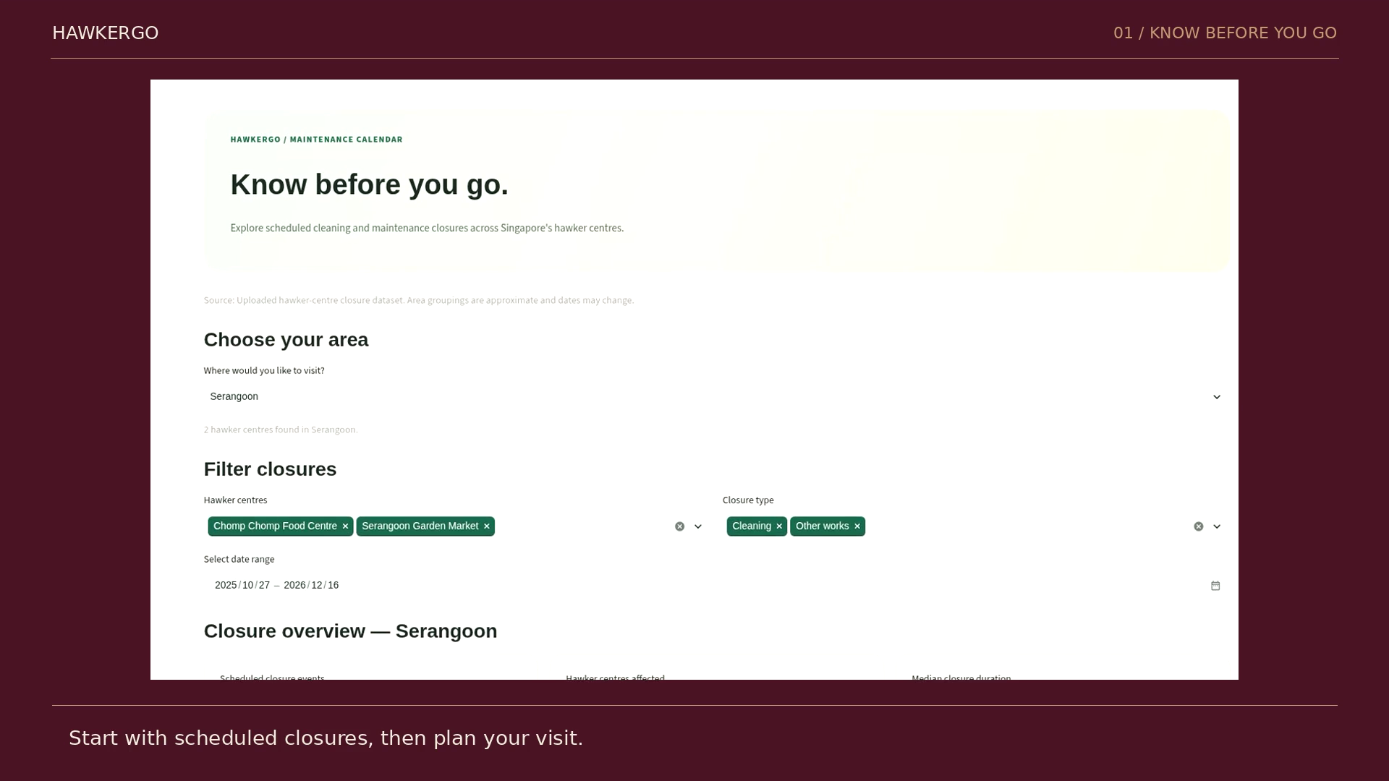
MOTIVATION &
OBJECTIVES
DATA SOURCES &
PREPARATION
APPROACH &
METHODOLOGY
DASHBOARD
CHALLENGES & LIMITATIONS
HawkerGO in action
CLICK TO PLAY / 1:13 / CAPTIONED
DS608 / GROUP PROJECT 2026
10
Notes:
Demo — play video | 80 seconds
Play the embedded video. The silent, captioned recording shows genuine interactions with the locally running Streamlit application: choose June, read the cleaning dates, filter Explore Hawkers by date and MRT, inspect the alternative finder, and open the stall-count table. Allow the complete 73.2-second clip to finish. Do not speak over the subtitles unless clarification is useful. After playback, explain that the example uses scheduled status rather than a real-time feed.

Slide 11
MOTIVATION &
OBJECTIVES
DATA SOURCES &
PREPARATION
APPROACH &
METHODOLOGY
DASHBOARD
CHALLENGES & LIMITATIONS
Make the next version
more trustworthy.
01
02
03
FRESHNESS
LINEAGE
REPRODUCIBILITY
Schedules can change.
“Open” means no recorded closure.
Source URLs and licences are incomplete.
Area groups use approximate keywords.
Walking precompute paths
and filename differ from
the app’s files.
Next: dated refreshes + official notices.
Next: verified sources + provenance.
Next: repair the pipeline + add tests.
DS608 / GROUP PROJECT 2026
11
Notes:
Limitations and roadmap | 50 seconds
Three limitations define the next version. First is freshness. The app uses uploaded schedules; the Explore heading says live operational status, but there is no live feed. No recorded closure does not guarantee that every stall is open. Second is lineage: verify the source URLs, licences and publication dates, and replace approximate area grouping if official boundaries are needed. Third is reproducibility: the walking-distance precompute script expects different paths and an output filename that differ from the runtime files. The distance matrix is included, so the app runs, but regeneration is incomplete. External map tiles were also blocked here. These are genuine limitations, not hidden by the demo.

Slide 12
MOTIVATION &
OBJECTIVES
DATA SOURCES &
PREPARATION
APPROACH &
METHODOLOGY
DASHBOARD
CHALLENGES & LIMITATIONS
HAWKERGO
Explore More.
Discover Better.
CHECK THE DATE.
FIND AN ALTERNATIVE.
UNDERSTAND THE OPTIONS.
Madhu · Nicolyne Tiana Lie · Enhui
Working local demo verified.
No production app link verified.
github.com/nicolynetiana/
HawkerGO_DS608_project
DS608 / GROUP PROJECT 2026
12
Notes:
Closing | 30 seconds
HawkerGO turns a collection of public schedules and centre attributes into a clearer visit decision. The experience connects three questions: when should I go, where could I go instead, and what kinds of stalls will I find? We have demonstrated the working local application and explained the data preparation and rules behind its results. The next priorities are trustworthy refreshes, documented data lineage and a reproducible deployment. The repository is linked on screen. Thank you. We welcome questions about the filtering logic, the meaning of scheduled status, and which operational improvements should come first.

