Slide 1
Data Structures and Algorithms -3 (25CS2103E)
Citation Flow Analysis for Identifying Influential Research Papers
M.Jagadish Krishna-2520030165
Sai Teja-2520030241
P.Venkata Sri Sai Madhurima-2520030182
Guided by
Prof.Anuradha
CSE

Slide 2
Contents
Abstract
Introduction
Literature survey
Problem Statement and Objectives
Hardware and Software requirements
Results
Conclusion
Future Scope

Slide 3
Abstract
Research papers cite other papers. Together they form a network.
Each paper is a node and each citation is a directed link.
We built the graph from the Cora dataset using Java.
We use BFS and DFS to explore the graph from any paper.
We also count citations to find the most cited papers.
This helps students see how ideas spread between papers.

Slide 4
Introduction
Papers cite earlier papers, so research forms a big network.
When there are many papers, it is hard to see which ones matter.
We store the papers as a directed graph.
BFS and DFS show how citations move from paper to paper.
The project uses simple Java code and no heavy tools.

Slide 5
Literature Survey
Old way: count how many times a paper is cited. Counts alone do not show how papers are connected.
Graph way: papers are nodes and citations are edges.
BFS explores level by level. DFS goes deep along one path first.
Advanced tools: such as PageRank, need big data and heavy software.
Our project: a simple Java version using graphs, BFS and DFS.

Slide 6
Problem Statement and Objectives
Problem: Papers are linked by many citations. It is hard to understand them by hand.
Objectives
Show papers as nodes and citations as directed edges
Build and display the citation graph
Use BFS and DFS to explore citations
Study how papers are connected
Build a simple Java program
Prepare for future work such as influence analysis

Slide 7
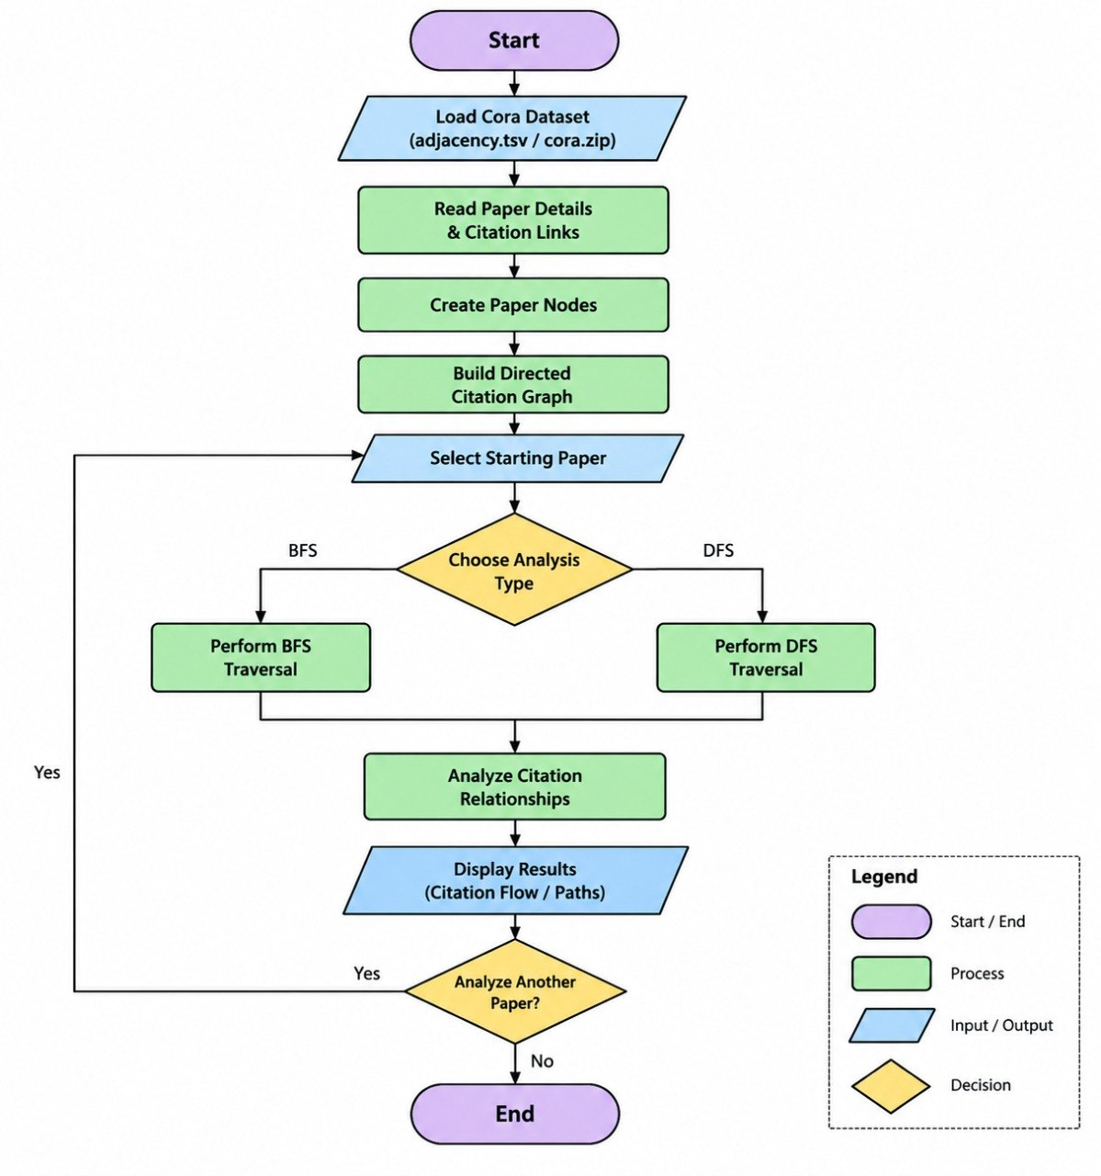
Flow Chart

Slide 8
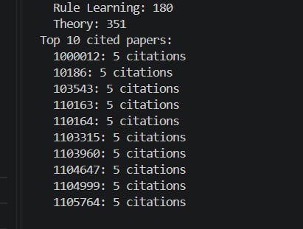
Results
Each paper is a node. Each citation is a link.
Start from any paper, for example P103.
BFS goes level by level: P103 → P105 → P110 → P115
DFS goes deep on one path first: P103 → P105 → P110 → P120
The screenshot shows papers per subject and the top cited papers.

Slide 9
Hardware and Software requirements
Hardware
Intel Core i3 or above
4 GB RAM minimum
1 GB free storage
Keyboard and mouse
Internet connection
Software
Windows, Linux or macOS
Java JDK 17 or above
Visual Studio Code
Cora dataset
Directed graph with BFS and DFS

Slide 10
Conclusion
Papers are nodes and citations are directed edges.
BFS goes level by level. DFS goes deep first.
The project shows how graphs and algorithms solve a real problem.
It is a good base for more advanced citation analysis.

Slide 11
Future Scope
Use bigger citation datasets
Add PageRank and centrality to find key papers
Draw the citation graph visually
Connect a database
Study research trends
Use machine learning for deeper insights

Slide 12
Thank you

