Slide 1
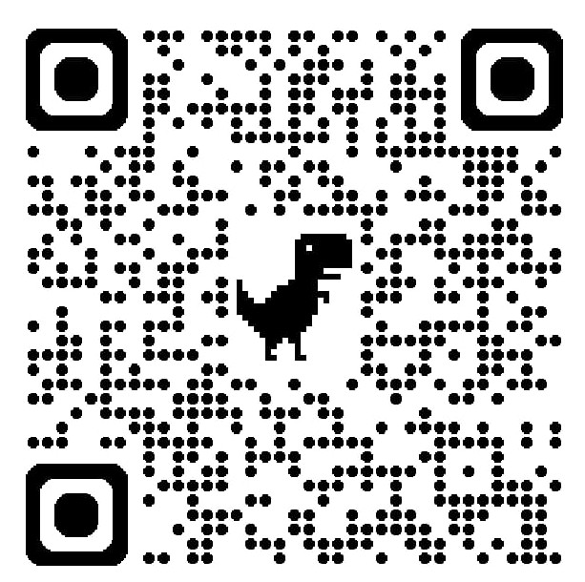
M R

Slide 2
Email Profile Picture Design
Design everything centered. Leave equal spacing on the left and right sides.
After creating the design, take a high-resolution screenshot and upload it as your Gmail profile picture.
Since Gmail slightly blurs images after upload, use a high-quality version so that the QR code remains clear and scannable.
Ensure the design aligns with your purpose or profession. For instance, choose a minimal tech-inspired background for a technical profile, or use your best photograph if you are in a creative field like photography.

