Slide 1




Madhurima Rawat
Project-Focused Professional | GitHub | Resource Development
rawatmadhurima4@gmail.com
https://madhurimarawat.github.io/Portfolio-Website/
https://www.linkedin.com/in/madhurima-rawat

Slide 2
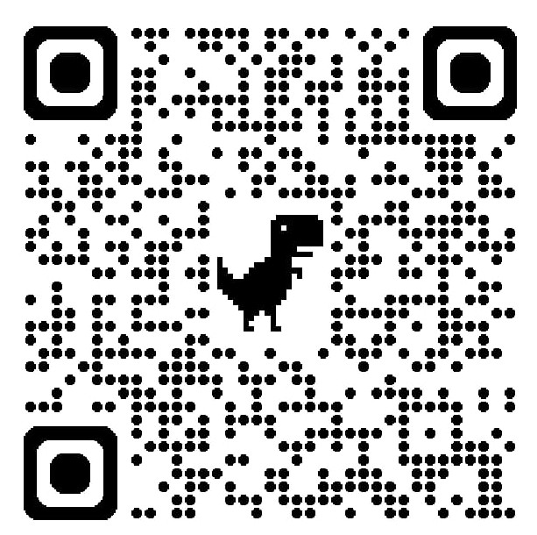
M R
Madhurima Rawat
Learning With Purpose
Open to Conversations

Slide 3

Madhurima Rawat
Project-Focused Professional | GitHub | Resource Development
rawatmadhurima4@gmail.com
https://madhurimarawat.github.io/Portfolio-Website/
https://www.linkedin.com/in/madhurima-rawat

Slide 4
M R
Madhurima Rawat
Learning With Purpose
Open to Conversations

Slide 5

Madhurima Rawat
Project-Focused Professional | GitHub | Resource Development
rawatmadhurima4@gmail.com
https://madhurimarawat.github.io/Portfolio-Website/
https://www.linkedin.com/in/madhurima-rawat

Slide 6
M R
Madhurima Rawat
Learning With Purpose
Open to Conversations

Slide 7

Madhurima Rawat
Project-Focused Professional | GitHub | Resource Development
rawatmadhurima4@gmail.com
https://madhurimarawat.github.io/Portfolio-Website/
https://www.linkedin.com/in/madhurima-rawat

Slide 8
M R
Madhurima Rawat
Learning With Purpose
Open to Conversations

Slide 9

Madhurima Rawat
Project-Focused Professional | GitHub | Resource Development
rawatmadhurima4@gmail.com
https://madhurimarawat.github.io/Portfolio-Website/
https://www.linkedin.com/in/madhurima-rawat

Slide 10
M R
Madhurima Rawat
Learning With Purpose
Open to Conversations

