Slide 1
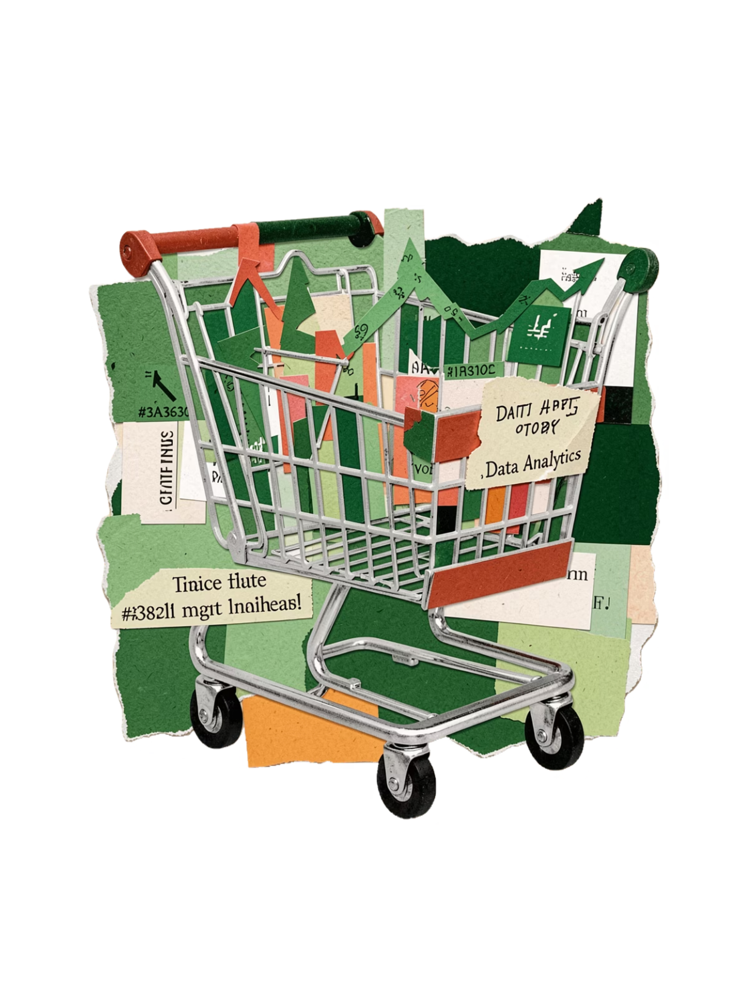
Customer Shopping Behavior Analysis
Uncovering insights from 5,050 transactions across product categories, customer segments, and subscription behavior.

Slide 2
Dataset at a Glance
370
556
5050
19
556
601
Total Rows
Data Columns
Missing Purchase
Amount
Missing Review
Ratings
Size
Previous Purchases
Customer Demographics
Purchase Details
Age, Gender, Location, Subscription Status
Item, Category, Amount, Season, Size, Color
Shopping behavior
Discount Applied, Promo Code Used, Previous Purchases, Frequency of Purchases, Review Rating, Shipping Type

Slide 3
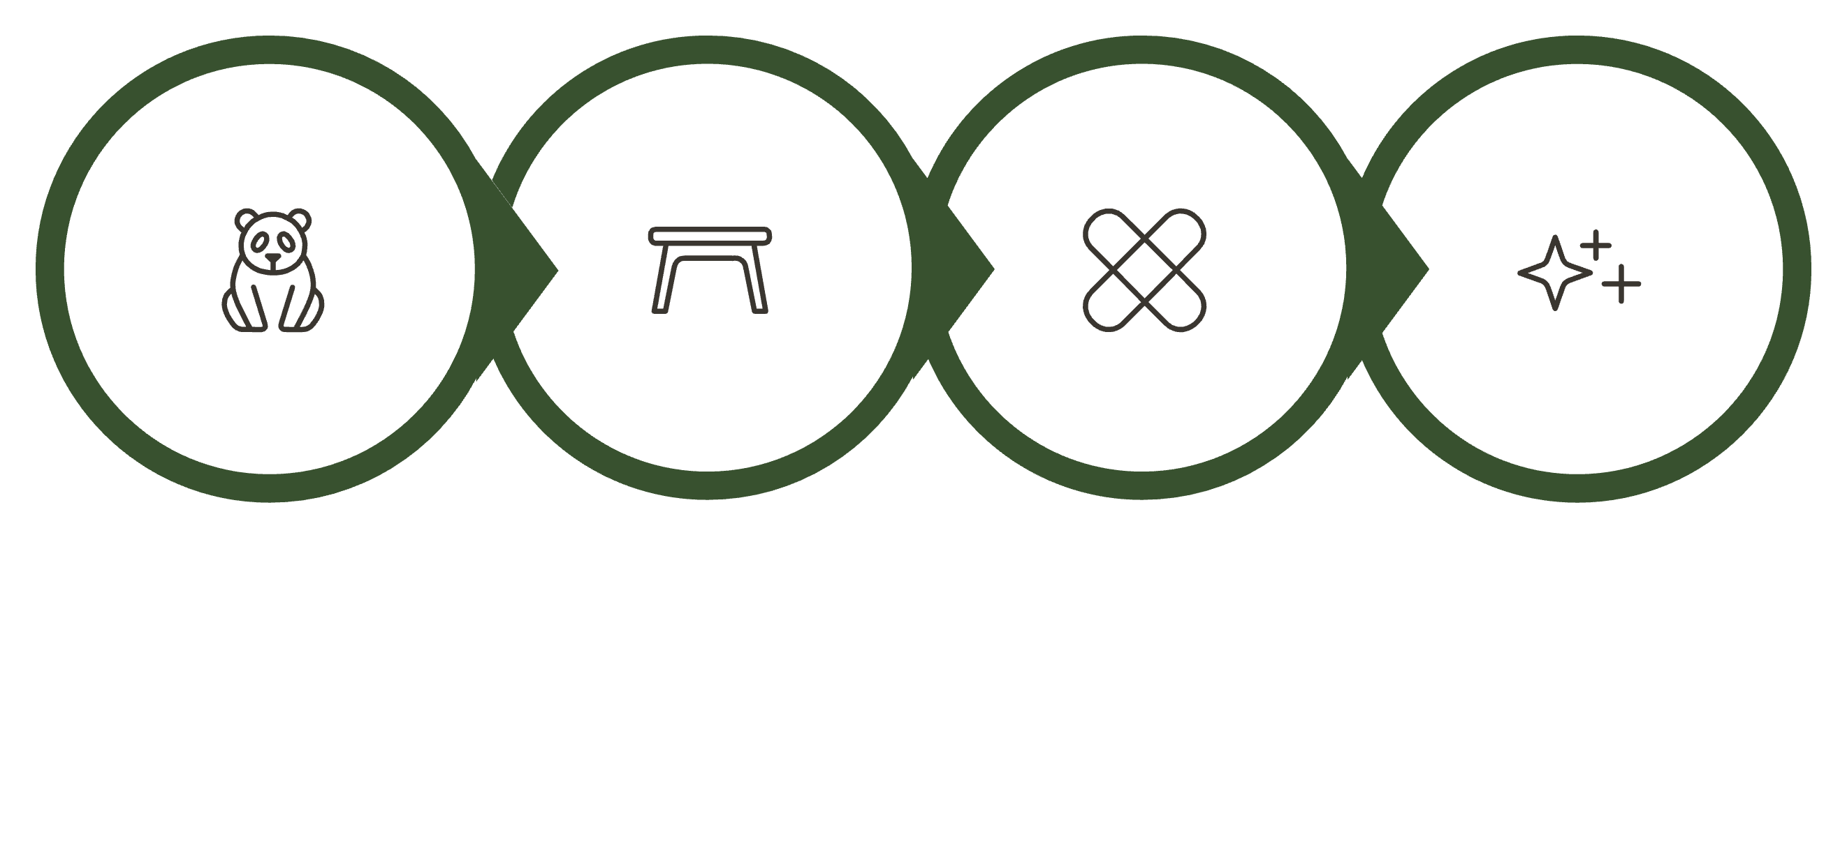
Python Data Preparation
Explore Structure
Handle Missing
Feature Engineering
Load Data
Loaded via pandas, explored with df.info() and .describe(), imputed missing values by product category mean/mode, and created age_group and purchase_frequency_days features. Cleaned data loaded into SQL Server for analysis.

Slide 4
Data Analysis using SQL
Revenue by Gender & Age Group

Slide 5
High value Discount Users
Customers using discounts while spending above average
Smart Shoppers
High spenders who maximize value with discounts
Strategic Opportunity
Target premium customers with exclusive offers.
Shipping Type
Top 5 Products by Rating

Slide 6



Subscription Impact
68%
45%
78%
Higher Spend
Revenue Share
Loyalty Rate
Subscribers vs non-subscribers
From subscription customers
Repeat purchase frequency

Slide 7



Customer Segmentation
Loyal
1
15% - High value customers
Returning
2
35% - Regular shoppers
New
3
50% - First-time buyers
Focus on converting New to Returning, Returning to Loyal

Slide 8
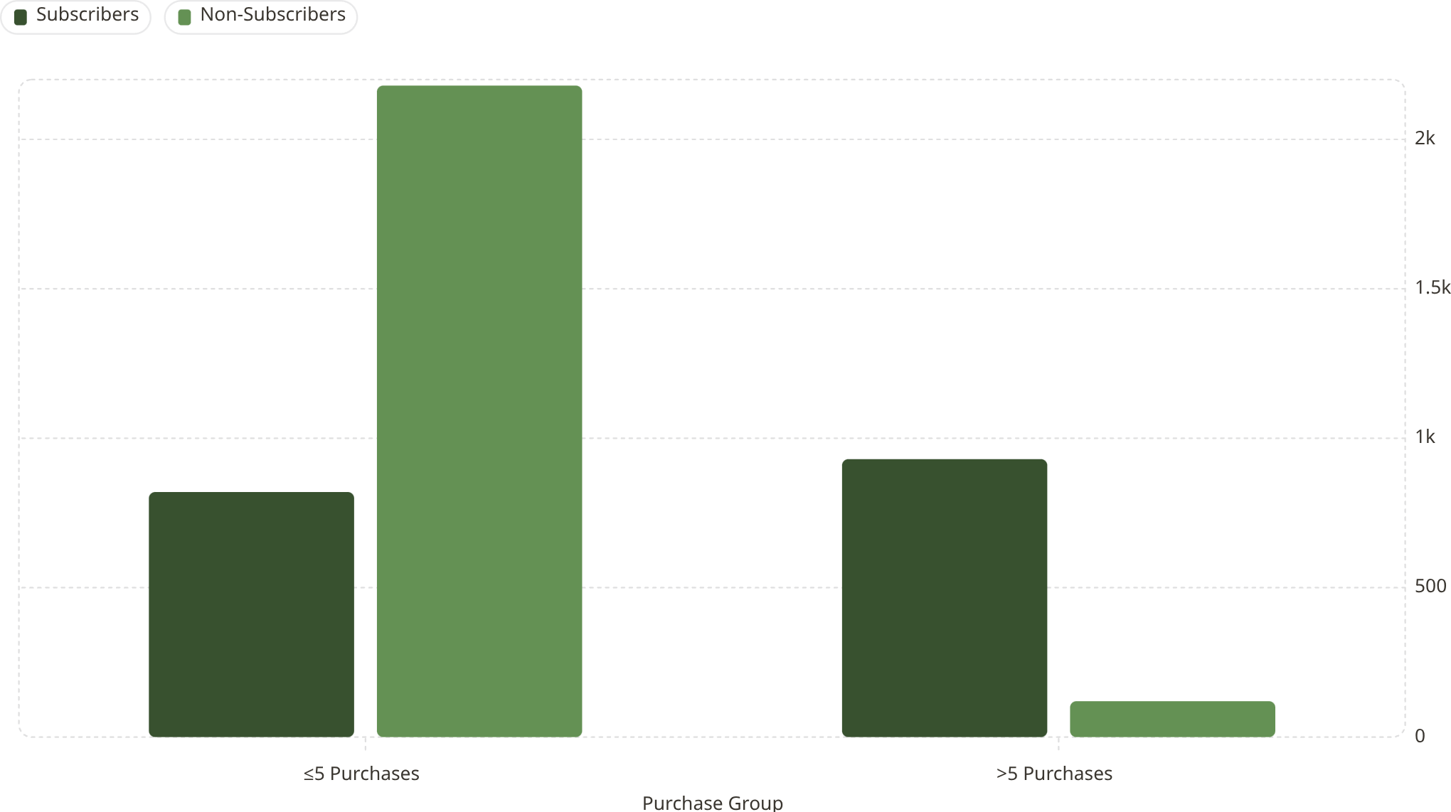
Repeat Buyers & Subscription Link
Customers with more than 5 purchases are significantly more likely to subscribe — a strong signal for loyalty-to-subscription conversion strategy.

Slide 9
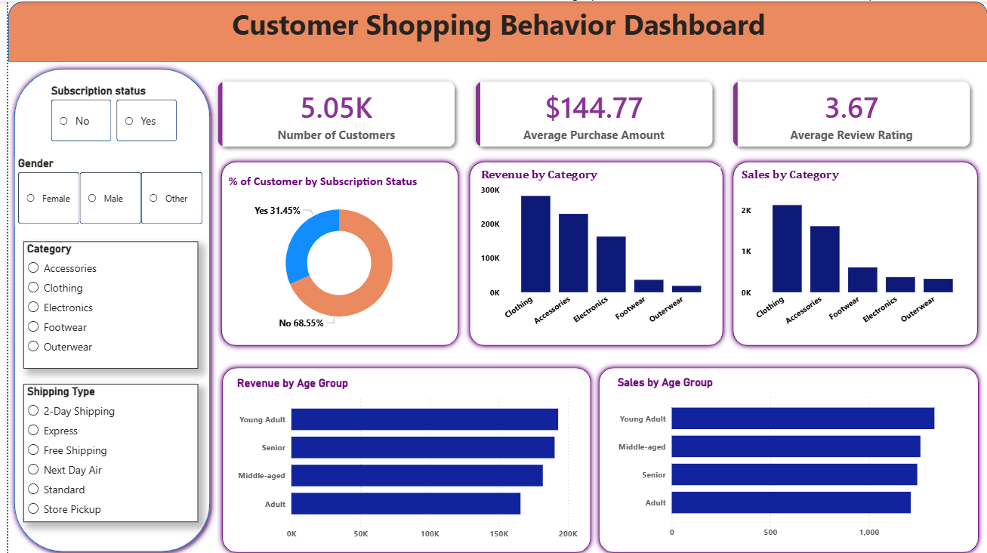
Power BI Dashboard
Interactive dashboard built to present all insights visually — revenue, segments, products, and subscriptions in one view.

Slide 10

Business Recommendations
Boost Subscriptions
Loyalty Programs
Review Discount Policy
Promote exclusive subscriber benefits
Reward repeat buyers → Loyal segment
Balance sales boosts with margin control
Targeted Marketing
Product Positioning
Focus on high-revenue age groups & express-shipping users
Highlight top-rated & best-selling products in campaigns

