Slide 1
DEVELOPERS ARENA INTERNSHIP PORTFOLIO
Multi-Domain Data Analysis Portfolio
5 Real-World Data Analysis Projects Across Distinct Domains
Author / Intern: Madhurja Bhattacharjee | Organization: Developers Arena | Core Stack: Python 3.13, Pandas, NumPy, SciPy, Matplotlib, Seaborn, Pytest
PROJECT 01
Supermarket Sales
Retail & Commerce
PROJECT 02
Student Performance
Academic & Education
PROJECT 03
Weather Analysis
Meteorology & Climate
PROJECT 04
COVID Trends
Healthcare & Epidemiology
PROJECT 05
Stock Market
Finance & Quantitative Risk
Multi-Domain Data Analysis Portfolio | Madhurja Bhattacharjee | Developers Arena Internship
Slide 01 of 12

Slide 2
PORTFOLIO FRAMEWORK
Project Overview & Analytics Methodology
Standardized 7-stage analytical pipeline applied consistently across 5 diverse domain datasets
STANDARDIZED END-TO-END DATA ANALYTICS WORKFLOW
1. Ingestion → 2. Data Cleaning → 3. Validation & Tests → 4. Statistical EDA → 5. Visualization → 6. Business Insights → 7. Strategic Actions
Five Multi-Domain Workstreams
• Supermarket Sales: 2,000 retail transactions; branch revenue, basket size, time-period traffic, and customer ratings.
• Student Performance: 500 student academic records; study hours, attendance %, subject-wise scores, and performance tiers.
• Weather Analysis: 365 daily station records; annual rainfall concentration, temperature cycles, and extreme conditions.
• COVID-19 Healthcare: 1,825 regional tracking logs; case waves, vaccination phases, and regional mortality disparities.
• Stock Market Risk: 252 trading days; compounded return, price volatility, max drawdown, and Sharpe ratio.
Statistical Analysis & Metrics
• Central Tendency: Mean, median to detect skewness and avoid distortion from outliers.
• Dispersion & Risk: Standard deviation, IQR, daily/annualized volatility, and maximum peak-to-trough drawdown.
• Correlation & Association: Pearson correlation coefficients and pairwise matrices; strict distinction between correlation and causation.
• Stratification & Tiers: Quartile segmentation, performance tiers, and vaccination phase stratification.
• Time-Series Modeling: Project-specific statistical analysis included moving averages, seasonal aggregation, and compounded returns.
Tech Stack & Engineering Rigor
• Python Core Stack: Python 3.13, Pandas 2.2.0, NumPy 1.24.0 for vectorized wrangling and numerical computing.
• Visualization: Matplotlib 3.8.0 and Seaborn 0.13.0 for publication-grade, accessible, labeled figures.
• Reporting & Docs: FPDF2 2.7.8 for automated executive PDF generation directly from python code.
• Automated Pytest: Pytest suite verifying dataset shapes, missing values, duplicates (18 tests passed).
• Integrity Principle: Zero artificial smoothing; raw source anomalies are documented as limitations, never fabricated.
Multi-Domain Data Analysis Portfolio | Madhurja Bhattacharjee | Developers Arena Internship
Slide 02 of 12

Slide 3
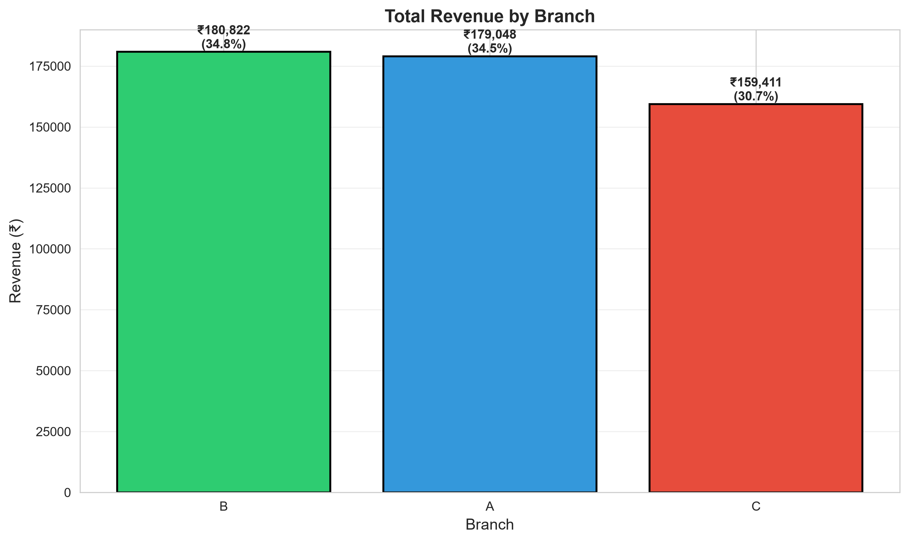
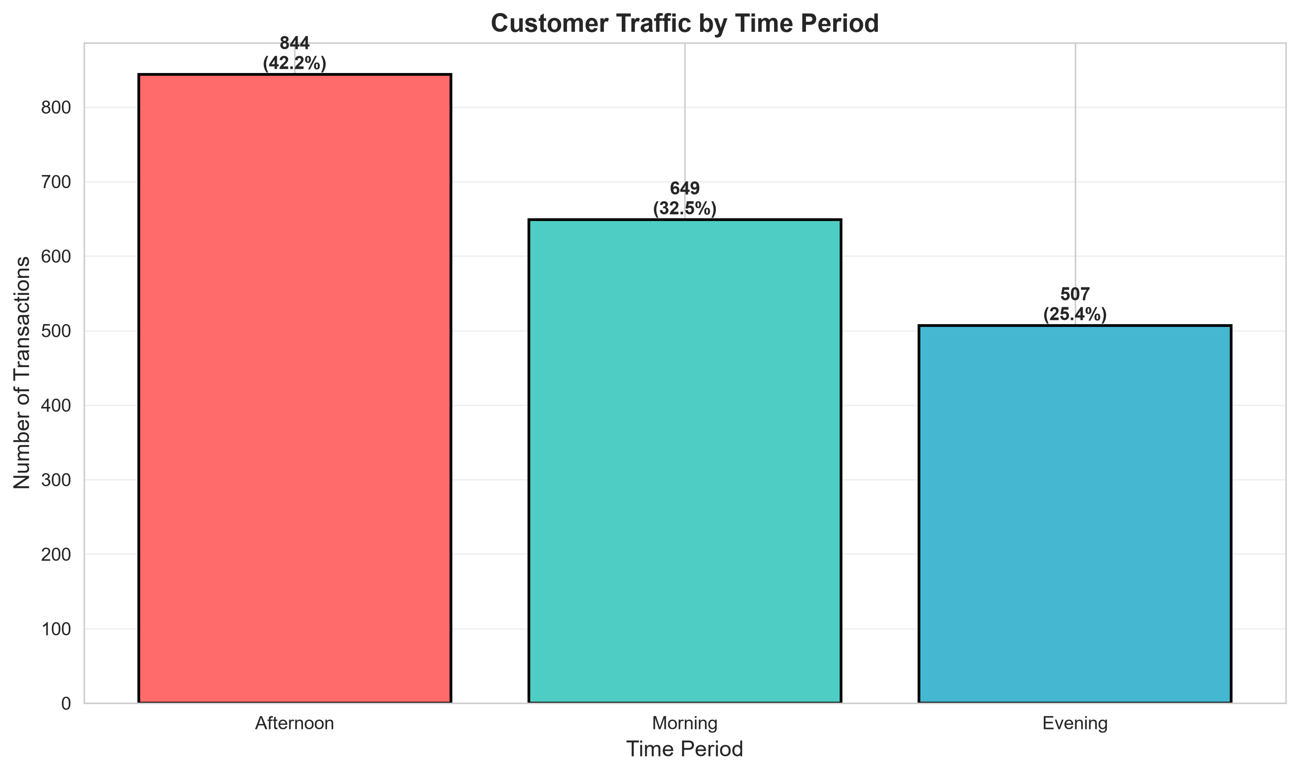
PROJECT 01: RETAIL & COMMERCE
Supermarket Sales Analysis
2,000 retail transactions evaluated across 3 branch locations, 6 product categories, and full-year 2023 seasonality
₹519,280.69
TOTAL REVENUE
2,000 Transactions
₹259.64
AVG TRANSACTION
Median: ₹258.04
6.96 / 10
AVG SATISFACTION
Median: 6.95 / 10
Figure 1.1: Total Revenue and Transaction Volume by Branch
Key Analytical Findings & Segment Profiles
• Branch Performance: Branch B leads at ₹180,821.79 (34.8%), Branch A closely tied at ₹179,047.93 (34.5%), while Branch C underperforms at ₹159,410.97 (30.7%, a 4.1% revenue gap).
• Afternoon Peak (12–5 PM): 42.2% of daily transactions (844 txns) occur in the afternoon rush, generating 9.7% more volume than morning (32.5%) and evening (25.4%).
• Product Balance: Health & Beauty leads at ₹96,970.32 (18.7%), followed by Sports & Travel (17.6%). The spread across all 6 categories is tight (3.8% spread), indicating stable demand.
• Member Volume Dynamics: Members generate +₹4,558 more total revenue via higher visit frequency (+36 txns), not higher basket size (Normal spends 1.86% more per visit: ₹262.08 vs ₹257.29).
• Gender Patterns: Female shoppers generated 3.68% higher total revenue (1,019 vs 981 txns) with higher satisfaction ratings (7.03 vs 6.88).
Figure 1.2: Hourly Shopping Distribution & Afternoon Peak Concentration
[DATA QUALITY LIMITATION] Financial Consistency Discrepancy
The supplied dataset contains a discrepancy between the provided 'Total' column and the calculated 'Unit Price × Quantity + Tax' for most transactions. Original Total values were strictly retained without modification to preserve raw source data integrity.
Multi-Domain Data Analysis Portfolio | Madhurja Bhattacharjee | Developers Arena Internship
Slide 03 of 12

Slide 4
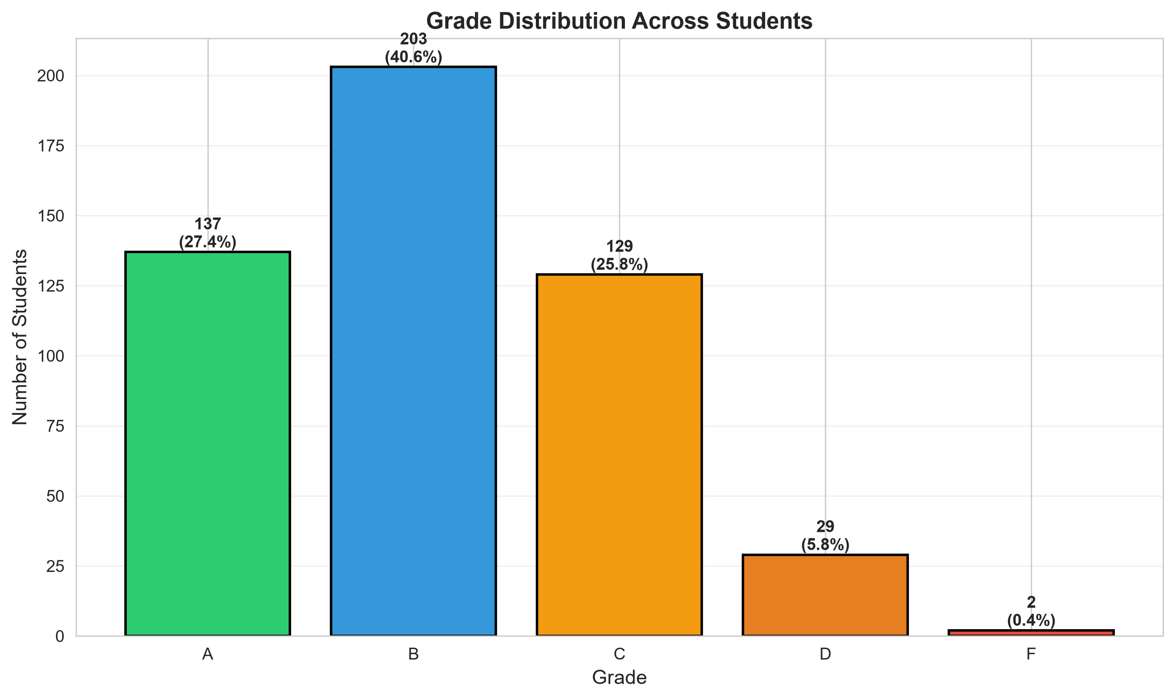
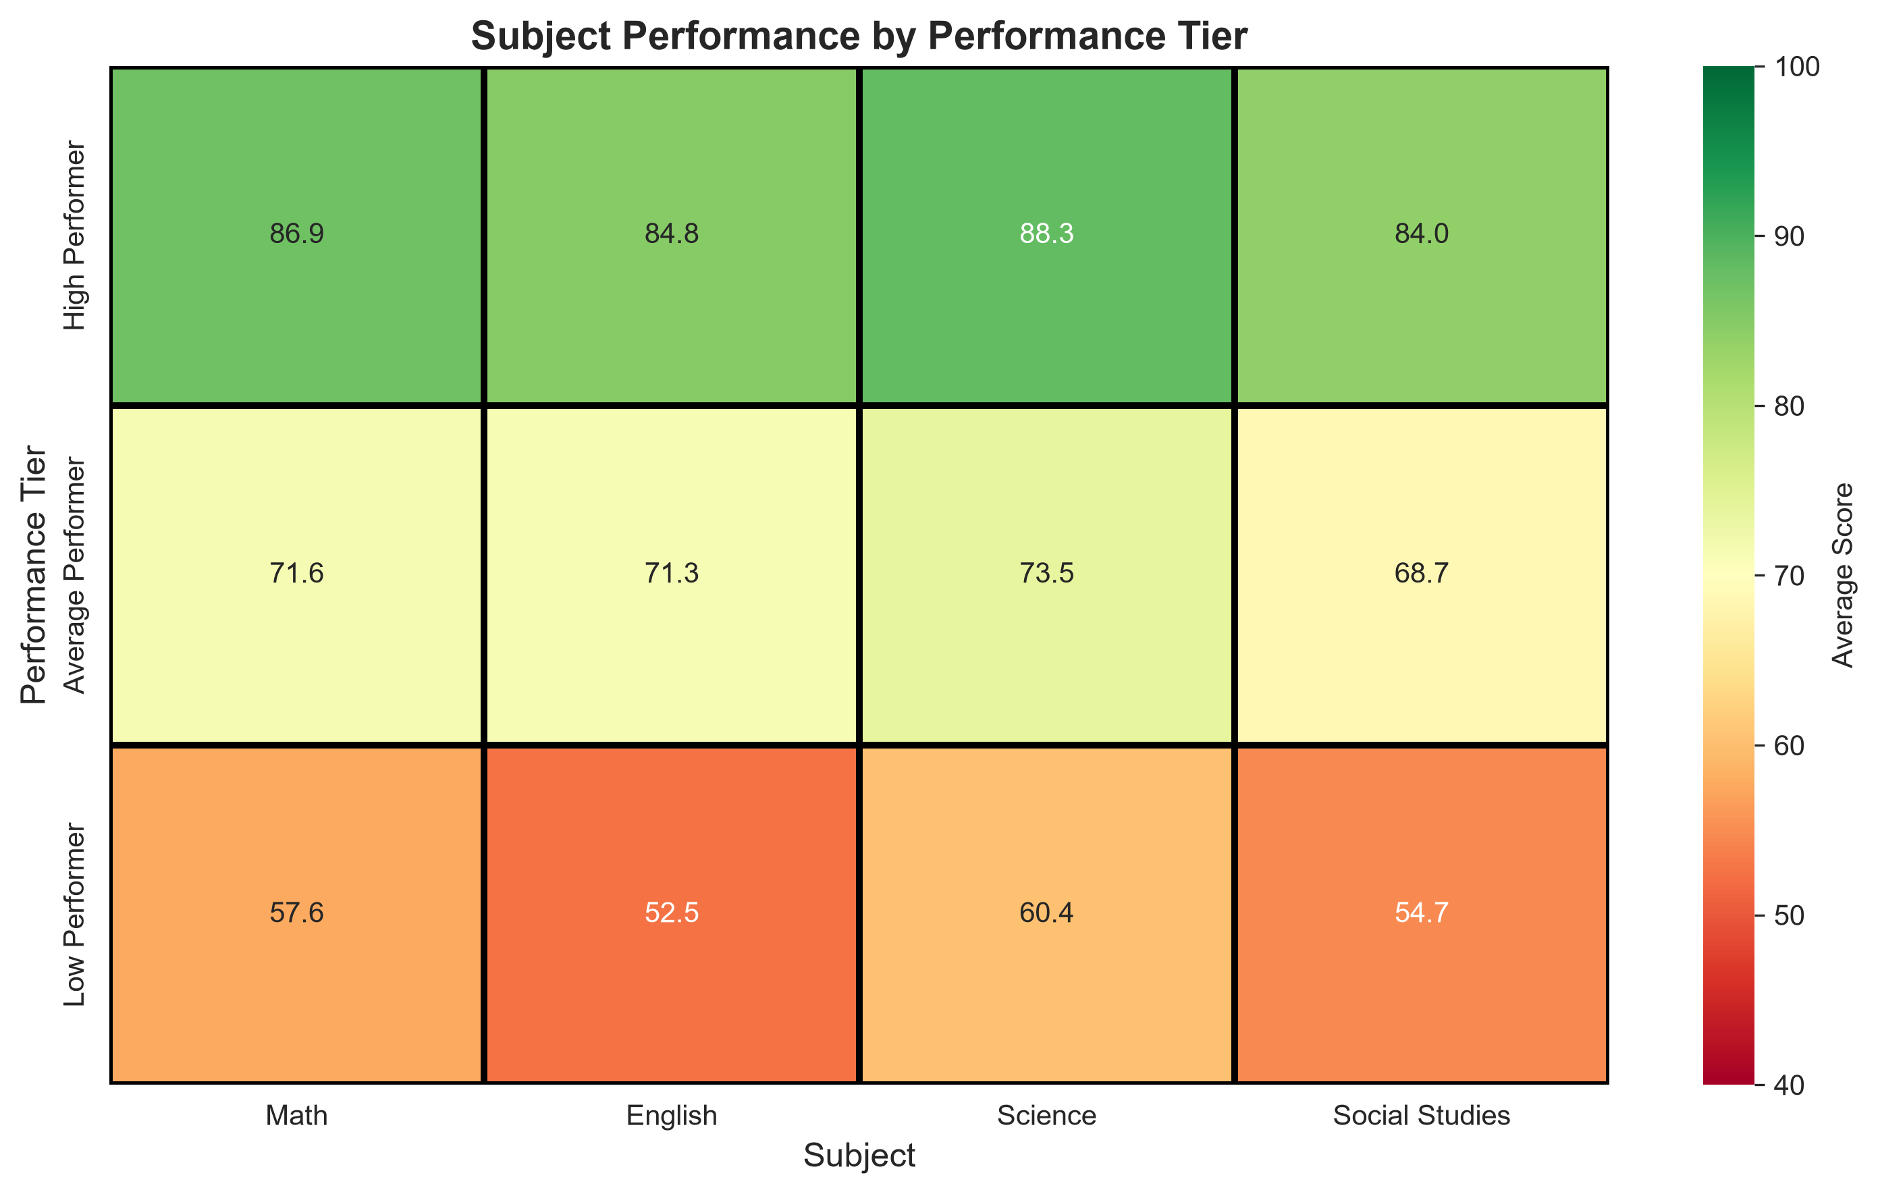
PROJECT 02: ACADEMIC & EDUCATION
Student Performance Analysis
500 student records evaluated across 4 academic subjects, attendance rates, study hours, and performance tiers
74.25
AVERAGE SCORE
Median: 74.25 (100% Pass)
r = +0.077
ATTENDANCE CORR
Very Weak Linear Assoc
r = +0.096
STUDY HOURS CORR
Very Weak Linear Assoc
Figure 2.1: Academic Grade Distribution Across 500 Students
Academic Insights & Student Segmentation
• Grade Distribution: Grade A: 27.4% (137 students), Grade B: 40.6% (203), Grade C: 25.8% (129), Grade D: 5.8% (29), Grade F: 0.4% (2). Overall pass rate was 100%.
• Subject Independence: Pairwise subject correlations are near zero (r = -0.069 to +0.063). Strong performance in Math does not linearly imply strong performance in Social Studies.
• Tier Disparities vs Effort: High Performers (27.4%) average 85.97, while Low Performers (6.2%) average 56.28. However, High vs Low attendance differs by only 2.97% (77.4% vs 74.4%) and study time by only 2.32 hrs/wk (24.2 vs 21.9 hrs).
• Subject-Wide Consistency: High performers score 84–88 across all four subjects, while low performers score 52–60 across all four, indicating broad multi-subject separation.
• Actionable Takeaway: Mere attendance enforcement and counting study hours explain little outcome variation; academic interventions must target study quality and core conceptual mastery.
Figure 2.2: Subject Score Consistency Across Performance Tiers
[ANALYTICAL CAUTION] Avoid Causal & Innate Ability Claims
The weak correlations demonstrate that measured effort quantity explains little score variance. However, this observational dataset lacks variables on teaching quality, prior preparation, home environment, or study effectiveness. It does NOT prove innate ability or genetic causation.
Multi-Domain Data Analysis Portfolio | Madhurja Bhattacharjee | Developers Arena Internship
Slide 04 of 12

Slide 5
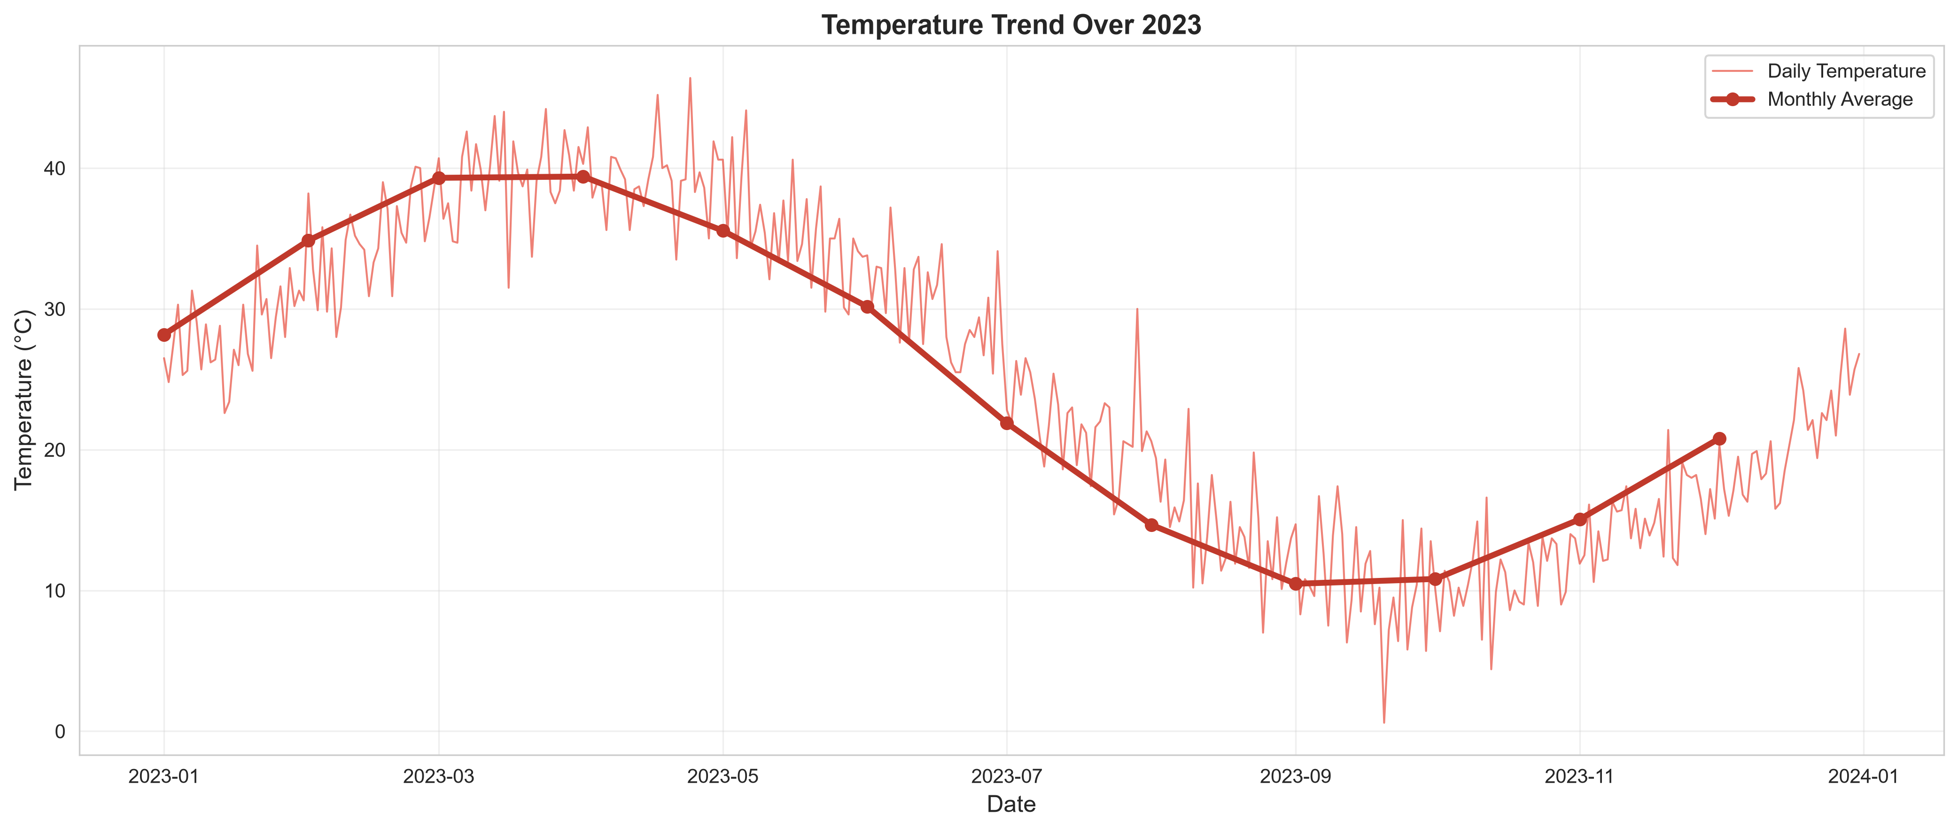
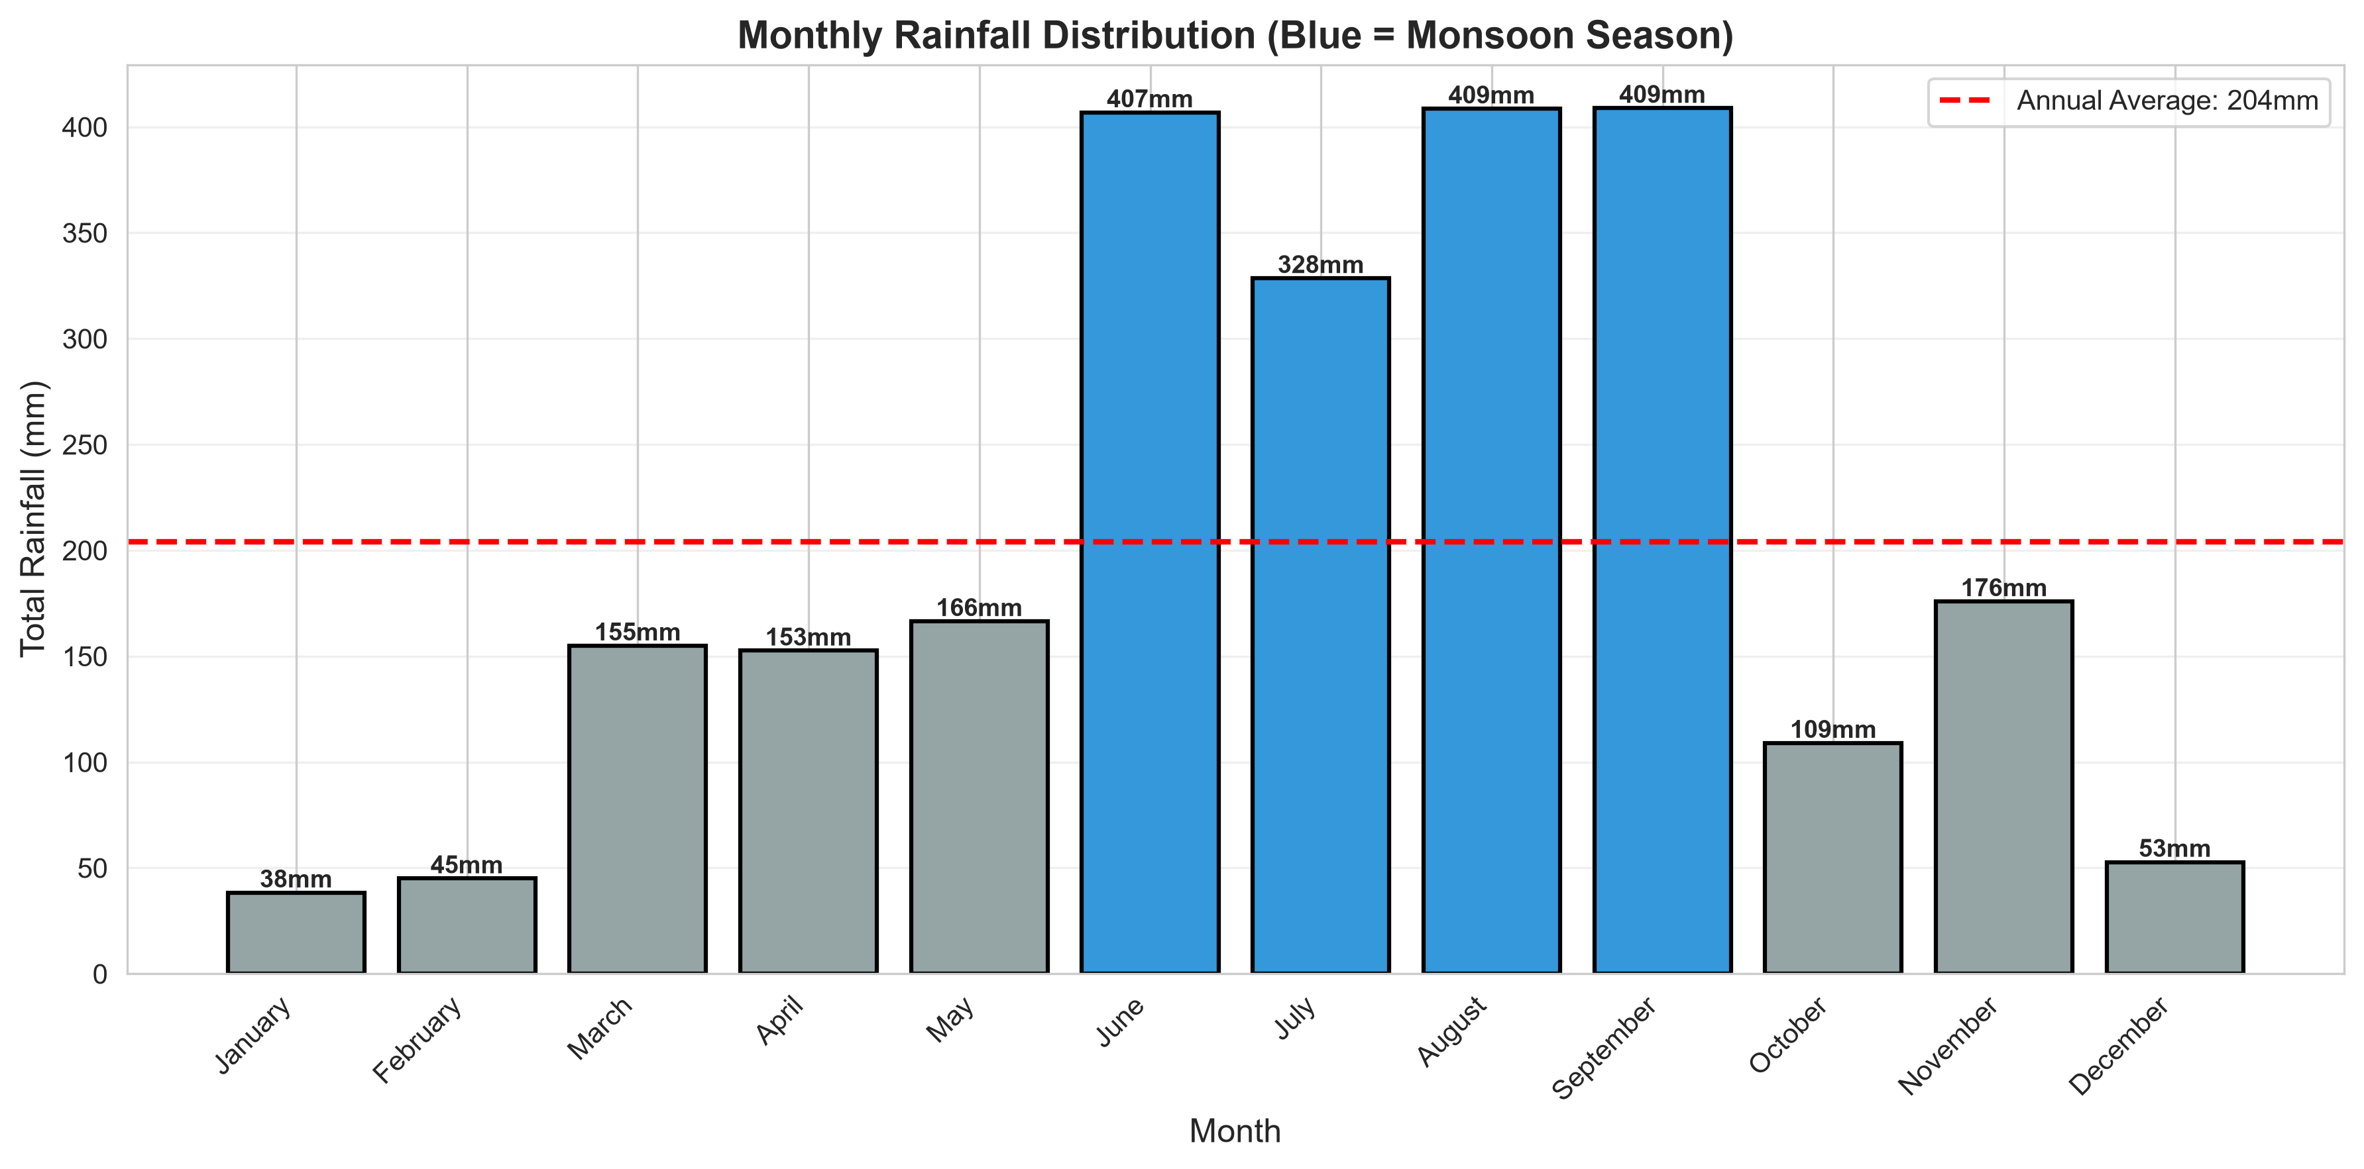
PROJECT 03: METEOROLOGY & ENVIRONMENT
Weather Data Analysis
365 daily observations (2023) from a single meteorological station analyzing temperature cycles and rainfall concentration
25.03°C
ANNUAL MEAN TEMP
Range: 0.6°C to 46.4°C
2,447.97 mm
ANNUAL RAINFALL
Daily Avg: 6.71 mm
64.7%
MONSOON PEAK SHARE
77 Heavy Days (>10mm)
Figure 3.1: Daily Temperature Trajectory and Extreme Bands Over 2023
Meteorological Patterns & Seasonal Observations
• Seasonal Temperature Shifts: Defined seasons exhibit marked variation: Spring is warmest (avg 38.07°C, max 46.4°C), Summer is moderate (avg 22.15°C), Winter is cool (avg 27.72°C), and Autumn is coldest (avg 12.10°C, min 0.6°C). Peak-to-trough spread is ~26°C.
• Monsoon Rainfall Concentration: 77 heavy-rain days (>10 mm) account for 1,583.00 mm (~65% of total annual rain), concentrated in June–September (June: 406.8mm, July: 328.5mm, Aug: 408.6mm, Sept: 408.9mm).
• Rainfall Frequency vs Intensity: Rain was recorded on 284 days (77.8% of year), but precipitation was heavily skewed: light rain days predominate, while acute monsoon bursts carry the bulk volume.
• Condition Breakdown: Hot days: 119 (32.6%), Pleasant: 106 (29.0%), Rainy: 77 (21.1%), Cold: 63 (17.3%).
• Weak Cross-Variable Linear Correlation: Pairwise correlations between temperature, humidity, wind, and rainfall were weak (|r| < 0.15), indicating non-linear atmospheric dynamics.
Figure 3.2: Monthly Precipitation Distribution Highlighting June–Sept Monsoon Peak
[SCIENTIFIC SCOPE LIMITATION] Single-Station Observation vs Climate Classification
This analysis strictly describes empirical observations from 365 days of 2023 data from a single station. A single year of data is insufficient to establish a formal long-term climate classification or multi-decadal trend under WMO standards. Practical applications can support municipal planning, drainage and rainwater-management considerations
Multi-Domain Data Analysis Portfolio | Madhurja Bhattacharjee | Developers Arena Internship
Slide 05 of 12

Slide 6
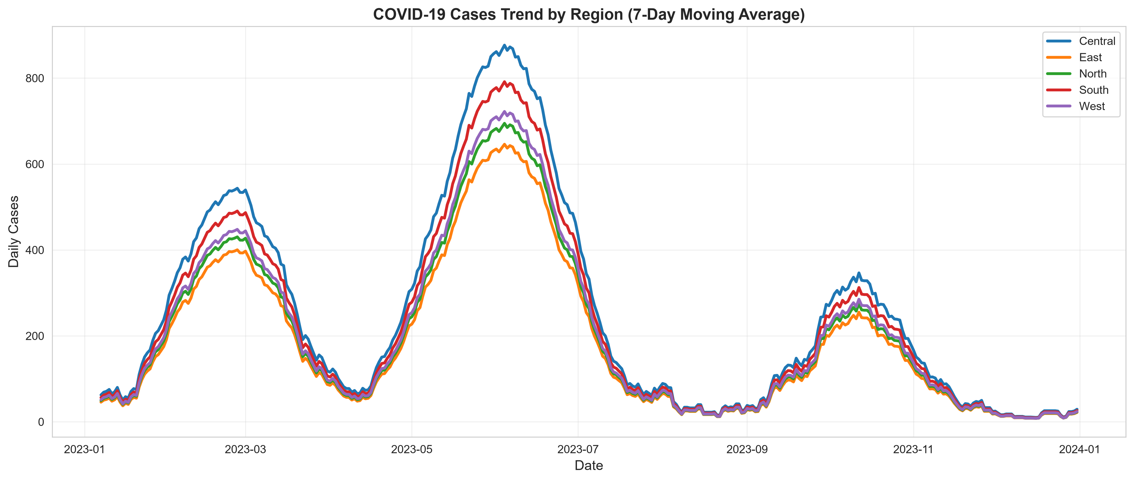
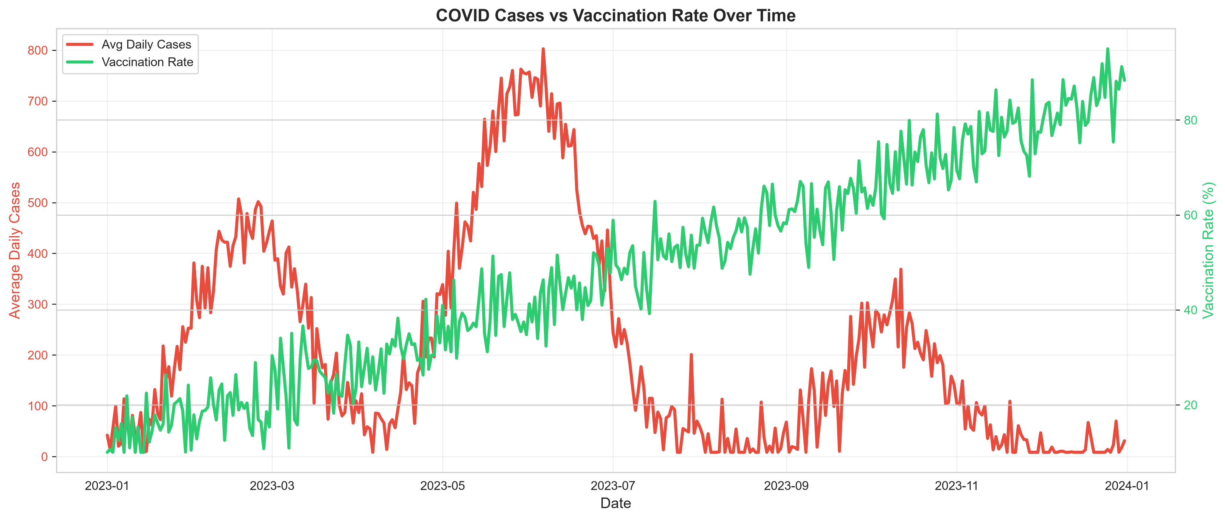
PROJECT 04: PUBLIC HEALTH & EPIDEMIOLOGY
COVID Trends Analysis
1,825 daily regional records across 5 geographic territories examining wave dynamics, mortality, and vaccination phases
391,062
TOTAL CASES
Deaths: 4,505 (CFR 1.15%)
86.23%
RECOVERY RATE
337,199 Recoveries
-56.7%
HIGH VAX PHASE ASSOC
101 vs 234 Daily Cases
Figure 4.1: COVID-19 7-Day Moving Average Trajectory Across 5 Regions
Epidemiological Patterns & Regional Disparities
• Three Periods of Elevated Case Activity: Period 1 (Feb–Mar): Peak 57,108 cases in Feb. Period 2 (May–Jun): Annual peak 87,244 cases in May. Period 3 (Sept–Oct): Muted peak 35,377 cases in Oct. December cases declined to annual low of 2,631.
• Vaccination Phase Association: High vaccination phases (60%+ coverage) averaged 101.28 daily cases vs 234.17 in low vaccination phases (0–30%), representing an observed 56.7% lower average daily case load.
• Regional Mortality Disparities: Central recorded 1,118 deaths (24.8% of total), whereas East recorded 787 deaths (17.5%). Central had 42.1% more deaths than East despite identical average vaccination rates (47.98%).
• Correlation Matrix Nuances: Vaccination rate vs Daily Cases showed moderate negative correlation (r = -0.3574); vaccination vs Daily Deaths was weak (r = -0.1604); Daily Cases vs Deaths was positive (r = +0.3433).
• Healthcare Capacity Implications: Regional mortality differences warrant further investigation using demographic, healthcare-capacity, and other contextual data.
Figure 4.2: Vaccination Rollout Progress vs Daily Case Counts Over Time
[METHODOLOGICAL NOTE] Distinguishing Association from Causation
The 56.7% case difference across vaccination phases is an observed statistical association. Observational aggregate data cannot establish singular clinical causation, as transmission was concurrently influenced by viral variants, public health mandates, testing rates, and population mobility.
Multi-Domain Data Analysis Portfolio | Madhurja Bhattacharjee | Developers Arena Internship
Slide 06 of 12

Slide 7
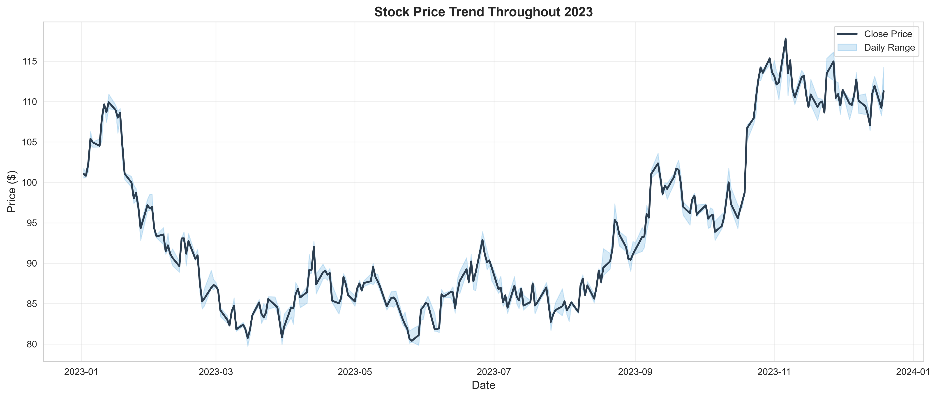
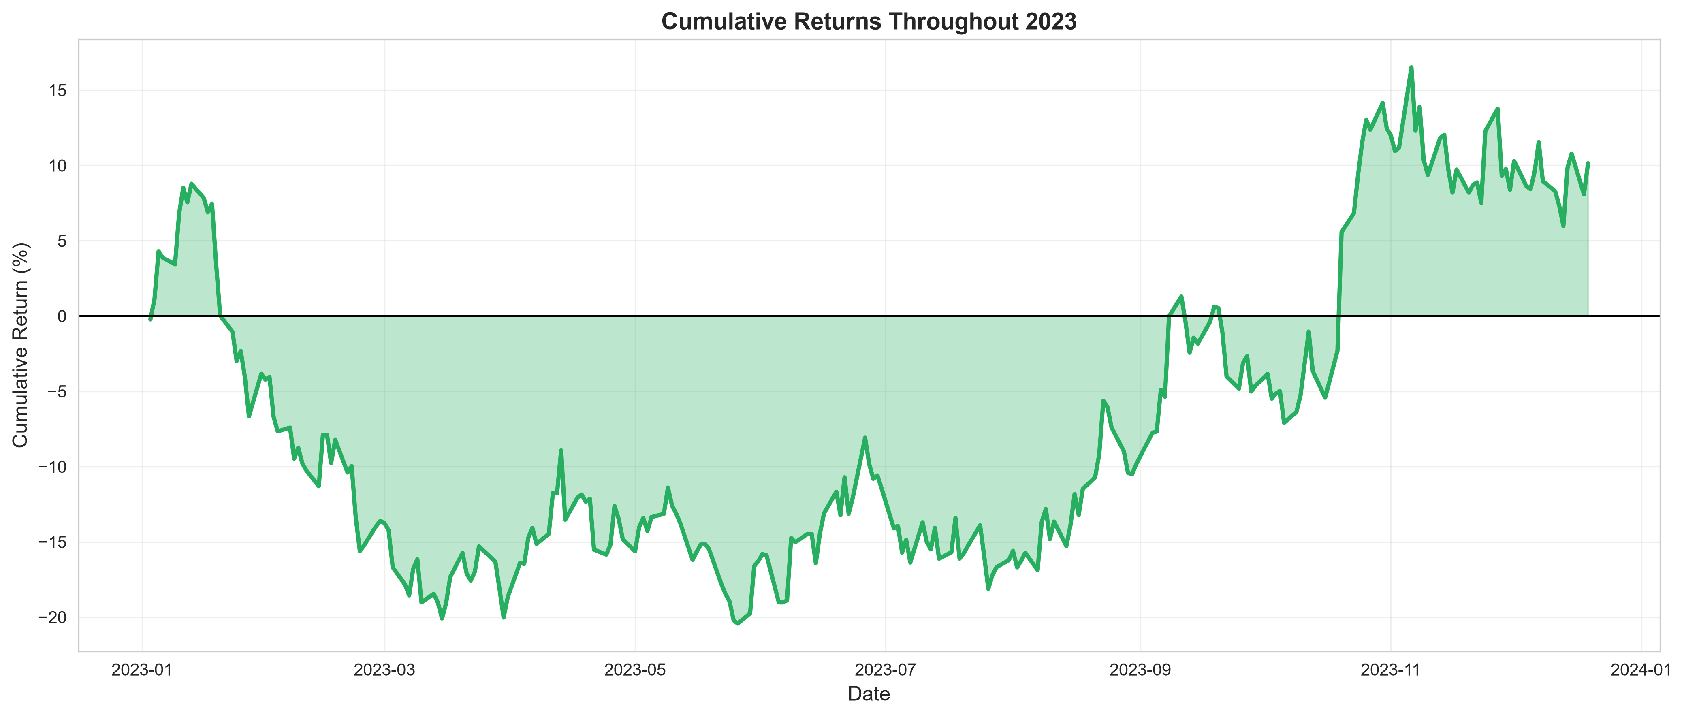
PROJECT 05: FINANCE & QUANTITATIVE EQUITY
Stock Market Analysis
252 trading days (Jan 2 to Dec 19, 2023) evaluating equity price trajectory, return volatility, and risk-adjusted metrics
+10.14%
PERIOD RETURN
Start $101.05 → End $111.30
30.87%
ANNUALIZED VOL
Daily Volatility: 1.94%
-26.85%
MAX DRAWDOWN
Trough on May 26 ($80.41)
Figure 5.1: Daily Close Price Trajectory with 50-Day Moving Average & Range
Price Action, Return Profiles & Risk Metrics
• Price Range & Rebound: Lowest close reached $80.41 on May 26; price subsequently rallied 46.4% to a peak close of $117.74 on Nov 6, closing the period at $111.30 (+10.14% return).
• Quarterly Trajectory: Severe early weakness in Q1 (-18.67% compounded, with Feb -9.79% worst month), followed by consistent rebound in Q2 (+8.89%), Q3 (+7.68%), and Q4 (+15.49%, led by Oct +17.91% best month).
• Daily Return Distribution: 130 positive days (51.6%) vs 121 negative days (48.0%), with 1 initial day having no calculated return. Daily returns ranged from −5.06% to +8.06%, with a median of +0.167% and mean of +0.057%.
• Sharpe Ratio (0% Rf Assumption): Annualized Sharpe ratio was 0.47, calculated using an explicit 0% risk-free rate assumption, reflecting modest risk-adjusted compensation for high 30.87% volatility.
• Volume-Return Disconnect: Correlation between trading volume and daily returns was r = +0.017, indicating volume spikes had negligible linear association with price direction.
Figure 5.2: Cumulative Return Profile Showing May Drawdown and Year-End Recovery
[DATA QUALITY LIMITATION] OHLC Data Consistency Anomalies
The supplied dataset contains 78 rows with OHLC consistency issues: 40 rows where Open > High, and 38 rows where Open < Low. High–Low and Close relationships had 0 violations. Return formulas were mathematically validated (<1e-13% diff). Original data was retained without alteration to preserve source integrity.
Multi-Domain Data Analysis Portfolio | Madhurja Bhattacharjee | Developers Arena Internship
Slide 07 of 12

Slide 8
PORTFOLIO SYNTHESIS
Cross-Domain Insights & Analytical Comparison
Demonstrating methodological adaptability and statistical rigor across disparate business and scientific domains
Domain & Dataset | Core Analytical Question | Key Statistical Measures | Primary Visualizations | Decision Impact
01 Supermarket (2,000 txns, 14 cols) | What drives sales across branches, time periods, & customer segments? | Totals, branch shares, hourly volumes, mean/median ratings, spend parity | Grouped bars, distribution histograms, trend lines | Staffing shift to 12-5 PM peak; Branch C traffic investigation
02 Student Scores (500 students, 10 cols) | How do study time and attendance relate to grades and performance tiers? | Pearson r, tier averages, inter-subject correlation matrix, percentiles | Grade bar charts, subject heatmaps, effort grouped bars | Shift from counting study hours to assessing learning strategies
03 Weather Data (365 days, 12 cols) | What are the seasonal cycles, rainfall concentration, & extreme events? | Percentiles (10th/90th), annual precipitation, seasonal means & IQR | Time-series bands, monthly rainfall bars, seasonal boxplots | Rainwater-management planning using observed monsoon concentration and peak rainfall.
04 COVID Healthcare (1,825 rows, 10 cols) | What are periods of elevated case activity, regional disparities, & vaccination-phase trends? | 7-day moving averages, CFR (1.15%), recovery rate (86.23%), phase means | Regional time series, dual-axis tracking, phase comparisons | Investigate regional mortality differences; targeted outreach for low-coverage areas.
05 Stock Market (252 trading days) | What are the asset return dynamics, price volatility, & risk-adjusted metrics? | Compounded return (10.14%), annualized vol (30.87%), drawdown, Sharpe | OHLC price trends, return histograms, drawdown profiles | Stress-test portfolios against -26.85% drawdown; reference $80-$85
Analytical Commonality Across Domains
• Structured Data Lifecycle: Each project advanced through uniform data ingestion, validation, and exploratory profiling.
• Integrity Preservation: Anomalies (OHLC inconsistencies, financial mismatches) were investigated and documented, not masked.
Turning Raw Data Into Decisions
• Avoiding Causal Traps: Maintained scientific discipline by treating weak correlations and associations without inventing causation.
• Testable Hypotheses: All operational proposals are framed as measurable, testable actions with trackable KPIs.
Multi-Domain Data Analysis Portfolio | Madhurja Bhattacharjee | Developers Arena Internship
Slide 08 of 12

Slide 9
QUALITY ASSURANCE & ENGINEERING
Data Quality, Validation & Automated Testing
Ensuring data integrity through automated unit testing, shape assertions, and anomaly detection
VERIFIED AUTOMATED TEST SUITE: 18 TESTS PASSED VIA PYTEST IN 1.36s
100% test pass rate across 6 test modules: test_supermarket.py (3), test_student.py (3), test_weather.py (3), test_covid.py (3), test_stock_market.py (3), test_data_validation.py (3).
Reusable Architecture (src/)
• check_dataset_shape(): Validates exact dimensional conformance against expected row and column counts.
• check_missing_values(): Audits global null counts across all dataset columns and data types.
• check_duplicate_rows(): Ensures zero duplicate record contamination across transactions and observations.
• DRY Modular Design: Standardized functions in src/data_validation.py imported directly into automated test scripts.
• Defensive Engineering: Enforces schema constraints before downstream statistical ingestion or modeling.
Dataset Dimensions & Completeness
• Supermarket Sales: 2,000 rows × 14 columns; 0 missing values; 0 duplicate rows.
• Student Performance: 500 rows × 10 columns; 0 missing values; 0 duplicate rows; verified score ranges (35-100).
• Weather Observations: 365 rows × 12 columns; 0 missing values; 0 duplicate rows; verified meteorological ranges.
• COVID-19 Tracking: 1,825 rows × 10 columns; 0 missing values; 0 duplicate rows; 5 regions × 365 days.
• Stock Market Data: 252 rows × 12 columns; 0 duplicate rows; 2 expected NaNs (Day 1 Daily & Cumulative Return).
Integrity Audits & Derived Metrics
• Supermarket Financial Check: Flagged calculation discrepancy between Unit Price × Quantity + Tax and Total. Original data retained.
• Stock OHLC Validation: Identified 78 rows with Open price anomalies (40 Open > High, 38 Open < Low). High >= Low had 0 violations.
• Return Calculation Check: Validated supplied Daily_Return and Cumulative_Return against price formulas: max error < 4.44e-14% (floating point precision).
• Preserving Raw Data : Source anomalies were documented as limitations rather than artificially altered
• Reproducible Pipeline: Automated checks are version-controlled and can be re-executed locally through the pytest test suite.
Multi-Domain Data Analysis Portfolio | Madhurja Bhattacharjee | Developers Arena Internship
Slide 09 of 12

Slide 10
STRATEGIC ACTION PLAN
Cross-Domain Business Recommendations
Translating empirical data findings into testable operational adjustments, resource allocations, and monitored KPIs
01 SUPERMARKET SALES
Empirical Finding: 42.2% of transactions occur in the afternoon (12-5 PM); Branch C lags Branch B by 4.1%; 18.7% give low ratings. | Strategic Action: Reallocate staff & open additional checkout lanes from 12-5 PM; audit Branch C footfall; address low-satisfaction issues.
Target Evaluation KPIs: Hourly queue times, Branch C revenue gap, customer rating trajectory, percentage of low ratings.
02 STUDENT PERFORMANCE
Empirical Finding: Study hours (r=0.096) and attendance (r=0.077) show very weak linear correlation with grades; effort between tiers differs by <3%. | Strategic Action: Move away from rigid study-hour mandates; implement diagnostic assessments early to identify specific concept gaps.
Target Evaluation KPIs: Diagnostic assessment scores, percentage of students transitioning out of lower tiers, concept mastery metrics.
03 WEATHER & ENVIRONMENT
Empirical Finding: 64.7% of annual rainfall (1,583 mm) falls in 77 days during June-September; peak daily rainfall reached 86.4 mm. | Strategic Action: Use observed rainfall concentration and peak rainfall as inputs for drainage and rainwater-management planning; consider seasonal construction scheduling.
Target Evaluation KPIs: Rainwater storage capture volume, flood incident frequency during monsoon, seasonal construction delays.
04 COVID HEALTHCARE
Empirical Finding: Central region recorded 42.1% excess mortality over East despite identical average vaccination rates (47.98%). | Strategic Action: Investigate the observed regional mortality difference using demographic and healthcare-capacity data; target outreach toward low-coverage areas.
Target Evaluation KPIs: Regional case fatality rate (CFR), ICU bed occupancy rate, localized vaccination coverage percentage.
05 STOCK MARKET & RISK
Empirical Finding: Stock delivered +10.14% return but suffered -26.85% maximum drawdown and 30.87% annualized volatility (Sharpe 0.47). | Strategic Action: Treat $80-$85 as historical reference rather than guaranteed support; implement risk management rules to limit drawdowns.
Target Evaluation KPIs: Trailing volatility, maximum peak-to-trough drawdown, Sharpe ratio using prevailing risk-free benchmark.
Multi-Domain Data Analysis Portfolio | Madhurja Bhattacharjee | Developers Arena Internship
Slide 10 of 12

Slide 11
TECHNICAL ARCHITECTURE
Technical Implementation & Repository Structure
Modular, reproducible data analysis architecture with reusable validation and testing.
Production Data Science Stack
• Python 3.13 Environment: High-performance Python runtime executing modern data-processing and analytics packages.
• Data Wrangling & Math: Pandas 2.2.0 for vectorized dataframe manipulation; NumPy 1.24.0 for array processing; SciPy 1.12.0 for statistical methods.
• Visualization Engine: Matplotlib 3.8.0 and Seaborn 0.13.0 for generating 22 saved analytical visualizations.
• Automated Reporting: FPDF2 2.7.8 for programmatic generation of formal analytical PDF reports.
• Automated Testing: Pytest framework running 18 tests validating dataset shapes, missing values, and duplicate records.
REPOSITORY STRUCTURE
Multi-Domain-Data-Analysis/ # Root directory
├── data/raw/ # 5 raw CSV datasets (retail, student, weather, covid, stock)
├── notebooks/ # 5 complete Jupyter notebooks.
│ ├── 01_supermarket_sales_analysis.ipynb # Retail transaction EDA & segmentation
│ ├── 02_student_performance_analysis.ipynb # Academic performance & correlation analysis
│ ├── 03_weather_data_analysis.ipynb # Meteorological time series & seasonal analysis
│ ├── 04_covid_healthcare_analysis.ipynb # Case-activity & regional mortality analysis
│ └── 05_stock_market_analysis.ipynb # Quantitative return, volatility & risk analysis
├── src/ # Reusable data validation and analytics functions
│ └── data_validation.py # Shape, null, and duplicate check functions
├── tests/ # Automated pytest test suite (18 tests passing)
│ ├── test_data_validation.py / test_supermarket.py / test_student.py # Unit tests
│ └── test_weather.py / test_covid.py / test_stock_market.py # Domain unit tests
├── visualizations/ # 22 high-resolution saved PNG charts
├── reports/ # 5 formal executive PDF analytical reports (FPDF2)
├── presentation/ # PowerPoint deck (.pptx) and interactive HTML presentation
├── docs/ # Portfolio documentation, methodology, and verification logs
└── requirements.txt # Project dependency manifest
Engineering & Reproducibility Principles
• DRY Architecture: Reusable validation routines centralized in src/data_validation.py across all five domain projects.
• Defensive Quality Checks: Automated pre-flight assertions for schema dimensions, null values, and duplicate row detection.
• Reproducible Artifacts: Project notebooks, PDF reports, visualizations, and presentation materials are organized within the repository.
• Strict Data Provenance: Raw data is never altered in-place; source inconsistencies are documented transparently.
Multi-Domain Data Analysis Portfolio | Madhurja Bhattacharjee | Developers Arena Internship
Slide 11 of 12

Slide 12
PORTFOLIO SUMMARY
Conclusion: Turning Data into Decisions
Demonstrating end-to-end data analytics capability, technical rigor, and objective business insight generation
1. Data Ingestion & Cleaning
Standardized handling of diverse data formats and dates, feature engineering (time-periods, moving averages), and structured data hygiene.
2. Validation & Quality Auditing
Pre-flight shape assertions, missing value verification, duplicate detection, and explicit documentation of raw data anomalies without distortion.
3. Exploratory & Statistical EDA
Rigorous application of central tendency, dispersion metrics, Pearson correlation matrices, and distribution profiling tailored to each domain.
22 analytical Matplotlib/Seaborn figures with consistent styling, readable labels, units, and clear analytical value.th consistent styling, readable labels, units, and clear analytical value
4. Publication-Quality Visualizations
5. Business Insight & Strategy
Translating empirical patterns into testable operational adjustments while strictly avoiding causal claims from observational associations.
6. Testing & Engineering Discipline
Automated pytest test suite with 18 passed tests, modular src/ architecture, documented dependencies, and reproducible PDF reporting.
“TURNING DATA INTO DECISIONS”
Multi-Domain Data Analysis Portfolio | Madhurja Bhattacharjee | Developers Arena Internship
Slide 12 of 12

