Slide 1

Coursify
One platform for all your course selection problems
Guided By:
Professor Rakesh Ranjan
Created By:
Madhur Khandelwal
Shafi Dayatar
Chaya Malik
Aditi Garg
(Team 26)

Slide 2
What problem we are dealing here ??
As a student, we face a lot of problems for selecting appropriate courses each semester?
We know the courses but not sure under which professor?
We know the technology we want to learn but not sure under which course and professor?
After hovering around over all the course description and degree requirements, we are not sure if there is a prerequisite or co-requisite check involved before registering for that course.

Slide 3
Our Research..
Reviews from few students who faced this problem
I selected CMPE 283 in my first semester.. was able to enroll in it.. but on first day of class professor told me that you need to complete CMPE 281 in a previous semester before enrolling in CMPE 283. With two days left to drop classes i got confused and panic. Had there been something like COURSIFY I would have known initially what can i take and saved myself from last minute trouble. Ketki Bhusari(011503180)
So many course pages had the criteria mentioned that they can be taken on instructor’s consent. But that is not the case always. I enrolled in courses based on the mentioned condition, but one first day did not get the instructor’s consent. And had to change the courses on short notice and all other courses were already full. If you develop an app like this, it will save lot of other students from these problems. Arpita Dixit(010953267)
Before selecting the courses I used to flip through pages of sjsu website to decide for courses. But this process is very confusing and time consuming. But if there is something that provides all the information at one end, it will save my day. Seema Rohilla(011438816)

Slide 4
Courisfy provides the solution !!
A student can create a course plan based on its interests and technology he wants to learn and Coursify will do the prerequisite and co-requisite check for the course requirements and will tell about the invalid condition if any.
A student can select the course and professor for learning a technology and coursify will provide an overview of that course under the selected professor, it is based on the feedback provided by students on that course.
Coursify provides solution on courses, professor and course enrollment conditions.

Slide 5
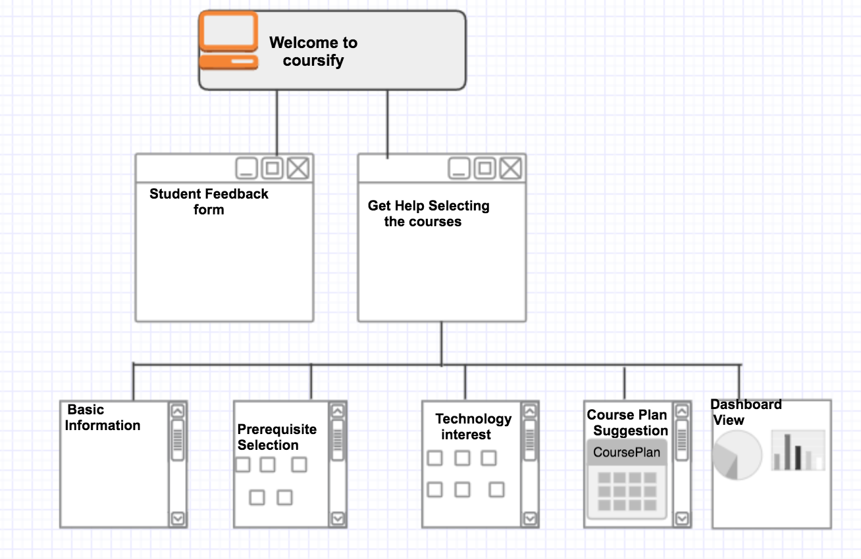
The way coursify works
Student is provided with the Web interface which provides an option for feedback form and Course Selection option.
Student can fill the feedback about the course by going to the feedback form option.
Student can go to course selection tab and proceed.
By selecting the basic informations, checking the assigned prerequisites and technology selection, students will be suggested the suitable given plan for their curriculum.

Slide 6
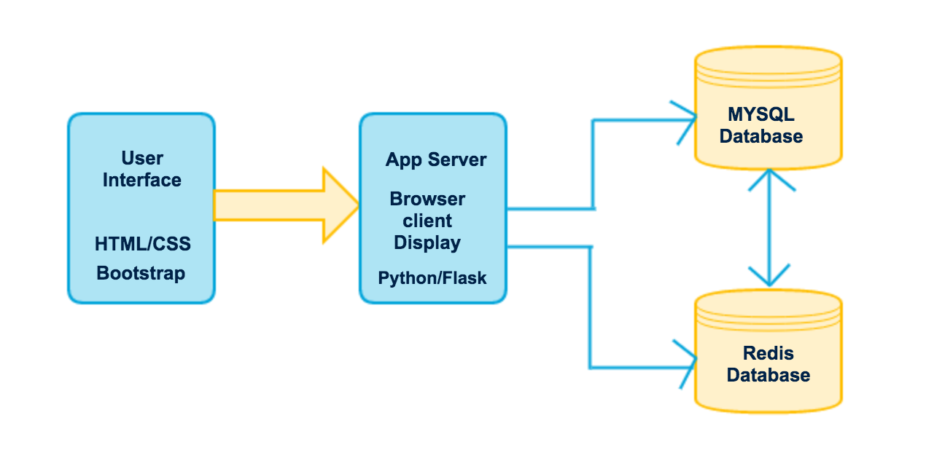
Architecture Diagram and description
The architecture diagram of coursify is described here, it consist of Web user interface for user interaction and we have worked on HTML/CSS and Bootstrap for web designing.
The application server is built on Python/ Flask module and it is dealing with all the user interaction queries.
Our app server coordinates and use both Redis and MySQL database for data retrieval.
MySQL database stores all the department and course related information such as all the department names, minor course options under department, major course options under that department and prerequisite course options and Redis database contains all the information taken from feedback and stores the review for all the course based on technologies and professor.

Slide 7
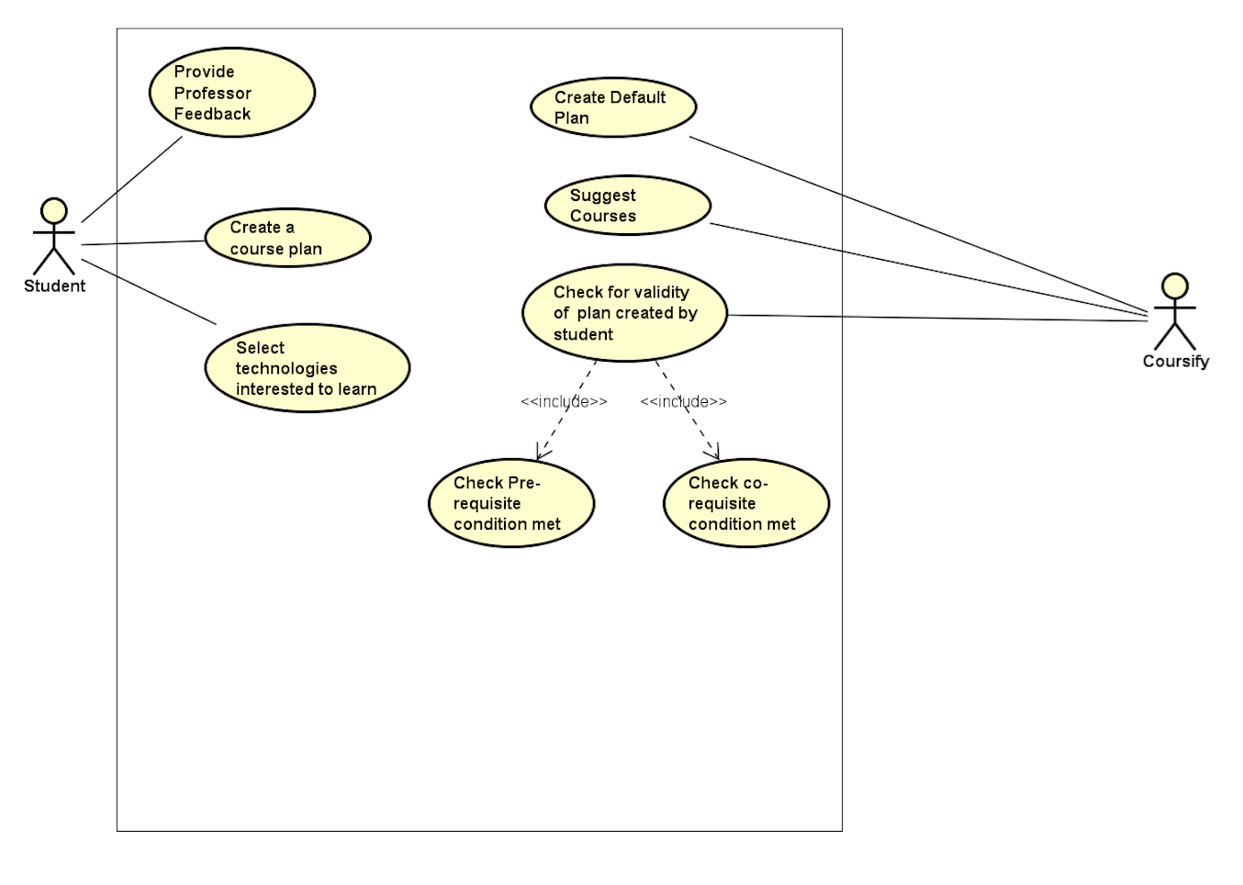
Use Case Diagram and description
The use case diagram for our system is mentioned here, the user student has following choices on coursify.
1.provide course feedback
2.Create a course plan
3.Select technologies student is interested in
learning and generate a view based on its selection.
The coursify supports the user with following features
1.help in creating a desired course plan based on tehcnology selection
2.Based on students selection for prerequisite and corequisite checks, it checks for validity for that plan.

Slide 8
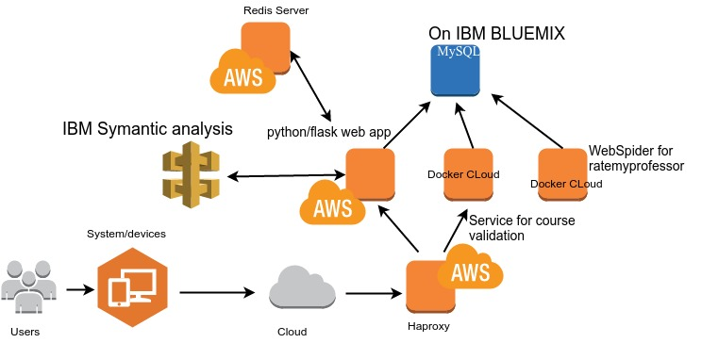
Technology Deployment Model

Slide 9
Feedback Analysis
–Logistic Classifier
–NLTK analyzer
–IBM Watson’s Alchemy API

Slide 10
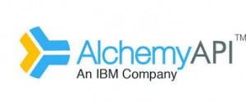
Watson’s AlchemyAPI
One of the most intelligent enterprise SAAS (AI as a service)
REST APIs

Slide 11







Technologies Used

Slide 12
Thank you

