Slide 1

Energy Consumption and its Impact during Covid-19 in USA
Group 5
Madhuroopa Irukulla
Prachitee Chouhan
Vaishnavi Vijayashankar

Slide 2
Motivation
All environment problems, like greenhouse gas emissions, pollutions, solid waste disposal, etc., are directly linked with energy consumption. These problems are making our planet less inhabitant.
Non-renewable energy resource is finite. The less energy used the longer those resources will last. Coal reserve will last till 2070, natural gas till 2060, petroleum till 2050. So, it is important to understand usage of each resources, so we can transit to nuclear energy and renewable energy resources.
Also, there is a fluctuation in energy consumption when there is an increase in population and natural hazard, like covid-19, if we know the trends of energy consumption from past years, then further energy demand can be anticipated.

Slide 3
Goals:
The purpose of this data visualization is to examine how the COVID-19 pandemic (for 2019-2020 years) has affected US energy consumption trends, particularly considering state-by-state population trends and the pandemic's chronology.
The visualization also tries to identify patterns in the use of various energy resources, such as nuclear, natural gas, renewable energy, electricity, coal and petroleum.

Slide 4
Intended Audience
Policymakers, academics, and individuals who are curious about how the pandemic may affect energy usage may be among the target audience for this problem statement.
Policymakers, who are planning to transit to more sustainable energy resources like, renewable and nuclear energy.
Students and educators who are interested in learning about the changes in US energy consumption trends and how they connect to population and COVID-19 may also be among the audience.

Slide 5
Main Questions
What were the US state-by-state trends of energy use before and after COVID-19?
How has the use of various energy resources, including nuclear, natural gas, renewable energy, and petroleum, altered before and after COVID-19?
Do states with larger and lower populations exhibit any appreciable disparities in the patterns of their energy consumption?

Slide 6
Data
Energy Consumption and Production data State wise in United States : https://www.eia.gov/energyexplained/us-energy-facts/
Population Data, State wise in United states : https://www2.census.gov/programs-surveys/popest/datasets/

Slide 7
Related Work
COVID-19 Impact on the Energy Sector in the United States (2020): https://www.mdpi.com/1996-1073/15/21/7867
In this paper, authors have concentrated on total energy consumption in USA for states, entire country, and have categories the usage based on residential, commercial, industrial, and transportation for years 2019-2020.
https://nicholasinstitute.duke.edu/sites/default/files/publications/Assessing-the-Long-Term-Impacts-of-COVID-19-on-Electricity-Consumption.pdf
The authors have shown the change in energy consumption in USA (2020-2021) based on energy sector. And how these sector has affected by Covid-19.
While in our project, we are concentrating on energy consumption from 2018 till 2020 based on their energy resources rather than energy sectors for USA and state wise..

Slide 8
Demo

Slide 9
Design Rationale and tools used
Design Rationale: The design approach for this project will be based on the principles of data visualization, including simplicity, clarity, and accuracy. The dashboard will be designed to cater to a wide range of users, from experts in the field to casual viewers. The layout will be simple and easy to navigate, with clear labeling and a logical flow of information. Color schemes and font choices will be used to enhance the visual appeal and readability of the dashboard.
The dashboard will include several key features that will help to highlight the impact of COVID-19 on energy consumption. These features include:
Time-series charts comparing energy consumption patterns in the pre-pandemic period with those during the pandemic.
Geographic maps showing the impact of COVID-19 on energy consumption in different regions.
Interactive filters and controls that allow users to explore the data and find insights.
Summary tables and charts that highlight key trends and insights.
Tools used:
Python3(IDE: Google Colab.): For merging datasets
Tableau: For Exploratory Data Analysis
Excel : For 3D world Maps

Slide 10
Insights
There is a decrease in energy consumption for 2019-2020 in comparison with 2018.
Decrease in Electricity and Petroleum consumption in 2019-2020 in most populated states such as Texas, California, New York, Florida etc.
COVID-19 pandemic in 2019 may have led to a reduction in electricity consumption in some areas, as businesses and industries closed or reduced their operations. Additionally, the decline in oil prices and the economic impact of the pandemic may have led to a reduction in petroleum consumption in the transportation sector.

Slide 11
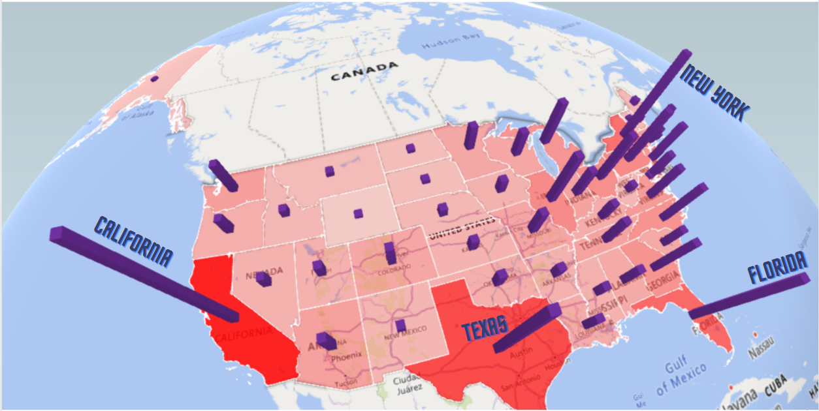
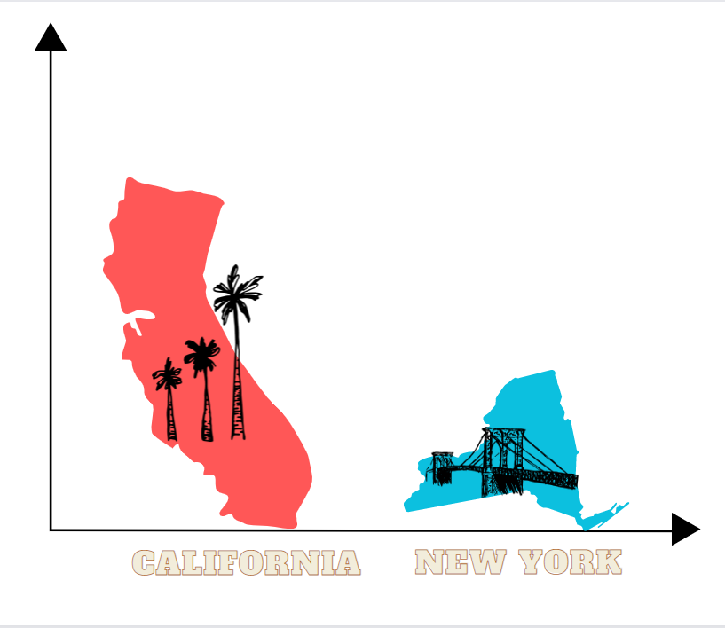
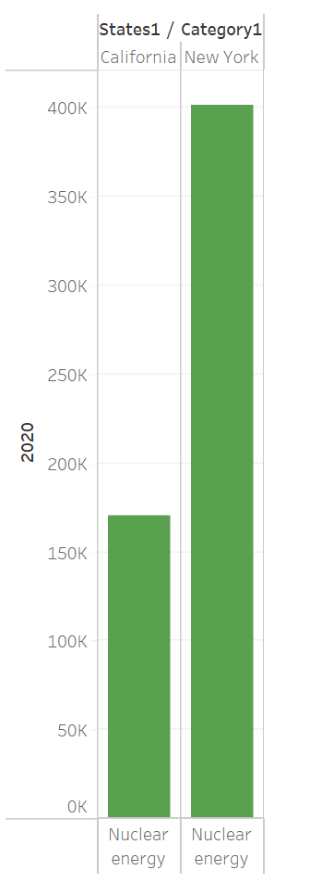
Insights...
3.3X
Nuclear energy consumption was high during COVID-19 regardless of population and region.
New York was the epicenter of COVID-19 and implemented policies in April 2020 to encourage renewable energy, potentially leading to a shift towards nuclear energy.
New York may have relied more on nuclear power plants due to reduced energy imports from neighboring states.
Higher population density and greater reliance on public transportation in New York may have led to more COVID-19 cases and increased energy consumption due to higher demand for healthcare services and public health measures.

Slide 12
Thank you!

