Slide 1
Project charter – grind003 Think NXT Customer session portal demo presentation

Slide 2
AGENDA
Introduction​
Team Members
Login Page
Login Page - Error handling
API - DB creation
API – Success/Error Flow
UML diagrams

Slide 3
Introduction
The Customer Session Portal is a comprehensive platform designed to streamline and enhance the interaction between customers and relationship managers. This system aims to provide an efficient and organized solution for managing customer queries, ensuring a seamless communication channel that fosters positive relationships and customer satisfaction.

Slide 4
Team members
Akshay Karpe
Ayesha shaikh
Gaurav borase
Kuldeep raut
Madhur patil
Megh varun
Mrunali kale
Nilam patil
Rupali wagh
Sagar gupta

Slide 5
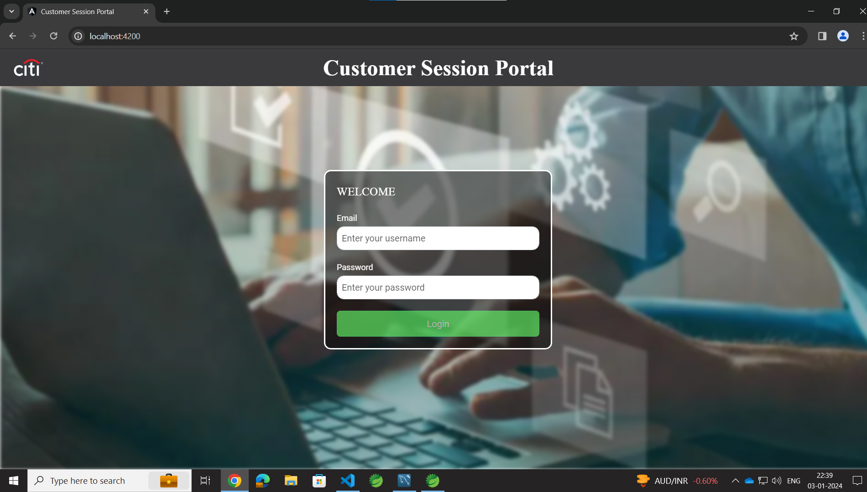

Slide 6
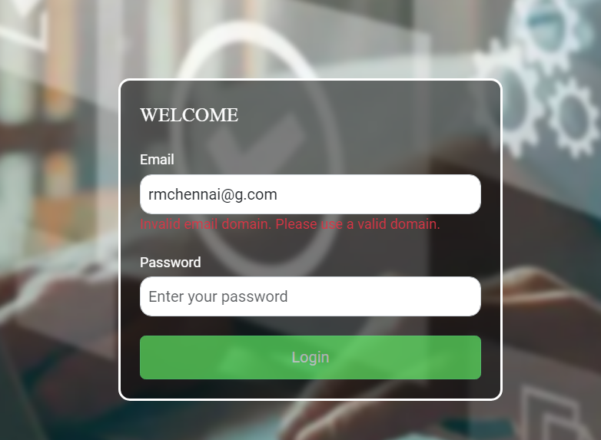

Slide 7
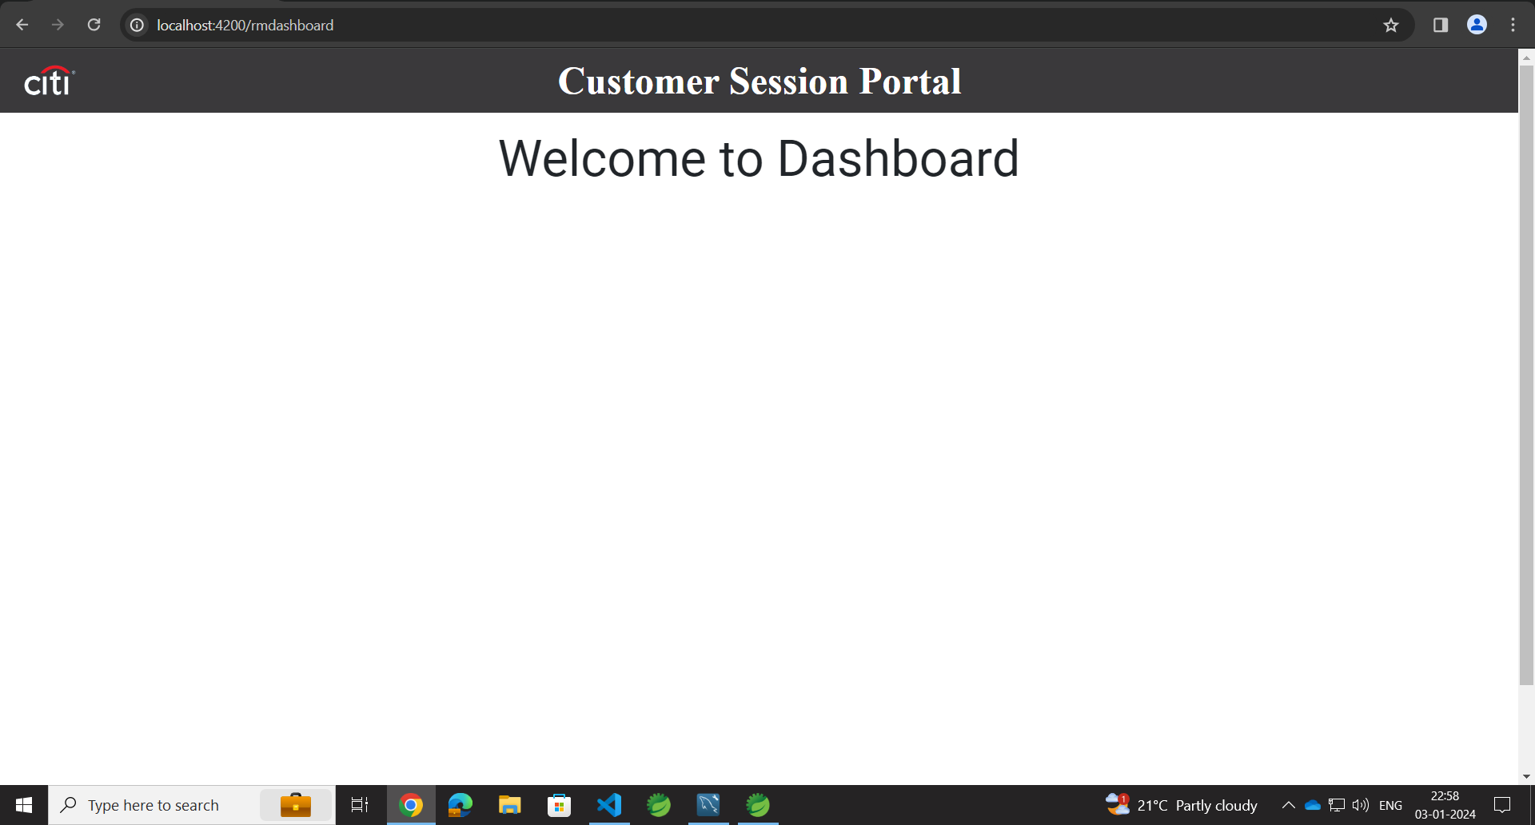

Slide 8
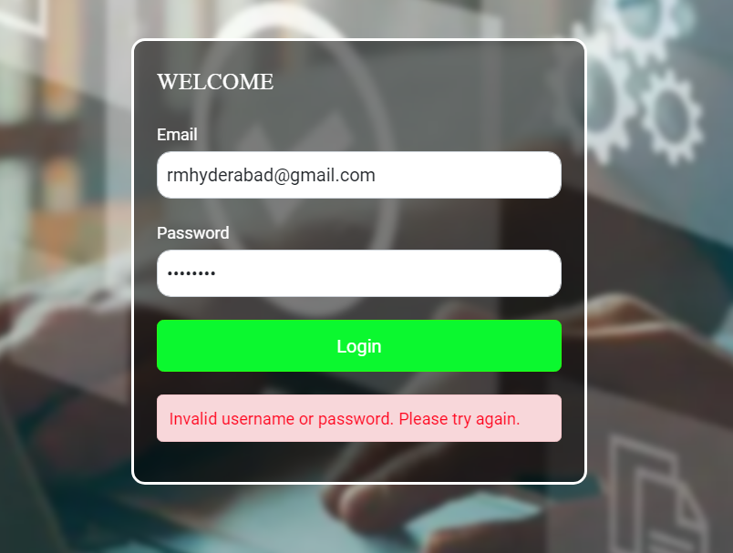

Slide 9
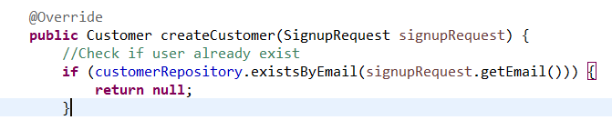
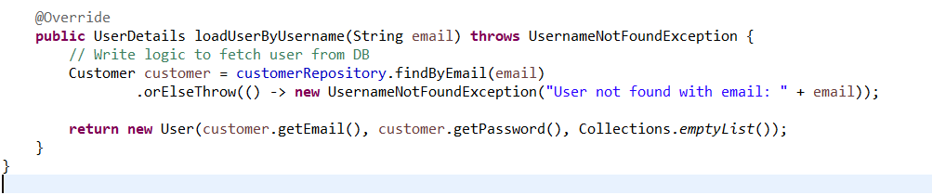
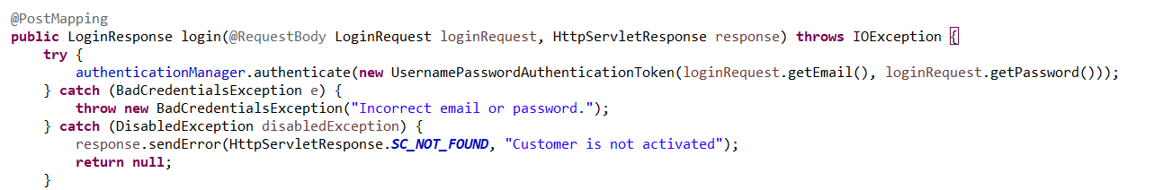

Slide 10
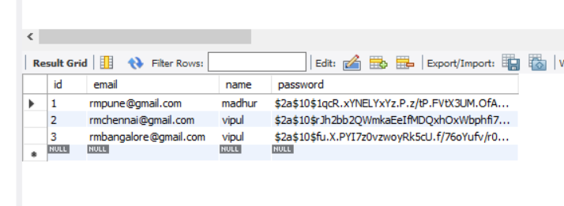

Slide 11
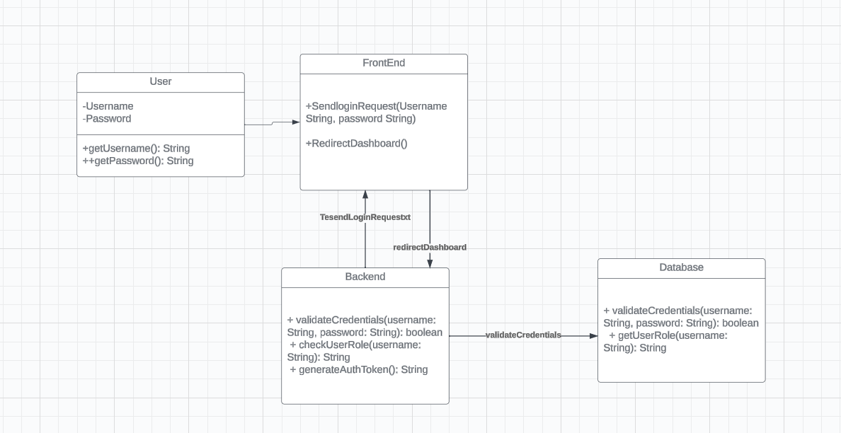
UML Diagrams
Class Diagram

Slide 12
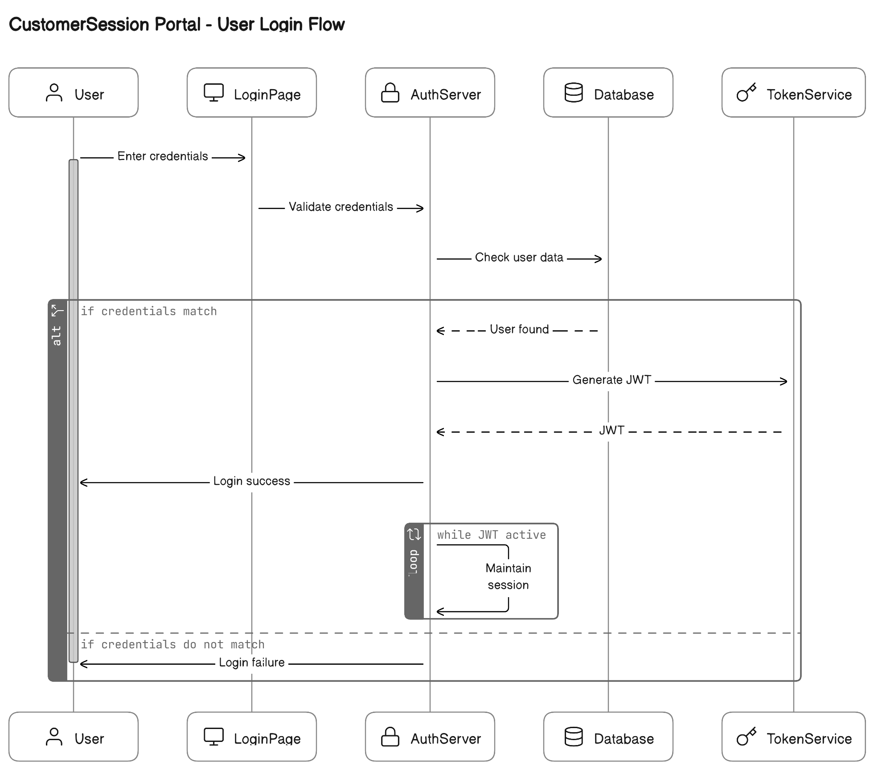
UML Diagrams
Sequence Diagram

Slide 13
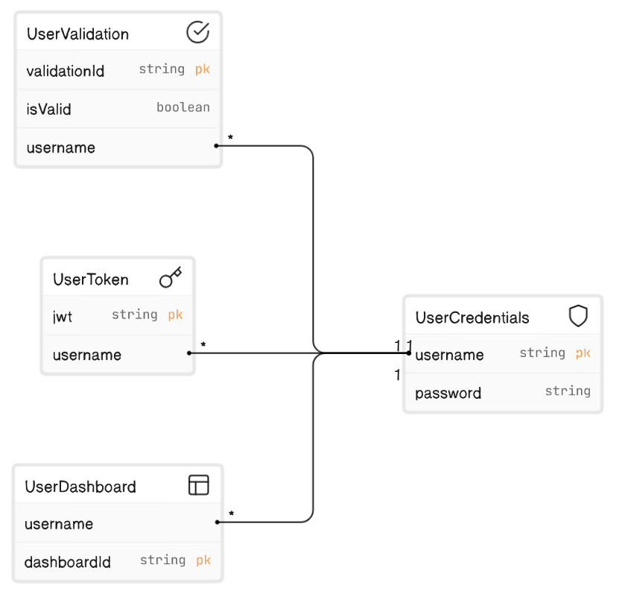
UML Diagrams
ER Diagram

Slide 14
Thankyou

