Slide 1
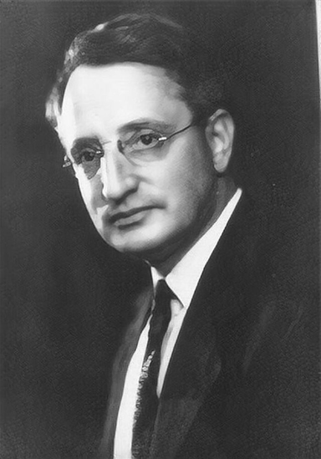
Benford’s Law for Twitter Data: Authenticity & Anomaly Detection
Team Exponents:
1.Kanishk Kumar Ranjan
2.Rahul Gupta
3.Madhur Devidas Rathod
4.Farzain Naikwade

Slide 2
Benford’s Law: Definition & Context
Definition: Probability the first digit = d is
This yields ~30.1% for d=1, 17.6% for d=2, … down to ~4.6% for d=9.
When it applies:
Data that spans several orders of magnitude (no fixed minimum scale)
tends to follow this log pattern. If digits were uniform, each digit would
be ~11.1%, but Benford’s Law is skewed toward lower digits.
Social Media Example:
Social counts often exhibit Benford behavior. For instance, studies show
nearly half of users’ friend/follower counts begin with 1 or 2, not uniformly
distributed This confirms smaller leading digits dominate in
natural social data.

Slide 3
Overview of Analysis
We examined five key columns from the Twitter dataset, grouped into two categories:
System-Generated Fields-
id: Auto-generated unique ID for each user.
tweetId: Auto-generated unique ID for each tweet.
lastSeen: Timestamp of a user’s most recent activity (system-recorded).
User-Controlled Fields
followersCount: Number of followers the user has.
friendsCount: Number of accounts the user follows.
Dataset & Analysis Goals
Our goal is to compare each field’s first-digit frequency against Benford’s Law to detect irregularities.
System IDs/timestamps span many magnitudes, so should naturally follow Benford’s distribution. User metrics may deviate (e.g. users targeting round follower milestones).
Prior research shows social metrics often obey Benford. E.g. friend/follower counts on social networks roughly follow the expected pattern. Deviations from Benford can signal fraud or data issues.

Slide 4
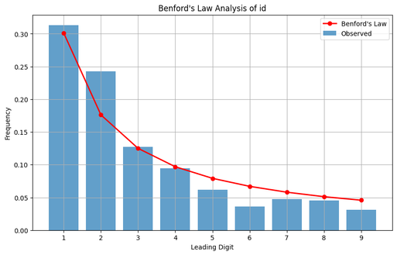
id (System-Generated ID)
Figure: First-digit distribution for id (blue = observed, red = Benford).
The id field (numeric user or tweet IDs) shows an almost perfect Benford pattern. Digit 1 is ~30%, 2 ~18%, and frequencies steadily decline. This is expected: these IDs are large, auto-incrementing (or pseudo-random) numbers covering many magnitudes. The close alignment (bars vs. Benford curve) indicates very strong conformity. Such a distribution is normal and unsurprising for system-generated numeric IDs

Slide 5
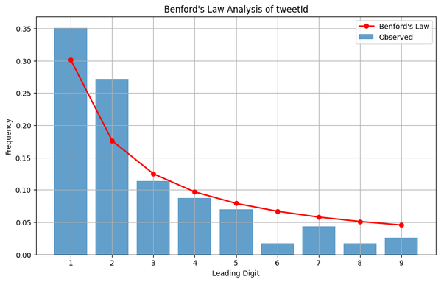
tweetId (System-Generated Tweet ID)
Figure: First-digit distribution for tweetId.
The tweetId field (chronological tweet identifiers) similarly follows Benford’s Law. The first digit 1 dominates (~35%), with a smooth decrease thereafter.
The slight over-representation of 1 (and under-representation of 6–9) likely reflects dataset age bias (more older tweets with small IDs).
Overall, however, the observed frequencies (blue) closely track the theoretical line (red). This strong conformance is expected for sequential unique IDs in large datasets

Slide 6
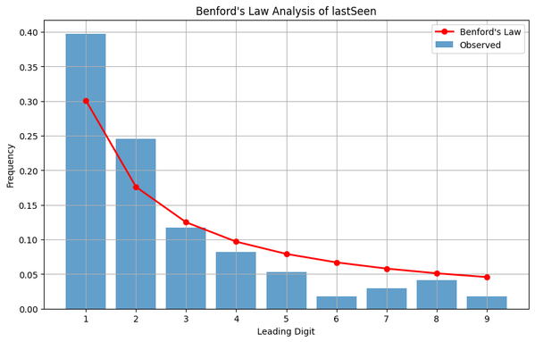
lastSeen(System-GeneratedTimestamp)
Figure: First-digit distribution for lastSeen.
The lastSeen field also exhibits a steep drop from digit 1 downward, in line with Benford’s curve. Digit 1 is very prominent (~39%), higher than the ideal 30%, and digit 2 is mildly elevated. Digits 3–9 are lower.
This skew is plausible if many users have low lastSeen values (e.g. times or counters with clustering at the start), but overall the downward trend matches Benford’s expectation.
In summary, lastSeen largely conforms to Benford’s distribution (minor bias is typical in limited samples

Slide 7
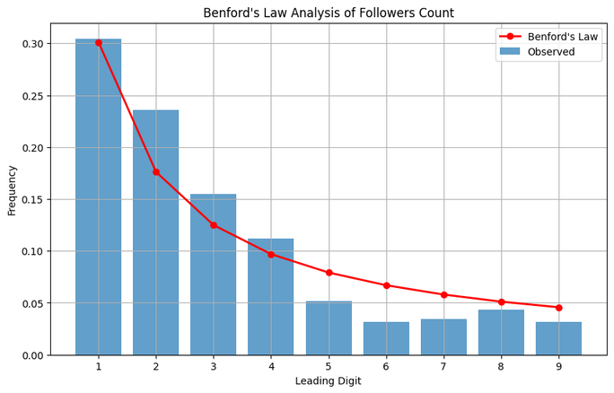
followersCount (User-Driven)
Figure: First-digit distribution for followersCount.
For followersCount, the first-digit pattern generally declines but with some anomalies. The bar for digit 1 is about 30%, and digits 2–5 follow a decreasing trend similar to Benford’s Law.
However, noticeable bumps occur at round-number thresholds (e.g. around 1, 10, 100, 1000), reflecting users hitting common milestones.
These “rounding” effects cause minor deviations from the smooth curve. Nonetheless, the overall distribution still roughly matches Benford’s expectation, indicating most genuine follower counts span multiple orders of magnitude

Slide 8
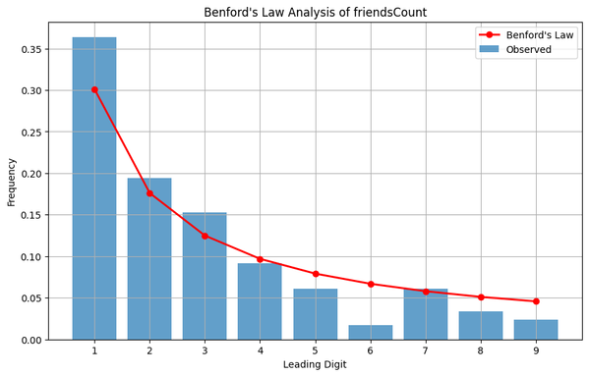
friendsCount (User-Driven)
Figure: First-digit distribution for friendsCount.
The friendsCount distribution is less aligned. The leading digit 1 is ~36%, higher than Benford’s 30.1%, while digits 6,8,9 are notably underrepresented.
The shape still declines, but the fit is weaker than for other fields.
Such distortion can signal unnatural behavior: fake or bot accounts typically follow many others, skewing this distribution. In fact, prior analyses of fake Twitter accounts show friends count frequencies often violate Benford’s Law.
This suggests we should scrutinize this field for anomalies.

Slide 9
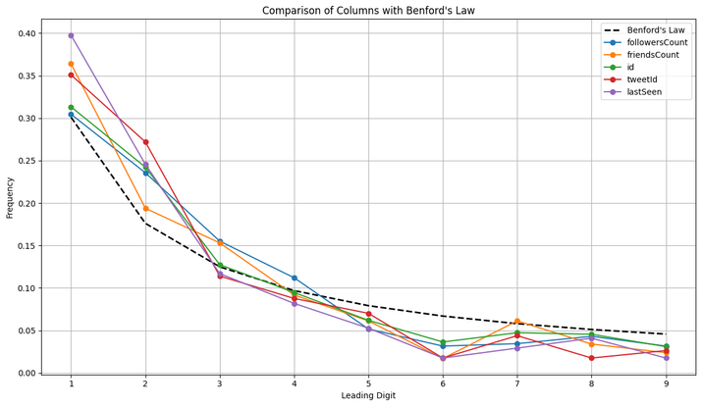
Key Findings & Conclusive Insights:
System fields pass Benford’s check: id, tweetId, lastSeen strongly match theoretical first-digit proportions.
Their high correlation with Benford’s Law is expected for auto-generated identifiers
User fields show deviations: followersCount is mostly conformant with mild spikes at round milestones.
friendsCount deviates more (oversized ‘1’, very small higher digits), consistent with known bot/fraud patterns
Benford as a filter: Using Benford’s Law is a lightweight pre-filter for data authenticity
Data subsets that fail the first-digit test can be flagged before applying heavier ML methods.
Further checks: We should also test second-digit distributions (a standard forensic audit technique) for subtle anomalies.
Drift monitoring: Track Benford conformity over time.
Significant shifts in first-digit patterns could indicate evolving fraud, dataset changes, or systemic drift in metrics.

Slide 10
Thank You

