Slide 1
Dog Breed Classifier application
Designed And Developed:
MADHUR SAHU
KSHITIJ SHARMA
KUNDAN KUMAR

Slide 2



Timeline
Abstract
Designing the classifier model
Training the model
Application development
Testing and analysis

Slide 3
Abstract
This Project deals with an application of Deep Learning (Especially Convolutional Neural Network) and Image processing to predict the breed of a dog out of more than 133 known breeds with more than 93% collects image from camera of the user and shows probability percentages of the top breeds predicted by our trained model. The app uses a tensor flow model which was trained on more than 35000 images of dogs tagged with their breeds using Transfer Learning. The model consists of a deep web of several Convolution and Pooling layers. We have used TensorFlow lite module of android which interprets the input and output dimensions of the model and converts the image into the required dimensions. Our application takes input from camera or gallery and converts it to 224*224*3 Byte Array and calculates the prediction function using the trained model which is nothing but the probability distribution (an array of probabilities) for all breeds. The app shows you the breed names and probabilities of the most likely breeds ,if the image is not of a dog else it displays “Sorry NO dog Detected !".

Slide 4
Designing the Classifier model
Our classifier model is based on deep learning. The model contains a deep web of :
An input layer of size =224*224*3
several Hidden layers each layer consisting of :
convolutions layers
ReLu activation
Max pooling layers and
A fully connected layer of size equal to number of trained breeds ,activated by SoftMax function.
The Input Layer: A Byte Array of size 224*224*3 (size of an image)
The Output Layer: A vector of size equal to number of breeds which stores probabilities of each breed.
The basic Design of the model is explained in the next figure.

Slide 5
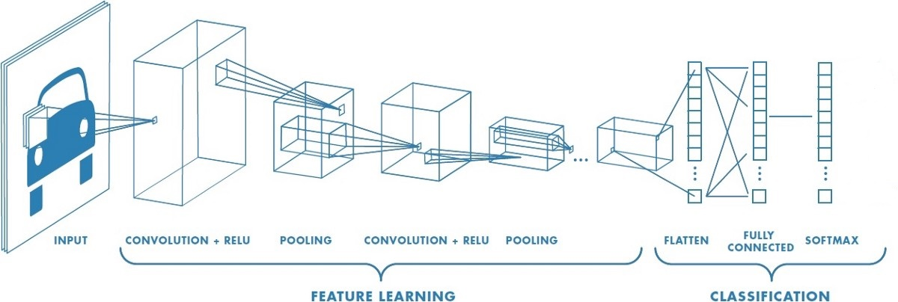
Figure explaining the basic design of the Model.

Slide 6
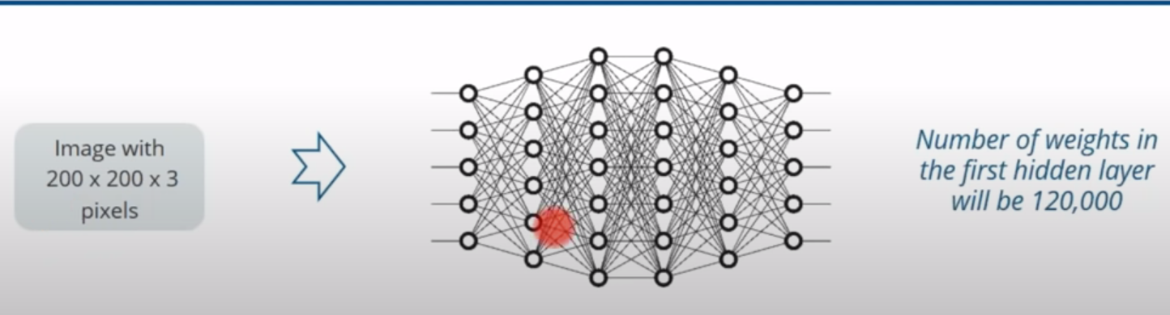
Why do we use CNN instead of Deep neural networks
Deep neural networks will give better results but in deep neural networks every neuron in one layer is connected to every neuron in the next layer and each connection is determined by the weight. Because of the dense connected network the number of weights can be very large and it soon becomes unmanageable as the pixels of the image increases.

Slide 7
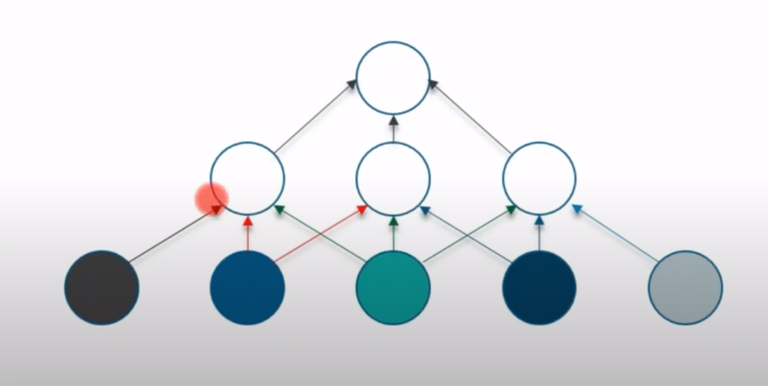
Advantages of convolutional neural networks -
In convolutional networks not all the neurons are connected to each other as shown in the following figure –
Convolutional networks are able to detect certain patterns in the images which differentiates it from other neural networks.
Along with dense layer , relu layer etc CNN also contains convolutional layers which recognize various patterns in the image such as straight lines , circles , edges , pointed objects etc.
These patterns get more detailed as we traverse into deeper layers of convolutional layers and it can eventually be able to detect patterns as complex as dogs, cats, cars etc.
The patterns are identified by the various features that we already have.

Slide 8
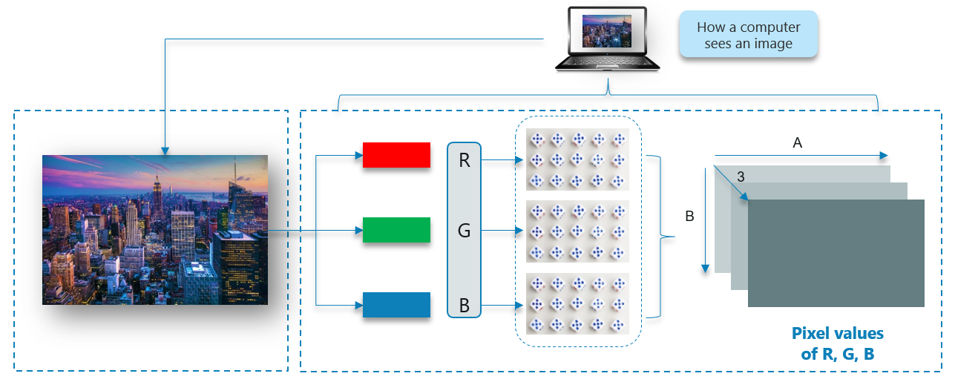
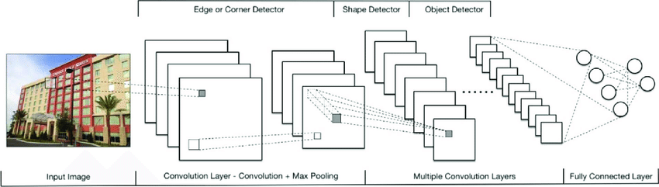
How the CNN Model Works
First it takes the input of the image to predict the breed of the dog. How our model perceives the image- For our model the image is just a 3D matrix of pixel values.
It gains the access of the training data.
Indexing of the breeds is done.
CNN consists of several layers of-
Convolutional layer
ReLu layer
Pooling layer
And a Fully connected layer
The whole model will be like this-

Slide 9
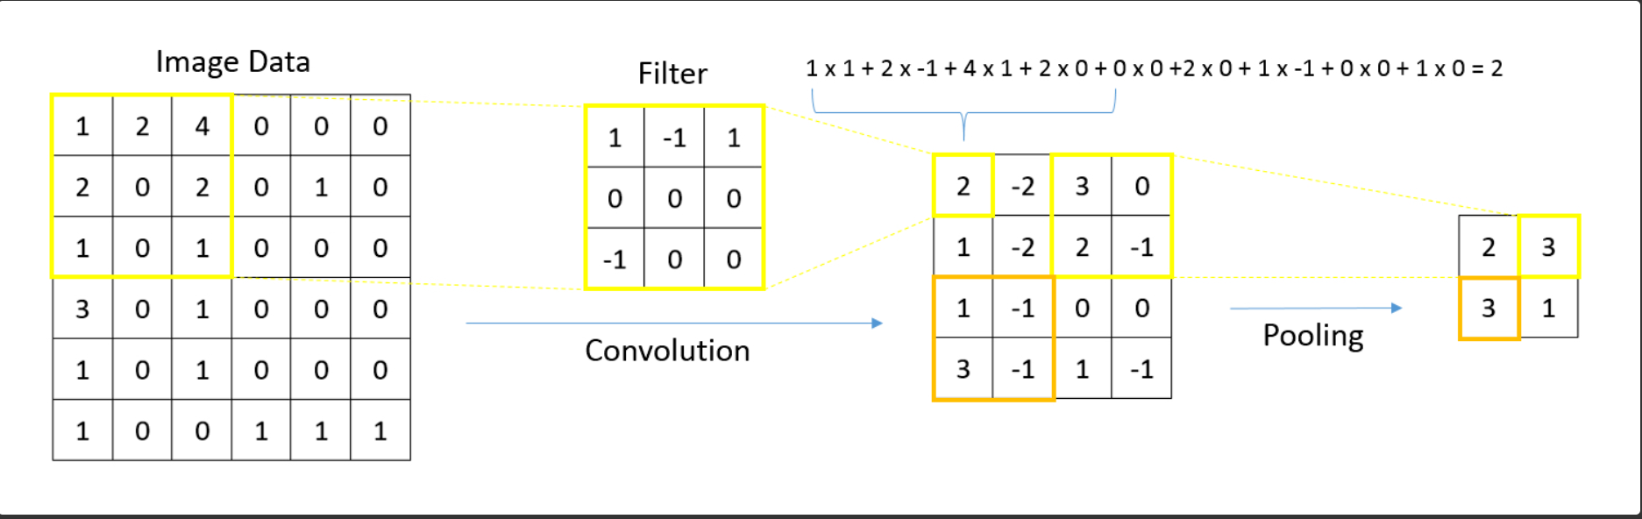
Working of convolution and Pooling

Slide 10
Training the Model
The Whole training and testing work of the model was done on Google Colab through Transfer Learning. The reason behind this is the limitation of our personal Systems and also the handy nature of the Transfer Learning as we don’t need to install the required libraries and modules one by one. We only needed to setup the separate directories for train, test, validation dataset and also for storing labels.txt which contains a lexographic list of the breeds.
Dataset :
The Dataset we have used consists of more than 8000 images of dogs tagged with their breeds. The dataset was downloaded from cloud storage of kaggle.com.
Partition :
We have used the following criteria of partition for different purposes:
Training: 80 percent of the total dataset was used for training (6400 images)
Testing: 10 percent of the total dataset was used for testing (800 images)
Validation: the rest 10 percent was used for validation (800 images)

Slide 11
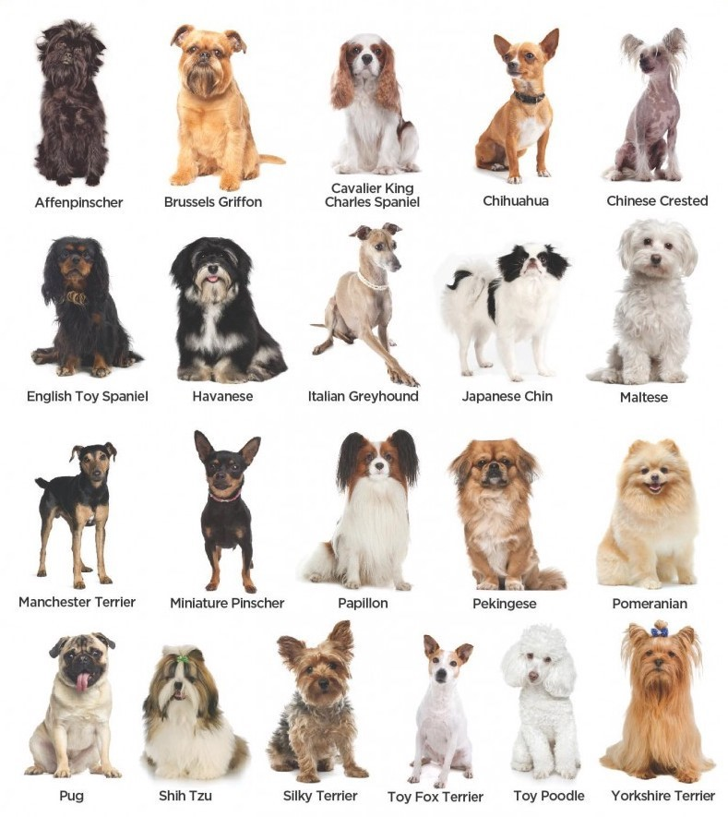
Sample
Dataset

Slide 12
Populating the training Data :
8000 images are not enough for obtaining a decent accuracy of the model. We have to expand the training dataset in order to improve the performance and ability of the model to generalize. Population can be done using ImageDataGenerator class of the Keras deep learning library. We can populate the data by Flipping each image vertically and horizontally by changing the brightness of the image.
Storing the List of Labels in a directory :
A file named labels.txt stores the list of all breeds in lexographical order.
Creating a CNN to Classify Dog Breeds :
The used CNN architecture has 3 convolutional layers alternating with maxpooling layers, 10layer which is then followed by a dense layer (the fully connected layer) to identify 133 breeds. The non-linearity used here is ReLu for each convolution and pooling layer and SoftMax for the fully connected layer. SoftMax maps each output of the last pooling layer to a value less than 1.0, the sum of all mappings is equal to
1.0 as we want to know the probability of each breed.

Slide 13
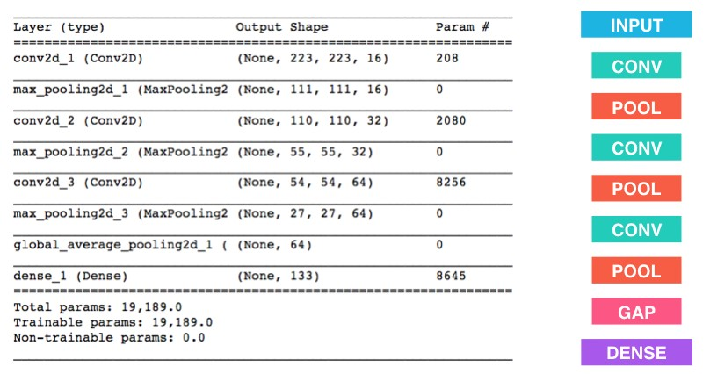
We need to compile the model using a suitable Loss function and optimizer function. In this project we have used the rmsprop optimizer and the categorical crossentropy loss. model.compile(loss=’categoricalcrossentropy’, optimizer=’rmsprop’)
The training was done on the batches of 32.The final accuracy after adjusting the Hyperparameters was close to 93 percent.
Below is a snapshot of training and validation parameters:

Slide 14
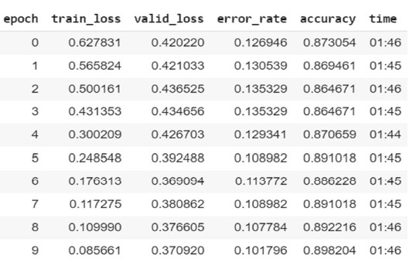
Metrics

Slide 15
Saving and Downloading the final model :
Finally, we save the best weights obtained by training testing and validation in model.hdf5 format. But this file cannot be used directly in android studio. We need to convert this file into model.tflite format so that TensorflowLite module of android can interpret it. In the next chapter we will use this file to design the android app.

Slide 16
App development
We will design a simple two activity app: The welcome/main activity and the Results activity. The main activity will have a TextView containing the Title and short manual of the app. There will be Two buttons: one for camera and another for gallery. The camera button will take you to the camera view where you can see the breed of your dog by clicking the picture.
The Gallery button will take you to the File manager where you can select the preclicked image of your dog. On the selection of image, you will be taken to the Results page where a TextView will show the results.
Adding the activities and buttons accordingly :
We Create an empty activity and name it MainActivity . On the bottom of this activity we add two buttons one for camera and one for gallery .On the Top the activity A text View will show the title of the app and In the centre part of the activity we have a TextView containing info about the app. Below is a snapshot the main activity.

Slide 17
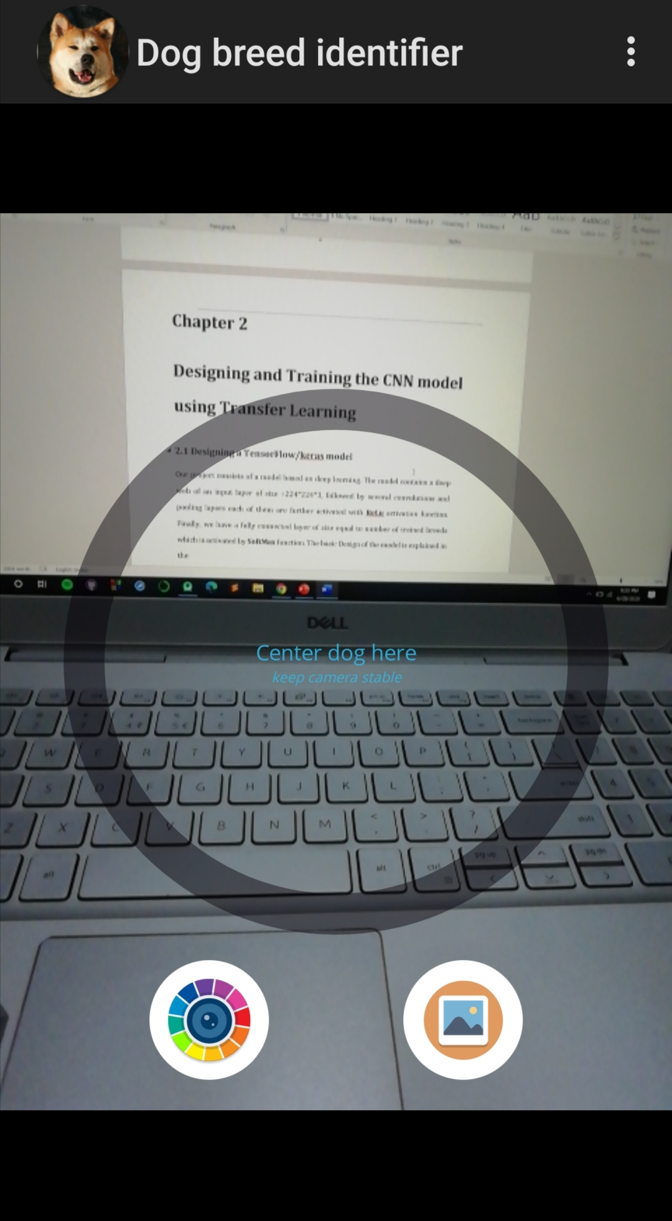
Snapshot of
the Main activity

Slide 18
Setting up the assets folder :
In the res folder of the project we create an Assets Folder in which we keep the
model.tflite and labels.txt file downloaded earlier. We store the whole list of breeds and their images in this folder for future use.
Asking permissions for access of camera and file manager:
We need to ask for the permission to access camera and file manager from the user.
For this we need to add a few lines of code in AndroidManifest.xml file of the app
TensorFlow interpreter interprets the input output configuration of the model
Now comes the use of TensorFlow Lite module of android to interpret the model. The interpreter returns the input and output dimensions of the model. In our project input shape is 224*224*3 and output shape is 125*1.
Converting the input into required format/pre-processing of image
The input image can be of any size depending upon the device configurations, so we need to convert the input image to 224*224*3 byte array. The image taken from camera is of bitmap object type and that from gallery is of Uri object type. We can do the conversions easily by the help of Converters present in android.
<uses-permission-sdk-29 android:name="android.permission.CAMERA"></uses-permission-sdk-29> <uses-feature android:name="android.hardware.camera" /> <uses-permission android:name="android.permission.READ_EXTERNAL_STORAGE"></uses-permission>

Slide 19
Run the interpreter and show the results :
Finally, we have to pass the byte array to the TensorFlow interpreter. The interpret simply calculates the SoftMax values using the saved model (model.tflite) and returns the final probability distribution in a vector of shape 125*1. We have to define a function that sorts this array and find the index of the top three probabilities. Using these indices, we can refer to the names of the breeds listed in labels.txt. Now the app is ready to run.

Slide 20
Results and analysis
The accuracy of the model which we have trained is 93 Percent.
The size of the dataset which we use to train our model plays a major role in deciding the accuracy of the model. Larger the dataset, more experienced the model and hence more the accuracy.
Activation function such as ReLu function, plays an important role here as it adds the non-linearity to our model. The SoftMax function helps provide our predicted result on the scale of 0 to 1.
We can build more complex models and make our machines learn to identify anything and also tell the detail about it.
Below are some snapshots of our Application.

Slide 21
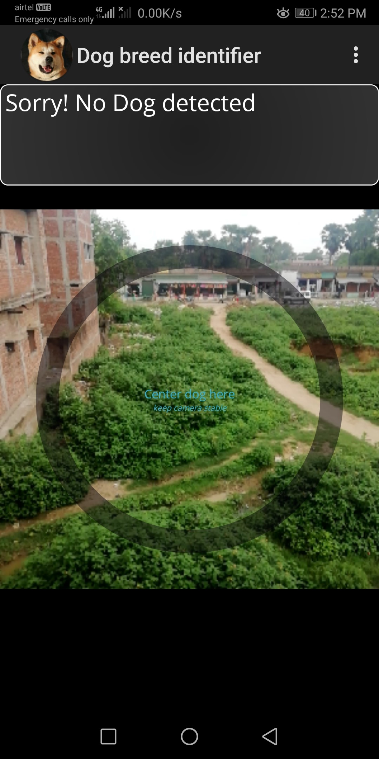
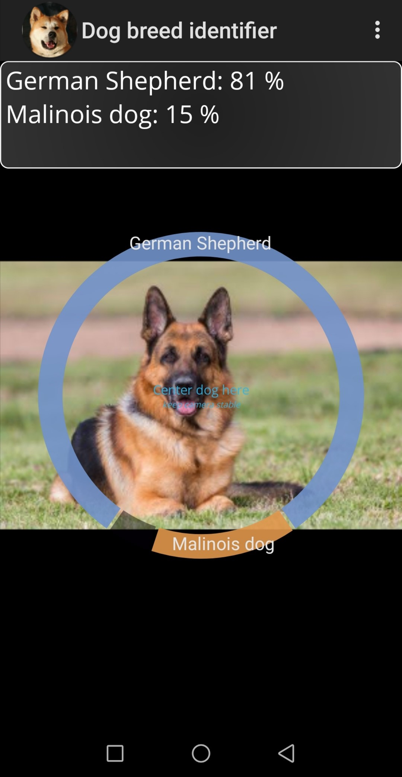
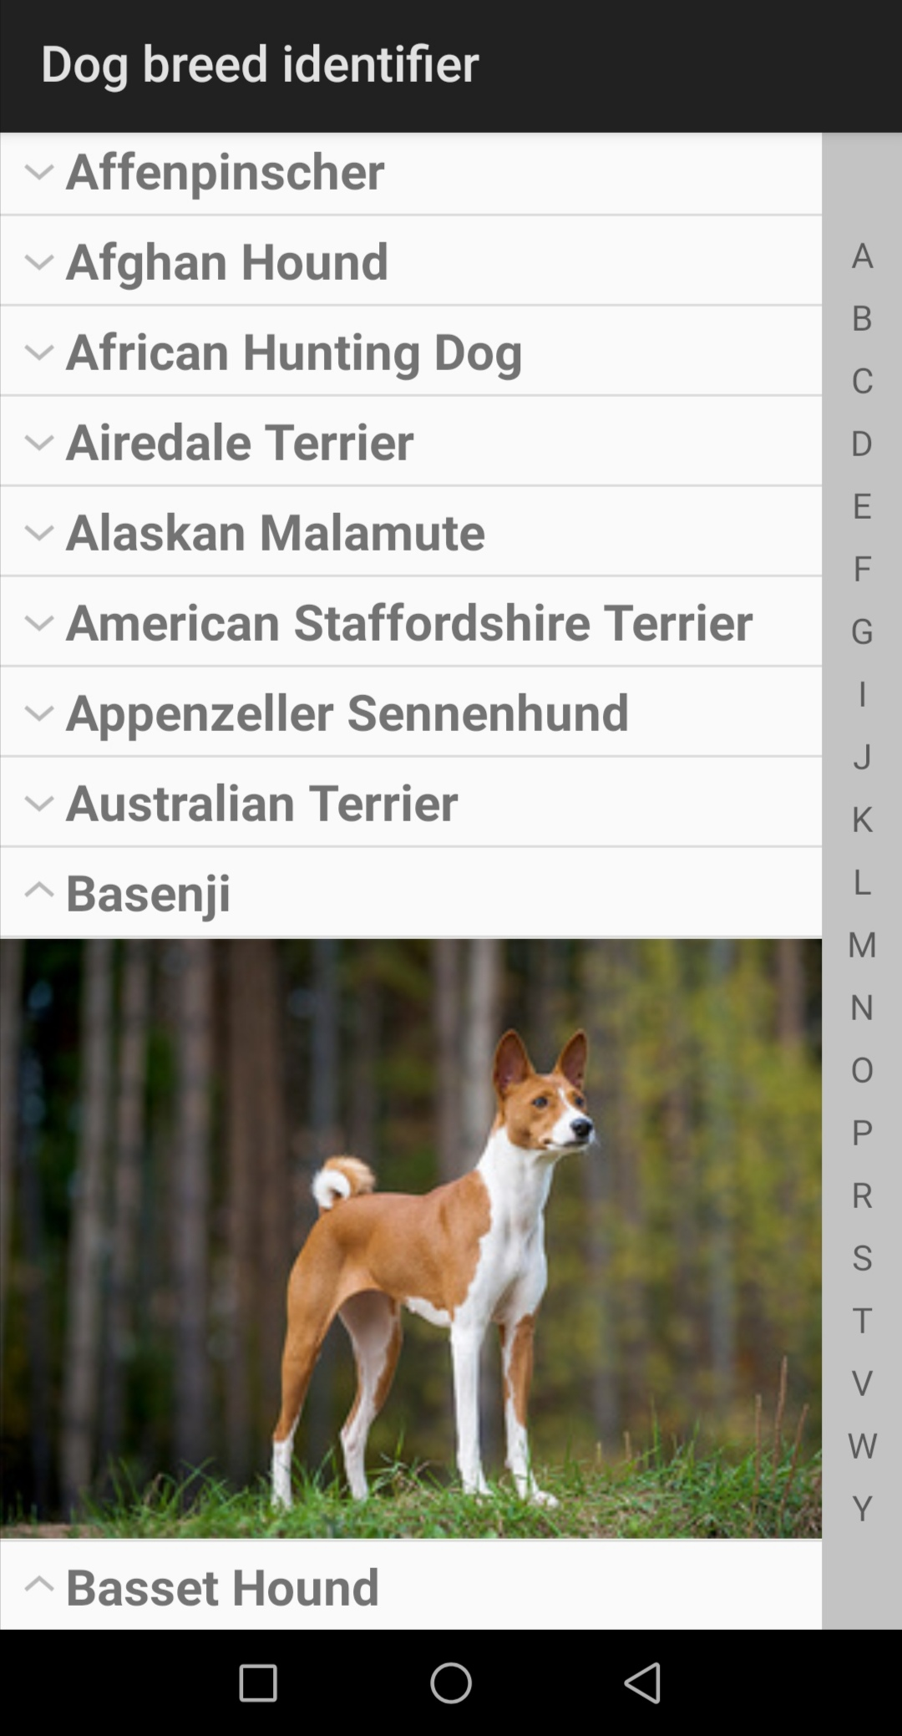
Snapshots

Slide 22

**THANK YOU**

