Slide 1
$67,406
MOVIE RENTAL
Total Revenue
ANALYTICS
16,044
A comprehensive data analysis of the Rental database
covering sales, customer behaviour, film inventory & business insights.
Total Rentals
599
PostgreSQL
Excel
Power BI
EDA
Data Modelling
Total Customers
1,000
Total Films
DOMAIN: DVD Rental Store | DATASET: 18 Tables, 16K+ Transactions | PERIOD: May 2005 – Feb 2006
01 / 11

Slide 2
DATASET OVERVIEW
About the Data
18
1,000
599
16,044
4,581
109
Tables
Films
Customers
Rentals
Inventory Items
Countries
TRANSACTIONS
CUSTOMERS
payment · rental
customer · address · city · country
CONTENT
OPERATIONS
film · film_actor · film_category · film_text · category · language
store · staff · inventory
⚠ Covers only 5 months (May 2005–Feb 2006). Seasonal trends are directional. No age/gender columns available.
02 / 11

Slide 3
METHODOLOGY
Project Process Layout
01
02
03
Data Collection
Data Cleaning
EDA via SQL and Excel
▶
▶
Sakila DB
18 CSV files
PostgreSQL load
Null checks
Type corrections
Relationship mapping
15 business questions
PostgreSQL queries
Key insight extraction
04
05
06
MECE Framework
Power BI Modelling
Dashboard & Insights
▶
▶
Structured breakdown
No overlap coverage
Analysis planning
Star schema
DAX measures
Relationships defined
4 dashboards
KPI cards
Business recommendations
03 / 11

Slide 4
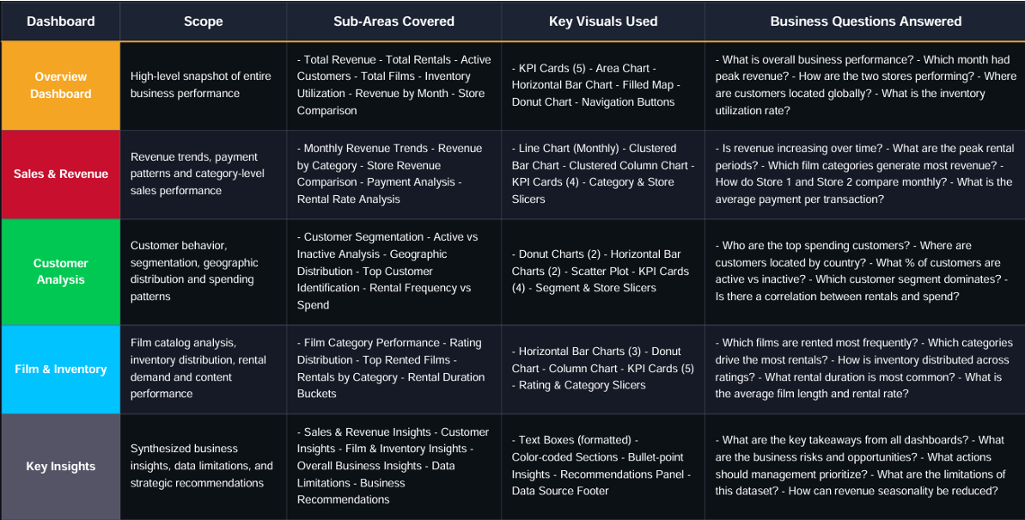
MECE FRAMEWORK
MECE Breakdown — Analysis Coverage
Mutually Exclusive · Collectively Exhaustive
04 / 11

Slide 5
EDA — QUESTIONS
Exploratory Data Analysis
15 business questions answered using PostgreSQL queries across all key dimensions
Customer
Film & Inventory
Location & Trends
Operations
Q1 – New vs repeat
purchasing patterns
Q2 – Highest rental
rate films & demand
Q4 – Seasonal trends
by location
Q3 – Staff performance
vs satisfaction
Q6 – Loyalty tier
impact on revenue
Q5 – Language films
vs customer segments
Q7 – Category popularity
by location
Q8 – Staff availability
vs customer rating
Q9 – Store proximity
vs rental frequency
Q10 – Film category
vs customer tenure
Q13 – Busiest hours/days
per store
Q15 – Language availability
vs rental frequency
Q11 – Top spender
demographics
Q12 – Inventory impact
on repeat business
Q14 – Cultural factors
influencing preferences
Tool: PostgreSQL (pgAdmin) · Queries: Window functions, CTEs, JOINs, RANK(), PERCENTILE_CONT()
05 / 11

Slide 6
EDA — FINDINGS
Key EDA Findings
Q1
Q2
100% Repeat Customers
Top Films Drive Revenue
All 599 customers are repeat renters — averaging 26.78 rentals each with $112.53 avg spend. Business has strong retention.
"Bucket Brotherhood" leads with 34 rentals. High-rate ($4.99) films in Sports, Animation & Family dominate revenue charts.
Q4
Q6
Strong Seasonality
Loyalty Tier Impact
Summer 2005 accounted for 91.7% of rentals. July 2005 alone contributed 41% of total revenue — significant concentration risk.
Gold tier (25-39 rentals) drives 71.54% of revenue with 392 customers. Platinum tier earns $185/customer on avg.
Q7
Q12
Geographic Preferences
Inventory Gap Identified
India & China are top customer countries (60, 53). Sci-Fi, Sports & Animation are the most geographically widespread genres.
11 films flagged as 'Low Stock' despite high demand (5 rentals/copy). These represent direct lost revenue opportunities.
06 / 11

Slide 7
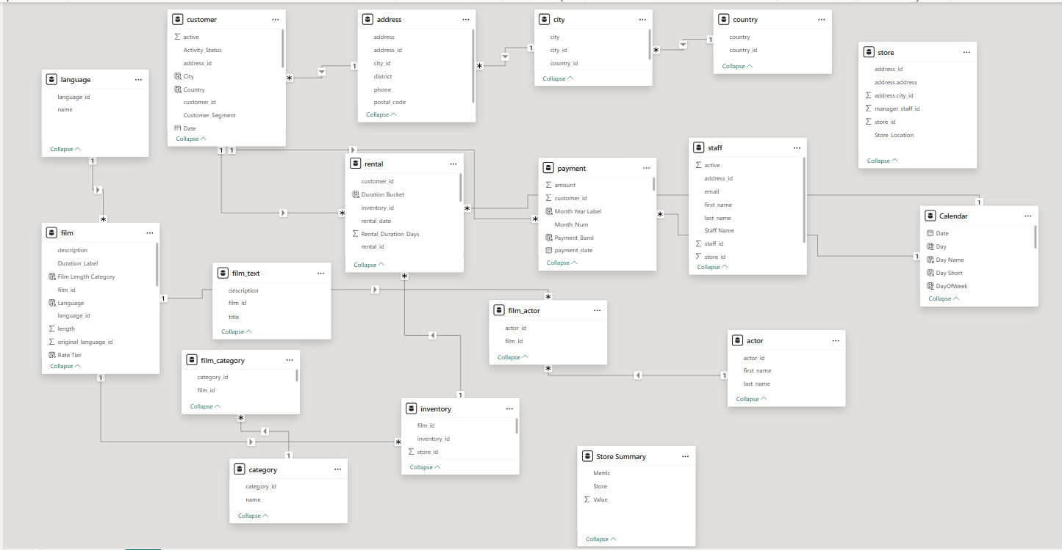
POWER BI — DATA MODEL
Data Modelling
Schema Type
Star Schema
Fact Tables
Payment · Rental
Dim Tables
Film · Customer · Store · Staff · Date · Category · Language
Relationships
One-to-Many (1:*) across all joins
DAX Measures
Active Customer %, Revenue per Customer, Customer Segment, Rental Duration Bucket
Date Table
Custom DateTable with Day, Month, Day of Week columns
07 / 11

Slide 8
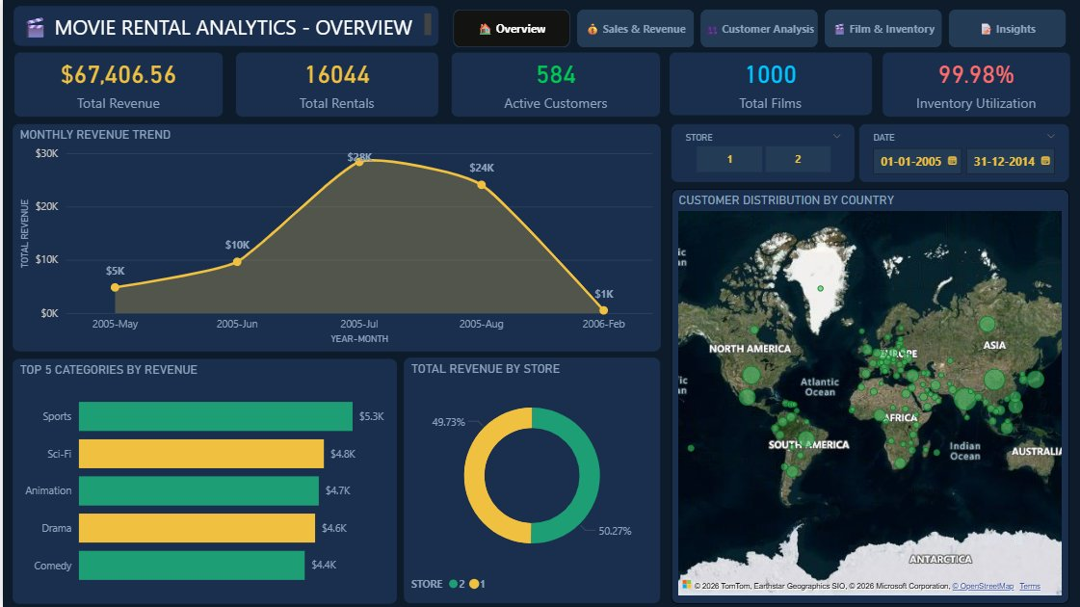
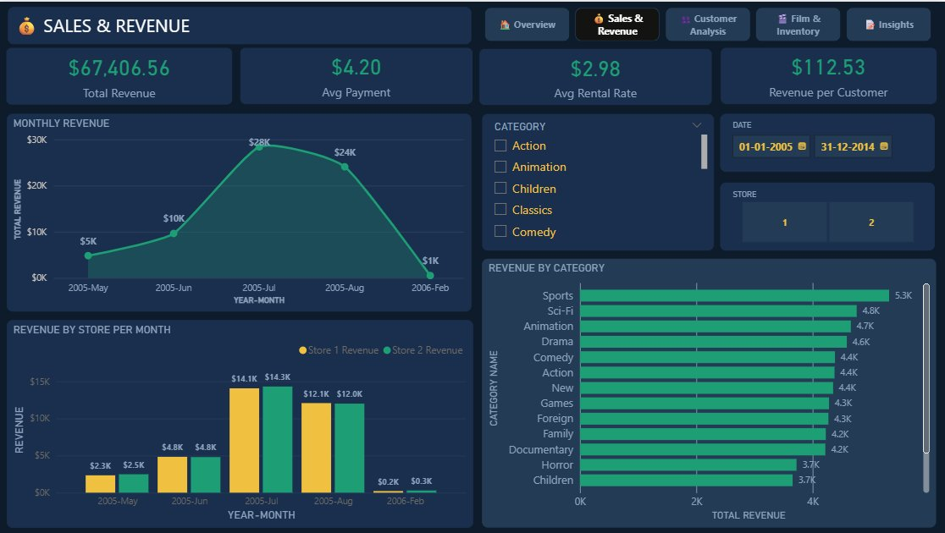
POWER BI — DASHBOARDS (1/2)
Overview & Sales & Revenue
📊 Overview Dashboard
💰 Sales & Revenue Dashboard
KPI cards · Area chart · World map · Donut chart · Category bars
Monthly trend · Revenue by store/month · Category revenue bars · Slicers
08 / 11

Slide 9
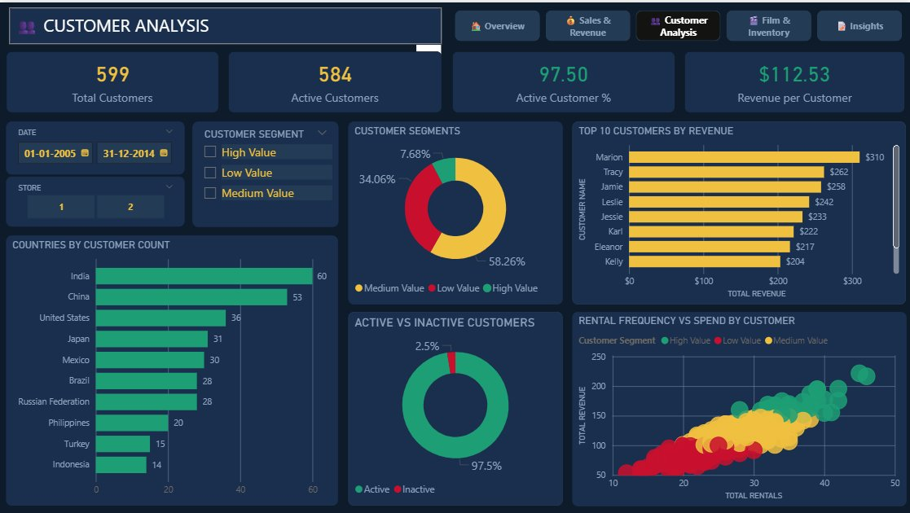
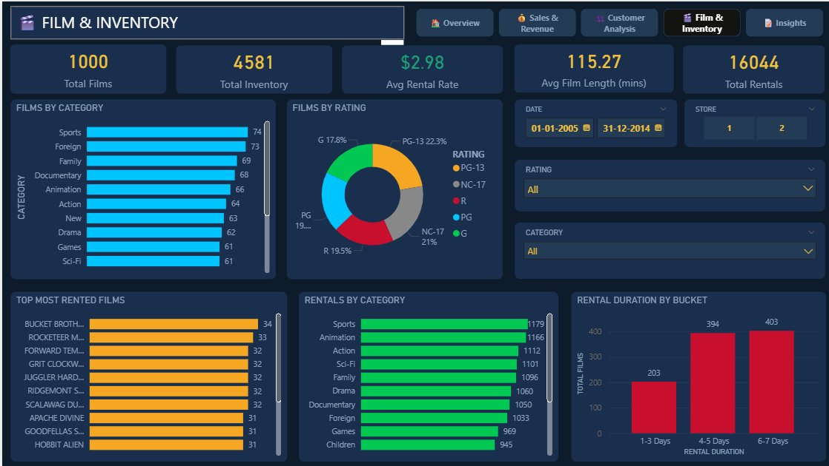
POWER BI — DASHBOARDS (2/2)
Customer Analysis & Film & Inventory
👥 Customer Analysis Dashboard
🎬 Film & Inventory Dashboard
Segmentation donut · Active % · Country bars · Scatter plot · Top customers
Category distribution · Rating donut · Top rented films · Duration buckets · KPIs
🔍 Insights page included: Sales · Customer · Film · Limitations · Recommendations
09 / 11

Slide 10
OVERALL INSIGHTS
Overall Business Insights
REVENUE
CUSTOMERS
FILM & INVENTORY
Total revenue of $67,406 from 16,044 rentals across 5 months
97.5% active customers — very high retention rate
1,000 films, 4,581 inventory items — 99.98% utilization rate
July 2005 contributed 41% of total revenue — high seasonal concentration
58.26% Medium Value, 34.06% Low Value, 7.68% High Value customers
Sports is most rented category (1,179 rentals); Children lowest
Both stores are nearly equal: Store 1 (49.73%) vs Store 2 (50.27%)
India (60) and China (53) are the top 2 customer countries
Majority of films (403) have 6–7-days rental window
Sports ($5.3K) and Sci-Fi ($4.8K) are the top 2 revenue categories
Top spender Marion generated $310 in total revenue
11 high-demand films are flagged as Low Stock — lost revenue risk
10 / 11

Slide 11
RECOMMENDATIONS & CONCLUSION
Recommendations & Conclusion
RECOMMENDATIONS
CONCLUSION
01
Launch promotions in Feb, May & Jun to reduce over-reliance on July revenue peak
Operational Efficiency is Strong
Both stores perform equally. 97.5% customer retention signals a healthy business.
02
Create loyalty program for High Value customers (7.68%) — protect top revenue segment
Revenue Seasonality is a Risk
Over-dependence on summer 2005 makes the business vulnerable without off-season strategies.
03
Restock the 11 Low Stock high-demand films — each has 5+ rentals per copy
Content Gap Identified
Entire catalog is English-only. Non-English films could unlock new customer segments globally.
04
India & China dominate customer base — add regional language content (Hindi, Mandarin)
Inventory Optimisation Needed
Low Stock films vs high demand = missed revenue. A restock protocol should be implemented.
05
Implement post-rental survey to replace proxy satisfaction metrics with direct feedback
Dataset: Sakila DVD Rental | Tools: PostgreSQL · Excel · Power BI | Period: May 2005 – Feb 2006 | Rows Analysed: 16,044 rentals
11 / 11

