Slide 1
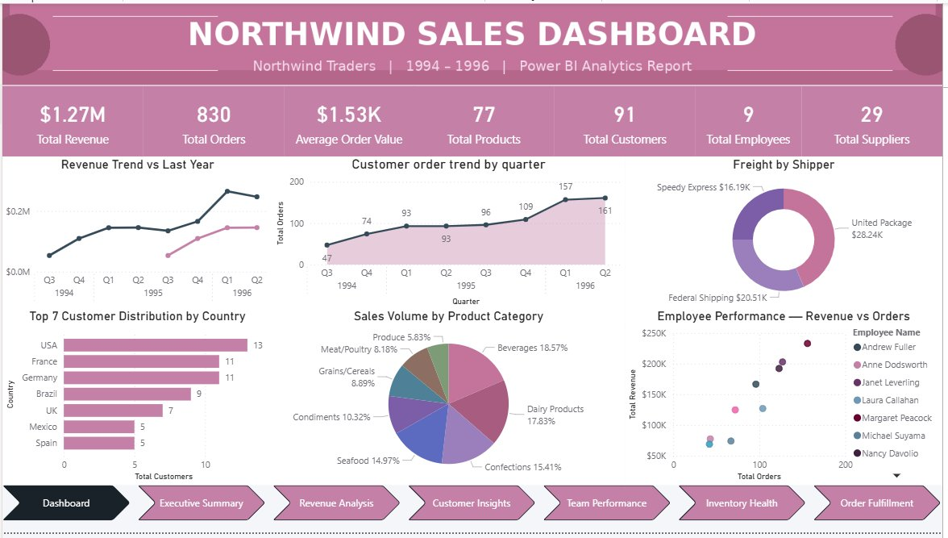
SALES
ANALYTICS
PROJECT
Northwind Traders | 1994–1996 | Power BI Analytics
📊
Excel
🗄️
SQL
📈
Power BI
🧮
DAX
Data-Driven Business Insights
Notes:
Welcome to the Northwind Traders Sales Analytics Project. This end-to-end project covers 830 orders, 91 customers, 77 products across 21 countries from 1994–1996. Tools used: Excel for EDA, SQL for 15 structured questions, Power BI + DAX for interactive dashboards. Total revenue analyzed: $1.27M with 114.2% YoY growth.

Slide 2
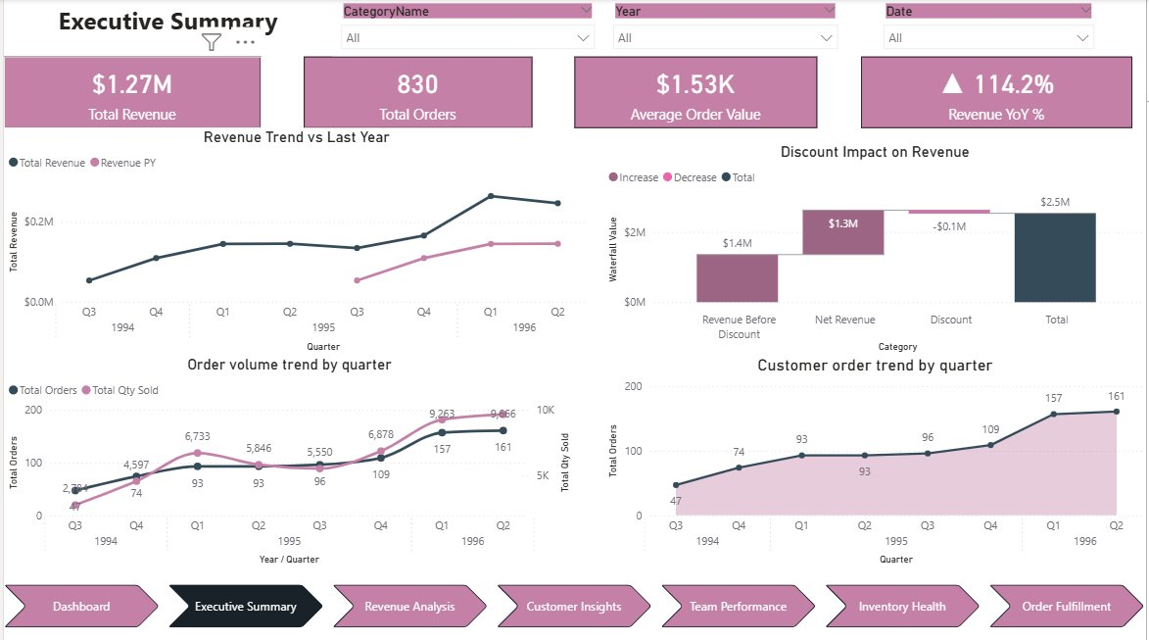
EXECUTIVE SUMMARY
$1.27M
830
Total Revenue
Total Orders
$1.53K
114.2%
Avg Order Value
Revenue YoY Growth
OVERVIEW
Revenue grew 114.2% YoY — from $53K (Q3 1994) to $247K (Q2 1996)
Beverages leads all categories at $267K (21.2%) — 'Côte de Blaye' alone = $141K
Top 3 customers (QUICK-Stop, Ernst Handel, Save-a-lot) = 25%+ of total revenue
96.7% repeat customer rate — only 3 one-time buyers across 2 years
95.5% on-time delivery — operational excellence is a competitive strength
$88.67K discounted — discount program needs ROI review
2 / 15
Notes:
Key headline: $1.27M total revenue with 114.2% YoY growth. Beverage concentration in single SKU is top risk. Customer loyalty at 96.7% repeat rate is exceptional. Discount program of $88.67K needs evaluation against volume gains.

Slide 3
PROBLEM STATEMENT & OBJECTIVE
CONTEXT
⚡ Business Challenges
🎯 Analytical Approach
No centralized reporting — data scattered across Excel, no single source of truth
STEP 1
Raw Data
Northwind DB
Manual analysis: slow, error-prone, no repeatable process
▼
STEP 2
Clean & Transform
No customer segmentation — all buyers treated equally, no loyalty strategy
Power Query + EDA
▼
STEP 3
Revenue blind spots — product profitability & discount impact not quantified
15 EDA Questions
MECE Framework
▼
Operational gaps — shipping delays, freight spikes & low-stock risks unmonitored
STEP 4
Star Schema + DAX + 15 Power BI Questions
Data Model + KPIs
▼
STEP 5
6 Power BI Dashboards
Interactive Reports
3 / 15
Notes:
Northwind had no analytics infrastructure. This project built it end-to-end: data cleaning, 15 structured SQL questions using MECE, a star schema data model, 6 DAX measures, and 6 interactive Power BI dashboards.

Slide 4
DATASET OVERVIEW & DATA CLEANING
DATA PREP
830
91
77
Orders
Customers
Products
9
29
21
Employees
Suppliers
Countries
🔧 Key Data Cleaning Steps
✓ TotalSales = UnitPrice × Quantity × (1 − Discount) — derived column validated
✓ Data types fixed: OrderDate → DATE | UnitPrice, Freight → DECIMAL(10,2)
✓ 375 ShipRegion NULLs — accepted (not all countries use regions)
✓ Stock flags: 22 Low Stock (<10 units) | 5 Stock-Out Risk (0 units)
✓ RFM tiers assigned: Platinum / Gold / Silver / Bronze by spend & frequency
4 / 15
Notes:
The Northwind dataset spans Aug 1994 to Jun 1996. All 77 products have at least one sale — no dead inventory. Data cleaning focused on derived column creation, NULL handling, and RFM-based customer classification.

Slide 5
MECE FRAMEWORK — 15 BUSINESS QUESTIONS STRUCTURED
Mutually Exclusive, Collectively Exhaustive | 5 Analytical Dimensions
👤 CUSTOMER
📦 PRODUCT
• Q1 · Avg orders & high-value segment identification
• Q4 · Category & top-product revenue breakdown
• Q2 · Geographic patterns by country & city
• Q5 · Location–category purchase correlation
• Q3 · RFM clustering — Platinum / Gold / Silver tiers
• Q10 · Pricing tiers, discount impact & stock health
Slides 6–7
15 Business
Questions
(MECE)
Slide 8
⏱️ TIME
👥 EMPLOYEE
• Q6 · Order frequency & repeat purchase cycles
• Q7 · Employee geography & customer assignment
• Q11 · Monthly & seasonal revenue trends
🚚 OPERATIONS
• Q8 · Hire date patterns & tenure distribution
• Q12 · Revenue anomalies & freight outlier detection
• Q13 · Supplier distribution across 16 countries
• Q9 · Title breakdown & revenue per employee
Slide 9
• Q14 · Shipper on-time %, freight cost ranking
Slide 10
• Q15 · Stock-out risk & inventory health monitoring
Slide 10
5 / 15
Slide 10
Notes:
MECE ensures every business question is covered without overlap. 5 dimensions: Customer, Product, Time, Employee, Operations — each with 3 questions mapped to specific Power BI pages. This structure makes the analysis reproducible and board-ready.

Slide 6
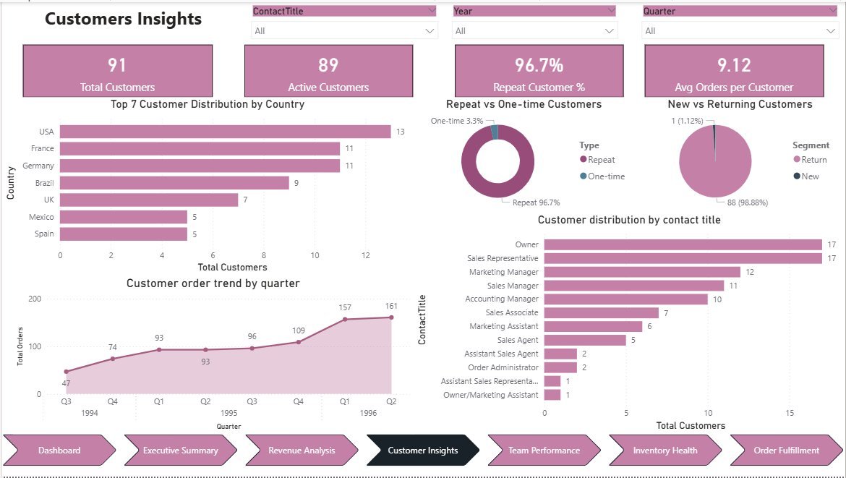
EDA — CUSTOMER ANALYSIS (Q1 · Q2)
91
89
Total Customers
Active Customers
96.7%
9.33
Repeat Rate
Avg Orders/Customer
Q1 · High-Value Customer Segments
9.33 avg orders/customer | 17 High-Value Repeat (≥15 orders, ≥$10K spend)
QUICK-Stop (Germany): $110,277 | Ernst Handel (Austria): $104,875
Save-a-lot Markets (USA): $104,362 — top 3 drive 25%+ of all revenue
4 Platinum-tier customers average $92K spend each
Q2 · Geographic Revenue Patterns
USA + Germany: 24 customers, ~46% of total revenue ($476K combined)
Austria: 2 customers → $128K (3rd highest) — 20× revenue per customer vs Mexico
21 countries served; Scandinavia & Benelux are under-penetrated growth markets
6 / 15
Notes:
Customer Q1 reveals a Pareto pattern: top 20% of customers generate 70%+ of revenue. Q2 geographic analysis shows Austria with 2 customers outperforms Mexico with 5. USA and Germany together = nearly half of all revenue. DACH region key-account risk is a priority action.

Slide 7
EDA — CUSTOMER CLUSTERING & RFM SEGMENTATION (Q3)
🏆 PLATINUM
4 customers | Avg $92K | ≥28 orders
Preferred: Beverages / Dairy
e.g. QUICK-Stop, Ernst Handel, Save-a-lot, Rattlesnake Canyon
🥇 GOLD
14 customers | Avg $27K | ≥10 orders
Preferred: Beverages / Seafood
e.g. Hungry Owl, Hanari Carnes, Königlich Essen, Folk och fä HB
🥈 SILVER
22 customers | Avg $10K | 5–9 orders
Preferred: Dairy / Condiments
e.g. Richter Supermarkt, Simons bistro, Seven Seas Imports
💡 Key Insight
🥉 BRONZE
49 customers | Avg $2.4K | <5 orders
Platinum (4 customers = 4.5% of base) generate ~29% of total revenue. Gold (14 customers) = ~30%. Combined, just 18 customers (20%) drive nearly 60% of $1.27M revenue — classic Pareto distribution. Bronze (49 customers) contribute only 10% each despite being 55% of the base.
Preferred: Mixed
e.g. Alfreds Futterkiste, Centro comercial, Galería del gastro.
7 / 15
Notes:
RFM clustering is the most actionable customer analysis. Recommendation: launch a tiered loyalty program — white-glove account management for Platinum, volume discounts for Gold, upsell campaigns for Silver. Bronze customers need acquisition cost evaluation.

Slide 8
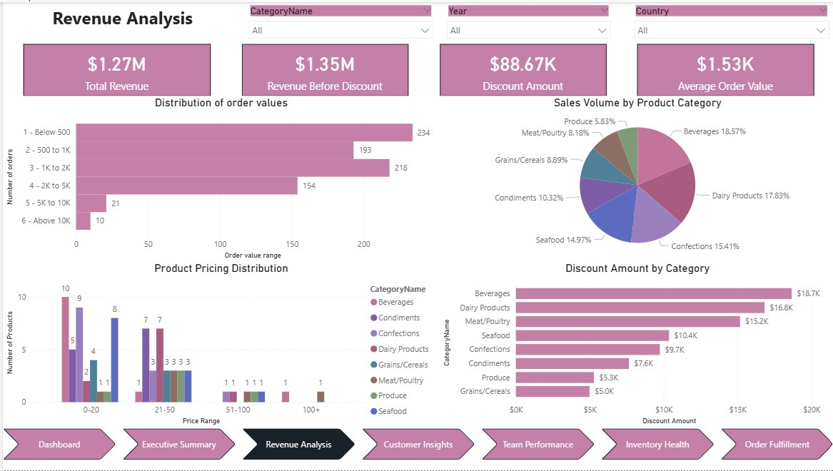
EDA — PRODUCT & REVENUE ANALYSIS (Q4 · Q10)
PRODUCT
Beverages
Côte de Blaye
Meat/Poultry
5 Products
#1 Category — $267K
#1 SKU — $141K
Highest $/Unit
Stock-Out Risk
Product Findings
Beverages = 21.2% of total revenue; Côte de Blaye alone = $141K (52.8% of Beverages)
Meat/Poultry: only 4,199 units sold yet generates $163K — highest revenue-per-unit category
Bottom 2 categories (Produce + Grains/Cereals) = 15.5% combined — bundling opportunity
Order value distribution: 28% below $500 | only 1.2% exceed $10K (luxury segment)
Discount impact: Beverages discounted most ($18.7K) with no proportional sales lift shown
22 low-stock products flagged; 5 at zero units — immediate reorder action required
8 / 15
Notes:
Product analysis reveals single-SKU dependency risk. Côte de Blaye at $263.50/unit drives over half of Beverages revenue. Meat/Poultry has the best revenue efficiency. Stock-out risk in 5 products requires immediate supply chain action. Discount-to-volume correlation needs controlled experiment.

Slide 9
EDA — TIME & SEASONAL ANALYSIS (Q6 · Q11 · Q12)
Key Time Insights
Q1 1996 ($265K) alone > entire combined Q3+Q4 1994 ($163K) — exponential growth
Q4 and Q1 consistently peak — holiday procurement drives demand surge every year
Order volume: 47 orders (Q3'94) → 161 orders (Q2'96) — 242% growth in 2 years
34 freight outlier orders detected (>$311.80); max single freight = $1,007 (QUICK-Stop)
June 1996 data incomplete (11 orders only — partial month, excluded from trend analysis)
9 / 15
Notes:
Time analysis confirms compounding revenue growth across all 8 quarters. Seasonal peaks in Q4/Q1 are consistent — supply chain and staffing should be pre-scaled. Freight anomaly detection flagged 34 orders averaging $450 freight each — primarily for top-tier customers shipping internationally.

Slide 10
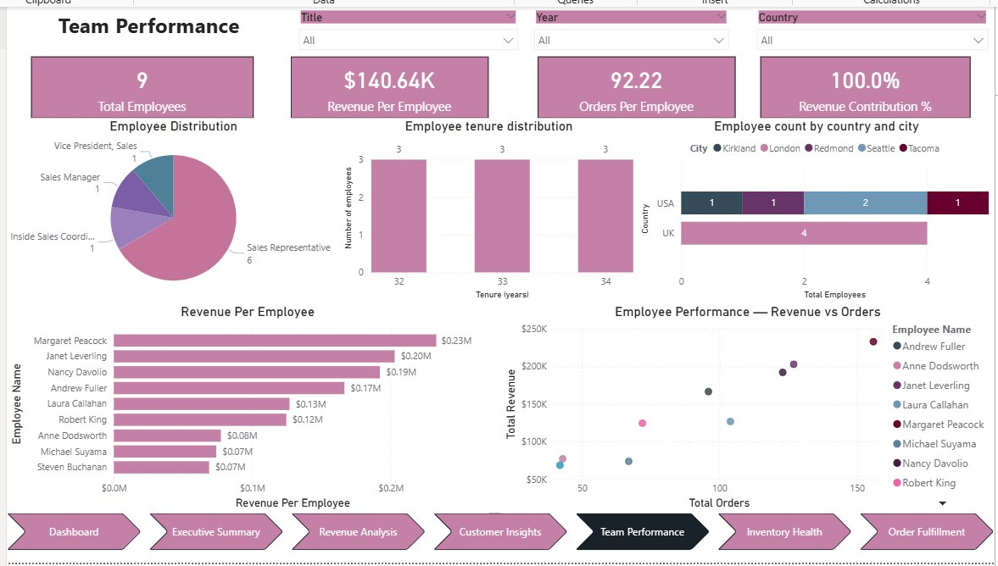
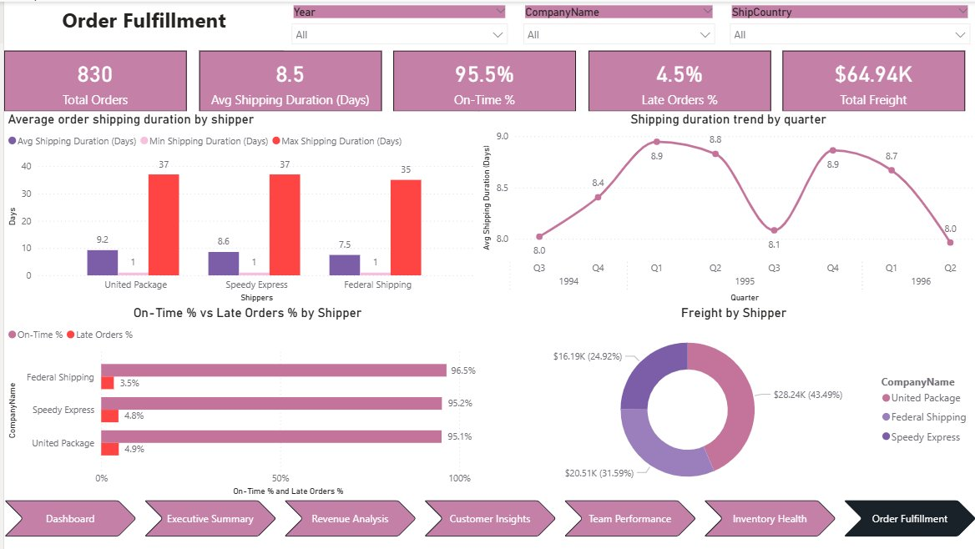
EDA — TEAM PERFORMANCE & OPERATIONS (Q7–Q9 · Q13–Q15)
👥 Team Performance (Q7 · Q8 · Q9)
9
$140.6K
Total Employees
Revenue / Employee
92.2
100%
Orders / Employee
Revenue Contribution
Margaret Peacock #1 ($230K) | Janet Leverling #2 ($200K) | Nancy Davolio #3 ($190K)
All 9 employees have 32–34 years tenure — stable, senior sales team
UK: 4 employees | USA: 5 (Kirkland, Redmond, Seattle, Tacoma, Portland)
6 Sales Reps, 1 Manager, 1 Inside Sales Coordinator, 1 VP Sales
🚚 Operations (Q13 · Q14 · Q15)
Federal Shipping: 96.5% on-time (BEST) | Speedy Express 95.2% | United Package 95.1%
29 suppliers across 16 countries — globally diversified supply chain
Avg shipping duration: 8.5 days | Max: 37 days — significant delivery variance
10 / 15
Notes:
9 employees generating $1.27M = $141K per employee, which is outstanding productivity. Federal Shipping is the clear best-value shipper. Supplier diversity across 16 countries provides resilience. 5 at-risk products need immediate reorder.

Slide 11
POWER BI DATA MODEL & DAX MEASURES
MODEL + DAX
⭐ Star Schema — Center: Order_Details (Fact)
🧮 Core DAX Measures & Results
Total Revenue
$1.27M
SUMX(Order_Details, [UnitPrice]*[Quantity]*(1-[Discount]))
👤 EMPLOYEES
9 rows
🛒 PRODUCTS
77 rows
Revenue PY
$0.59M
CALCULATE([Total Revenue], SAMEPERIODLASTYEAR(Date[Date]))
📊 ORDERS
(FACT) · 830 rows
📊 ORDER DETAILS
(FACT) · 2,155 rows
📊 ORDERS
(FACT) · 830 rows
Revenue YoY %
114.2%
DIVIDE([Total Revenue]-[Revenue PY], [Revenue PY], BLANK())
Avg Order Value
$1.53K
👥 CUSTOMERS
91 rows
🏷️ CATEGORIES
8 rows
DIVIDE([Total Revenue], DISTINCTCOUNT(Orders[OrderID]))
Repeat Customer %
96.7%
🚚 SHIPPERS
3 rows
DIVIDE(COUNTROWS(FILTER(Custs,[Orders]>1)),[Total Customers])
📦 ORDERS
830 rows
On-Time %
95.5%
All relationships: 1 → Many | Bi-directional filtering: OFF
DIVIDE(COUNTROWS(FILTER(Orders,[ShippedDate]<=[RequiredDate])),COUNTROWS(Orders))
12 / 15
Notes:
Star schema centers on Order_Details fact table with 6 dimension tables. All relationships are 1-to-many from dimension to fact. Date table created with CALENDAR() DAX function and marked as date table to enable SAMEPERIODLASTYEAR time intelligence. All 6 DAX measures use DIVIDE with BLANK() fallback.

Slide 12
DASHBOARD WALKTHROUGH — SALES OVERVIEW & EXECUTIVE SUMMARY
DASHBOARD
Page 1: Northwind Sales Dashboard
$1.27M Revenue | 830 Orders | $1.53K AOV | 77 Products | 91 Customers | 9 Employees
Revenue Trend vs Last Year — dual-line chart showing YoY growth acceleration
Customer order trend by quarter — from 47 (Q3 1994) to 161 (Q2 1996)
Freight by Shipper donut | Employee Performance scatter plot
Top 7 Countries bar chart | Sales Volume by Category pie chart
Page 2: Executive Summary
4 KPI cards: Revenue, Orders, AOV, Revenue YoY% (114.2%) — all interactive
Discount Impact waterfall: $1.4M gross → $1.3M net → $88.67K discounted → $2.5M total
Order volume + quantity trend by quarter with dual Y-axis
Customer order trend by quarter — consistent upward trajectory
Filters: CategoryName | Year | Date — cross-page interactive slicers
13 / 15
Notes:
The Sales Dashboard is the executive landing page. 7 navigation tabs at the bottom link all pages. KPI cards use DAX measures and respond to all cross-filtering. The Executive Summary adds the Discount Impact waterfall which is a key financial analysis visual.

Slide 13
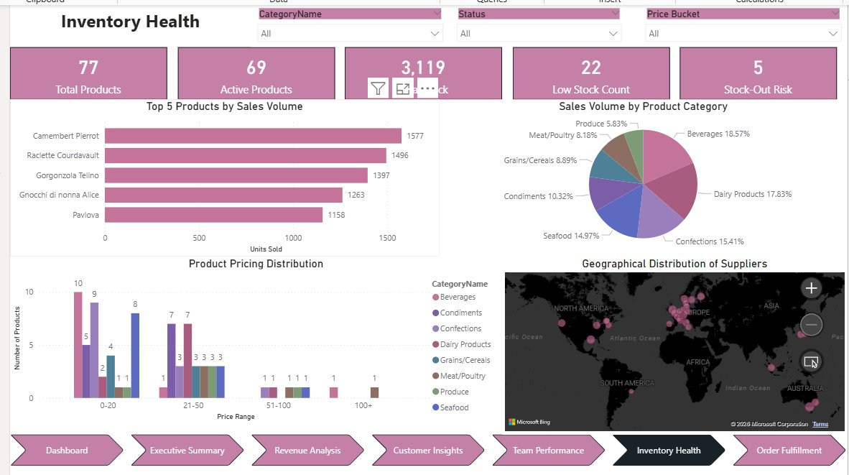
DASHBOARD WALKTHROUGH — REVENUE · CUSTOMER · INVENTORY · FULFILLMENT
DASHBOARD
Revenue Analysis
Customer Insights
Inventory Health
Order Fulfillment
14 / 15
Notes:
Revenue Analysis shows distribution of order values, product pricing, and discount by category. Customer Insights shows repeat vs one-time, geographic distribution, and order trends. Inventory Health flags low-stock and stock-out products. Order Fulfillment tracks shipper performance and freight costs.

Slide 14
KEY INSIGHTS &
CONCLUSION
PROJECT SUMMARY
✅ 15 business questions answered across 5 MECE dimensions
✅ $1.27M revenue analyzed | 114.2% YoY growth confirmed
💰 Revenue Concentration
✅ 6 interactive Power BI dashboard pages delivered
Top 3 customers = 25%+ revenue. Côte de Blaye SKU = 11.2% of ALL revenue. Diversification is urgent priority.
✅ Star schema + 6 core DAX measures powering all KPIs
📈 114.2% YoY Growth
Q1 1996 ($265K) > entire 1994 revenue ($163K). Momentum is exceptional — scale infrastructure now.
✅ Actionable insights: Customer, Product, Time & Operations
👑 96.7% Repeat Rate
FUTURE SCOPE
World-class retention. Only 3 one-time buyers. Monetize loyalty via tiered pricing and white-glove service.
Live data pipeline via SQL Server DirectQuery
🌍 DACH Region ROI
Austria: 2 customers → $128K. Mexico: 5 customers → $24K. Geographic ROI is wildly uneven — focus DACH.
Automated alerts for stock-out & late delivery thresholds
🚚 Operational Strength
95.5% on-time delivery. Federal Shipping = best value shipper. Operational edge is a marketable differentiator.
AI-driven demand forecasting with ML regression models
⚠️ Discount Review Needed
Customer churn prediction using RFM + behavioral signals
$88.67K discounted with no measurable volume lift. High discount = margin erosion. Run controlled experiments.
Tools: Excel | SQL (PostgreSQL) | Power BI | DAX | Northwind Traders 1994–1996
Notes:
This project demonstrates full-stack analytics: from raw data ingestion and SQL analysis through Power BI modeling and interactive dashboards. Future scope includes DirectQuery for live data, automated alerts, and ML-based demand forecasting. The MECE framework ensures the analysis is boardroom-ready and exhaustive.

