Slide 1
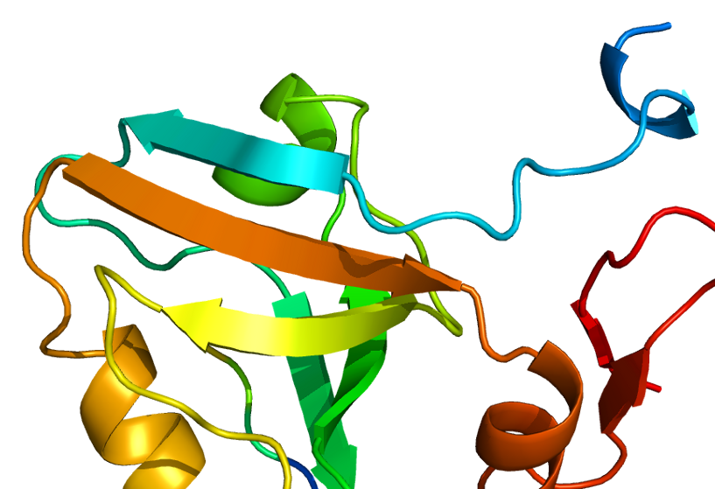
Automated Directed-Evolution
PBfB2018 Project
Amaury Ovalle
Madhurya Lutikurti

Slide 2
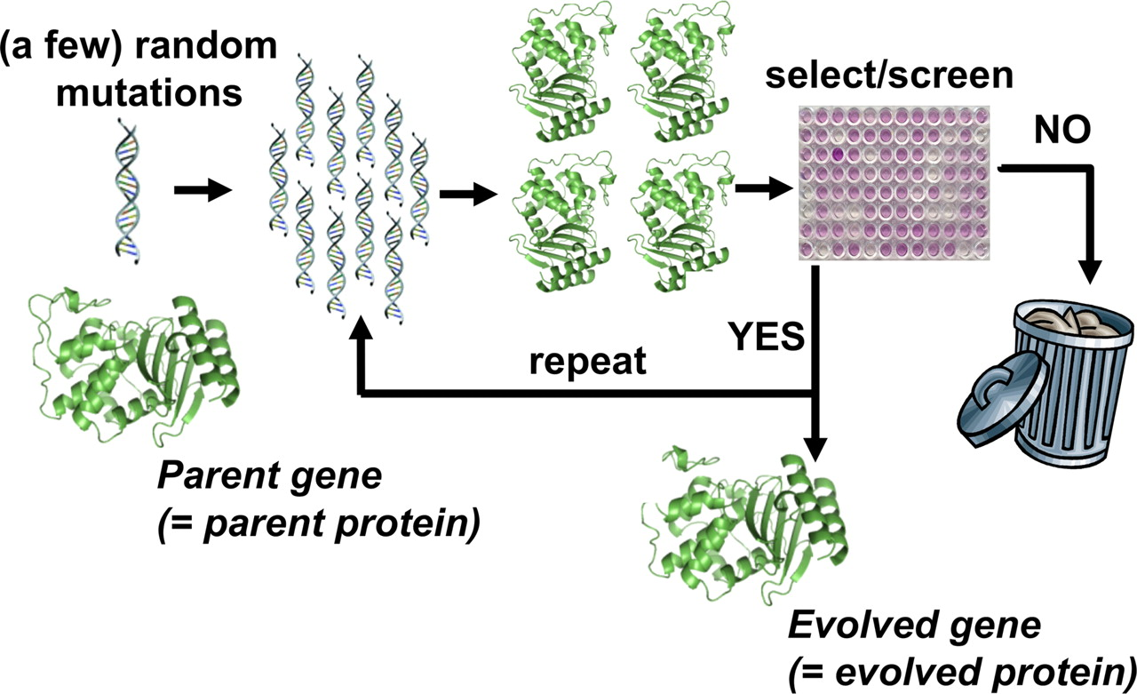
Directed Evolution…??
Bloom and Arnold et al. (2008) DOI: 10.1073/pnas.0901522106

Slide 3
Cons of Directed Evolution
Generating libraries of mutants is tedious.
Every step requires manual screening protocols.
Prone to man-made errors .
Takes several months to years.
Automated Directed Evolution using
a computational approach!

Slide 4


X₁X₂X₃X₄X₅X₆
Import peptide PDB file
Import PDB file of target protein
Grid box coordinates
AutoDockTools (GUI)
Pymol commands
Mutagenesis of peptide residues
For every mutant
Reformat into PDBQT file
AutoDock Vina
command line
Docking mutants on target protein
Comparison of Affinities from results
Reformat into PDB file
Best mutant
Best ligand found!

Slide 5
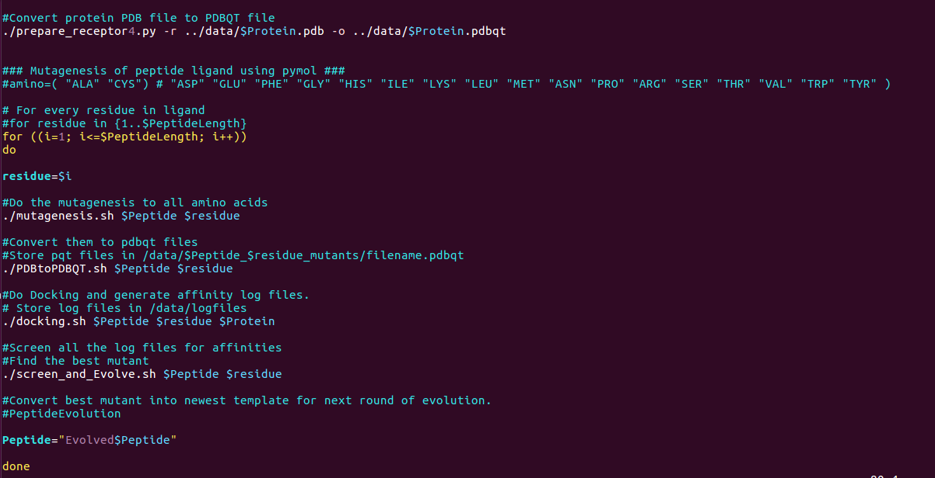

Slide 6
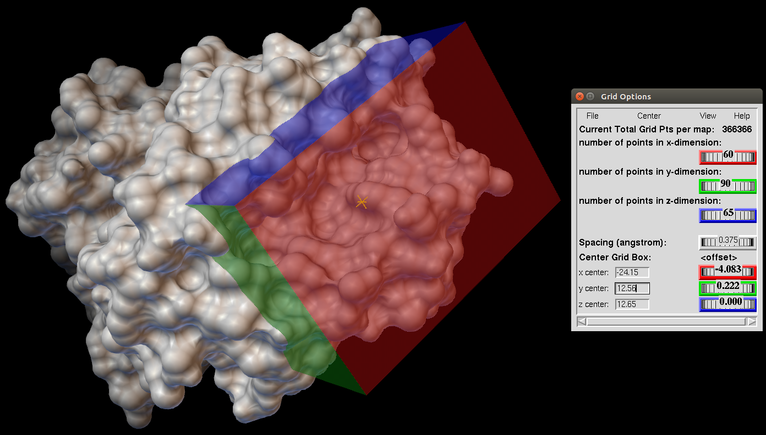
User Inputs:
PDB files of protein and ligand peptide
Grid box : Defining a search space on target protein.

Slide 7
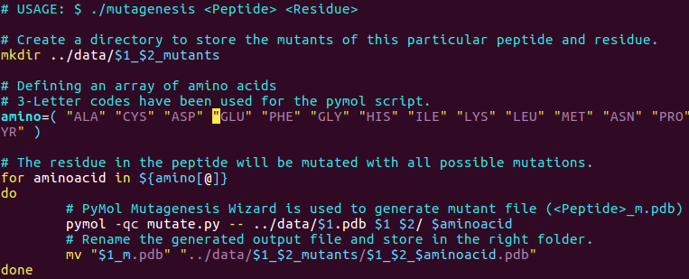
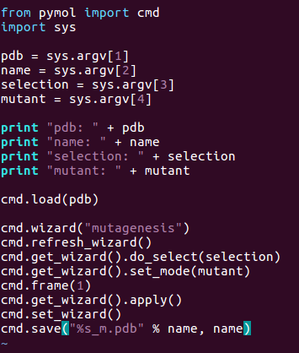
X₁X₂X₃X₄X₅X₆
Import peptide PDB file
Import PDB file of target protein
Grid box coordinates
AutoDockTools (GUI)
Pymol commands
Mutagenesis of peptide residues
Pymol commands
For every mutant
Reformat into PDBQT file
master.sh
mutate.py
AutoDock Vina
command line
Docking mutants on target protein
Comparison of Affinities from results
Reformat into PDB file
Best mutant
Best ligand found!

Slide 8
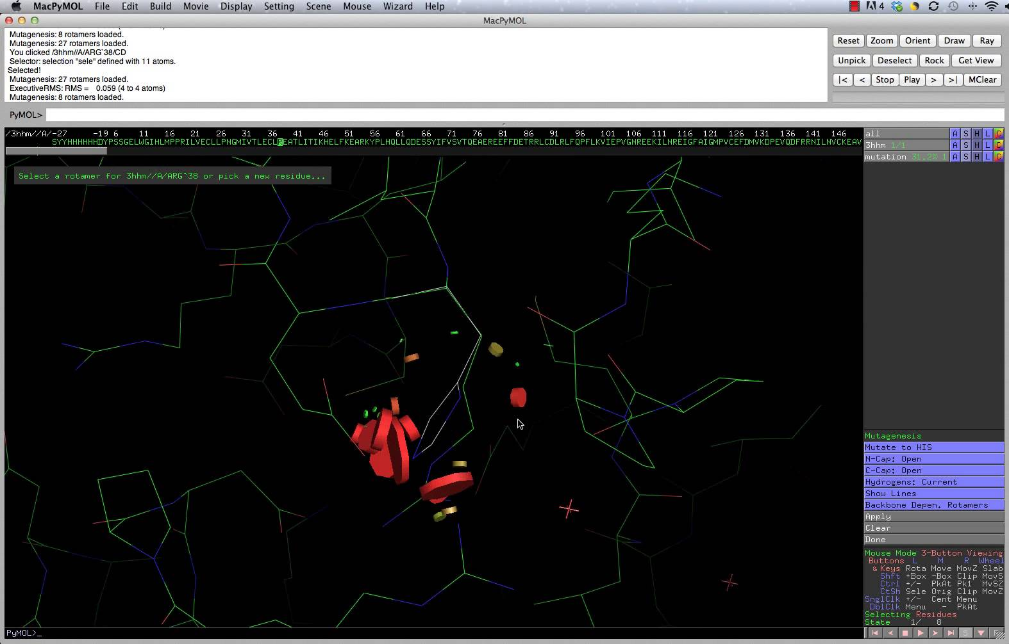
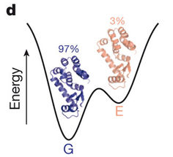
Mutagenesis using PyMOL
PyMOL Mutagenesis Wizard introduces mutation at desired residue.
Selects the best rotamer at the site.
Bouvignies, d et al. (2011) DOI: 10.1038/nature10349

Slide 9
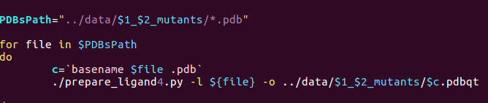
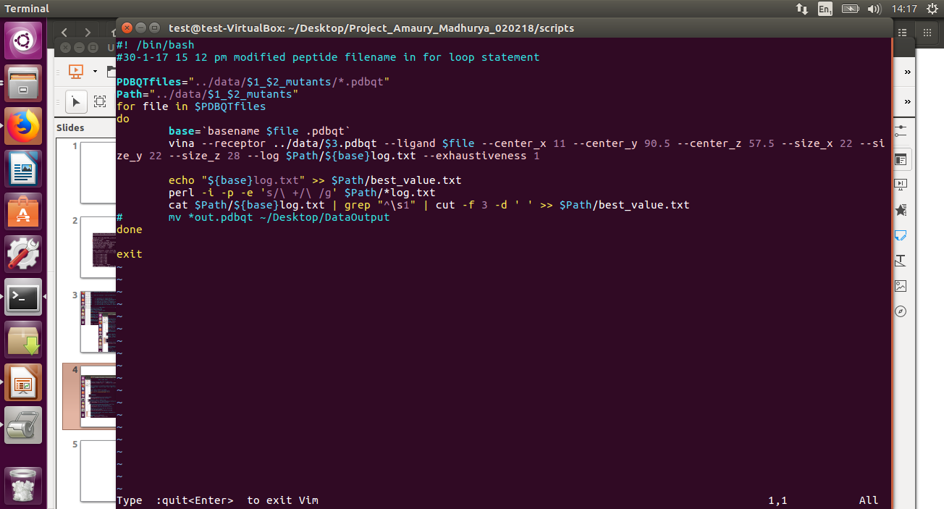
X₁X₂X₃X₄X₅X₆
Import peptide PDB file
Import PDB file of target protein
Grid box coordinates
PDBtoPDBQT.sh
AutoDockTools (GUI)
Pymol commands
Mutagenesis of peptide residues
For every mutant
Reformat into PDBQT file
AutoDock Vina
command line
AutoDock Vina
command line
Docking mutants on target protein
Comparison of Affinities from results
docking.sh
Reformat into PDB file
Best mutant
Best ligand found!

Slide 10
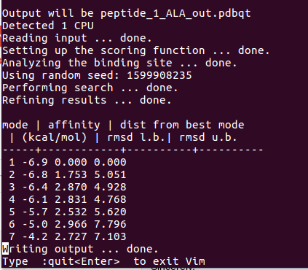
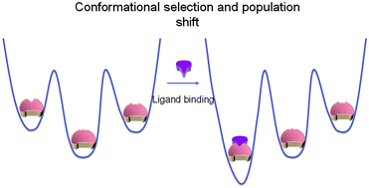
Screening the Mutants
*_log.txt
Lowest energy confirmation is screened for and selected as the best mutant for further evolution
Tsai and Nusinnov et al. (2014) http://dx.doi.org/10.1039/C3CP54253J
Notes:
mad

Slide 11
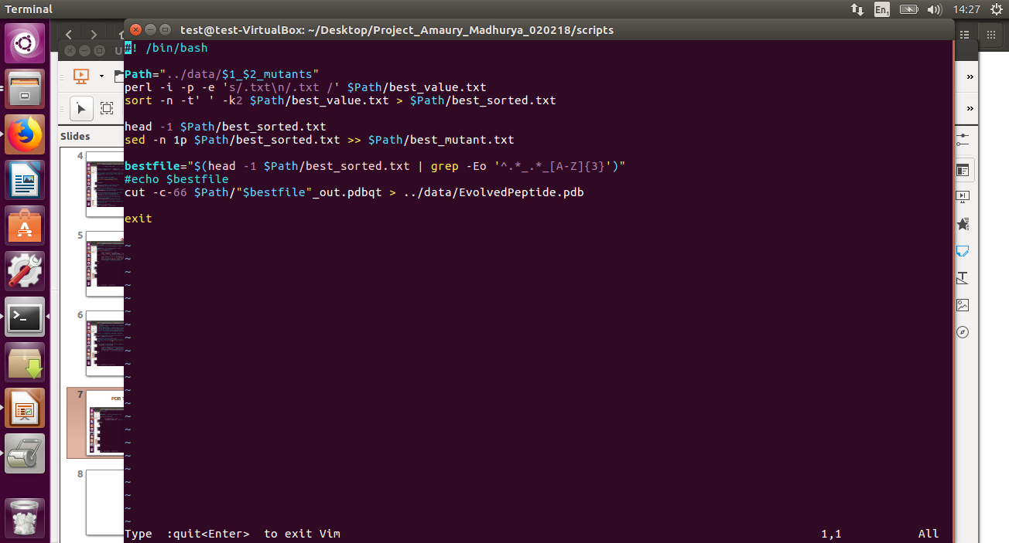
X₁X₂X₃X₄X₅X₆
Import peptide PDB file
Import PDB file of target protein
Grid box coordinates
AutoDockTools (GUI)
docking.sh
Pymol commands
Mutagenesis of peptide residues
For every mutant
Reformat into PDBQT file
AutoDock Vina
command line
Docking mutants on target protein
Comparison of Affinities from results
Reformat into PDB file
screen_and_evolve.sh
Best mutant
Best ligand found!

Slide 12
X₁X₂X₃X₄X₅X₆
Import peptide PDB file
Import PDB file of target protein
Grid box coordinates
AutoDockTools (GUI)
Pymol commands
Mutagenesis of peptide residues
For every mutant
Reformat into PDBQT file
AutoDock Vina
command line
Docking mutants on target protein
screen_and_evolve.sh
Comparison of Affinities from results
Reformat into PDB file
Best mutant
Best ligand found!

Slide 13
Output
At each step, the best_sorted.txt and best_mutant.txt gives the lowest energy confirmation mutant.
The PDB file of the final evolved peptide is created in the main data folder.
The PDBQT file of the mutant peptide also contains the conformations that this ligand takes.

Slide 14
What’s next?
Sample size is highly reduced.
The generated mutant can be tested in the lab.
Some of the best mutants can also be tested in lab.
Critical positions of binding in the protein and ligand could be identified.

Slide 15
Future Perspectives
Multiple templates can be used, to account for flexibility of target protein.
Constraints of mutations should be introduced.

Slide 16
Thank You…

