Slide 1
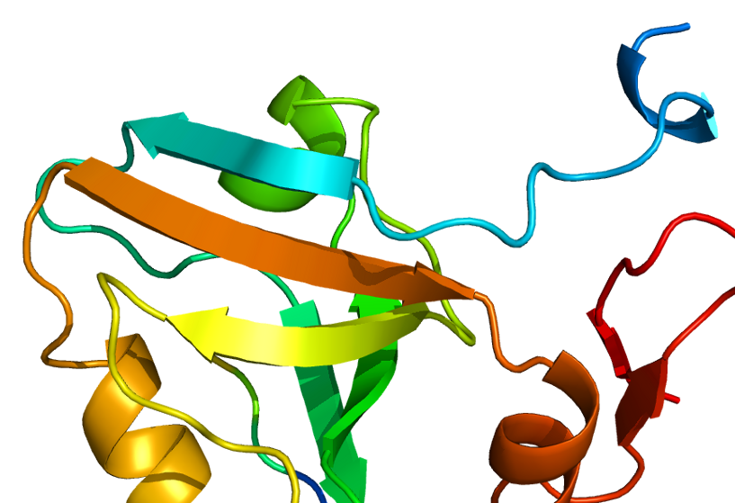
Automated Directed-Evolution
PBfB2018 Project
Amaury Ovalle
Madhurya Lutikurti

Slide 2
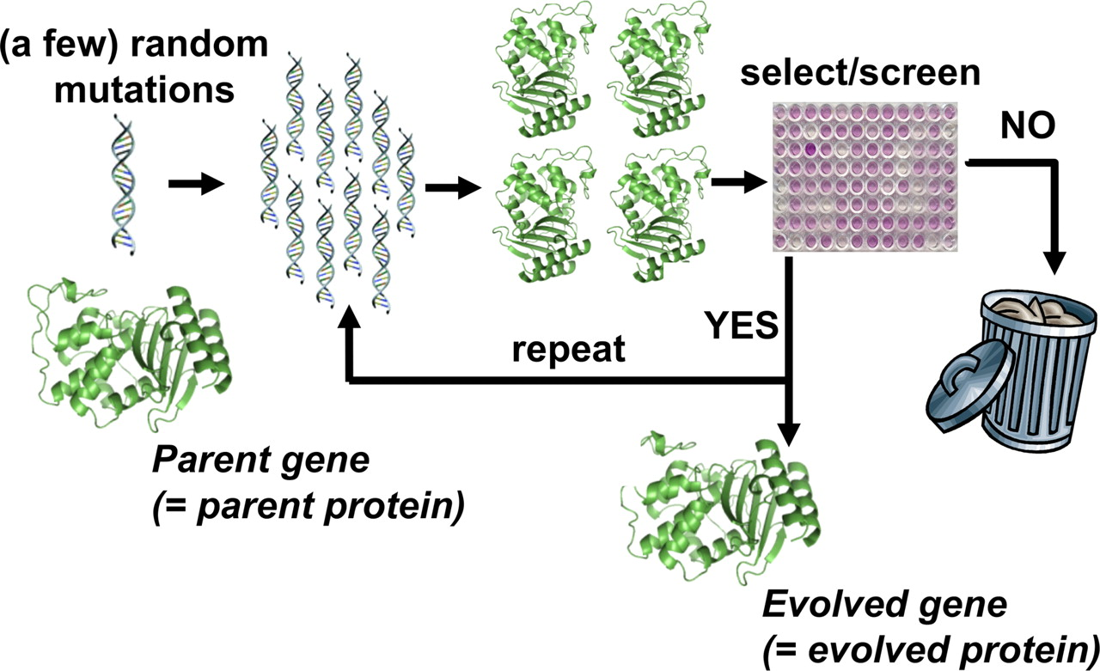
Directed Evolution…??
Bloom and Arnold et al. (2008) DOI: 10.1073/pnas.0901522106

Slide 3
Cons of Directed Evolution
Generating libraries of mutants is tedious.
Every step requires manual screening protocols.
Prone to man-made errors .
Takes several months to years.
Automated Directed Evolution using
a computational approach!

Slide 4


Import PDB file of target protein
Generate peptide PDB file
Reformat input files
X₁X₂X₃X₄X₅X₆
Work Flow
Pymol/Chimera commands
Mutagenesis of peptide residues
For every mutant
Template for next mutagenesis
AutoDock Vina
command line
Docking mutants on target protien
Comparision of Affinities from results
Best mutant
Best ligand found!

Slide 5
Thank You…

