Slide 1
FIFA World Cup 2026
Analytics
Objective 1 • Four statistical investigations
From real World Cup data to evidence-based conclusions
HIT140 Foundations of Data Science
Group 78 • Nabin Thapa • KB Bohora • Suman • Prabin Shrestha
Notes:
[object Object],[object Object]

Slide 2
Four questions, one analytical framework
Each task has a distinct football performance focal point
Shooting efficiency
01
Nabin Thapa
Is the average Goals ÷ Expected Goals ratio different from 1.0?
Disciplinary record
02
KB Bohora
Do midfielders commit more fouls per 90 than defenders?
Goalkeeper save percentage
03
Suman
Is average squad save percentage different from 85%?
Passing accuracy by position
04
Prabin Shrestha
Do defenders have higher average passing accuracy than midfielders?
Notes:
[object Object],[object Object],[object Object]

Slide 3
Shared workflow & reproducibility
A consistent process across all four tasks
1
2
3
4
5
6
Collect
Wrangle
Sample
Describe
Infer
Reproduce
FIFA / FBref data
Clean, filter, validate
Define population & sample
Mean, median, spread
95% CI + t-test
Python + GitHub
Why Python?
Why GitHub?
Repeatable sampling, transparent calculations, confidence intervals, t-tests and visualisations.
Group repository keeps code and analysis files together so the workflow can be reviewed and reproduced.
Core tools: pandas • NumPy • SciPy • Matplotlib
Notes:
[object Object],[object Object],[object Object]

Slide 4
Task 1 — Shooting efficiency vs. expected goals
TASK 1
Nabin Thapa
Did players finish as well as their chances predicted?
Analytic question
POPULATION
SAMPLE
Is the average Goals ÷ Expected Goals ratio different from 1.0?
88
30
players
randomly selected
Interpretation
1.0 means goals scored match expected goals. Values above 1.0 indicate over-performance; below 1.0 indicate under-performance.
A better finishing metric
Using Goals ÷ Expected Goals accounts for chance quality rather than relying only on a raw conversion percentage.
Data & sample
FIFA official World Cup 2026 attacking statistics
Population: 88 players
Random sample: 30 players
Notes:
[object Object],[object Object],[object Object]

Slide 5
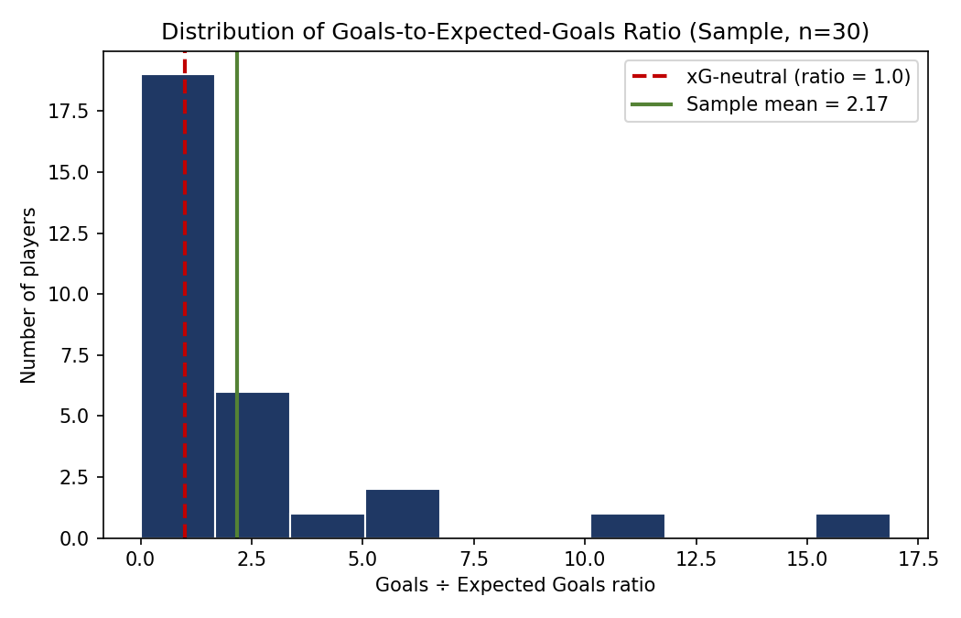
Task 1 — Statistical result
TASK 1
Nabin Thapa
Original Python-generated distribution retained
95% CI
P-VALUE
0.78–3.56
0.096
FAIL TO REJECT H₀
Goals ÷ xG ratio
one-sample t-test
What the result shows
Sample mean
Neutral benchmark
2.17
1.0
p = 0.096 > 0.05, so the difference from 1.0 is not statistically significant.
Position check: forwards 1.80 vs midfielders 2.14; p = 0.782.
Original Python-generated histogram from Task 1
Notes:
[object Object],[object Object],[object Object]

Slide 6
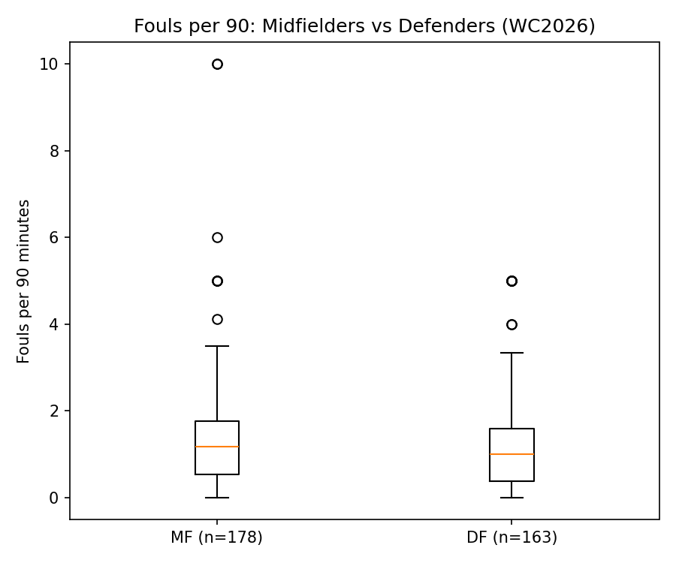
Task 2 — Disciplinary record
TASK 2
KB Bohora
Original Python boxplot retained for visual evidence
Question
Do midfielders commit more fouls per 90 minutes than defenders?
Method
FBref World Cup 2026 miscellaneous statistics
Removed players with zero minutes
Filtered to midfielders and defenders
Normalised fouls per 90 minutes
MF
DF
178
163
Original Python-generated boxplot
players
players
Mean: MF 1.374 vs DF 1.162 • Median: MF 1.183 vs DF 1.000
Notes:
[object Object],[object Object],[object Object]

Slide 7
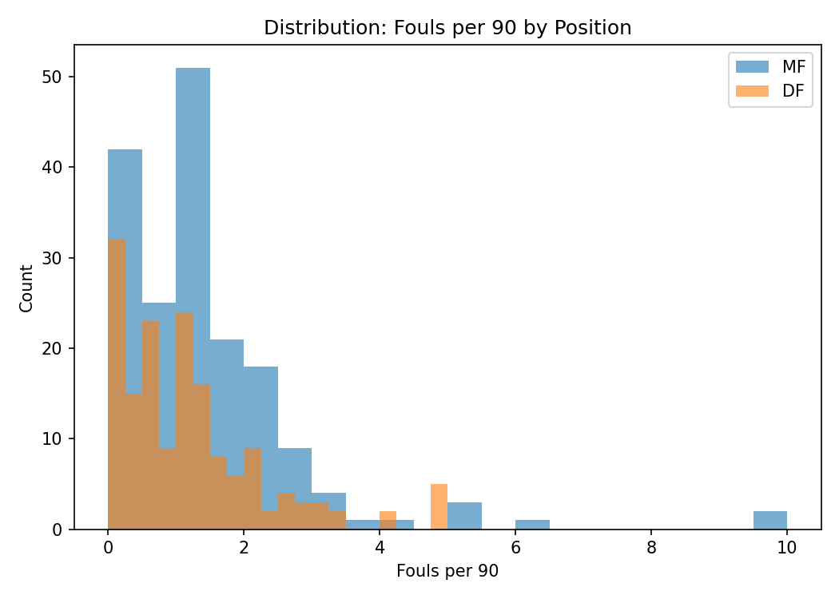
Task 2 — Inferential statistics
TASK 2
KB Bohora
Trend toward more fouls by midfielders, but not significant
MF MEAN
DF MEAN
P-VALUE
1.374
1.162
0.0617
FAIL TO REJECT H₀
fouls / 90
fouls / 90
one-tailed
95% confidence intervals
MF: 1.168 – 1.580 fouls/90
DF: 0.990 – 1.334 fouls/90
Welch / independent two-sample test
t(339) = 1.544
p = 0.0617
Cohen’s d = 0.167
The effect is small and the p-value is just above α = 0.05.
Original Python-generated distribution plot
Notes:
[object Object],[object Object],[object Object]

Slide 8
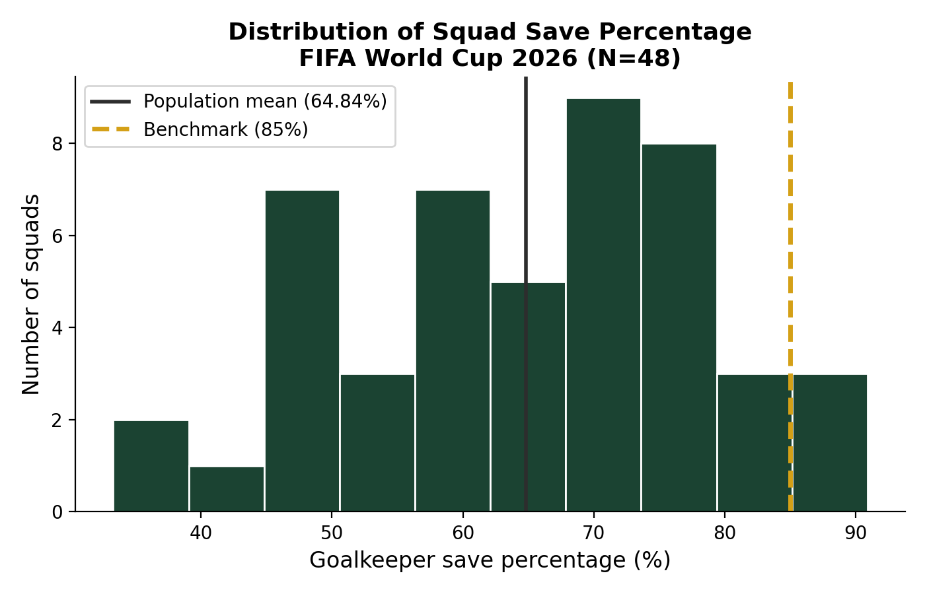
Task 3 — Goalkeeper save percentage
TASK 3
Suman
Metric change stated transparently; original Python histogram retained
Question tested
Is average squad save percentage significantly different from 85%?
Why Save%?
The available FBref dataset contained Save%, not goalkeeper distribution accuracy. The change was documented rather than inventing unavailable data.
POPULATION
SAMPLE
48
30
squads
seed = 42
Validation: no missing Save%, no duplicates, values within 0–100%.
Original Python-generated population histogram
Population mean = 64.84% • 85% benchmark shown on chart
Notes:
[object Object],[object Object],[object Object]

Slide 9
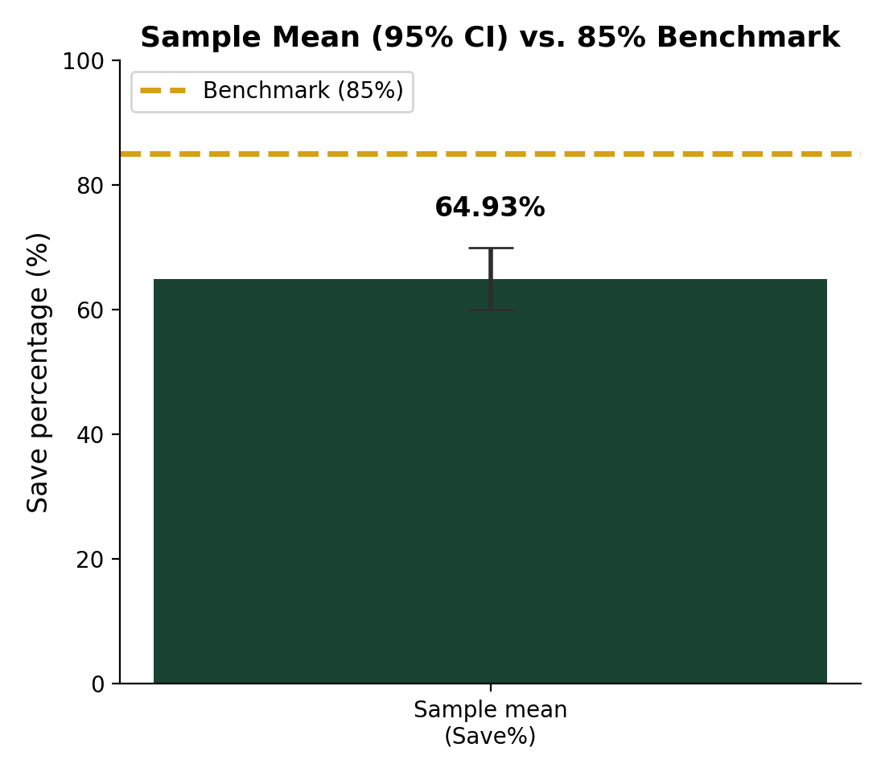
Task 3 — Strong statistical evidence
TASK 3
Suman
Average save percentage was significantly below 85%
SAMPLE MEAN
95% CI
P-VALUE
64.93%
59.96–69.91%
< 0.001
REJECT H₀
n = 30
population mean
two-tailed
One-sample t-test
H₀: μ = 85%
H₁: μ ≠ 85%
t = −8.251
df = 29
α = 0.05
Only 3 of 48 squads reached or exceeded the 85% benchmark.
Original Python-generated confidence-interval chart
Notes:
[object Object],[object Object],[object Object]

Slide 10
Task 4 — Passing accuracy by position
TASK 4
Prabin Shrestha
Do defenders have higher average passing accuracy than midfielders?
Data wrangling
Stratified random sampling
FIFA World Cup 2026 player statistics — Distribution
Kept defenders (DF) and midfielders (MF) only
Variables: passes, completed passes, passing accuracy
Checked missing values before analysis
30 defenders
+
30 midfielders
Final sample = 60 players
random_state = 140
Available sampling frame
The fixed seed makes the selected sample reproducible every time the script is run.
DF
MF
80
59
available
available
Python output and sample CSV are stored with the project files.
Notes:
[object Object],[object Object],[object Object]

Slide 11
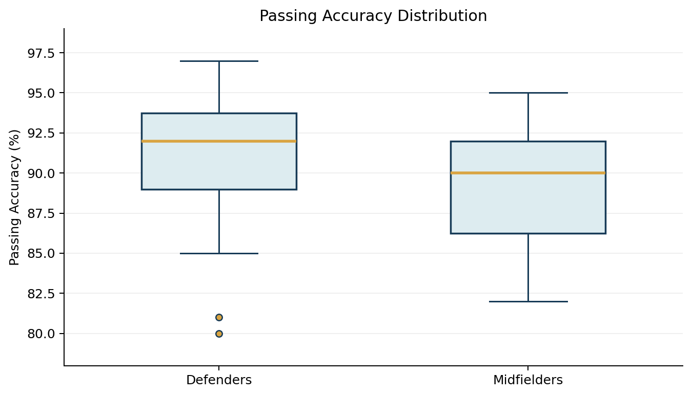
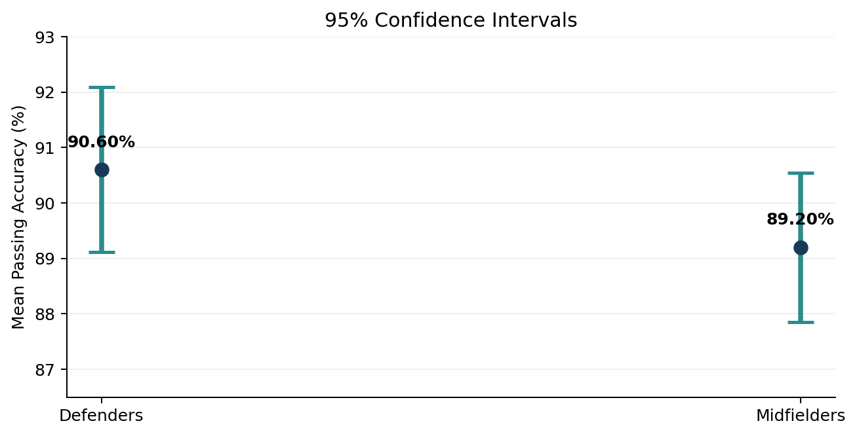
Task 4 — Statistical result
TASK 4
Prabin Shrestha
Exact Python-generated boxplot and CI chart retained
DF MEAN
MF MEAN
P-VALUE
90.60%
89.20%
0.0796
FAIL TO REJECT H₀
n = 30
n = 30
Welch, one-tailed
Original Python-generated boxplot
Original Python-generated 95% CI chart
Welch t = 1.426 • p = 0.0796 > 0.05 • observed mean gap = 1.40 percentage points
Notes:
[object Object],[object Object],[object Object]

Slide 12
Across the four tasks
Only Task 3 crossed the 5% significance threshold
α = 0.05
Task 1 • Shooting efficiency
p = 0.096
Task 2 • Fouls per 90
p = 0.0617
Task 3 • Save percentage
p = < 0.001
Task 4 • Passing accuracy
p = 0.0796
Interpret carefully: “not significant” does not prove “no difference” — it means the available evidence did not meet α = 0.05.
Notes:
[object Object],[object Object],[object Object]

Slide 13
Final synthesis
What the four analyses collectively show
Shooting efficiency
Matched expectations
Disciplinary record
Trend, not proof
No significant deviation from xG-based benchmark.
Midfielders fouled more numerically, but p = 0.0617.
Goalkeeper save %
Clear difference
Passing accuracy
Small sample gap
Average save percentage was significantly below 85%.
Defenders were 1.40 points higher, but not significant.
Reproducibility & project evidence
Primary data sources
Python scripts, cleaned/sample datasets and analysis outputs are maintained in the Group 78 GitHub repository. Full code does not need to crowd the presentation slides.
FIFA World Cup 2026 statistics
FBref World Cup 2026 statistics
Thank you
Group 78 • HIT140 Foundations of Data Science
Notes:
[object Object],[object Object],[object Object],[object Object]

