Slide 1
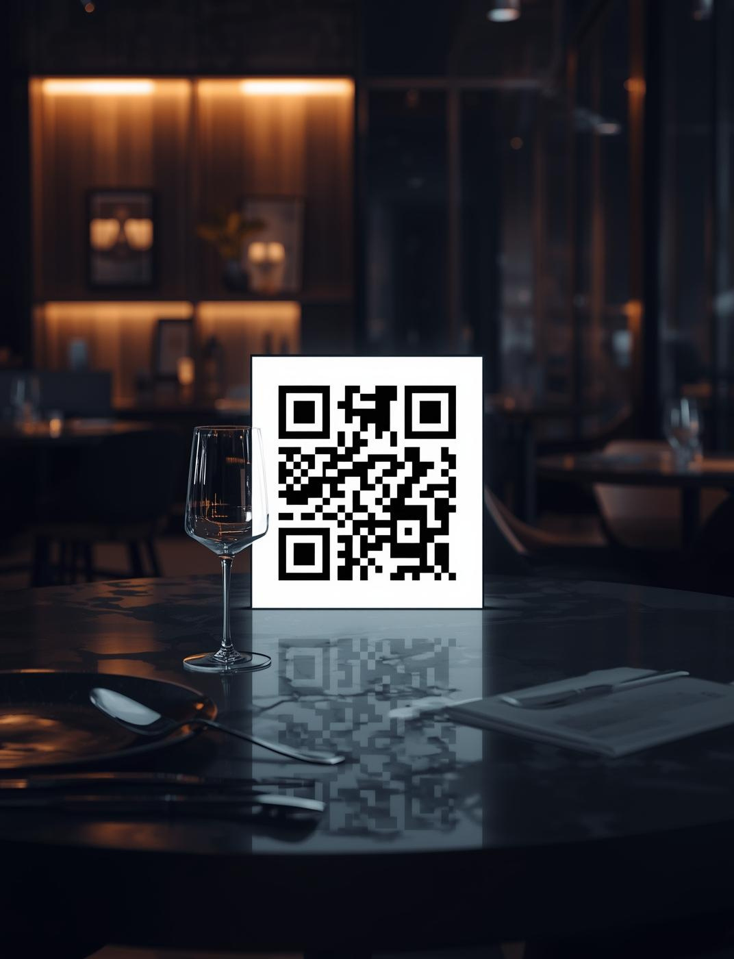
Smart Restaurant Using QR Code
A Modern Dining Solution
Project Team:
B.N.R.S.L.V.S.Akhil(22221A4503)
S.V.V.S.N.D.Praveen(22221A4553)
Mellimi.Devanshi (22221A4540) S.Surya Teja(22221A4552)
P.Madhusayi.K.M.P.Rao(22221A4545)
B.Shashank(22221A4508)

Slide 2


Project Overview
The Smart Restaurant Using QR Code project enhances dining by enabling contactless ordering, improving efficiency, and creating a seamless experience for both customers and staff in modern restaurants.

Slide 3

Problem Statement
Traditional dining faces significant challenges like order delays, communication issues, and increased pressure on staff, especially during peak hours, compromising overall customer experience and satisfaction.

Slide 4

Smart QR Code Solution
The QR code system revolutionizes dining by allowing customers to order directly from their tables, streamlining the process and reducing wait times while ensuring contactless service.

Slide 5
Technologies Used
01
02
03
Next.js 14
Tailwind CSS
MongoDB
Scalable framework for modern web applications.
Fast, customizable UI component design system.
Flexible, cloud-based database for storage.

Slide 6
Technologies Used
01
02
03
REST APIs
Animated Backgrounds
Database Diagrams
Ensure smooth frontend-backend communication.
Create engaging, futuristic user experiences.
Visualize data flow and system architecture.

Slide 7
Key Features
01
02
03
QR Code Scanning
Smart Cart
Table Number Selection
Effortless item addition and modification.
Seamless access to the digital menu.
Integrated ordering without waiter assistance.

Slide 8
Advantages of Smart Dining
01
02
03
Contactless Ordering
Time-Saving
Increased Service Speed
Reduces wait times for customers significantly.
Ensures safety and hygiene for patrons.
Enhances overall dining experience and satisfaction.

Slide 9
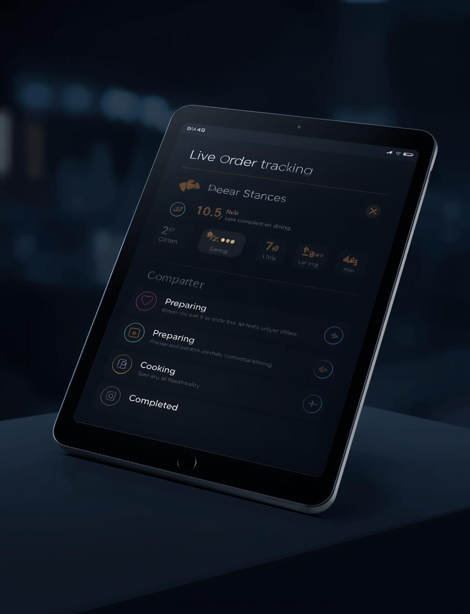

Live Order Tracking
The live order tracking interface provides real-time updates on order status, enhancing transparency for customers and streamlining operations for staff, improving overall dining experience and efficiency.

Slide 10
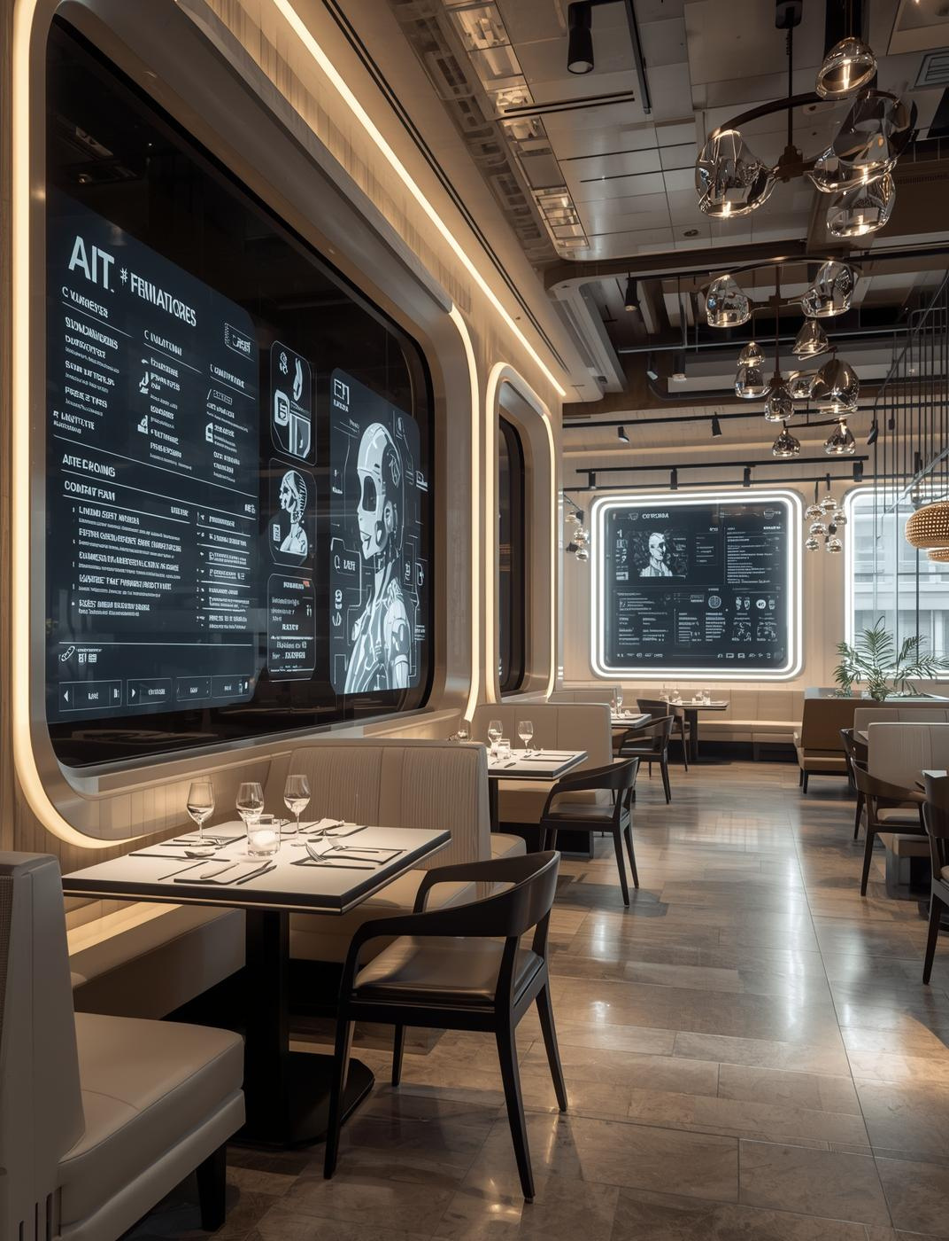
Future Enhancements
We aim to implement AI recommendations for personalized dining experiences, enhance multi-language support, and integrate seamless payment options for a more efficient restaurant system.

Slide 11
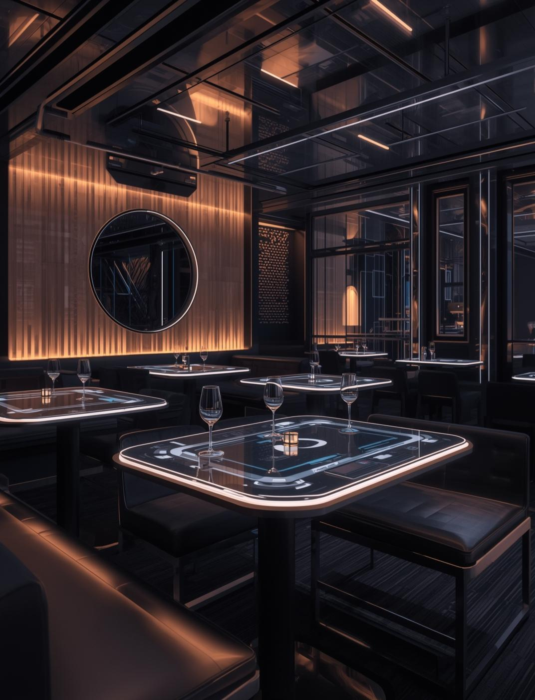
Embracing Smart Dining
The future of dining lies in smart innovations that enhance customer experience, improve efficiency, and promote hygiene, paving the way for a new era in restaurant service.

