Slide 1


Slide 2

Build management
It is the process of compiling and assembling a software system
Build automation is the act of scripting or automating a wide variety of tasks
Compiling source code
Packing binaries
Running automated tests
Deploying to production system
Creating documentation

Slide 3
Introduction
What is Maven?
“Maven is a project management tool which encompasses
a project object model, a set of standards, a project lifecycle, a dependency management system, and
logic for executing plugin goals at defined phases in a lifecycle”
Maven provides superset of features found in a build tool
Maven manages project build, reporting, and documentation from a central piece of information

Slide 4
Characteristics of MAVEN
Maven is more than just Build Tool
Maven was built considering certain objectives
Maven Provides:
Easy Build Process
Uniform Build System
Quality Project Information
Guidelines for Best Practices Development
Achieved Characteristics:
Visibility
Reusability
Maintainability
Comprehensibility “Accumulator of Knowledge”

Slide 5
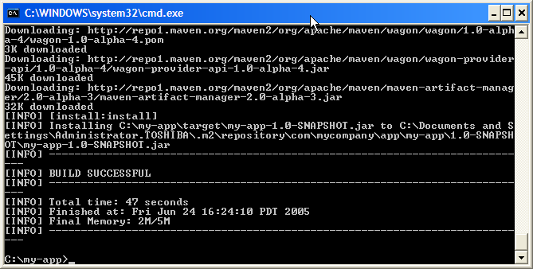
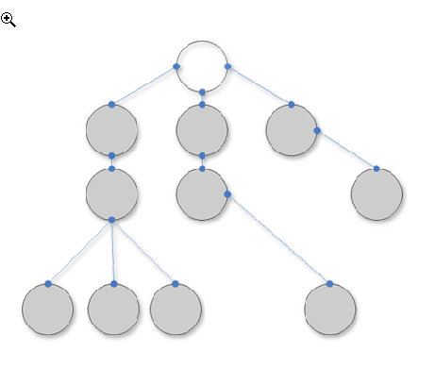
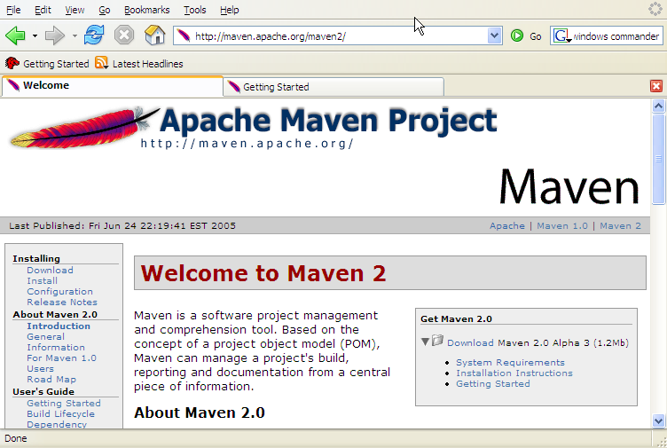
Main Features of MAVEN
Build-Tool
Dependency Management Tool
Documentation Tool

Slide 6

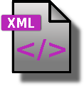
Overview of Simple Architecture
Build System
(goals)
http
pom.xml
maven
Local
Repo
Remote
Repo
Notes:
A repository in Maven is used to hold build artifacts and dependencies of varying types
The local repository refers to a copy on your own installation that is a cache of the remote downloads, and also contains the temporary build artifacts that you have not yet released.
Remote repositories refer to any other type of repository, accessed by a variety of protocols such as file:// and http://. These repositories might be a truly remote repository set up by a third party to provide their artifacts for downloading

Slide 7
Maven Build Lifecycle
A Maven build follow a lifecycle
Default lifecycle
generate-sources/generate-resources
compile
test
package
Install
deploy
There is also a Clean, Site lifecycle

Slide 8
Example Maven Goals
To invoke a Maven build you set a lifecycle “goal”
mvn install
Invokes generate* and compile, test, package, integration-test, install
mvn clean
Invokes just clean
mvn clean compile
Clean old builds and execute generate*, compile
mvn compile install
Invokes generate*, compile, test, integration-test, package, install
mvn test clean
Invokes generate*, compile, test then cleans

Slide 9
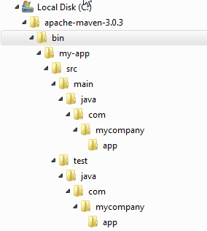
Standard Directory Layout
src/main/java | Application/Library sources
src/main/resources | Application/Library resources
src/main/filters | Resource filter files
src/main/assembly | Assembly descriptors
src/main/config | Configuration files
src/main/scripts | Application/Library scripts
src/main/webapp | Web application sources
src/test/java | Test sources
src/test/resources | Test resources
src/test/filters | Test resource filter files
src/site | Site
LICENSE.txt | Project's license
NOTICE.txt | Notices and attributions required by libraries that the project depends on
README.txt | Project's readme
Notes:
If you were to create a Maven project by hand this is the directory structure that we recommend using.Having a common directory layout would allow for users familiar with one Maven project to immediately feel at home in another Maven project. The advantages are analogous to adopting a site-wide look-and-feel.

Slide 10
Project Name (GAV)
Maven uniquely identifies a project using:
groupID: Arbitrary project grouping identifier (no spaces or colons)
Usually loosely based on Java package
artfiactId: Arbitrary name of project (no spaces or colons)
version: Version of project
Format {Major}.{Minor}.{Maintenance}
Add ‘-SNAPSHOT ‘ to identify in development
GAV Syntax: groupId:artifactId:version
Build type identified using the “packaging” element
Tells Maven how to build the project
Example packaging types:
pom, jar, war, ear, custom
Default is jar
<?xml version="1.0" encoding="UTF-8"?>
<project>
<modelVersion>4.0.0</modelVersion>
<artifactId>maven-training</artifactId>
<groupId>org.lds.training</groupId>
<version>1.0</version>
<packaging>jar</packaging>
</project>

Slide 11
Maven Environment Setup
JAVA_HOME
M2_HOME
M2
MAVEN_OPTS = -Xms256m -Xmx512m
PATH=%PATH%;%M2%
% yum install java-1.8.0-openjdk-devel (install JDK, check the binary link)
% cd /usr/local
% wget http://www-us.apache.org/dist/maven/maven-3/3.5.3/binaries/apache-maven-3.5.3-bin.tar.gz % tar xzf apache-maven-3.5.3-bin.tar.gz
% ln -s apache-maven-3.5.3 maven
export M2_HOME=/usr/local/maven
export PATH=${M2_HOME}/bin:${PATH}
mvn archetype:generate
Notes:
% mvn archetype:generate -DgroupId=demo -DartifactId=samplewar -DarchetypeArtifactId=maven-archetype-webapp -DinteractiveMode=false

Slide 12
Maven Repositories
Dependencies are downloaded from repositories
Via http
Downloaded dependencies are cached in a local repository
Usually found in ${user.home}/.m2/repository
Repository follows a simple directory structure
{groupId}/{artifactId}/{version}/{artifactId}-{version}.jar
groupId ‘.’ is replaced with ‘/’
Maven Central is primary community repo
http://repo1.maven.org/maven2

Slide 13
POM
What is POM?
POM Stands for Project Object Model
As a fundamental unit of work in Maven, POM is an XML file that contains information about project and configuration details used by Maven to build the project”
Describes a project
Name and Version
Artifact Type
Source Code Locations
Dependencies
Plugins
Profiles (Alternate build configurations)
Uses XML by Default
Not the way Ant uses XML

Slide 14
Maven Plugin management
Maven is actually a plugin execution framework where every task is actually done by plugins
A plugin generally provides a set of goals and which can be executed using following syntax:
% mvn [plugin-name]:[goal-name]
% mvn compiler:compiler
Plugin Types
Build plugins : They execute during the build and should be configured in the <build/> element of pom.xml
Reporting plugins : They execute during the site generation and they should be configured in the <reporting/> element of the pom.xml
Plugins are specified in pom.xml using plugins element.
Each plugin can have multiple goals.
You can define phase from where plugin should starts its processing using its phase element. You can configure tasks to be executed by binding them to goals of plugin.
That's it, Maven will handle the rest. It will download the plugin if not available in local repository

Slide 15
Example 1
<project>
<build>
<plugins>
<plugin>
<groupId>org.apache.maven.plugins</groupId>
<artifactId>maven-antrun-plugin</artifactId>
<version>1.1</version>
<executions>
<execution>
<id>id.clean</id>
<phase>clean</phase>
<goals>
<goal>run</goal>
</goals>
<configuration>
<tasks>
<echo>clean phase</echo>
</tasks>
</configuration>
</execution>
</executions>
</plugin>
</plugins>
</build>
</project>

Slide 16
Example 2
<plugin>
<groupId>org.codehaus.mojo</groupId>
<artifactId>exec-maven-plugin</artifactId>
<version>1.2.1</version>
<configuration>
<executable>git</executable>
<arguments>
<argument>--version</argument>
</arguments>
</configuration>
</plugin>
mvn exec:exec

Slide 17
Example 3
<plugin>
<groupId>org.codehaus.mojo</groupId>
<artifactId>rpm-maven-plugin</artifactId>
<version>2.2.0</version>
<extensions>true</extensions>
<executions>
<execution>
<id>generate-rpm</id>
<goals>
<goal>rpm</goal>
</goals>
</execution>
</executions>
<configuration>
<copyright>Copyright (c) 2018 WEZVA, Inc. All Rights Reserved. </copyright>
<group>WEZVA</group>
<release>test_release</release>
<needarch>noarch</needarch>
<noarch>false</noarch>
<mappings>
<mapping>
<directory>/tmp/test</directory>
<sources>
<source>
<location>target</location>
<includes>
<include>*.jar</include>
</includes>
</source>
</sources>
</mapping>
</mappings>
</configuration>
</plugin>
mvn rpm:rpm

Slide 18
Maven SNAPSHOTS
A large software application generally consists of multiple modules and it is common scenario where multiple
teams are working on different modules of same application
For ex Demo2 team uses Demo.jar
Now if Demo team builds a new jar
Demo should inform every time when they release an updated code
Demo2 have to update their pom.xml to get the latest Demo.jar
What is SNAPSHOT?
SNAPSHOT is a special version that indicates a current development copy. Unlike regular versions, Maven checks for a new SNAPSHOT version in a remote repository for every build.

Slide 19
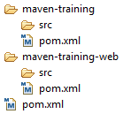
Multi Module Projects
Maven has 1st class multi-module support
Each maven project creates 1 primary artifact
A parent pom is used to group modules
To run a particular module alone
$ mvn clean –pl <modulename>
<project>
<groupId>EBU</groupId>
<artifactId>Parent-module</artifactId>
<version>1.0-SNAPSHOT</version>
<packaging>pom</packaging>
<modules>
<module>Child-jar</module>
<module>child-war</module>
</modules>
</project>

Slide 20
Multi Modules ..
<project>
…
<parent>
<groupId>EBU</groupId>
<artifactId>Parent-module</artifactId>
<version>1.0-SNAPSHOT</version>
</parent>
<groupId>EBU</groupId>
<artifactId>child-jar</artifactId>
<version>1.0-SNAPSHOT</version>
<packaging>jar</packaging>
…
</project>
-------------------------------------------------------------------------------------------
<project>
…
<parent>
<groupId>EBU</groupId>
<artifactId>Parent-module</artifactId>
<version>1.0-SNAPSHOT</version>
</parent>
<groupId>EBU</groupId>
<artifactId>child-war</artifactId>
<version>1.0-SNAPSHOT</version>
<packaging>jar</packaging>
…
</project>

Slide 21
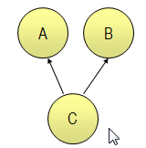
Dependency Management
« Any Version After 1.0 »
<dependencies> <dependency> <groupId>com.acme</groupId> <artifactId>B</artifactId> <version>[1.0,)</version> <scope>compile</scope> </dependency> </dependencies>
Artifact
Repository
(Local)
Artifact
Repositories
(Remote)
Build C
Look for A & B
Look for A & B

Slide 22
Lets try with adding dependency of child-jar for the child-war from the previous example
<dependencies>
<dependency>
<groupId>junit</groupId>
<artifactId>junit</artifactId>
<version>3.8.1</version>
<scope>test</scope>
</dependency>
<dependency>
<groupId>EBU</groupId>
<artifactId>child-jar</artifactId>
<version>1.0-SNAPSHOT</version>
</dependency>
</dependencies>

Slide 23
Deployment Automation
<build>
<plugins>
<plugin>
<groupId>org.jboss.as.plugins</groupId>
<artifactId>jboss-as-maven-plugin</artifactId>
<version>7.3.Final</version>
<configuration>
<jbossHome>C:\WEZVA\jboss-as-7.1.0.Final\jboss-as-7.1.0.Final</jbossHome>
<serverName>default</serverName>
<groupId>wezva</groupId>
<artifactId>mod2</artifactId>
<version>1.0-SNAPSHOT</version>
</configuration>
</plugin>
</plugins>
</build>
mvn jboss-as:deploy
mvn jboss-as:undeploy
https://localhost:9990/console http://127.0.0.1:9990
Notes:
set JAVA_HOME=C:\Program Files\Java\jdk1.7.0_79

Slide 24
Maven update version
mvn versions:set -DnewVersion=your_new_version
ex : mvn versions:set -DnewVersion=2.1.1
mvn versions:commit
mvn versions:revert

Slide 25
Maven: Prepare a Release
mvn release:prepare
mvn release:prepare
mvn release:prepare
mvn release:rollback
<scm>
<connection>scm:git:https://github.com/scmlearningcentre/maven.git</connection>
<developerConnection>scm:git:https://github.com/scmlearningcentre/maven.git</developerConnection>
</scm>
<build>
<plugins>
<plugin>
<groupId>org.apache.maven.plugins</groupId>
<artifactId>maven-release-plugin</artifactId>
<version>2.5.3</version>
<configuration>
<tagNameFormat>v@{project.version}</tagNameFormat>
</configuration>
</plugin>
</plugins>
</build>

Slide 26
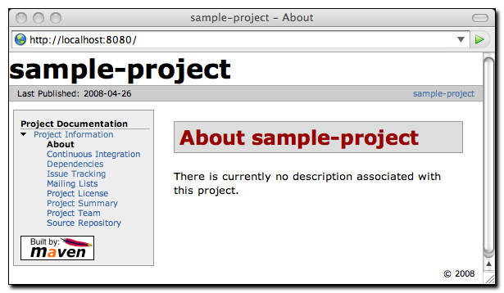
Documentation – Building Own Site
mvn site
pom.xml
<project> ...
<distributionManagement>
<site>
<id>website</id>
<url>scp://www.mycompany.com/www/docs/project/</url>
</site>
</distributionManagement> ...
</project>

Slide 27
Command Line Options
-D : defines a system property
-P : activates a profile
-o : works offline without accessing network
-f : specifies an alternate of POM.xml
-s : alternate settings.xml
-fn : never fail the build
-q : show only errors
-X : debug output

Slide 28

Software Quality
TestCase : A test case is usually a sequence of steps, to test the correct
behavior/functionality, features of an application
Types of testing
Unit testing : A unit test is a test written by the programmer to verify that a relatively small piece of code is doing what it is intended to do.
Integration testing : An integration test is done to demonstrate that different pieces of the system work together. usually tested by the developers
Smoke Testing : Smoke testing is a surface level testing to verify/ ensure that build provided/ given by development team to QA team is ready for further testing.
System Testing : Its a functional testing where entire system is tested as per the requirements. Based on overall requirements specifications, covers all combined parts of a system.
Regression Testing : Regression testing is done when any code modification is done to the existing software application. Or, any new module is added to the existing application. Testing the application as a whole for the modification in any module or functionality.
Performance Testing : Performance testing is the testing to assess the speed and effectiveness of the system and to make sure it is generating results within a specified time as in performance requirements.
Beta Testing : Beta testing is the testing which is done by end users, a team outside development, or publicly releasing full pre-version of the product which is known as beta version. The aim of beta testing is to cover unexpected errors.

Slide 29

Code Coverage
CodeCoverage : is a measure used to describe the degree to which the source code of a program is executed when a particular test suite runs
It is a measurement of how many lines/blocks/arcs of your code are executed while an application is running
Determine the amount of code being tested & not tested
Eliminate Dead code, remove code which doesn’t affect the program results
Identifying additional test cases which might have been missed in the test suite
Program with high code coverage has a lower chance of containing undetected bugs
Basic coverage criteria :
Function coverage – Has each function (or subroutine) in the program been called?
Statement coverage – Has each statement in the program been executed?
Branch coverage – Has all decisions been executed for both the true and false cases?
Condition coverage – Has each Boolean sub-expression evaluated both to true and false?

Slide 30
Code Coverage metrics
It would be nice to be able to achieve 100% coverage for all the criteria, but that is probably not a sensible goal.
The coverage % depends on various factors to decide like:
cost of failure
what the software or hardware will be used for and by how many people
how late into the project you start using code coverage
Priorities of the project
The way the software is designed
> 90% would be an ideal percentage
Code-Coverage Tools : JTest, Cobertura, Emma, JCov, JaCoCo

Slide 31
Maven Code Coverage Plugin
<build>
<plugins>
<plugin>
<groupId>org.codehaus.mojo</groupId>
<artifactId>cobertura-maven-plugin</artifactId>
<version>2.7</version>
<configuration>
<formats>
<format>xml</format>
</formats>
<aggregate>true</aggregate>
</configuration>
</plugin>
</plugins>
</build>
mvn cobertura:cobertura

Slide 32


Source code analysis
Software security is a very important concern for todays Software market, where they have to make their code safe in an almost infinite number of scenarios and configurations and for which a code analysis of the project is very much essential before it is distributed.
Traditional review methods are expensive and cannot test more complex code base, hence it is necessary to auto detect the flaws as soon as possible in the SDLC.
Static Code Analysis:
It a software verification activity in which source code is analyzed for quality, safety and security.
This analysis enables software developers and testers to identify and diagnose various types of bugs/errors such as overflows, divide by zero, memory and pointer errors, run-time errors, and other issues.
It functions by reviewing the code without actually executing the code.
Benefits
Static analysis scans ALL code. We will have a higher probability of finding those vulnerabilities which are not even used.
You can define your project specific rules, and they will be ensured to follow without any manual intervention.
SCA can be part of Build process where they can find the bug early in development cycle, which means less cost to fix them.
Target zero warnings from Code analysis from the beginning of the project.
Faster release cycles

Slide 33

SCA Tools : Clang, Cppcheck, RIPS(PHP), PyCharm, PerlTidy, YASCA, Checkstyle, FindBugs, Eclipse, SonarQube
SonarQube Setup
Require Java 1.8
Get Started in Two minutes : https://docs.sonarqube.org/display/SONAR/Get+Started+in+Two+Minutes
http://localhost:9000 (default System administrator credentials are admin/admin)
The SonarQube Scanner is recommended as the default launcher to analyze a project with SonarQube.
A mojo is a Maven plain Old Java Object. Each mojo is an executable goal in Maven, and a plugin is a distribution of one or more related mojos
A mojo is a maven goal, to extend functionality not already found in maven

Slide 34
<build>
<plugins>
<plugin>
<groupId>ord.codehaus.mojo</groupId>
<artifactId>sonar-maven-plugin</artifactId>
<version>2.2<version>
</plugin>
</plugins>
</build>
mvn sonar:sonar
sonar-scanner.bat -Dsonar.projectKey=Adam -Dsonar.projectName=Demonew -Dsonar.projectVersion=1.0 -Dsonar.sources=src

