Slide 1


Slide 2

Software Configuration Management
SCM is a process of tracking and controlling changes in the software
The goals of SCM are generally
Teamwork
Defect tracking
Configuration auditing
Process management

Slide 3
SCM Terminologies
Server/Client
Repository
Workspace
Branch
Checkin/Checkout
Revision
Baseline

Slide 4
Git History
Came out of Linux development community
Linus Torvalds, 2005
Initial goals:
Speed
Support for non-linear development (thousands of parallel branches)
Fully distributed
Able to handle large projects like Linux efficiently
Notes:
Initial goals were to support development of Linux

Slide 5

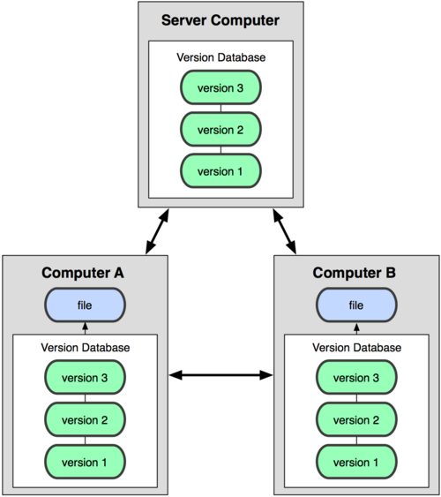
Distributed version control system
Centralized Model
Distributed Model
(CVS, Subversion, Perforce)
(Git, Mercurial)
Result: Many operations are local

Slide 6
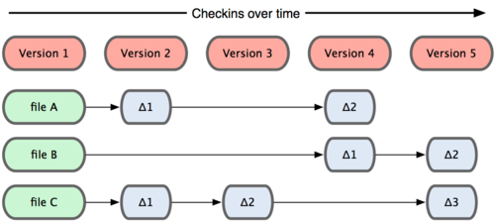
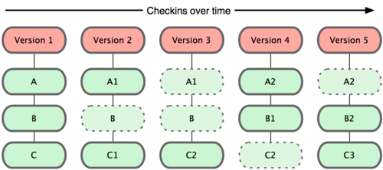
Git takes snapshots
Subversion
Git

Slide 7
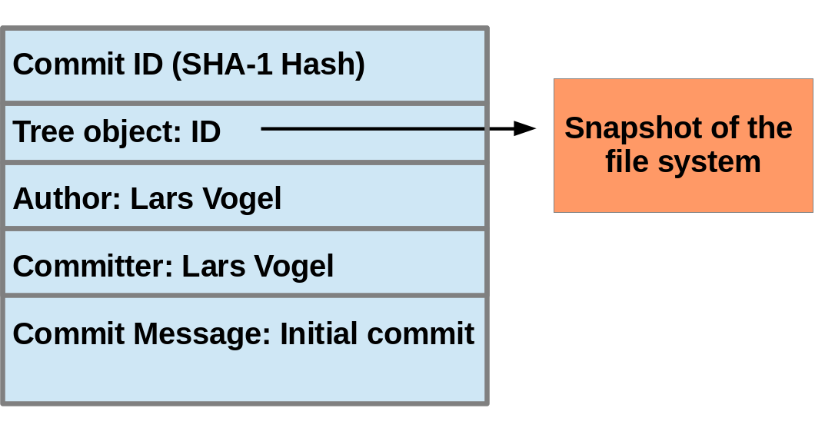
Git uses checksums
Notes:
The commit object points to the individual files in this commit via a tree object.
The files are stored in the Git repository as blob objects
Blobs are addressed via their SHA-1 hash
storing changes as deltas, compression and storage of many objects in a single pack file

Slide 8

A Local Git project has three areas
Unmodified/modified Files
Staged Files
Committed Files
Note: working directory sometimes called the “working tree”, staging area sometimes called the “index”.

Slide 9
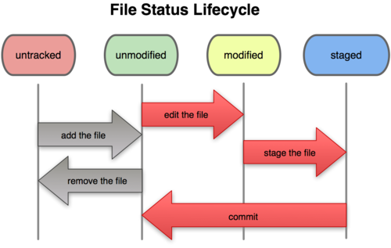
Git file lifecycle

Slide 10
Aside: So what is github?
GitHub.com is a site for online storage of Git repositories.
Many open source projects use it, such as the Linux kernel.
You can get free space for open source projects or you can pay for private projects.
Question: Do I have to use github to use Git?
Answer: No!
you can use Git completely locally for your own purposes, or
you or someone else could set up a server to share files, or
you could share a repo with users on the same file system, such as we did for homework 9 (as long everyone has the needed file permissions).

Slide 11
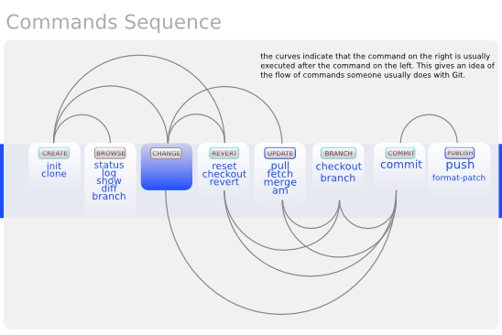
Basic Workflow

Slide 12
Get ready to use Git!
Set the name and email for Git to use when you commit:
$ git config --global user.name “Adam M”
$ git config --global user.email mailme@wezva.com
$ git config --global push.default simple
$ git config credential.helper store
You can call git config –list to verify these are set.
These will be set globally for all Git projects you work with.
You can also set variables on a project-only basis by not using the --global flag.
You can also set the editor that is used for writing commit messages: $ git config --global core.editor emacs (it is vim by default)

Slide 13
Repositories
bare repository
contains the version control information and no working files
by convention the name of a bare repository should end with the .git extension
$ git init --bare
Non-bare repository
These are regular user repository which has the working files & .git dir
Creating a new local repository
$ git clone <remote> <local>

Slide 14
Git commands
command | description
git clone url [dir] | copy a git repository so you can add to it
git add files | adds file contents to the staging area
git commit | records a snapshot of the staging area
git status | view the status of your files in the working directory and staging area
git diff | shows diff of what is staged and what is modified but unstaged
git help [command] | get help info about a particular command
git pull | fetch from a remote repo and try to merge into the current branch
git push | push your new branches and data to a remote repository
others: init, reset, branch, checkout, merge, log, tag

Slide 15
Add, Status and Diff
To add changes to the staging area :
$ git add <file>
To view the status of your files in the working directory and staging area:
$ git status or
$ git status –s
(-s shows a short one line version similar to svn)
To see what is modified but unstaged:
$ git diff

Slide 16
Pulling and Pushing
Good practice:
Add and Commit your changes to your local repo
Pull from remote repo to get most recent changes (fix conflicts if necessary, add and commit them to your local repo)
Push your changes to the remote repo
To fetch the most recent updates from the remote repo:
$ git pull origin master
To push your changes from your local repo to the remote repo:
$ git push origin master
Notes: origin = an alias for the URL you cloned from
master = the remote branch you are pulling from/pushing to, (the local branch you are pulling to/pushing from is your current branch)
$ git push -u --all
To push all the local branches to the remote
$ git push -u origin central_branch
To push all the changes to a specific branch in the central repository
Notes:
$ git remote -v
origin https://github.com/rea2000/santalist.git (fetch)
origin https://github.com/rea2000/santalist.git (push)

Slide 17
Ignoring files & Viewing logs
Ignoring certain files and directories
.gitignore
Git never ignores files which are already tracked, so changes in the .gitignore file only affect new files
Commit the .gitignore to the Git repository
File version
$ git log
$ git log --oneline --grep "workspace"
$ git log branchname
$ git log -1

Slide 18
Branching
To create a branch called experimental:
$ git branch experimental
To list all branches: (* shows which one you are currently on)
$ git branch
To switch to the experimental branch:
$ git checkout experimental
Difference between branches:
$ git diff master <your_branch>
Merge branches :
$ git merge <source_branch> <destination_branch>
$ git cherry-pick <commitid>
$ git branch –a ( to see the branches obtained from remote)

Slide 19
Stashing commited changes
creates stash, remove changes from working dir:
$ git stash
To list all stash available for the repository :
$ git stash list
Reapply the changes, remove stash:
$ git stash pop
Apply a specific stash from repo:
$ git stash apply stash@{num}
Remove stash from repo
$ git stash clear

Slide 20
Reverting changes
Revert uncommitted changes:
$ git reset <file>
Move only to HEAD pointer:
$ git reset --soft
Move the HEAD pointer & reset the staging area (default):
$ git reset --mixed
Move the HEAD pointer, resets staging area & working tree to the new HEAD:
$ git reset --hard

Slide 21
Reverting changes …
Revert a commit:
$ git revert <commit>
Checkout specific commit:
$ git checkout <commit_id>
Deleting a file:
$ git rm <file>
Removing untracked file:
$ git clean -n (-n is for dry run)
$ git clean -f (force delete)
Discard changes in working directory
$ git checkout -- <file>

Slide 22
Tags
Git has the option to tag a commit in the repository history so that you find it easier at a later point in time
Apply tag to a commit:
$ git tag –a <pattern> -m ‘comment’ <commitid>
Contents of the tag:
$ git show <pattern>
Display list of tags available:
$ git tag
Push the tags:
$ git push --tags
Delete a tag:
$ git tag –d <tag>

Slide 23
SVN vs. Git
SVN:
central repository approach – the main repository is the only “true” source, only the main repository has the complete file history
Users check out local copies of the current version
Git:
Distributed repository approach – every checkout of the repository is a full fledged repository, complete with history
Greater redundancy and speed
Branching and merging repositories is more heavily used as a result

Slide 24
Do This:
$ git config --global user.name “Your Name”
$ git config --global user.email youremail@whatever.com
$ git clone https://github.com/rea2000/santalist.git
Then try:
$ git log, $ git log --oneline
Create a file named userID.txt (e.g. rea.txt)
$ git status, $ git status –s
Add the file: $ git add userID.txt
$ git status, $ git status –s
Commit the file to your local repo: $ git commit –m “added rea.txt file”
$ git status, $ git status –s, $ git log --oneline
*WAIT, DO NOT GO ON TO THE NEXT STEPS UNTIL YOU ARE TOLD TO!!
Pull from remote repo: $git pull origin master
Push to remote repo: $git push origin master

