Slide 1
IEEE std 802.1AS generalized Precision Time Protocol [gPTP]

Slide 2
Document History
S. No | Version No. | Author | Section(s) Affected | Change(s) made | Approved Date | Approved By
1 | 0.1 | Anandhakrishnan R | All | Initial | 13th June 2013
2
3
4

Slide 3
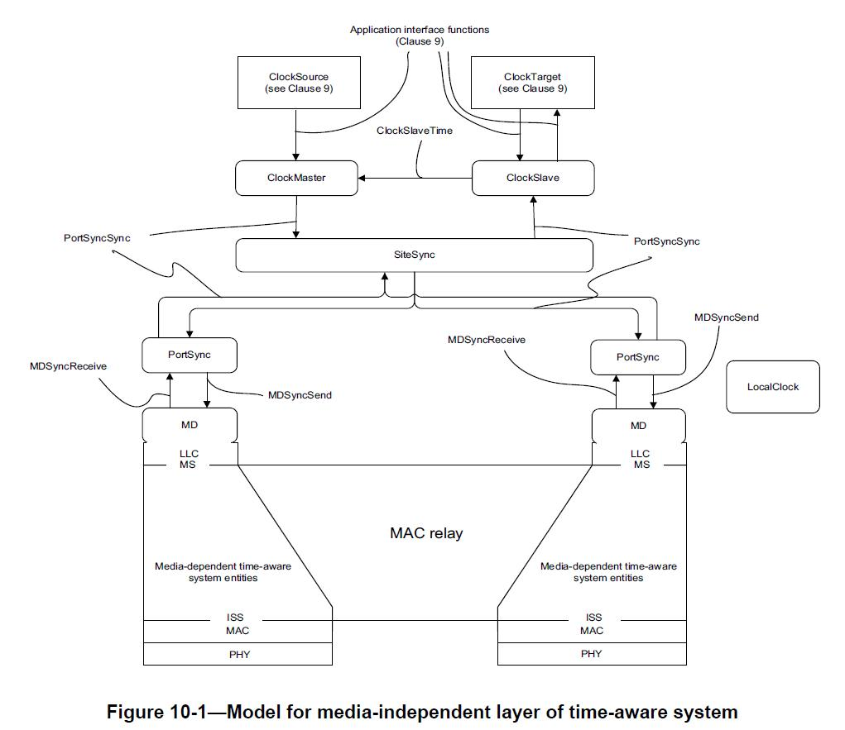
Media-Independent Layer

Slide 4
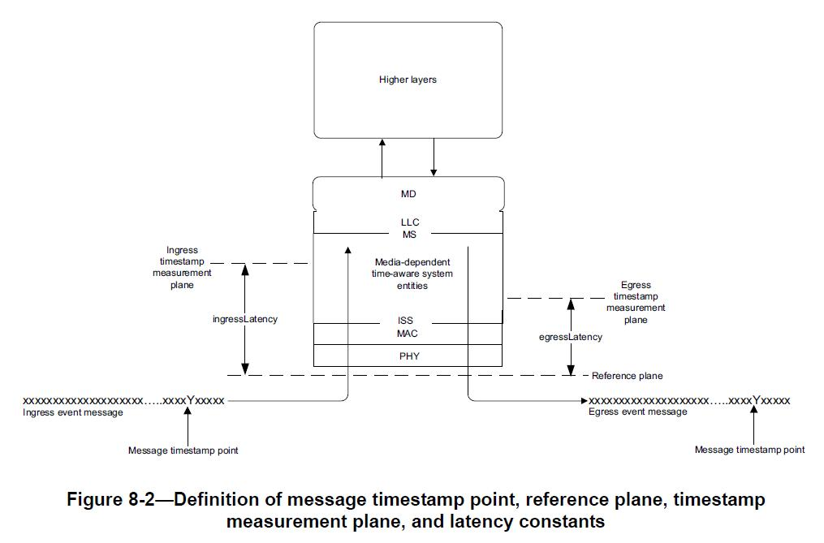
Media-Dependent Layer

Slide 5
Consider This Scenario…!
Timings
Master
Slave
Timings
09.59
08.59
Reference: Page No.110 of IEEE 1588 - 2008

Slide 6
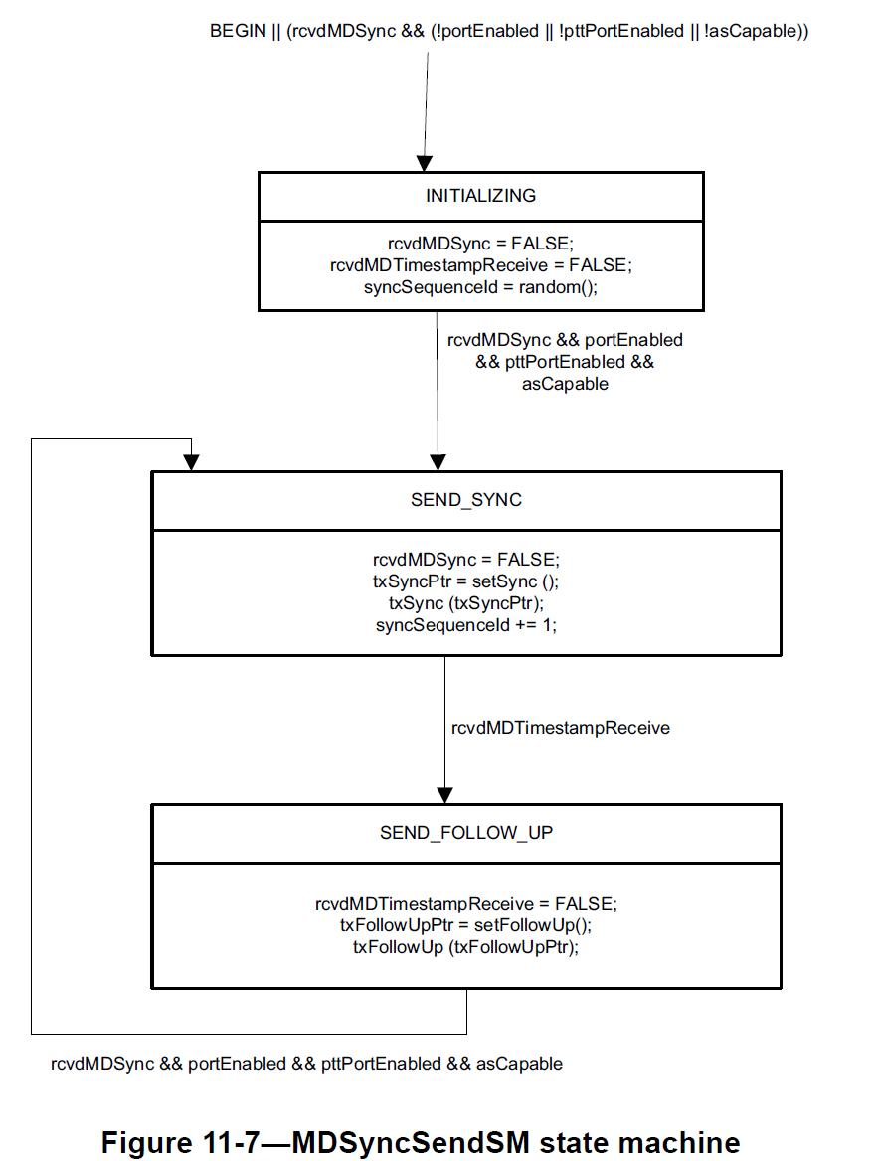
MDSyncSendSM

Slide 7
Transmission of Sync
Timings
Master
Slave
Timings
09.59
08.59
T_{x} = 10.00
09.00
Sync
10.01
T_{y} = 09.01
Reference: Page No.110 of IEEE 1588 - 2008

Slide 8
Transmission of FollowUp
Timings
Master
Slave
Timings
09.59
08.59
T_{x} = 10.00
09.00
Sync
10.01
T_{y} = 09.01
FollowUp = 10.00
10.02
09.02
Reference: Page No.110 of IEEE 1588 - 2008

Slide 9
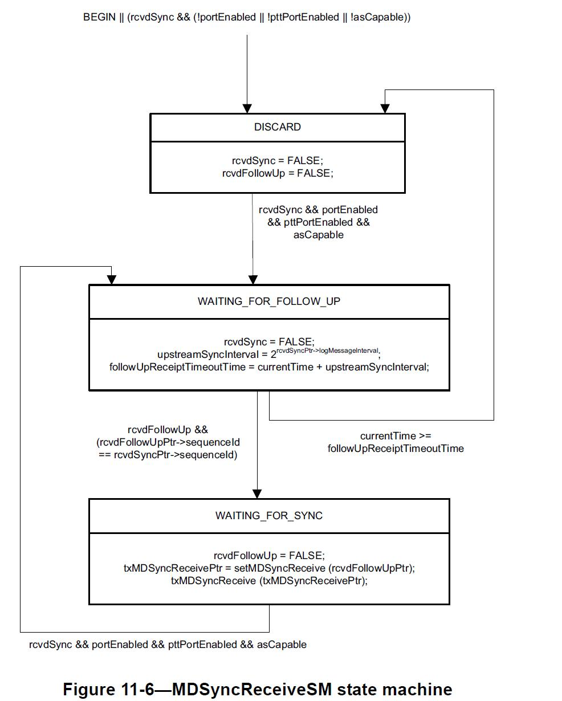
MDSyncReceiveSM

Slide 10
So, What we have to do?
Timings
Master
Slave
Timings
Known
T_{y}
T_{x}, T_{y}
T_{x} = 10.00
Sync
Transit Time
T_{y} = 09.01
FollowUp = 10.00
From this,
So, T_{y} – T_{x} = [09.01] – [10.00]
= – 00.59
This answer is equal to Offset = [OffsetFromMaster + TransitTime]
So, Offset = [OffsetFromMaster + TransitTime] = [T_{y} – T_{x}]
Hence, OffsetFromMaster = [T_{y} – T_{x}] – TransitTime

Slide 11
So, What we have to do?
OffsetFromMaster = [T_{y} – T_{x}] – TransitTime
In the above equation we know [T_{y} – T_{x}].
But, at this point of time we do not know the value of TransitTime.
So, we have to use Peer to Peer Mechanism to calculate TransitTime.
Note:
Slave will Issue MDPDelayReq and the Master will respond to it using MDPDelayResp Message.

Slide 12
Peer to Peer Mechanism

Slide 13
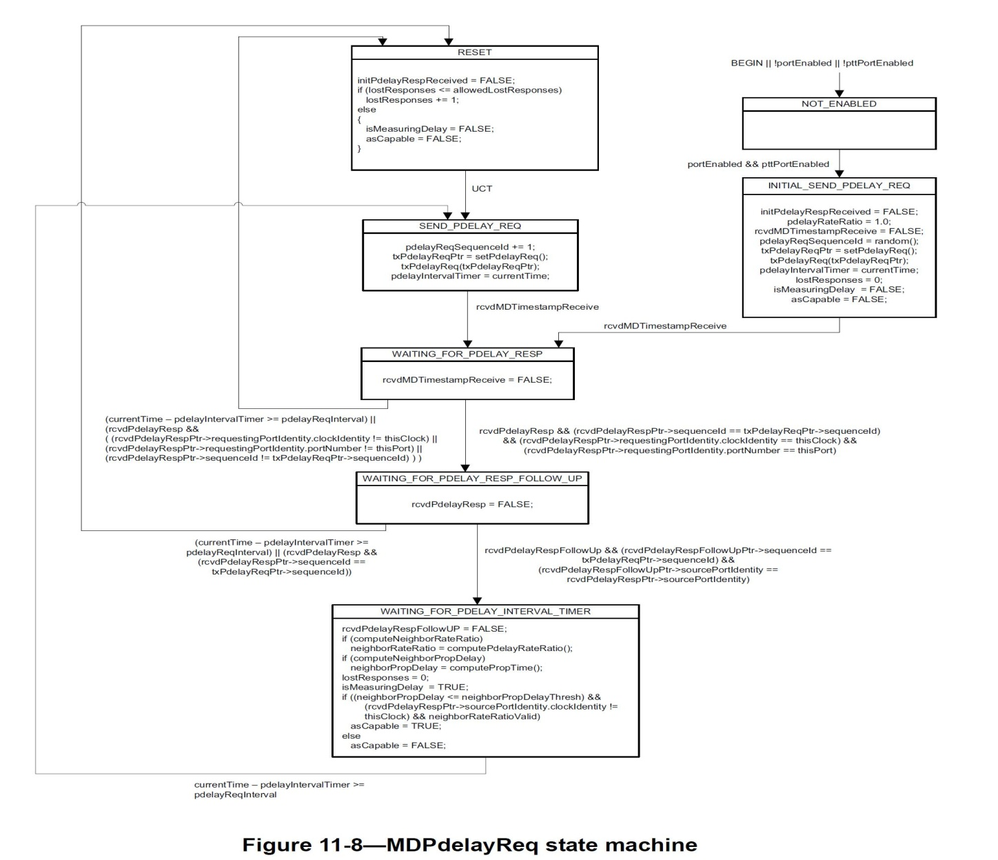
MDPDelayReqSM

Slide 14
Transmission of PDelayReq
Timings
Master
Slave
Timings
T_{x} = 10.00
Sync
T_{y} = 09.01
FollowUp = 10.00
09.03
T₁ = 09.04
PDelayReq
T₂ = 10.05

Slide 15
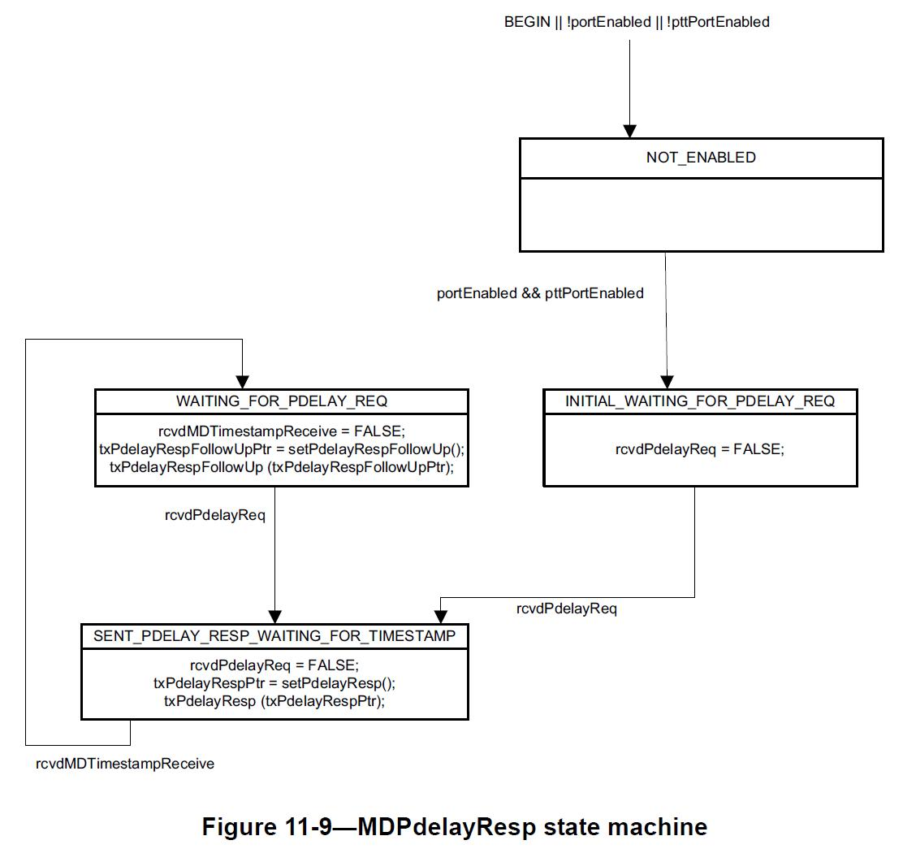
MDPDelayRespSM

Slide 16
Transmission of PDelayResp
Timings
Master
Slave
Timings
T_{x} = 10.00
Sync
T_{y} = 09.01
FollowUp = 10.00
09.03
T₁ = 09.04
PDelayReq
T₂ = 10.05
T₃ = 10.06
PDelayResp [10.05]
T₄ = 09.07

Slide 17
Transmission of PDelayRespFollowUp
Timings
Master
Slave
Timings
T_{x} = 10.00
Sync
T_{y} = 09.01
FollowUp = 10.00
09.03
T₁ = 09.04
PDelayReq
T₂ = 10.05
SlaveToMasterDelay
T₃ – T₂
T₄ – T₁
T₃ = 10.06
PDelayResp [10.05]
MasterToSlaveDelay
T₄ = 09.07
PDelayRespFollowUp [10.06]

Slide 18
So, What we have to do?
TransitTime = MeanPathDelay = [SlaveToMasterDelay + MasterToSlaveDelay] / 2
Where,
SlaveToMasterDelay = T₂ – T₁ and MasterToSlaveDelay = T₄ – T₃
So, we can form a equation as follows,
TransitTime = MeanPathDelay = [(T₄ – T₃) + (T₂ – T₁)] /2 = [(T₄ – T₁) – (T₃ – T₂)] /2
Where,
T1 = 09.04 , T2 = 10.05 , T3 = 10.06 , T4 = 09.07
So, TransitTime = MeanPathDelay = [ (09.07 – 09.04) – (10.06 – 10.05) ] / 2
= [ 00.03 – 00.01] / 2
= [ 00.02 ] / 2
So, TransitTime = MeanPathDelay = 00.01
So, From slide Number 4,
OffsetFromMaster = [T_{y} – T_{x}] – TransitTime
= [ 09.01 – 10.00 ] – 00.01
= – 00.59 – 00.01
OffsetFromMaster = – 01.00

Slide 19
Finally Its done…!
SlaveTime = CurrentSlaveTime - OffsetFromMaster
SlaveTime = 09.08 – (-01.00) = 10.08
Timings
Master
Slave
Timings
T_{x} = 10.00
Sync
T_{y} = 09.01
FollowUp = 10.00
09.03
T₁ = 09.04
PDelayReq
T₂ = 10.05
T₃ = 10.06
PDelayResp
T₄ = 09.07
PDelayRespFollowUp [10.06]
10.08
10.08

