Slide 1
PREDICTING LOAN REPAYMENT RISK USING MACHINE LEARNING : A HOMECREDIT DEFAULT RISK ANALYSIS
Phase 4
Group-6
ANISH NAIR, HARISH SURESH,
MADHUMATHI SEKAR, SHAHETHA SHANMUGAM

Slide 2
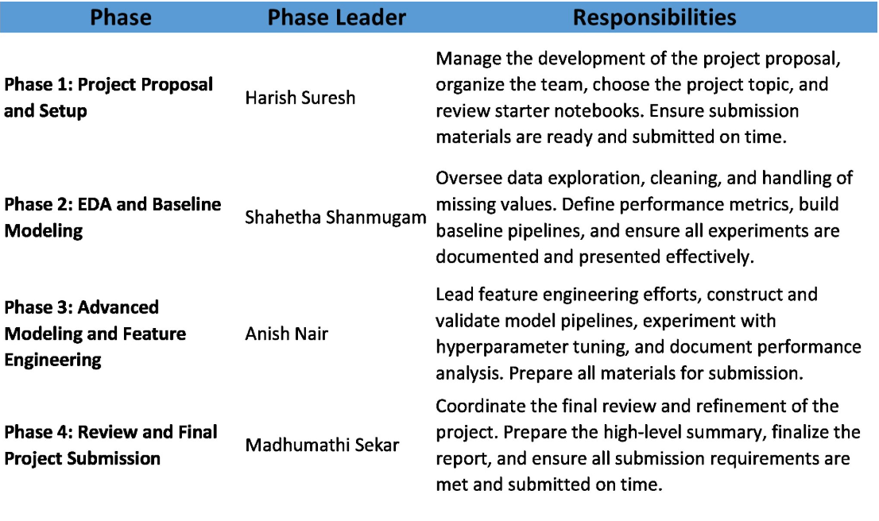
Phase Leadership plan

Slide 3
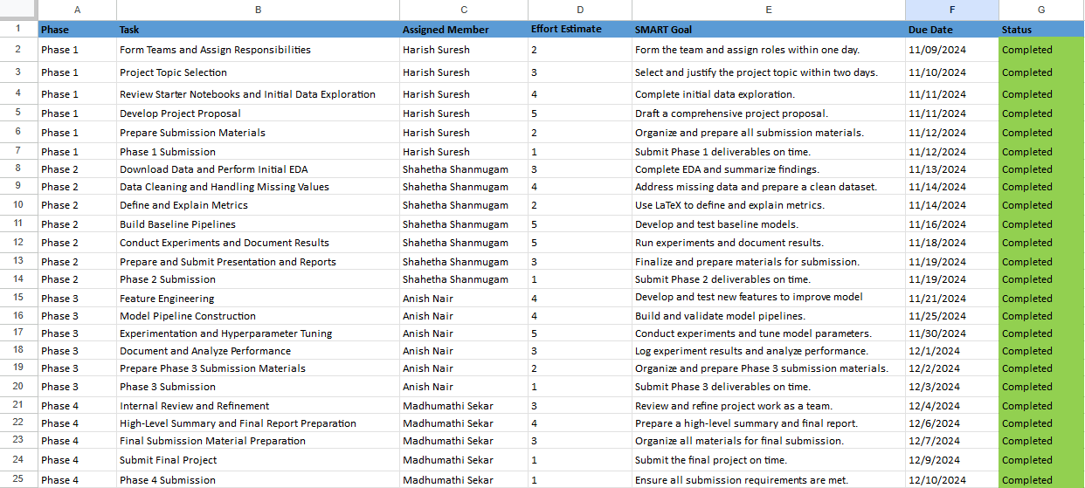
CREDIT ASSIGNMENT PLAN

Slide 4
Abstract
Obtaining loans can be particularly difficult for individuals with little or no credit history, as financial institutions often respond by either rejecting applications or imposing higher interest rates. To address this challenge, Home Credit leverages extensive data collection to evaluate loan applications more comprehensively. The goal of this project is to build a machine learning (ML) model capable of predicting loan repayment likelihood for potential customers.
In earlier stages of the project, we conducted exploratory data analysis, established baseline ML pipelines, applied feature engineering techniques, and fine-tuned hyperparameters for various algorithms such as Logistic Regression, Random Forest, and Decision Trees. The best results were achieved using a Logistic Regression pipeline, which obtained a Kaggle score of 0.734.
In the current phase, we transitioned to developing a deep learning model, specifically a Multi-Layer Perceptron (MLP), implemented using the PyTorch Lightning framework. TensorBoard was utilized to monitor training progress and visualize results. Despite experimenting with various architectures, the MLP achieved a Kaggle public score of 0.728, slightly below the Logistic Regression model's performance. This highlights the challenges of transitioning from traditional ML to deep learning for this problem.

Slide 5
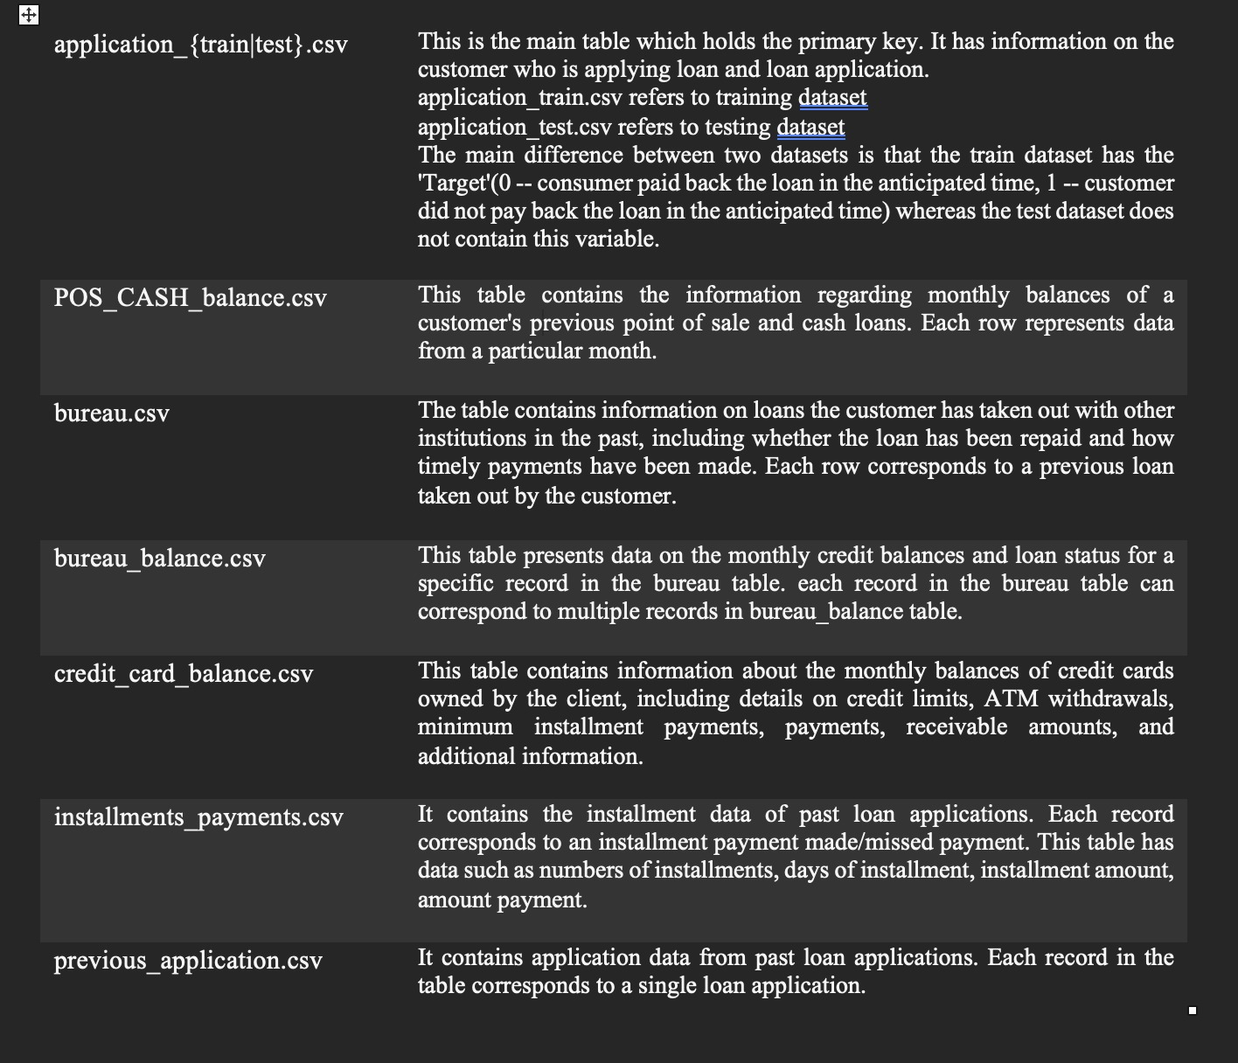
Project description
In this project we will be using the data from Kaggle on Home credit Default Risk. This dataset comprises several tables that aid in the comprehensive evaluation of creditworthiness.

Slide 6
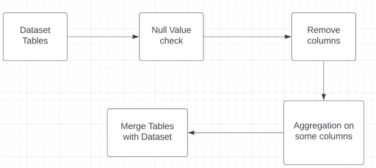
Feature ENgineering
During the Feature Engineering phase, we performed several tasks to prepare the data for model training.
These tasks included identifying null values, removing columns with more than 50% null values, and performing aggregation operations to create new features.
One of the main features we added was the number of previous loans the applicant had taken out. And we appended the table directly into the application dataset.
This feature could potentially be useful as previous loan history may be indicative of the applicant's ability to repay loans.
We performed several experiments using different combinations of features and algorithms.
We found that the new features did have a positive impact on the model's performance, improving accuracy and AUC scores.

Slide 7
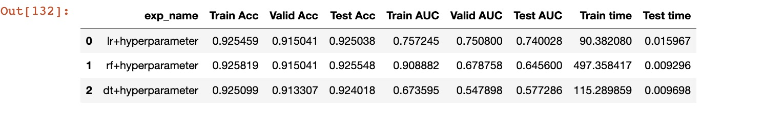
Hyperparameter Tuning
In this step we performed grid search on our models: Random Forest Classifier, Decision Tree Classifier, Logistic Regression, Multilayer Perceptron. Since, this is a classification problem, we are using the following binary cross-entropy loss function. Here are the results of different models with hyperparameter tuning:

Slide 8
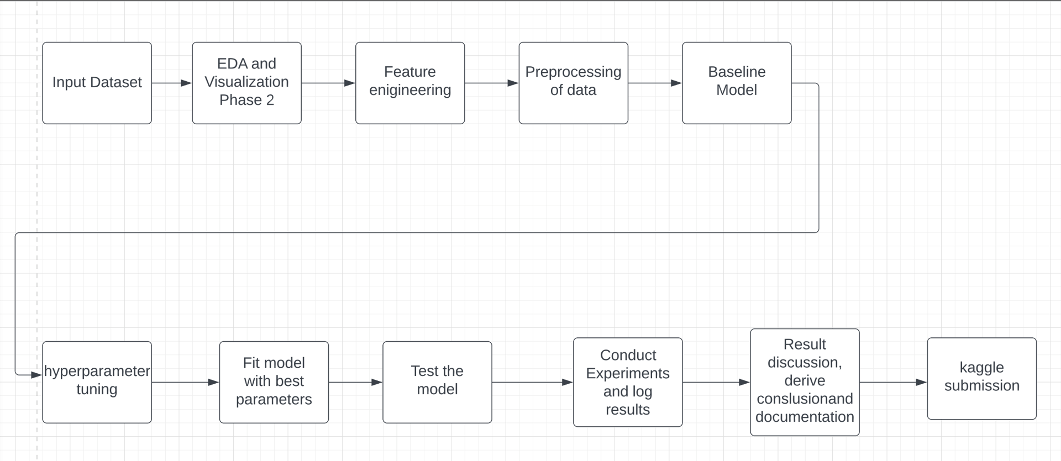
PHASE 4 description
Initial phases involved building baseline models using algorithms such as Logistic Regression, Random Forest, and Decision Trees. Through feature engineering, key predictors were selected and transformed to enhance model accuracy. Hyperparameter tuning and ensemble techniques, such as hard and soft voting, were explored to improve performance and robustness.
In the current phase, the focus shifted to developing a deep learning model using a Multi-Layer Perceptron (MLP). Binary classification was implemented with the BCEWithLogitsLoss function, which combines a Sigmoid activation with Binary Cross-Entropy loss. The ReLU activation function was applied after linear layers to introduce non-linearity and tackle the vanishing gradient problem. Experiments were conducted with varying network architectures, including the number of neurons and hidden layers, to optimize the model's performance. The PyTorch Lightning framework was utilized to leverage GPU acceleration, improve debugging, and visualize training progress.
Workflow:

Slide 9
Neural Network/PyTorch
In PyTorch, MLPs can be constructed using the nn.Sequential module, which allows us to stack layers sequentially. We have used BCEWithLogitsLoss function and RELU activation in this phase .
The BCEWithLogitsLoss is a loss function used in binary classification problems. It combines a Sigmoid layer and a Binary Cross Entropy loss function. The formula for BCEWithLogitsLoss is as follows:
BCEWithLogitsLoss = 1/N * Σ(i=1 to N)[y(i) * log(σ(x(i))) + (1 - y(i)) * log(1 - σ(x(i)))]
Activation Function: RELU f(x) = max(0, x)
This function applies the element-wise ReLU operation to its input, which sets all negative values to 0 and leaves all positive values unchanged. The purpose of applying ReLU activation to the output of a linear transformation layer is to introduce non-linearity into the neural network, which allows it to model more complex relationships between the input and output. ReLU is a commonly used activation function in neural networks due to its simplicity and effectiveness in avoiding the vanishing gradient problem.

Slide 10
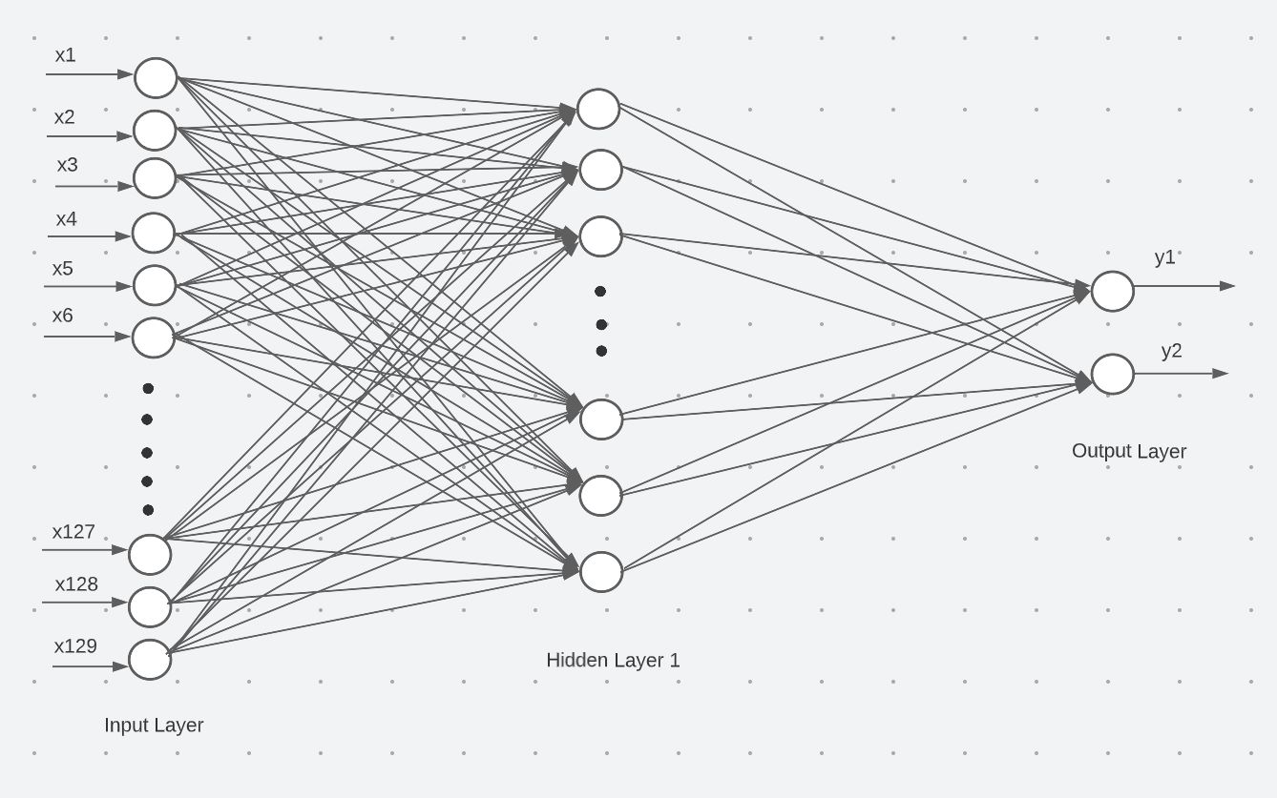
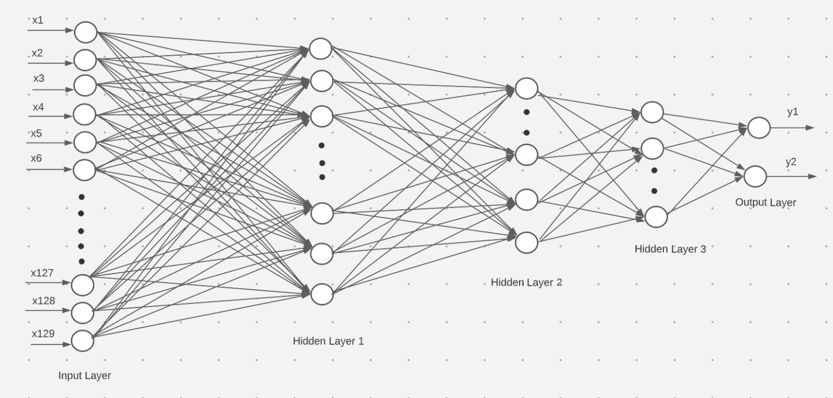
MLP 1 hidden layer
MLP 3 hidden Layer
129 - Hidden Layer 1 - RELU - 2
Input Layer (129 nodes) → 64 - ReLU → 32 - ReLU → 16 - ReLU → 2

Slide 11
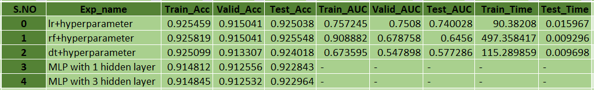
Experimental Results
We can see that the tree-based models (Random Forest and Decision Tree) have higher training accuracy compared to the other models. However, their validation and test accuracies are lower, indicating overfitting.
On the other hand, the MLP models have lower training accuracy, but higher validation and test accuracies, indicating better generalization. Comparing the three tree-based models, we can see that Random Forest has the highest test accuracy and AUC values. However, it has the longest training time, almost five times longer than Decision Tree.
Overall, if we prioritize model accuracy, Random Forest seems to be the best choice. However, if we prioritize model generalization and faster training/testing times, MLP models may be a better choice. It is important to note that the choice of model ultimately depends on the specific requirements and constraints of the problem at hand.

Slide 12
Leakage
We did proper training on the training set and evaluation done on the validation and test sets.
In this case, the MLP models are performing better on the validation and test sets compared to their training accuracy, which suggests that the models are generalizing well and there is no indication of leakage.
Conclusion
Our objective is to empower lenders to make informed lending decisions while minimizing financial risks. In the final phase of our project, we continued refining our predictive modeling efforts, focusing on implementing a deep learning Multi-Layer Perceptron (MLP) model using PyTorch Lightning. Through the project's phases, we emphasized the critical role of Exploratory Data Analysis (EDA), Feature Engineering, and Hyperparameter Tuning in improving machine learning model performance. Moving forward, there is potential to enhance our models by exploring:
Advanced hyperparameter tuning techniques.
Refined feature selection and engineering methods.
Better compute resources to support more complex and robust architectures.
We are optimistic that these improvements can refine the MLP model, boost its accuracy, and help achieve a higher leaderboard ranking. By contributing to the Home Credit Default Risk (HCDR) initiative, this work supports more accurate risk assessment, which can positively impact individuals and communities by promoting financial inclusion and responsible lending.

Slide 13
THANK YOU

