Slide 1
Final Project: HandPicked Giftware
Madhuri Patibandla, Madhumathi Sekar, Thy Kieu

Slide 2
Purpose
-The purpose of this project is to forecast UK retail sales using time series analysis for 2012 by analyzing actual sales observed from 2009-2011.
- The project highlights the importance of adaptive forecasts in retail environments characterized by changing sales patterns and irregularities.
- The analysis involves comparing the forecasting performance of the Exponential Smoothing (ETS) and Autoregressive Integrated Moving Average (ARIMA) models.

Slide 3
Tools/Database Technologies
The project is implemented using the R programming language. Key R libraries used include:
fpp3 for time series analysis and forecasting.
readxl for reading Excel files.
ggplot2 for data visualization.
forecast for additional forecasting tools.
scales for plot scaling.
tsibble for time series data structures.
seasonal for seasonal decomposition.
Shiny for webapps

Slide 4
Data
The project uses the "Online Retail" dataset, which contains UK retail sales data.
The dataset is in Excel format (.xlsx). It appears to consist of two sheets, one for the period 2009-2010 and another for 2010-2011.
Data cleaning steps included handling missing values in CustomerID, removing duplicates, and filtering records for the UK. Transformations involved calculating total prices and creating monthly and yearly aggregated time series.
The data is characterized by changing sales patterns and irregularities, making it suitable for demonstrating the strengths of adaptive forecasting methods.

Slide 5
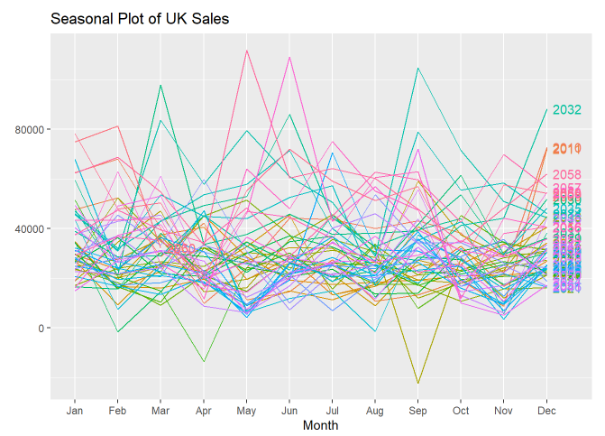
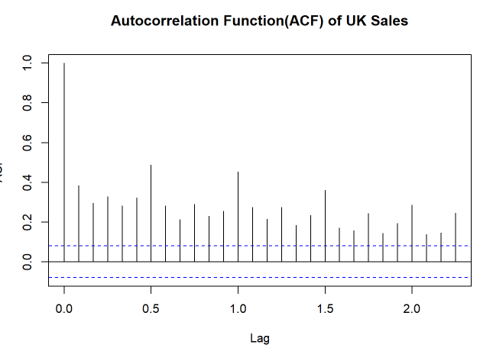
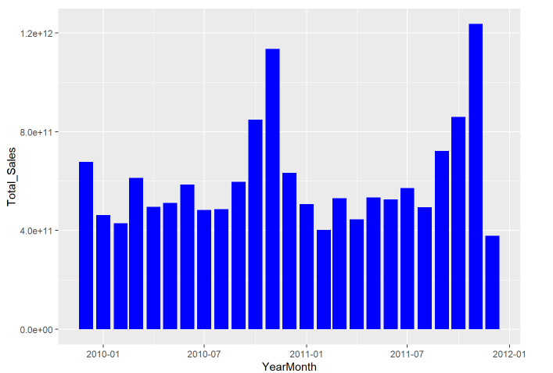
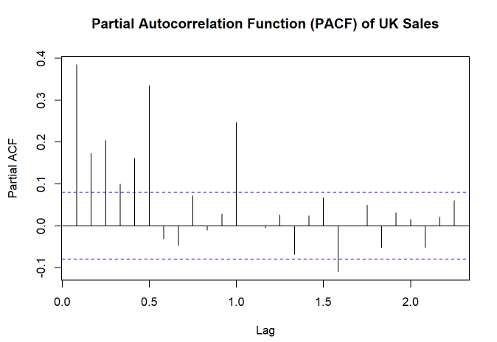
Timeseries Analysis on UK sales Data Visualization.
Notes:
seasonal plot : The seasonal plot validates the need to incorporate seasonality explicitly in forecasting models to improve prediction accuracy.
Auto correlation : Strong autocorrelations at short lags indicate that recent sales heavily influence future.
Seasonal spikes at 12-month intervals confirm annual seasonality.
The slow decay suggests the presence of a trend in the sales data.
Bar Plot of Monthly Sales Trend (2009–2011) : Sales peak in Nov–Dec each year due to holidays.
Lower sales in mid-year months.
Year-over-year growth shows positive retail trends.
Partial Auto correlation : Strong direct influence from sales at short lags (especially lag 1).
Sharp cutoff after early lags suggests a low-order AR model.
Minor seasonal signals also visible at longer lags.

Slide 6
Functionalities
Data Loading and Preprocessing: The project loads the Excel datasets, combines them, handles missing values (specifically for CustomerID), and removes duplicates. It also performs data transformations, such as calculating total prices and extracting month and year information from dates.
Exploratory Data Analysis (EDA): The project includes EDA to understand the data's characteristics. This involves:
Calculating and visualizing daily, monthly, and yearly sales trends.
Analyzing summary statistics and data structures.

Slide 7
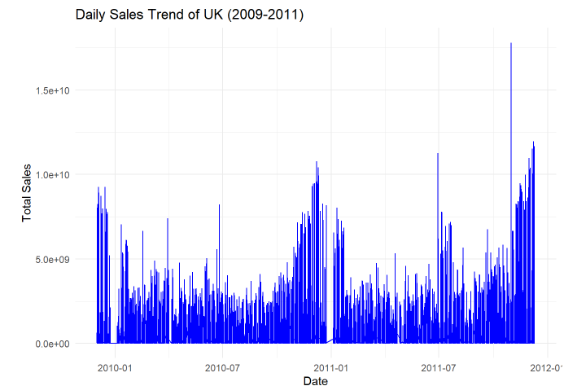
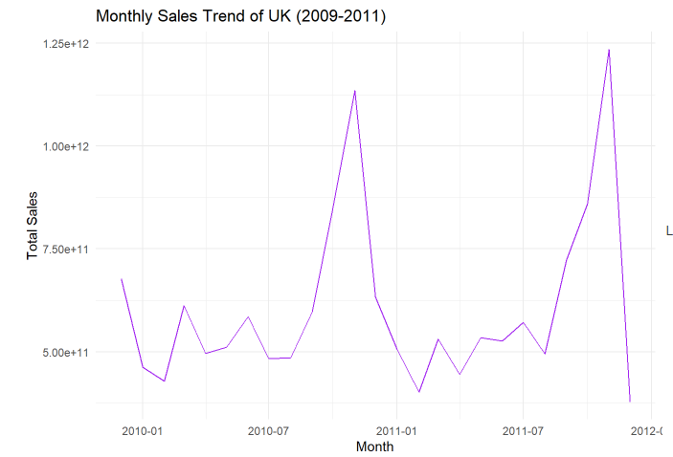
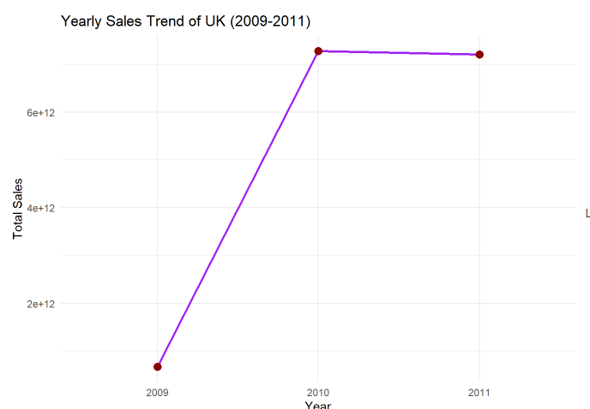
Sales trend on UK sales Data Visualization.
Notes:
Daily sales trend : 2009 to 2011, there is a general upward trend. There seems to be higher peaks in the later periods. Seasonality-wise, there are recurring peaks and dips at regular intervals. There a spikes around the end of the year possibly due to seasonal effects. Overall, it is not stationary.
Monthly sales Trend : from the beginning to the end of each year, there is an upward trend. Again, it also shows yearly seasonality where it spikes around the end of the year(possibly due to holiday sales). This graph is not stationary.
Yearly sales Trend : there is an increase from 2009 to 2010, and then a small decrease from 2010 to 2011. Seasonality and stationary can’t be assessed.

Slide 8
Functionalities
Time Series Analysis: The core functionalities revolve around time series analysis:
Time Series Visualization: Creating seasonal plots, ACF (Autocorrelation Function) plots, PACF (Partial Autocorrelation Function) plots, and bar plots to visualize sales patterns.
Time Series Decomposition: Performing classical (additive) and STL (Seasonal-Trend decomposition using Loess) decomposition to separate the time series into trend, seasonal, and remainder components.
Time Series Modeling: Fitting ETS (Exponential Smoothing) and ARIMA models to the sales data. A Neural Network model (NNAR) is also used.
Forecasting: Generating forecasts for future sales using the fitted models.
Model Comparison and Evaluation: Comparing the forecasts from different models (ETS, ARIMA) and evaluating their accuracy using metrics like MAE (Mean Absolute Error), RMSE (Root Mean Squared Error), and MAPE (Mean Absolute Percentage Error).
Predictions: All models predicted an overall increasing trend in sales with regular seasonal peaks, particularly around year-end (likely due to holidays). NNAR offered the most flexible and adaptive forecasts, especially suited for UK sales retail environments where sales patterns change and irregularities exist. ETS and ARIMA provided solid, interpretable baselines and can be useful in more stable forecasting environments.

Slide 9
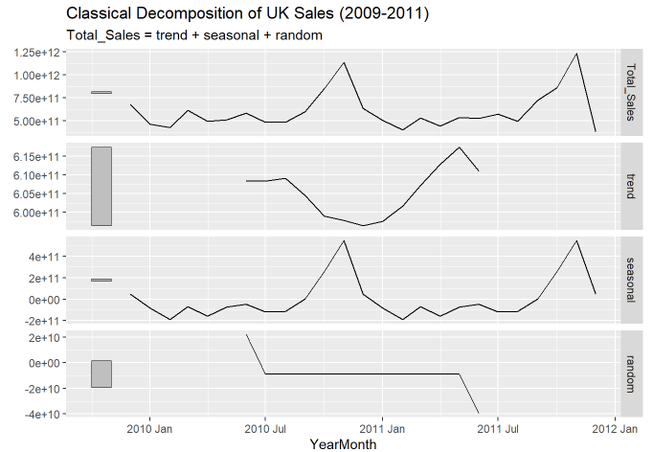
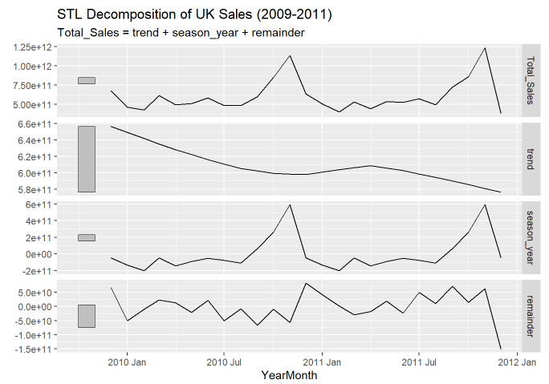
Time series decomposition on UK sales Data Visualization
Notes:
Classical Decomposition : Total_sales variable was executed using the “additive” type because the seasonal variations were constant over time. The trend line is increasing with a slight decline around the end, so there is a non-stationary trend in sales. The seasonal component shows strong seasonality due to the recurring patterns.
STL Decomposition : because it allows for changing seasonal patterns. It shows an overall downward trend. There seems to be signs of seasonality due to the recurring patterns. The remainder/residuals show the possible noise and irregularities.
Overall, STL decomposition seems to be the better model because it was able to adapt to the changing seasonality. The residuals seems to be closer to the true noise as well. Another benefit of using this model is that it is resistant to any possible outliers.

Slide 10
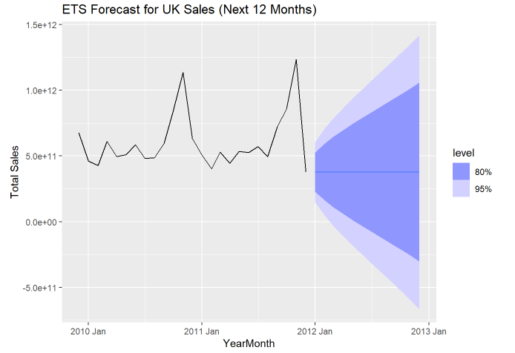
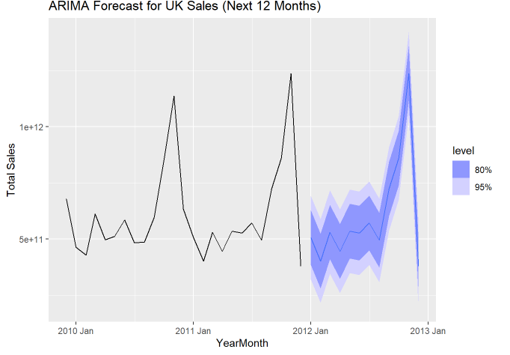
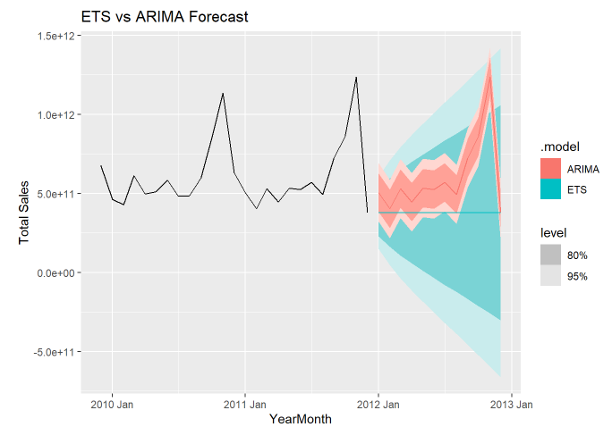
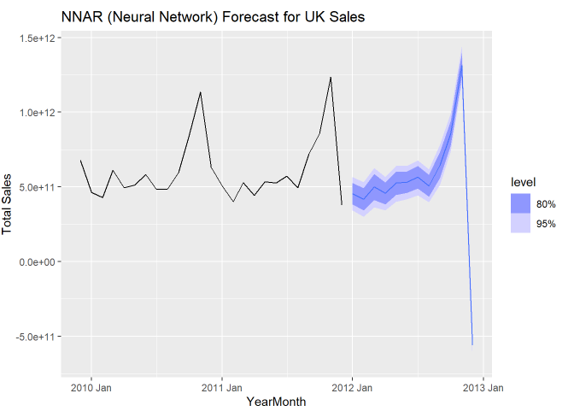
Predicitions on UK sales Data Visualization.
Notes:
ETS Forecast : A line graph where the historical data is extended with forecasted values. The forecasted line follows a pattern that includes level, trend, and seasonality if present.Shaded areas around the forecast line show confidence intervals, indicating forecast uncertainty. The ETS model provides a visually accurate and smooth forecast, effectively capturing both the increasing trend and stable seasonal patterns seen in historical UK sales data.It is especially effective when seasonality is consistent over time, which aligns well with your dataset. The forecast aligns with business expectations—higher sales during holidays and steady growth throughout the years.
ARIMA Forecast : The ARIMA model produces a smooth forecast curve that extends from the end of the historical data. The predicted sales show a slight upward trend, indicating a continuation of past growth patterns in sales. The widening gray or shaded bands around the forecast line represent the uncertainty of the prediction. The further out we forecast (e.g., month 10, 11, 12), the wider the interval becomes, indicating less confidence the model has in those values. This is expected behavior in time series models—uncertainty increases with time. The forecast is statistically sound within its confidence bounds and provides a solid baseline.
ETS vs ARIMA Forecast : The Evaluate Forecast Accuracy model with lower values for MAE, RMSE, and MAPE is considered more accurate.
NNAR (Neural Network) Forecast : X-axis: Time — monthly from your historical data (YearMonth).Y-axis: Total_Sales — total sales in the UK per month. Solid Line (Historical Data): This shows the actual sales observed from 2009 to 2011. Forecast Line (Dashed or Extended Line): The NNAR model’s forecasted sales for the next 12 months. Shaded Area (Confidence Intervals): These indicate the range of uncertainty around the forecasts (typically 80% and 95% prediction intervals).

Slide 11
Issues
Data Quality and Missing Values
Issue: The dataset had a significant number of missing CustomerID values, which posed a challenge for customer-level analysis.
Solution: We replaced missing CustomerIDs with a placeholder value "Unknown" to ensure consistency in the dataset while still allowing aggregate analysis.
Model Selection Confusion
Issue: Choosing between ETS, ARIMA, and NNAR models required experimentation due to similar performance.
Solution: We used cross-validation and accuracy metrics like MAE and RMSE to evaluate each model's performance and selected NNAR for its flexibility and robustness in handling irregular seasonality

Slide 12
Demo

Slide 13
Reflection
One of the most challenging aspects of this project was selecting the right forecasting model. While ETS and ARIMA provided strong baselines, their performance was very close, and it took careful experimentation and evaluation to understand their differences. Understanding when and why to use models like NNAR, especially in a retail context with non-linear and changing seasonal patterns was both a technical and conceptual learning experience.
The most interesting part was seeing how various models interpreted the same dataset differently. Comparing their forecasts side-by-side helped us visualize predictions better. We also enjoyed using visual storytelling to explain trends like holiday spikes in sales which made the data feel more connected to real-world behavior.

Slide 14
Final Takeway
The sales data from 2009 to 2011 demonstrates non-stationary behavior with strong seasonal effects. Models that account for changing seasonality and nonlinear trends—like NNAR and Prophet—are more suitable for long-term forecasting in this case.
For businesses seeking robust sales forecasting, especially with holiday effects and potential outliers, combining forecasts from multiple models or using an ensemble approach can enhance reliability and accuracy.

