Slide 1
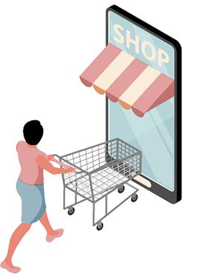
LUXORA E-Commerce Platform
Welcome to our LUXORA online shop

Slide 2

GROUP MEMBERS
BSc/WD/22/36/25 – W.M.S.S.Ariyapala
BSc/WD/22/36/36 – W.A.M.Madhusani
BSc/WD/22/36/26 – D.T.Jayasinghe

Slide 3

TABLE OF CONTENTS
03
02
01
INTRODUCTION
PROJECT GOALS & OBJECTIVES
FUNCTIONS & NON FUNCTIONS
04
06
05
TECHNOLOGY
KEY FEATURES
DEMOSTRATION
07
CONCLUSION

Slide 4
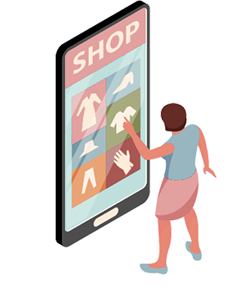
01
INTRODUCTION

Slide 5
The Luxora Project is a specialized e-commerce platform for luxury goods, designed to offer a secure and seamless shopping experience.
By connecting high-end sellers with discerning buyers, Luxora provides a curated space with features like personalized dashboards, secure payments, and responsive design, redefining the luxury shopping experience.

Slide 6
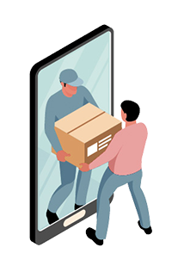
PROJECT GOALS & OBJECTIVES
02

Slide 7
Goals
Create a user-friendly and scalable e-commerce platform.
Ensure security and seamless shopping experiences.
Objectives
Develop core features like catalog, cart, and checkout.
Integrate secure payments and analytics.

Slide 8
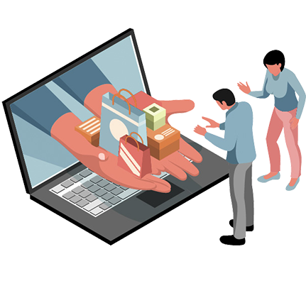
03
FUNCTIONS & NON FUNCTIONS

Slide 9
Function
• User Management
• Product Catalog and Search
• Shopping Cart and Checkout
• Order Management and Tracking
• Admin Dashboard
• Analytics and Reporting
Non Function
• Performance
• Security
• Usability
• Reliability
• Scalability

Slide 10

04
KEY FEATURES

Slide 11
Customer Features
Product Search & Filtering
User Authentication (Sign-up/Login)
Wishlist & Cart Management
Secure Payment Integration
Admin Features
Product Management
Inventory Tracking
Order Fulfillment Dashboard
Sales Analytics

Slide 12
05
TECHNOLOGY
Notes:
Okay, now let's talk about the technologies used to build this system.

Slide 13




Notes:
“The technology for LUXORA has been carefully selected to ensure scalability, security, and high performance. It includes a robust backend, a dynamic frontend, a reliable database, and seamless integrations.
Here's an overview of the tools and technologies that power LUXORA:“
We used Laravel version 11 as the framework, and used mqsql to create the database, and git for use version control.

Slide 14
06
DEMOSTRATION
Notes:
Our system has an admin dashboard and a user dashboard. Currently, we have only created a few functions for the user dashboard. Now let's see what they are.
Welcome to the our LUXORA e-cormmerce website.

Slide 15
07
CONCLUSION

Slide 16
LUXORA is a modern, scalable e-commerce platform designed to enhance business operations and deliver seamless shopping experiences.
By leveraging Laravel 11 and secure integrations, it ensures usability, reliability, and customer satisfaction.

Slide 17
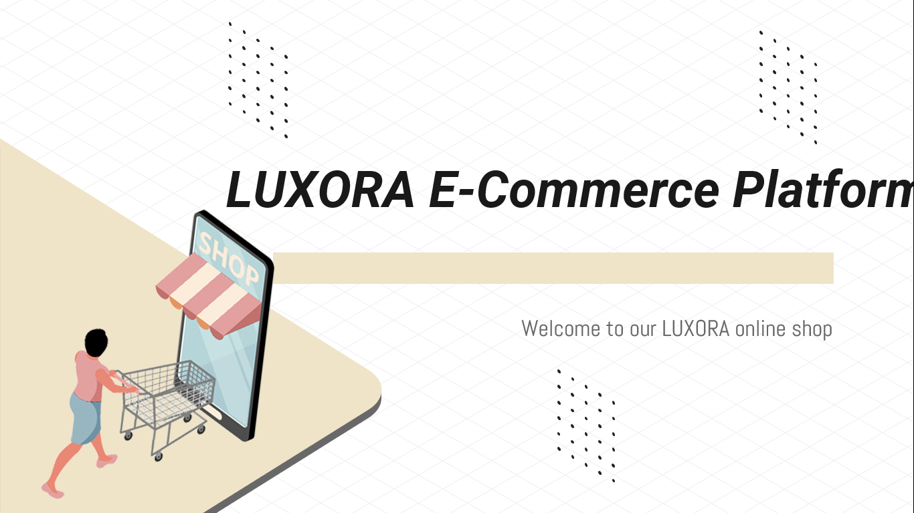
THANK YOU!

