Slide 1





GLA UNIVERSITY
Computer Network

Slide 2

Outline
Introduction Concepts:
  Goals and Applications of networks
  Network structure and architecture
  The OSI reference model and services
  Network topology design
  Physical Layer Transmission Media
  Line coding scheme
  Switching methods (circuit switching, Packet switching)
  TDM

Slide 3
Introduction Concepts

Slide 4

Introduction
Network
It is defined as a medium which is responsible for carrying the
data from one node to another
Eg: intranet, internet, PAN, etc

Slide 5


Introduction
Computer Network
A computer network is comprised of nodes and links
A node is the end point whereas links are the medium
It is defined as a network through which one system can communicate with the other system

Slide 6
Goals of network
The main goals of network are:
Resource sharing
  Eg: printer on network, shared drives, etc
High reliability
  Eg: alternative sources, multiple copies, etc
Increase system utilization
  Eg: load sharing, pooling, etc
Powerful communication medium
  Eg: update is reflected immediately

Slide 7
Application of network
The main applications of network are:
Accessing web
File transfer
File sharing
Remote procedure call, etc

Slide 8
Network architecture
Network architecture is the design of a computer network
It is a framework for the specification of a network's physical
components and their functional organization
It also defines the set of rules which are followed during
communication (also known as protocols)
Network architecture refers to the way network devices and services are structured to serve the connectivity needs of client devices
A architecture defines how the computers should get connected to get the maximum advantages of a computer network such as better response time, security, scalability, etc

Slide 9
Network architecture
The two most common network architecture are
Peer-to-Peer
  Known as P2P
Client-Server
  Known as tiered

Slide 10
P2P architecture
All the nodes in a network are inter-connected with every other nodes
There is no one who acts as a master (also known as server) for all,
rather all acts as a master independently
It is useful for small environment

Slide 11
P2P architecture
Advantages
Less costly as there is no central server
In case of a node failure, other nodes in the network are not affected
Installation is quite easy
Disadvantages
Each computer has to take the backup of its own
Security measures are to be
taken by all the independently
Scalability is a issue
nodes

Slide 12
Client-Server architecture
All the nodes in a network are connected with the central node (known as master/server)
The master node receive request from all the other nodes (clients) and respond their request

Slide 13
Client-Server architecture
Disadvantages
In case of server failure, the
entire network is down.
Server maintenance cost is high
Cost is high
Advantages
Data backup is easy
Performance is
better as the
is greatly
response time improves
Security is better as unauthorized access are denied by server
Scalability is not an issue in this architecture as large number of computers can be connected with server.

Slide 14
Network topology
The topology defines how the nodes in the network are connected
It also defines the flow of data from one node to another
There are five types of topologies defines
  Mesh topology
  Star topology
  Bus topology
  Ring topology
  Hybrid topology

Slide 15
Network topology
Mesh topology
In this topology, each node is connected to every other node in the network
Implementing the mesh topology is expensive and difficult
In this type of topology, each node may send message to destination through multiple paths
While the data is travelling, it is automatically configured to reach the destination by taking the shortest route which means the least number of hops

Slide 16
Network topology
Star topology
Each node is connected to a central device called a hub
The hub takes a request from any node and pass it to the other node
Data on a star topology passes through the hub, switch, or
concentrator before continuing to its destination
The hub, switch, or concentrator manages and controls all functions of the network
The star topology reduces the chance of network failure by connecting all of the systems to a central node

Slide 17
Network topology
Bus topology
All the nodes topology are connected by one single cable
A bus topology consists of a main run of cable with a terminator at each end. All nodes (file server, workstations, and peripherals) are connected to the linear cable
Popular on LANs because they are inexpensive and easy to install

Slide 18
Network topology
Ring topology
In a ring topology, every device has exactly two neighbors for
communication purposes.
All messages travel through a ring in the same direction.
A failure in any cable or node breaks the loop and can take down the
entire network
To implement a ring network we use the Token Ring technology
A token, or small data packet, is continuously passed around the network. When a device needs to transmit, it reserves the token for the next trip around, then attaches its data packet to it

Slide 19
Network topology
Hybrid topology
A combination of any two or more network topologies
A hybrid topology always accrues when two different basic network topologies are connected
It is a mixture of above mentioned topologies. Usually, a central computer is attached with sub-controllers which in turn participate in a variety of topologies

Slide 20
Network Technologies
It can be classified under two category
Based on transmission technology
Based on scale

Slide 21
Network Technologies
Based on transmission technology
Broadcast
  Broadcast network have a single communication channel that is shared by all the nodes on the network
Point to point
  There may exist multiple paths between a source-destination pair and the nodes in between provide a route to move the data from one to other until it reach to the destination

Slide 22
Network Technologies
Based on scale
Local Area Network (LAN)
Metropolitan Area Network (MAN)
Wide Area Network (WAN)

Slide 23
Network Technologies
Based on scale
LAN
  usually privately owned
  used to links the devices in a single office, building or campus of up to few
distance
  restricted in size
  run at speeds of 10 to 100 Mbps (but now much higher speeds can be
achieved)
  most common topologies are bus, ring and star

Slide 24
Network Technologies
Based on scale
MAN
  designed to extend over the entire city
  may be a single network or a connection of number of LANs

Slide 25
Network Technologies
Based on scale
WAN
  provides long-distance transmission of data over large geographical areas that may comprise a country, continent or even the globe
  not restricted in size

Slide 26
What is a network?
Every network includes:
At least two nodes
A cable or wireless pathway, called Transmission Media
Rules, called Protocols, so that computers can use the unified principle of data communication
Networking Interface Cards (NIC)

Slide 27
Why Layered Architecture?
To make the design process easy by breaking unmanageable tasks into several smaller and manageable tasks (by divide-and-conquer approach)
Modularity and clear interfaces, so as to provide comparability between the different providers' components
Ensure independence of layers, so that implementation of each layer can be changed or modified without affecting other layers
Each layer can be analyzed and tested independently of all other layers

Slide 28
OSI reference model
OSI stands for Open Systems Interconnection
It has been developed by ISO – “International Organization of
Standardization”
It is a 7 layer architecture
Each layer is responsible for specific functionality
All these 7 layers work collaboratively to transmit the data from one end (top to bottom) and receive the data at other end (bottom to top)

Slide 29
OSI reference model (terminology)
Protocol
– is a formal set of rules and conventions that governs how computers
exchange information over a network medium.

Slide 30
OSI reference model
Application Layer
Presentation Layer Session Layer Transport Layer Network Layer Data link Layer Physical Layer

Slide 31
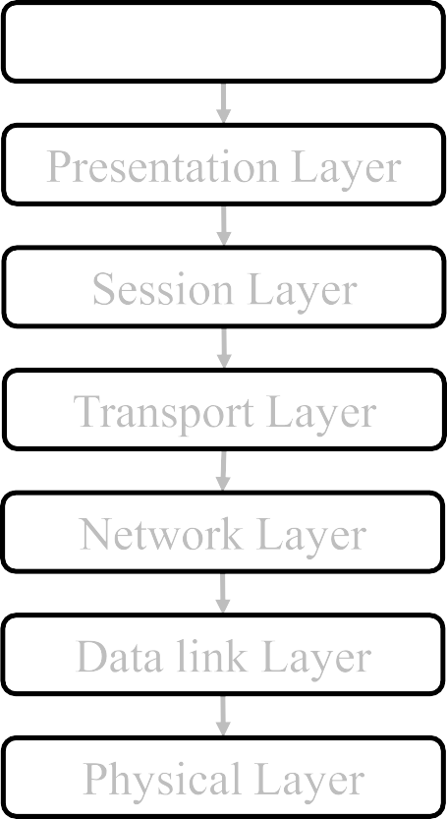
OSI reference model and its services
Application Layer
This layer is responsible to generate the data, which has to be transferred over the network
Eg: browser

Slide 32
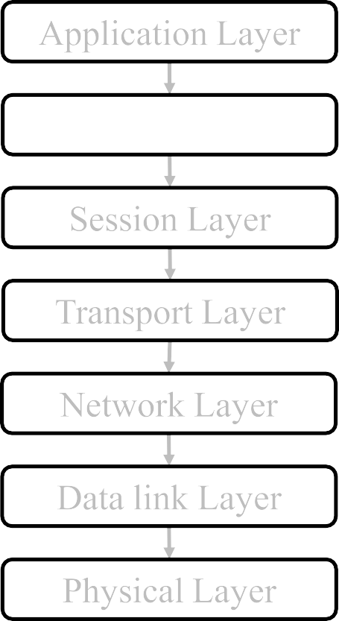
OSI reference model and its services
The data from the application layer is extracted here and converted as per the required format to transmit over the network
The functions of the presentation layer
are :
  Translation
  Encryption/ Decryption
  Compression
Presentation Layer

Slide 33
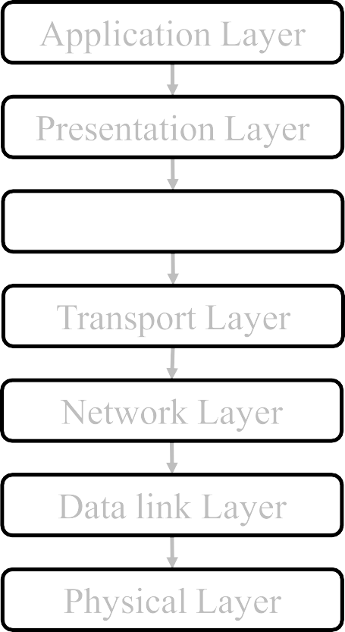
OSI reference model and its services
This layer is responsible for establishment of connection, maintenance of sessions, authentication and security
Session Layer

Slide 34
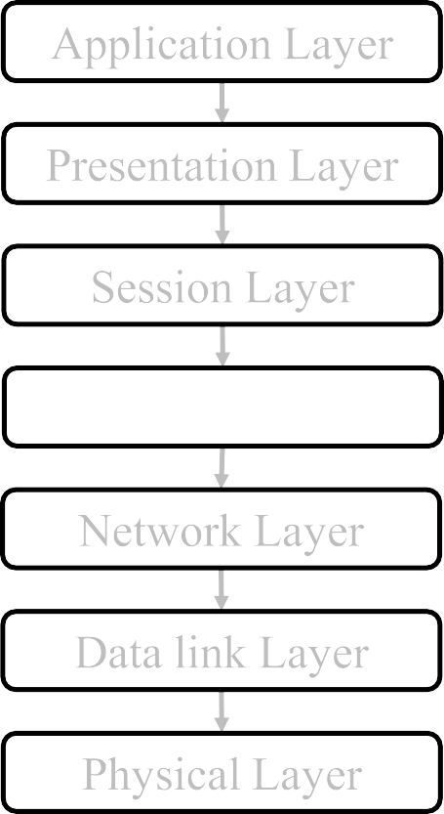
OSI reference model and its services
The data in the transport layer is referred to as
segments
It is responsible for the End to End delivery of the complete message
The transport
layer also provides the of the successful data
Transport Layer
acknowledgement
transmission and re-transmits the data if an error is found
Two type of services are provided:
  Connection oriented
  Connection less

Slide 35
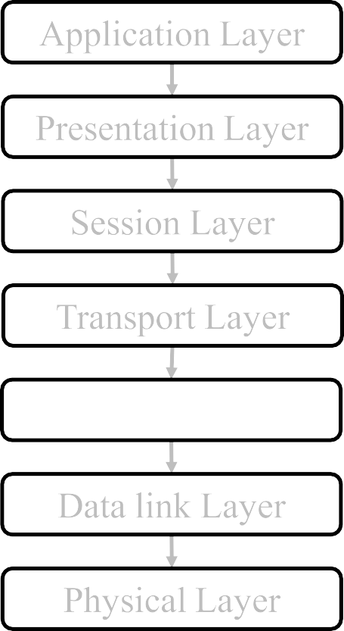
OSI reference model and its services
Network layer works for the transmission of data
It also takes care of packet routing i.e. selection of the shortest path
The sender & receiver’s IP address are
placed in the header by the network layer.
Network Layer

Slide 36
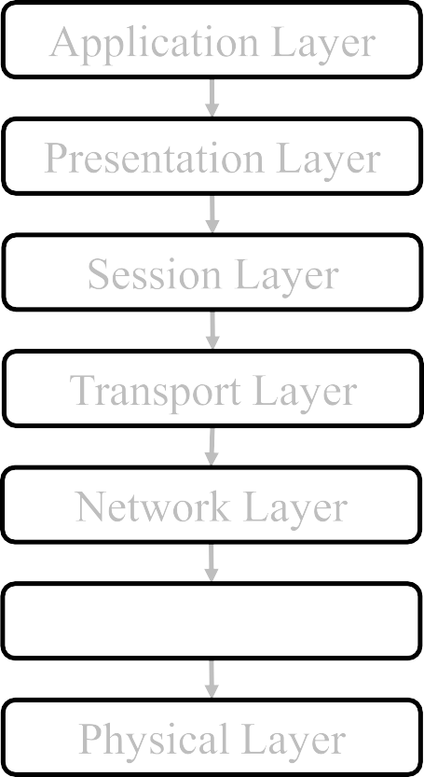
OSI reference model and its services
The main function of this layer is to make sure data transfer is error-free from one node to another, over the physical layer
When a packet arrives, it is the
responsibility of DLL to transmit it to the
Host using its MAC address.
Data Link Layer is divided into two sub layers :
Data link Layer
Logical Link Control (LLC)
Media Access Control (MAC)

Slide 37
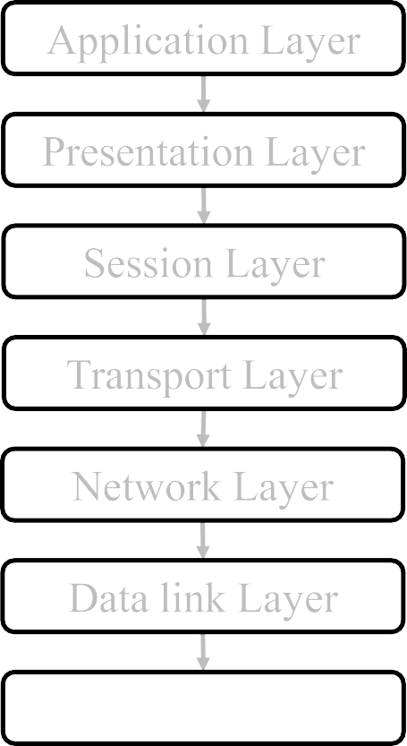
OSI reference model and its services
It is responsible for the actual physical connection between the devices
The physical layer contains information in the form of bits
It is responsible for transmitting
individual bits
When receiving data, this layer will get the signal and convert it into 0s and 1s and send them to the Data Link layer, which will put the frame back together.
Physical Layer

Slide 38
OSI reference model and its services (in brief)
Application Layer
Provides service to the user
Performs translation, compression and encryption
Presentation Layer
Session Layer
Manage session
Responsible for end- to-end transmission of data
Transport Layer
Data into packets and putting network header
Network Layer
Packets into frames, error free transfer and mapping
Data link Layer
Frames into bits and a
medium of transfer
Physical Layer

Slide 39


OSI reference model and its services (review)
Application Layer
Sender
Receiver
DATA
DATA
To: Presentation layer
From: Presentation layer

Slide 40
OSI reference model and its services (review)
Application Layer
responsible for generating the data
contains a variety of protocols that
are commonly needed by users
  HTTP
  FTP
  SMTP

Slide 41
OSI reference model and its services (review)
Application Layer
Sender Receiver
Presentation Layer
From: Application layer
To: Application layer
Encode, Encrypt,
Compress
Decode, Decrypt,
Decompress
To: Session layer
From: Session layer

Slide 42
OSI reference model and its services (review)
Application Layer
Purpose
– Make
it possible for computers with
to
Presentation Layer
different data representations
communicate
Concerns
  Syntax and semantics of information transmitted
  Understands the nature of the data being transmitted
  Converts ASCII, EBCDIC, etc

Slide 43
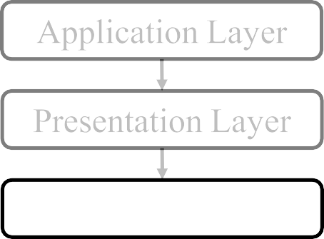
OSI reference model and its services (review)
Sender Receiver
From: Presentation layer
To: Presentation layer
Session Layer
Sync and recovery
Sync and recovery
To: Transport layer
From: Transport layer

Slide 44
OSI reference model and its services (review)
Application Layer
Purpose
  Allow users on different machines to
establish sessions between them
Concerns
  Authentication and authorization
  Check Pointing
  Dialog control
  Logical grouping of operation
  Synchronization
Presentation Layer
Session Layer

Slide 45
OSI reference model and its services (review)
Application Layer
Sender Receiver
Presentation Layer
From: Session layer
To: Session layer
Session Layer
Break data into
segments
Merge segments to
form data
Transport Layer
To: Network layer
From: Network layer
DATA
DS1 | DS2 | DS3 | … | DSn

Slide 46
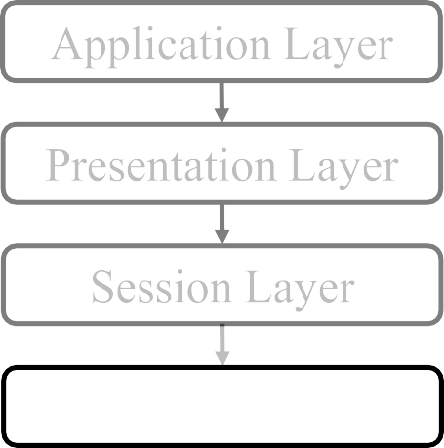
OSI reference model and its services (review)
Sender Receiver
From: Session layer
To: Session layer
Break data into
segments
Merge segments to
form data
Transport Layer
To: Network layer
From: Network layer
Two protocols used in this layer:
TCP – follow same route
UDP – may follow same route

Slide 47
OSI reference model and its services (review)
Sender Receiver
From: Session layer
To: Session layer
Break data into
segments
Merge segments to
form data
Transport Layer
Function of this layer:
To: Network layer
From: Network layer
Service point addressing
Segmentation and reassembling
Connection control
Flow control
Error control

Slide 48
OSI reference model and its services (review)
Application Layer • Purpose
– Accept data from above it, split it up into smaller
_{Presentation Layer} units, pass them to network layer, and ensure that the
pieces all arrive correctly at the other end
Concerns
Session Layer
Service Decisions: What type of service to provide; error-free point to point, datagram, etc
End-to-end: it carries data all the way from the source
to the destination
Reliability: Ensures that packets arrive at their destination
Transport Layer
Hides network: Allows details of the network to be
hidden from higher level layers
Mapping: Determines which messages belong to which connection
Flow control: keeps a fast transmitter from flooding a slow receiver

Slide 49
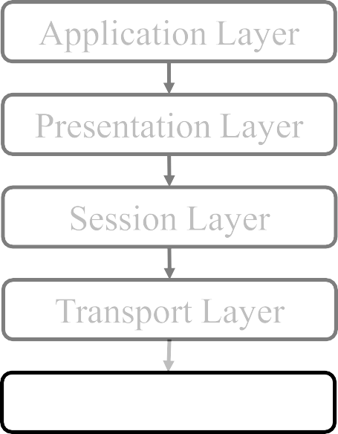
OSI reference model and its services (review)
Sender Receiver
From: Transport layer
To: Transport layer
Break segments into
packets
Merge packets to
form segments
Network Layer
To: DLL
From: DLL
Protocol used:
IP
DS1
DSP1 | DSP2 | DSP3 | … | DSPn

Slide 50
OSI reference model and its services (review)
Application Layer
Purpose
– Route packets from source to destination
Concerns
Presentation Layer
Routing: What path is followed by packets from source to destination. Can be based on a static table, can be determined when the connection is created, or can be highly dynamic, being determined a new for each packet, to reflect the current network load
Congestion: Controls the number packets in the subnet
QoS: Quality of Service provided
Fragmentation
Heterogeneity: Interfacing so that one type of network can talk to another
Addressing, packet size, protocols
Session Layer
Transport Layer
Network Layer

Slide 51
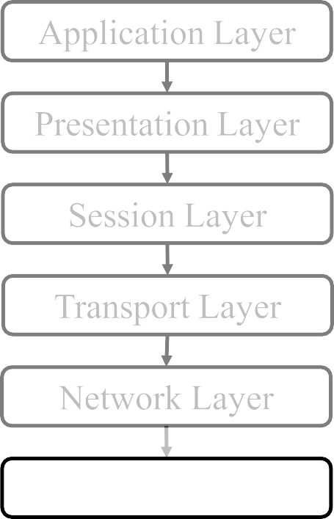
OSI reference model and its services (review)
Sender Receiver
From: Network layer
To: Network layer
Break packets into
frames
Merge frames to
form packets
To: Physical layer
From: Physical layer
Data link Layer
DSP1
DSPF1 | DSPF2 | DSPF3 | … | DSPFn

Slide 52
OSI reference model and its services (review)
It contains two sub-layers:
Logical Link Control Layer
  It identifies the address of the network layer protocol from the header
  It also provides flow control
Media Access Control Layer
  A Media access control layer is a link between the Logical Link Control layer and the network's physical layer
Data link Layer

Slide 53
OSI reference model and its services (review)
Application Layer
Purpose
– Transform a raw transmission line into a line that appears free of undetected transmission errors to the networks layer
Presentation Layer
Concerns
Session Layer
Framing: Breaks apart input data into frames
and transmit the frames sequentially
Error handling: if the service is reliable, the receiver confirms correct receipt of each frame by sending back an acknowledgement frame
Flow control: keeps a fast transmitter from drowning a slow receiver in data
Physical Addressing
Access Control (CSMA/CD, Token passing)
Transport Layer
Network Layer
Data link Layer

Slide 54
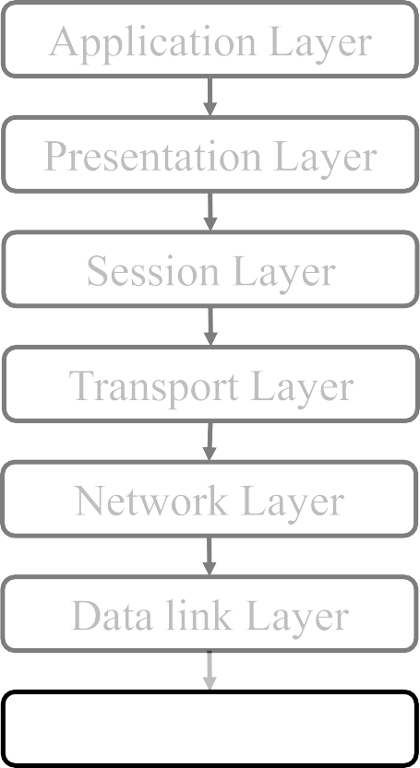
OSI reference model and its services (review)
Sender Receiver
From: DLL
To: DLL
Break frame into
bits
Merge bits to form
frame
medium
DSPF1
1 | 1 | 0 | … | 1
Physical Layer

Slide 55
OSI reference model and its services (review)
Application Layer
Purpose
  Transmits raw bits across a medium
Functional
  Flow of data (simplex, half duplex, full
duplex)
  Topology
  Encoding
Presentation Layer
Session Layer
Transport Layer
Network Layer
Data link Layer
Physical Layer

Slide 56
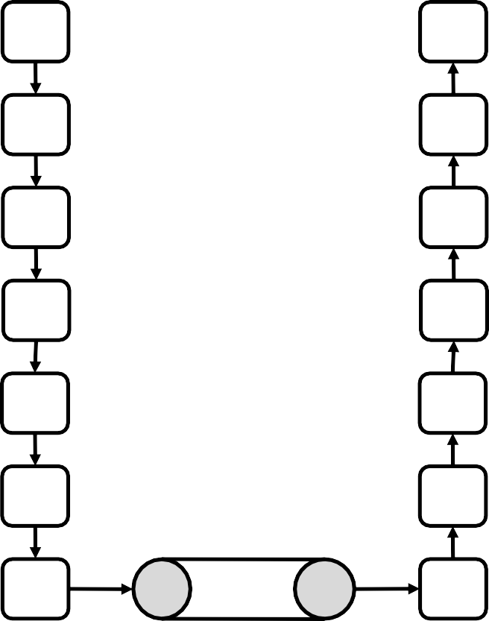
An exchange using OSI reference model
data
A A
P P
S S
T T
N N
D D
data
data
data
data
data
data
data
data
data
data
data
data
P P
data
medium
56

Slide 57
TCP/IP reference model
Application Layer
Presentation Layer
Application Layer
Application Layer
Session Layer
Transport Layer
Transport Layer
Transport Layer
Network Layer
Network Layer
Internet Layer
Data link Layer
Data link Layer
Link Layer
Physical Layer
Physical Layer

Slide 58
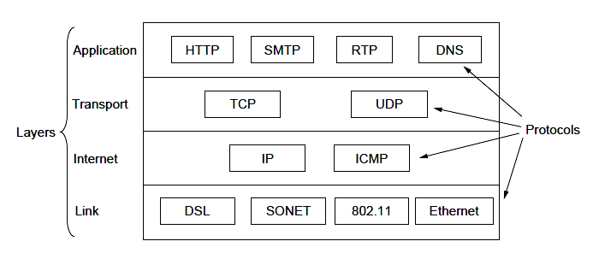
TCP/IP reference model

Slide 59
TCP/IP reference model
Concepts central to the OSI model
  Services
  Interfaces
  Protocols
OSI has good definition of service, interface, and protocol. Fits well with object oriented programming concepts.
Protocols are better hidden
TCP/IP model did not distinguish between service, interface, and protocol
With TCP/IP, the protocols came first; model was just a description of the protocols

Slide 60
Transmission Mode
Three types of data flow mode can be used
  Simplex
  Half duplex
  Full duplex

Slide 61
Transmission Mode
Simplex
  there is only unidirectional flow of data
  only one of the node on a link can transmit, the other can only receive
  this mode use the entire capacity of the channel to send data in one direction
  Eg: one way road

Slide 62
Transmission Mode
Half duplex
  there is bidirectional flow of data but at a time only one node can send
  each node can both transmit and receive, but not at the same time
  when one node is sending, the other can only receive, and vice versa
  the entire capacity of the channel can be utilized for each direction
  Eg: walkie-talkies

Slide 63
Transmission Mode
Full duplex
  there is bidirectional flow of data
  each node can both transmit as well as receive simultaneously which can be achieved by two ways
    either the link must contain two physically separate transmission paths, one for
sending and other for receiving OR
    the capacity is divided between signals travelling in both directions
  the entire capacity of the channel can be utilized for both direction
  Eg: mobile communication

Slide 64
Networking Hardware
Networking hardware includes all computers, peripherals, interface cards and other equipment needed to perform data- processing and communications within the network like
  Network Interface Card
  Switch
  Router
  Bridge etc

Slide 65
Networking Hardware
Network Interface Card
  Network interface cards, commonly referred to as NICs, are used to connect
a PC to a network
  The NIC provides a physical connection between the networking cable and
the computer's internal bus
  NICs come in three basic varieties: 8-bit, 16-bit, and 32-bit. The larger the number of bits that can be transferred to the NIC, the faster the NIC can transfer data to the network cable

Slide 66
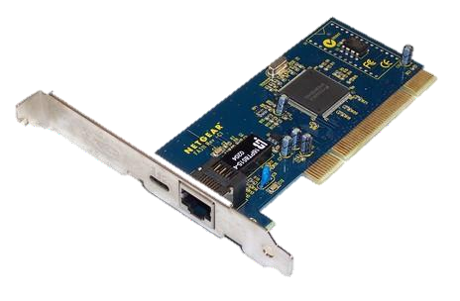
Networking Hardware
Network Interface Card

Slide 67
Networking Hardware
Hub
  A hub joins multiple computers (or other network devices) together to form
a single network
  On this network, all computers can communicate directly with each other
  The networking hub is a junction box with several ports in the back for receiving the Ethernet cables that are plugged into each computer on the LAN

Slide 68
Networking Hardware
Hub (Types)
  Passive: This type of hub does not amplify or boost the signal. It does not manipulate or view the traffic that crosses it. The passive hub does not require electrical power to work.
  Active: It amplifies the incoming signal before passing it to the other ports. It requires AC power to do the task.
  Intelligent: They are also called as smart hubs. It function as an active hub and also include diagnostic capabilities. They also provide flexible data rates to network devices. It also enables an administrator to monitor the traffic passing through the hub and to configure each port in the hub.

Slide 69
Networking Hardware
Repeater
  Since a signal loses strength as it passes along a cable, it is often necessary
to boost the signal with a device called a repeater
  A repeater is an electronic device that receives a signal, cleans the unnecessary noise, regenerates it, and retransmits it at a higher power level so that the signal can cover longer distances without degradation

Slide 70
Networking Hardware
Switch
  A network switch is a small hardware device that joins multiple computers
together within one network
  Network switches appear nearly identical to network hubs, but a switch
generally contains more intelligence than a hub
  Unlike hubs, network switches are capable of inspecting data packets as they are received, determining the source and destination device of each packet, and forwarding them appropriately
  Allow several users to send information over a network at the same time without slowing each other down

Slide 71
Networking Hardware
Router
  A device to interconnect SIMILAR networks, e.g. similar protocols and
workstations and servers
  A router is an electronic device that interconnects two or more computer
networks, and selectively interchanges packets of data between them
  Each data packet contains address information that a router can use to determine if the source and destination are on the same network, or if the data packet must be transferred from one network to another

Slide 72
Networking Hardware
Bridge
  A bridge is a device that connects a local network to another local network
  The function of a bridge is to connect separate networks together
  Bridges map the Ethernet addresses of the nodes residing on each network segment and allow only necessary traffic to pass through the bridge. When a packet is received by the bridge, the bridge determines the destination and source segments

Slide 73
Networking Hardware
Bridge (types)
  Local bridges: Directly connect local area networks (LANs)
  Remote bridges: Can be used to create a wide area network (WAN) link between LANs
  Wireless bridges: Can be used to join LANs or connect remote stations to
LANs (wirelessly)

Slide 74
Networking Hardware
Gateway
  Gateways are used to interconnect two different networks having different
protocols
  Networks using different protocols use different addressing formats
  A gateway is a network point acts as an entrance to another network
  Gateways are also called protocol converters

Slide 75
Difference
Bridge:
  device to interconnect two LANs that use the SAME logical link control
protocol but may use different medium access control protocols
Router:
  device to interconnect SIMILAR networks, e.g. similar protocols and
workstations and servers
Gateway:
  device to interconnect DISSIMILAR protocols and servers

Slide 76
Difference
Hub
Switch
Router
Physical layer
signal or bits
Non-intelligent device
LAN
Half duplex
MAC address
Data link layer
frames
Intelligent device
LAN
Half/Full duplex
MAC address
Network layer
packets
Intelligent device
LAN, WAN
Full duplex
IP address
MAN,

Slide 77
Addressing

Slide 78
Addressing
Four levels of addresses are used in an internet employing the TCP/IP protocols:
  physical address,
  logical address,
  port address, and
  application-specific address.
Each address is related to a one layer in the TCP/IP architecture

Slide 79
Addressing
Application Layer
Transport Layer Internet Layer Link Layer
Application specific
Port address Logical address
Physical address

Slide 80
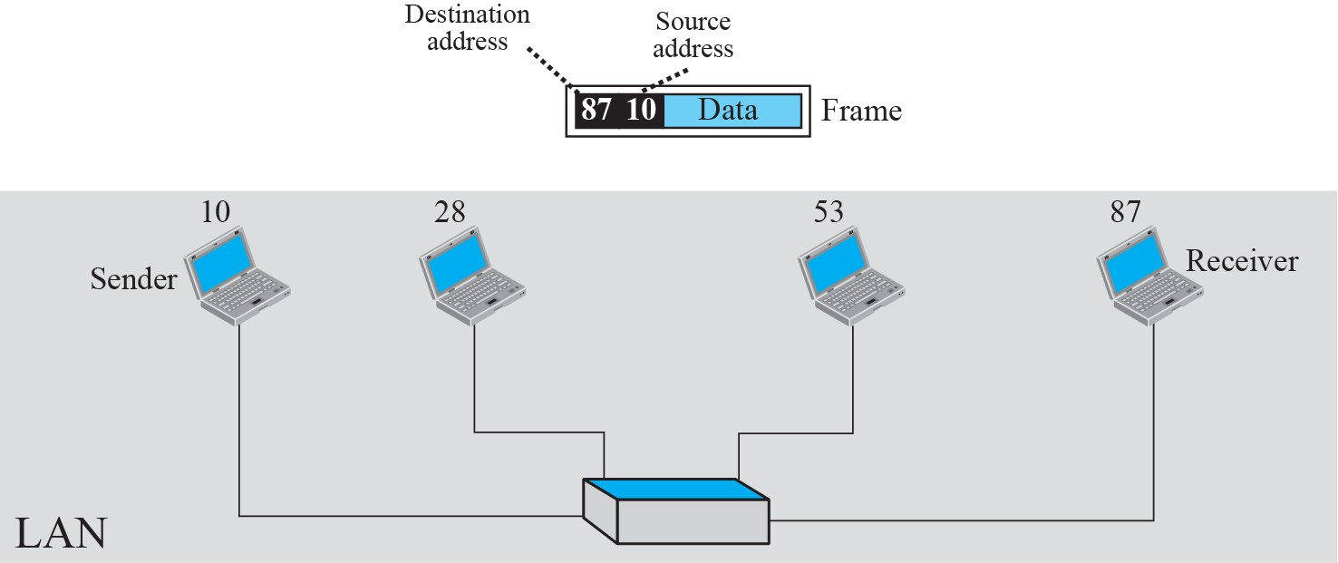
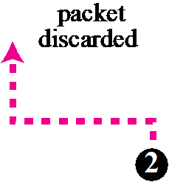
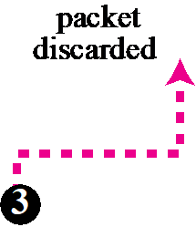


Addressing
Eg:
1
packet accepted
87 10 Data
87 10 Data
4

Slide 81
Addressing
local area networks use a 48-bit (6-byte) physical address written as 12 hexadecimal digits; every byte (2 hexadecimal digits) is separated by a colon
Eg:
07:01:02:01:2C:4B
A 6-byte (12 hexadecimal digits) physical address

Slide 82
Addressing
The physical addresses will change from hop to hop, but the logical addresses may remain the same.

Slide 83
Addressing
A port address is a 16-bit integer address represented by one decimal number
This number is assigned automatically by the OS, manually by the user or is set as a default for some popular applications.
Eg:
753, 443, 8080, etc
A 16-bit port address represented as one single decimal number

Slide 84
Addressing
Notable well-known port numbers
• | 20 | File Transfer Protocol (FTP) Data Transfer
• | 21 | File Transfer Protocol (FTP) Command Control
• | 22 | Secure Shell (SSH) Secure Login
• | 25 | Simple Mail Transfer Protocol (SMTP) E-mail routing
• | 53 | Domain Name System (DNS) service
• | 67, 68 | Dynamic Host Configuration Protocol (DHCP)
• | 80 | Hypertext Transfer Protocol (HTTP)
• | 110 | Post Office Protocol (POP3)
• | 161 | Simple Network Management Protocol (SNMP)
• | 443 | HTTP Secure (HTTPS) HTTP over TLS/SSL

Slide 85
Analog and Digital data
Data can be analog or digital
Analog data is continuous and takes continuous values
Digital data have discrete states and takes discrete values

Slide 86
Data and Signals

Slide 87
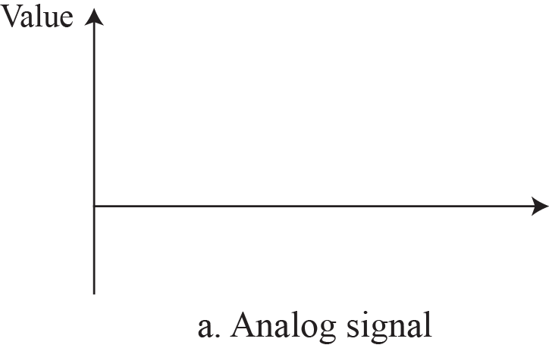
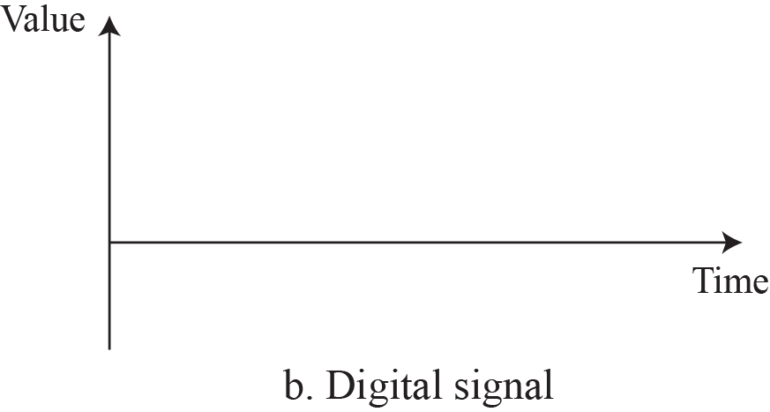

Analog and Digital signal
Signals can be analog or digital
Analog signals can have an infinite number of values in a range
Digital signals can have only a limited number of values

Slide 88
Difference
Analog
Analog signals are difficult to get
analyzed at first
Analog signals are more accurate
Analog signals take time to be
stored
Analog signals produce too much noise
Eg: Human voice, Thermometer,
Analog phones etc
Digital
Digital signals are easy to
analyze
Digital signals are less accurate
Digital signals can be easily
stored
Digital signals do not produce noise
Eg: Computers, Digital Phones,
Digital pens, etc

Slide 89
Periodic and Non-periodic
A periodic signal completes a pattern within a measurable time frame, called a period, and repeats that pattern. The completion of one full pattern is called a cycle.
A non periodic signal changes without exhibiting a pattern or cycle that repeats over time

Slide 90

Periodic and Non-periodic
Period refer to amount of time in second a signal need to complete 1 cycle
Frequency refer to number of period in 1 s
They are the inverse of each other

Slide 91

Periodic and Non-periodic
Value
• • •
Time
The sine wave is the most fundamental form of a periodic analog signal

Slide 92
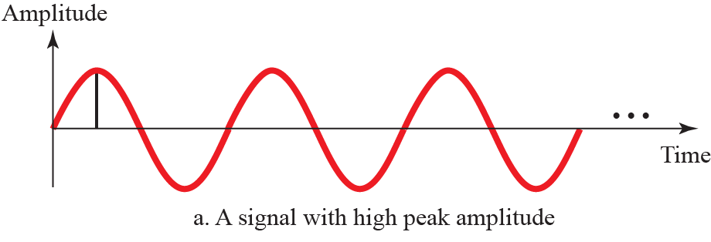
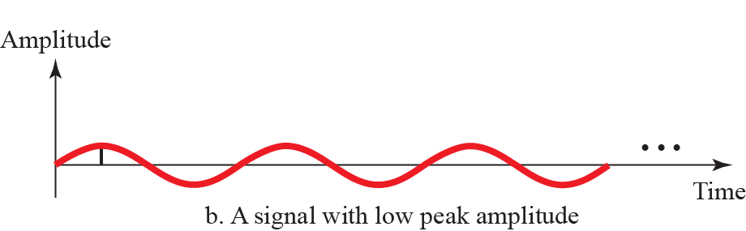
Periodic and Non-periodic
Peak amplitude

Slide 93
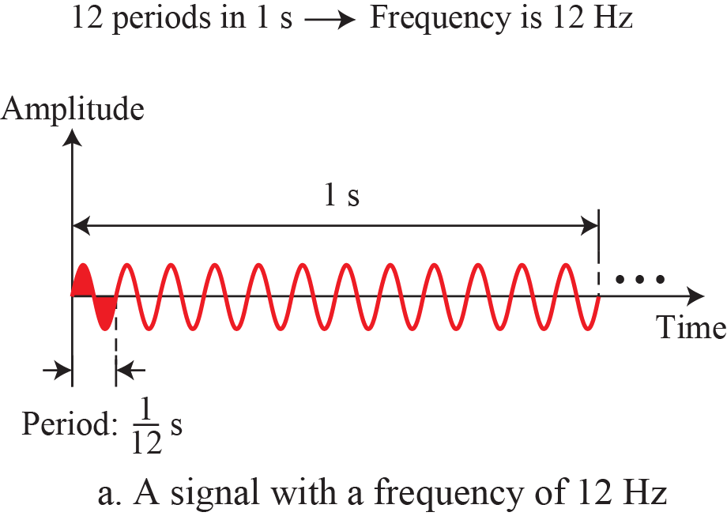
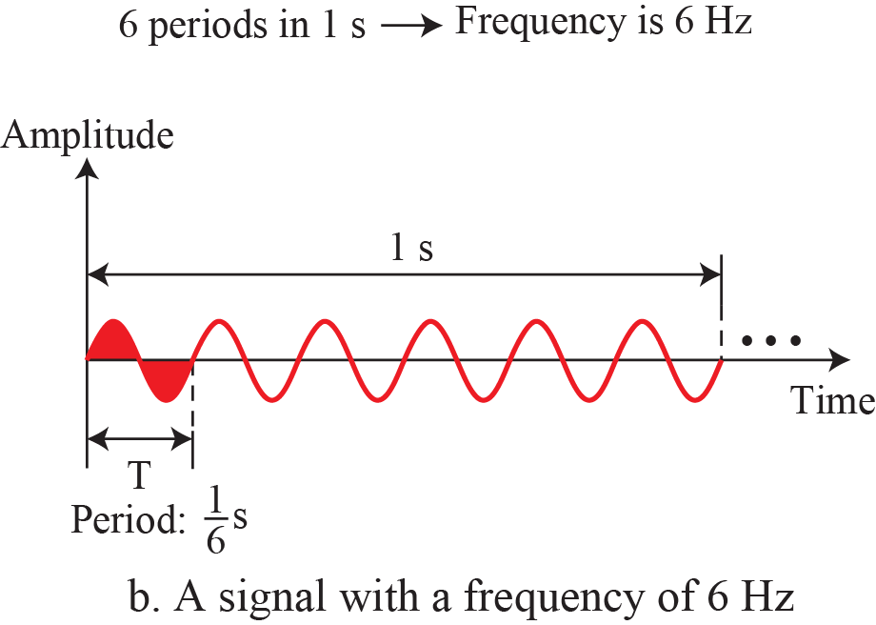
Signal

Slide 94
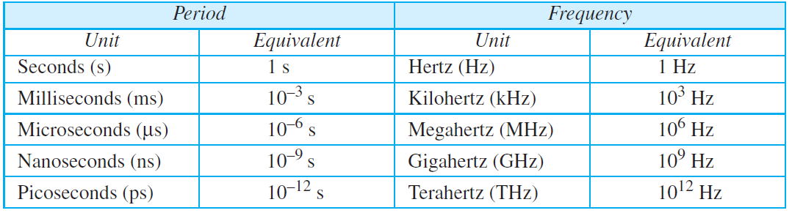
Units of period and frequency

Slide 95
Eg
Express a period of 100 ms in microseconds.

Slide 96
Solution
The equivalents of 1ms (1 ms is 10^{–3} s) and 1s (1s is 10⁶ μs) By substituting:
100 ms
= 100 * 10⁻³ s
= 100 * 10⁻³ * 10⁶ μs
= 10⁵ μs

Slide 97
The power we use at home has a frequency of 60 Hz. What is the period of that wave?
Eg
Solution
T = 1/f
= 1/60 s
= 0.0166 s
= 0.0166 * 10³ ms
= 16.6 ms

Slide 98
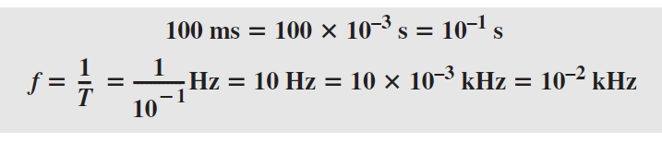
The period of a signal is 100 ms. What is its frequency in kilohertz?.
Eg
Solution
First we change 100 ms to seconds, and then we calculate the frequency from the period (1 Hz = 10^{–3} kHz).

Slide 99
Frequency
Frequency is the rate of change with respect to time
Change in a short span of time means high frequency
Change over a long span of time means low frequency
  If a signal does not change at all, its frequency is zero
  If a signal changes instantaneously, its frequency is infinite

Slide 100
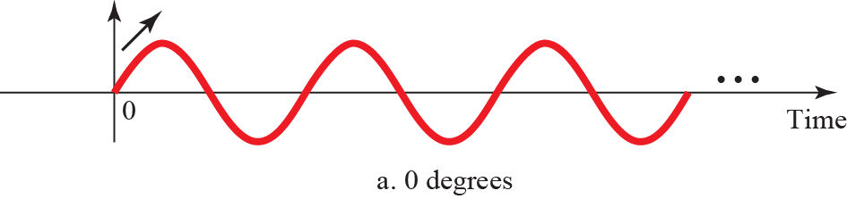
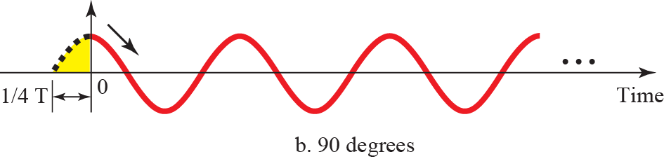
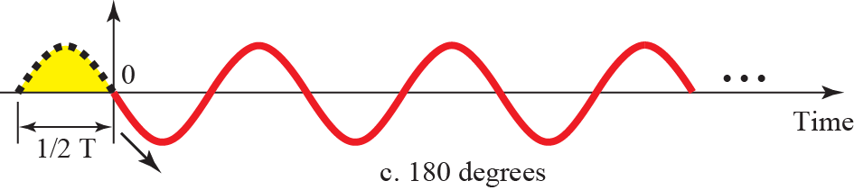
Phase
The term PHASE, or PHASE SHIFT, describes the position of the waveform relative to time 0
A complete cycle is defined as 360 degrees of phase
Phase difference , also called phase angle , in degrees is conventionally
defined as a number greater than -180, and less than or equal to +180
Leading phase refers to a wave that occurs "ahead" of another wave of the same frequency. Lagging phase refers to a wave that occurs "behind" another wave of the same frequency.

Slide 101
Phase
Eg:
– A sine wave is offset 1/6 cycle with respect to time 0. What is its phase in
degrees and radians?
Solution
We know that 1 complete cycle is 360°. Therefore, 1/6 cycle is
1/6 * 360
= 60°
= 60 * 2Π/360 rad
= Π/3 rad

Slide 102
Application of Simple Signals
Simple sine waves have many applications in daily life
We can send a single sine wave to carry electric energy from one
place to another
  Eg: electric power
  an alarm to a security center

Slide 103
Signals and Communication
A single-frequency sine wave is not useful in data communications
We need to send a composite signal, a signal made of many simple
sine waves
According to Fourier analysis, any composite signal is a combination of simple sine waves with different frequencies, amplitudes, and phases

Slide 104
Composite Signals and Periodicity
If the composite signal is periodic, the decomposition gives a series of signals with discrete frequencies
If the composite signal is non-periodic, the decomposition gives a combination of sine waves with continuous frequencies

Slide 105
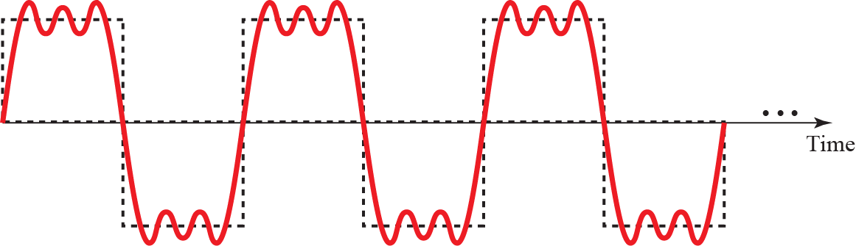
Composite Period Signal
A Composite Signal is collection of multiple single simple signals

Slide 106

Decomposition of a composite periodic signal
Amplitude
• • •
Time
Amplitude
f
3f 9f
b. Frequency-domain decomposition of the composite signal
Frequency

Slide 107
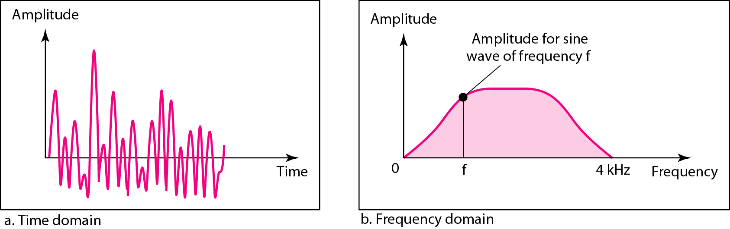
Decomposition of a composite non-periodic signal

Slide 108
Bandwidth
The range of frequencies contained in a composite signal is its bandwidth
The bandwidth is normally a difference between two numbers
Eg:
– if a composite signal contains frequencies between 1000 and 5000, its bandwidth is 5000 − 1000, or 4000

Slide 109
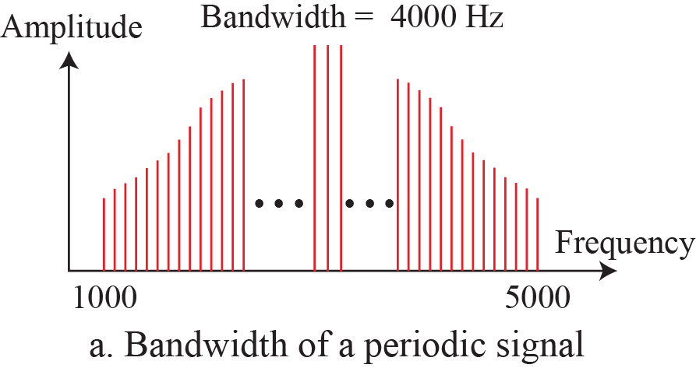
Bandwidth

Slide 110
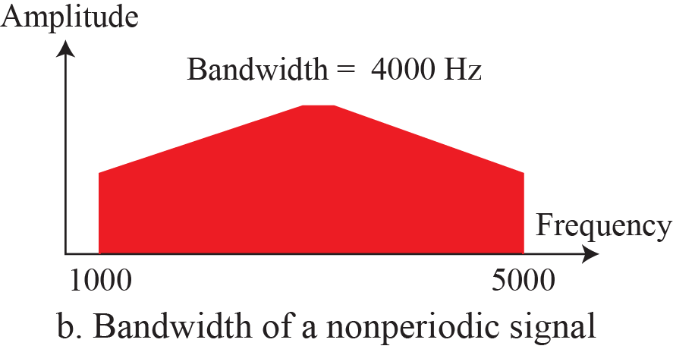
Bandwidth

Slide 111
Bandwidth
Eg:
– If a periodic signal is decomposed into five sine waves with frequencies of
100, 300, 500, 700, and 900 Hz, what is its bandwidth?
Solution
Let f_{h} be the highest frequency, f_{l} the lowest frequency, and BW
the bandwidth. Then,
BW = f_{h} – f_{l}
= 900 – 100
= 800 Hz

Slide 112
Bandwidth
Eg:
– A periodic signal has a bandwidth of 20 Hz. The highest frequency is 60 Hz.
What is the lowest frequency?
Solution
Let f_{h} be the highest frequency, f_{l} the lowest frequency, and B the
bandwidth. Then,
B = f_{h} – f_{l}
20 = 60 – f_{l}
f_{l} = 40 Hz

Slide 113
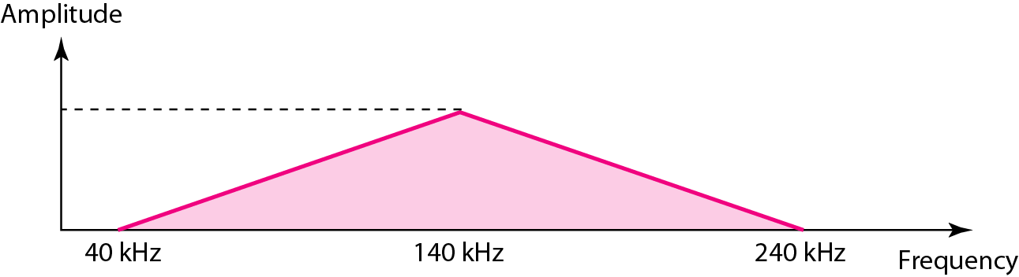
Bandwidth
Eg:
– A non-periodic composite signal has a bandwidth of 200 kHz, with a middle frequency of 140 kHz and peak amplitude of 20 V. The two extreme frequencies have an amplitude of 0. Draw the frequency domain of the signal
Solution
The lowest frequency must be at 40 kHz and the highest at 240 kHz

Slide 114
Fourier Analysis
Fourier analysis is a tool that changes a time domain signal to a frequency domain signal and vice versa
Time domain ↔ frequency domain

Slide 115
Digital Signals
In addition to being represented by an analog signal, information can also be represented by a digital signal
Eg:
– 1 can be encoded as a positive voltage and a 0 as zero voltage
A digital signal can have more than two levels

Slide 116
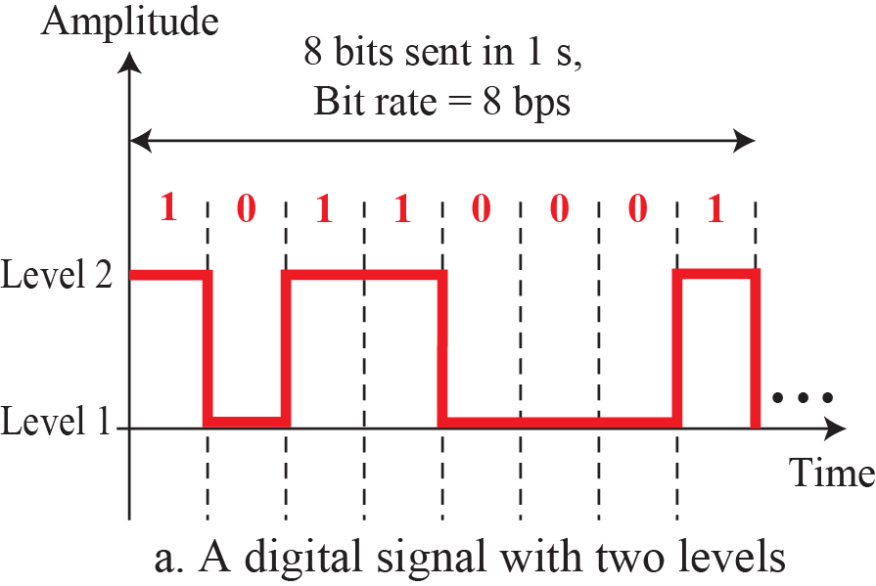
Digital Signal

Slide 117
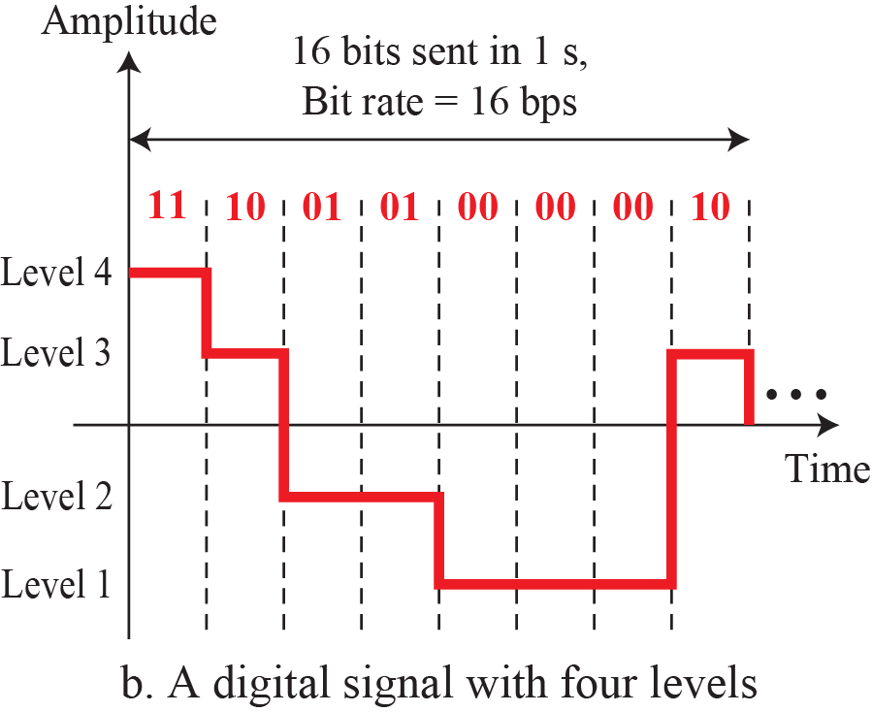
Digital Signal

Slide 118
Digital Signal
Eg:
– A digital signal has eight levels. How many bits are needed per level?
Solution
number of levels = 2^{n}
8 = 2^{n}
log₂8 = log₂2^{n} log₂8 = n log₂2 n = 3

Slide 119
Digital Signal
Eg:
– A digital signal has nine levels. How many bits are needed per level?

Slide 120
Bit Rate
The term Bit Rate is used to describe digital signals
The bit rate is the number of bits sent in 1s, expressed in bits per
second (bps).

Slide 121
Transmission Impairment
Signals travel through transmission media, which are not perfect, the imperfection causes signal impairment (damage/loss/weak)
This means that the signal at the beginning of the medium is not the same as the signal at the end of the medium. What is sent is not what is received
Three causes of impairment are attenuation, distortion, and noise
Impairment causes
Attenuation
Distortion
Noise

Slide 122
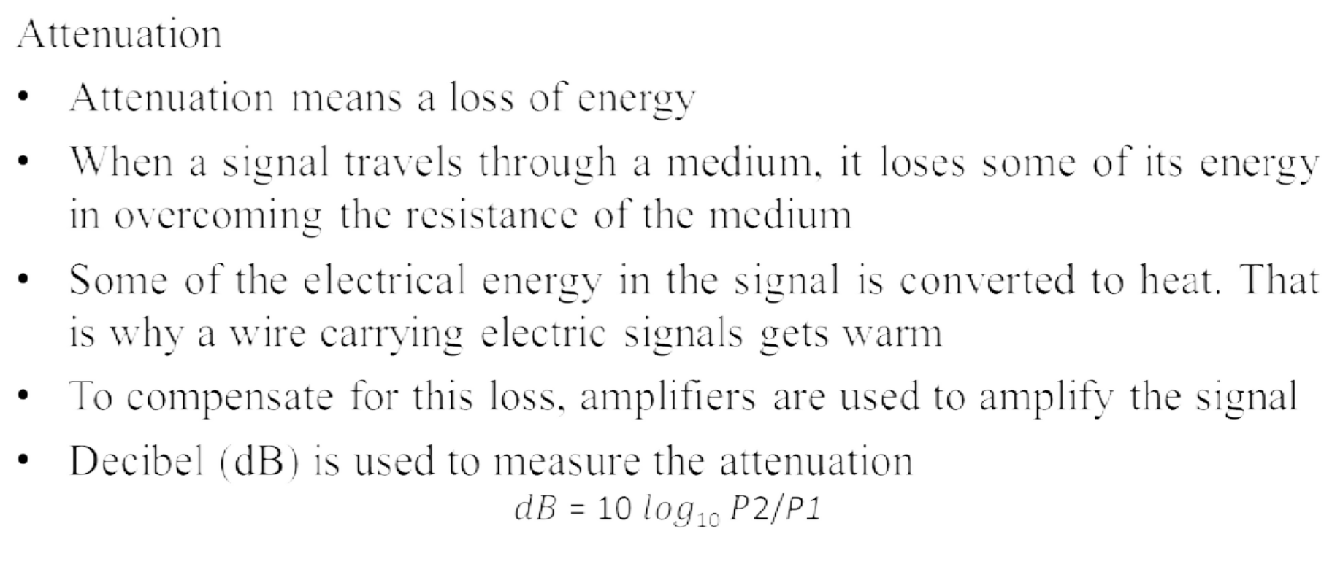
Impairment

Slide 123
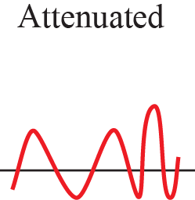
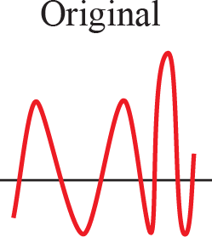
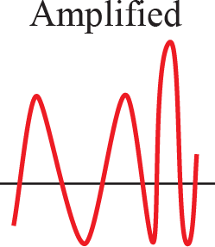
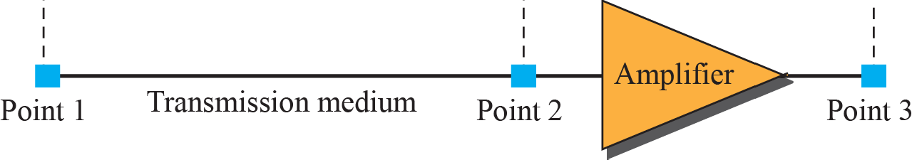
Impairment
Attenuation and Amplification

Slide 124
Impairment
Attenuation and Amplification
Eg:
– Suppose a signal travels through a transmission medium and its power is reduced to one half. This means that P₂ = 0.5 P₁. In this case, the attenuation (loss of power) can be calculated as
Solution
10 log₁₀ P₂/P₁
= 10 log₁₀ (0.5 P₁/P₁)
= 10 log₁₀ (0.5)
= 10 (-0.3)
= -3 dB

Slide 125
Impairment
Attenuation and Amplification
Eg:
– A signal travels through an amplifier, and its power is increased 10 times. This means that P₂ = 10P₁. In this case, the amplification (gain of power) can be calculated as
Solution
10 log₁₀ P₂/P₁
= 10 log₁₀ (10 P₁/P₁)
= 10 log₁₀ (10)
= 10 (1)
= 10 dB

Slide 126
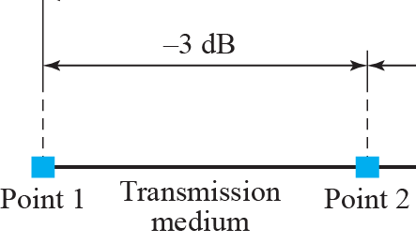
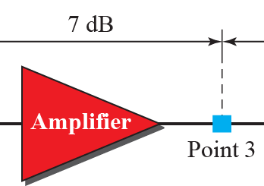
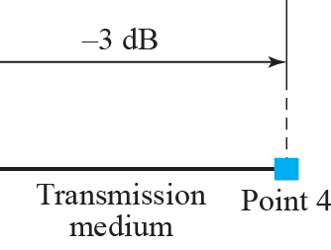
Impairment
Attenuation and Amplification
Eg:
– How much total gain/loss in signal from point 1 to point 4
Solution

Slide 127
Impairment
Attenuation and Amplification
Eg:
– Sometimes the decibel is used to measure signal power in milliwatts. In this case, it is referred to as dB_{m} and is calculated as dB_{m} = 10 log10 P_{m}, where P_{m} is the power in milliwatts. Calculate the power of a signal if its dB_{m} =
−30
Solution
10 log₁₀ P_{m} = dB_{m} 10 log₁₀ P_{m} = -30 log₁₀ P_{m} = -3
P_{m} = 10⁻³ mW

Slide 128
Impairment
Attenuation and Amplification
Eg:
– The loss in a cable is usually defined in decibels per kilometer (dB/km). If the signal at the beginning of a cable with −0.3 dB/km has a power of 2 mW, what is the power of the signal at 5 km?
Solution
Loss in the cable is (-0.3) * 5 = -1.5 dB Now, the power can be calculated as 10 log₁₀ P₂/P₁ = -1.5
log₁₀ P₂/P₁ = -0.15
P₂/P₁ = 10^{-0.15} = 0.7
P₂ = 0.7P₁
P₂ = 0.7*2 = 1.4 mW

Slide 129
Impairment
Distortion
Distortion means that the signal changes its form or shape
Distortion can occur in a composite signal made of different frequencies
Each signal component has its own propagation speed through a medium and, therefore, its own delay in arriving at the final destination
Differences in delay may create a difference in phase if the delay is not exactly the same as the period duration

Slide 130
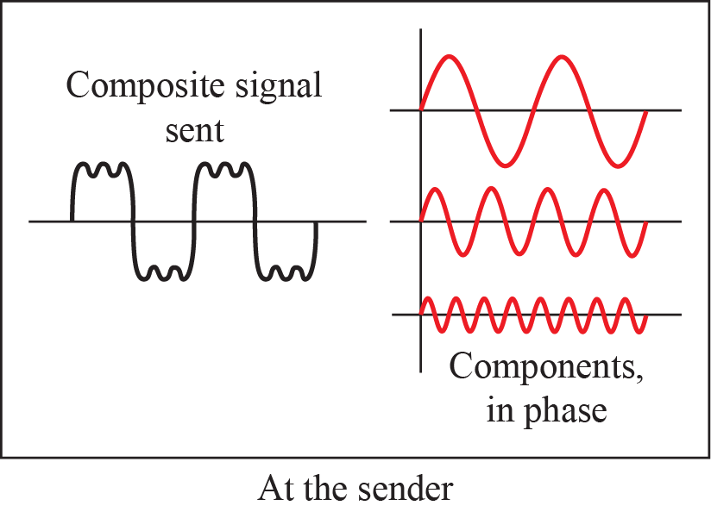
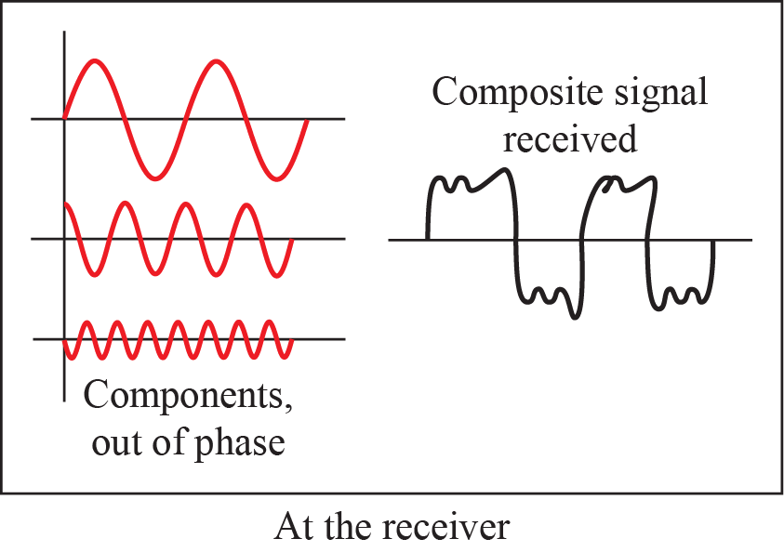
Impairment
Distortion

Slide 131
Impairment
Noise
Noise is another cause of impairment
Several types of noise, such as thermal noise, induced noise, crosstalk, etc may corrupt the signal
  Thermal noise is the random motion of electrons in a wire, which creates an extra signal not originally sent by the transmitter
  Induced noise comes from sources such as motors
  Crosstalk is the effect of one wire on the other
Noise is measured in terms of SNR ( Signal to Noise Ratio)

Slide 132
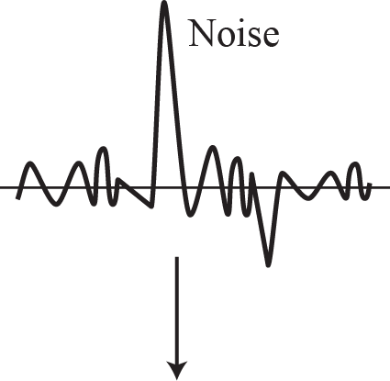
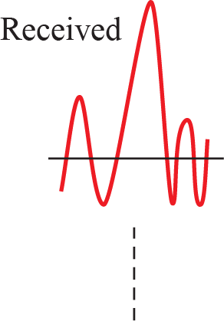
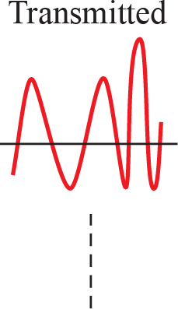
Impairment
Noise

Slide 133
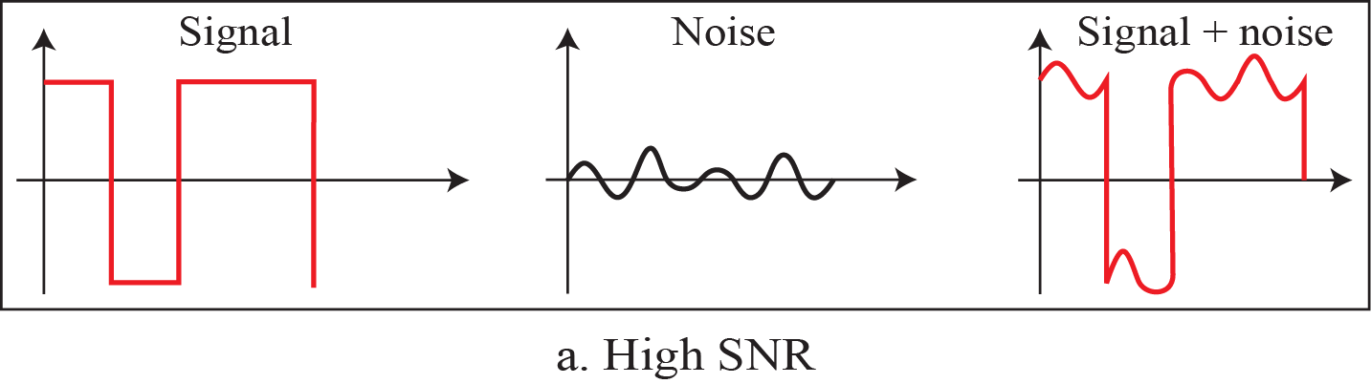

Two cases of SNR: a high SNR and a low SNR

Slide 134

How to Calculate SNR

Slide 135
SNR
Eg:
– The power of a signal is 10 mW and the power of the noise is 1 μW. What
are the values of SNR and SNR_{dB}?
Solution
The values of SNR and SNR_{dB} can be calculated as follows:
SNR = 10 * 10⁻³/10⁻⁶
= 10 * 10³
= 10000 dB SNR_{dB} = 10 log₁₀10000
= 10 log₁₀10⁴
= 40 dB

Slide 136
SNR
The values of SNR and SNR_{dB} for a noiseless channel are Solution
SNR = (signal power)/0
= ∞
SNR_{dB} = 10 log₁₀ ∞
= ∞
We can never achieve this ratio in real life; it is an ideal

Slide 137

Noiseless Channel: Nyquist Rate

Slide 138
Nyquist Rate
Eg:
– Consider a noiseless channel with a bandwidth of 3000 Hz transmitting a
signal with two signal levels. The maximum bit rate can be calculated as
Solution
Bit rate = 2 * 3000 * log₂2
= 6000 bps

Slide 139
Nyquist Rate
Eg:
– Consider the same noiseless channel transmitting a signal with 2 bits for
each level. The maximum bit rate can be calculated as
Solution
Bit rate = 2 * 3000 * log₂4
= 12000 bps

Slide 140

Noisy Channel: Shannon Capacity

Slide 141
Noisy Channel: Shannon Capacity
Eg:
– Consider an extremely noisy channel in which the value of the signal-to-
noise ratio is almost zero. For this channel the capacity C is calculated as
Solution
C = BW * log₂(1 + SNR)
= BW * log₂(1+0)
= BW * 0
= 0
This means that the capacity of this channel is zero regardless of the bandwidth. In other words, we cannot receive any data through this channel

Slide 142
Noisy Channel: Shannon Capacity
Eg:
– Assume that SNR_{dB} = 36 and the channel bandwidth is 2 MHz. The
theoretical channel capacity can be calculated as
Solution
SNR = 10 log SNR
dB 10
36 = 10 log₁₀SNR
SNR = 10^{3.6}
SNR = 3981
C = BW * log₂(1+SNR)
= 2 * 10⁶ * log₂3982
= 2 * 10⁶ * 11.95
= 24 Mbps

Slide 143
Noisy Channel: Shannon Capacity
Eg:
  We have a channel with a 1-MHz bandwidth. The SNR for this channel is
63. What are the appropriate bit rate and signal level?
Solution
  First, we use the Shannon formula to find the upper limit
  Then we use the Nyquist formula to find the number of signal levels
C = BW * log₂(1+SNR)
= 10⁶ * log₂64
= 6 Mbps
Bit rate = 2 * BW * log₂L
6 = 2 * 1 * log L
2
L = 2³ = 8

Slide 144

Latency or Delay

Slide 145
Types of delay
Propagation speed
  speed at which a bit travels though the medium from source to destination
Transmission speed
  the speed at which all the bits in a message arrive at the destination
(difference in arrival time of first and last bit)

Slide 146
Types of delay
Queuing delay
  is the time spent by the packet in a queue, waiting to be transmitted onto the
link
Processing delay
  time taken by the routers to process the packet header

Slide 147
Bandwidth
One characteristic that measures network performance is bandwidth
However, the term can be used in two different contexts with two different measuring values
  bandwidth in hertz
  bandwidth in bits per second

Slide 148
Bandwidth
The first, bandwidth in hertz, refers to the range of frequencies in a composite signal or the range of frequencies that a channel can pass
The second, bandwidth in bits per second, refers to the speed of bit transmission in a channel or link, often referred to as Capacity

Slide 149
Throughput
The throughput is a measure of how fast we can actually send data through a network
OR
How much data can be transferred from source to destination in a given time frame
A link may have a bandwidth of BW bps, but we can only send T bps through this link with T always less than B (T < B)

Slide 150



Bandwidth-Delay
Bandwidth and delay are two performance metrics of a link

Slide 151

Bandwidth-Delay
Sender
Receiver
1st bit
2nd bit | 1st bit
3rd bit | 2nd bit | 1st bit
4th bit | 3rd bit | 2nd bit | 1st bit
5th bit | 4th bit | 3rd bit | 2nd bit | 1st bit
After 1 s
After 2 s
After 3 s
After 4 s
After 5 s

Slide 152

Bandwidth-Delay
Sender
Receiver
After 1 s
After 2 s
After 3 s
After 4 s
After 5 s

Slide 153
Delay
Eg:
– A network with bandwidth of 10 Mbps can pass only an average of 12,000 frames per minute with each frame carrying an average of 10,000 bits. What is the throughput of this network?
Solution
We can calculate the throughput as
Throughput = (12000 * 10000)/60
= 2 * 10⁶
= 2 Mbps
151

Slide 154
Delay
Eg:
– What is the propagation time if the distance between the two points is
12,000 km? Assume the propagation speed to be 2.4 × 10⁸ m/s in cable
Solution
We can calculate the propagation time as
Propagation Time = (12000 * 1000)/(2.4 * 10⁸)
= 0.05 s
= 50 ms

Slide 155
Delay
Eg:
– What are the propagation time and the transmission time for a 2.5 KB message if the bandwidth of the network is 1 Gbps? Assume that the distance between the sender and the receiver is 12,000 km and that light travels at 2.4 × 10⁸ m/s
Solution
Propagation Time = (12000 * 1000)/(2.4 * 10⁸)
= 0.05 s
= 50 ms
Transmission Time = (2.5 * 10³ * 8)/(10⁹)
= 20000/10⁹
= 0.00002 s = 0.02 ms

Slide 156
Delay
Eg:
– What are the propagation time and the transmission time for a 5 MB message if the bandwidth of the network is 1 Mbps? Assume that the distance between the sender and the receiver is 12,000 km and that light travels at 2.4 × 10⁸ m/s
Solution
Propagation Time = (12000 * 1000)/(2.4 * 10⁸)
= 50 ms
Transmission Time = (5 * 10⁶ * 8)/(10⁶)
= 40 s

