Slide 1
Discrete Mathematics
BCSC0010
Module 1
Permutations

Slide 2
Example
In how many ways can we select three students from a group of five students to stand in line for a picture?
Solution
5 ways are there to select the first student
4 ways are there to select the second student
3 ways are there to select the third student
By the product rule,
There are 5 . 4 . 3 = 60 ways to select three students from a group of five students to stand in line for a picture.

Slide 3
Example
In how many ways can we arrange all five of these students in a line for a picture?
To arrange all five students in a line for a picture, we select
the first student in five ways,
the second in four ways,
the third in three ways,
the fourth in two ways,
and the fifth in one way.
Consequently, there are 5 . 4 . 3 . 2 . 1 = 120 ways to arrange all five students in a line for a picture.

Slide 4
Permutation
Any arrangement of a set of n objects in a given order is called a permutation (taken all at a time).
Any arrangement of any r ≤ n of these objects in a given order is called an “r-permutation” or “a permutation of the n objects taken r at a time.”

Slide 5
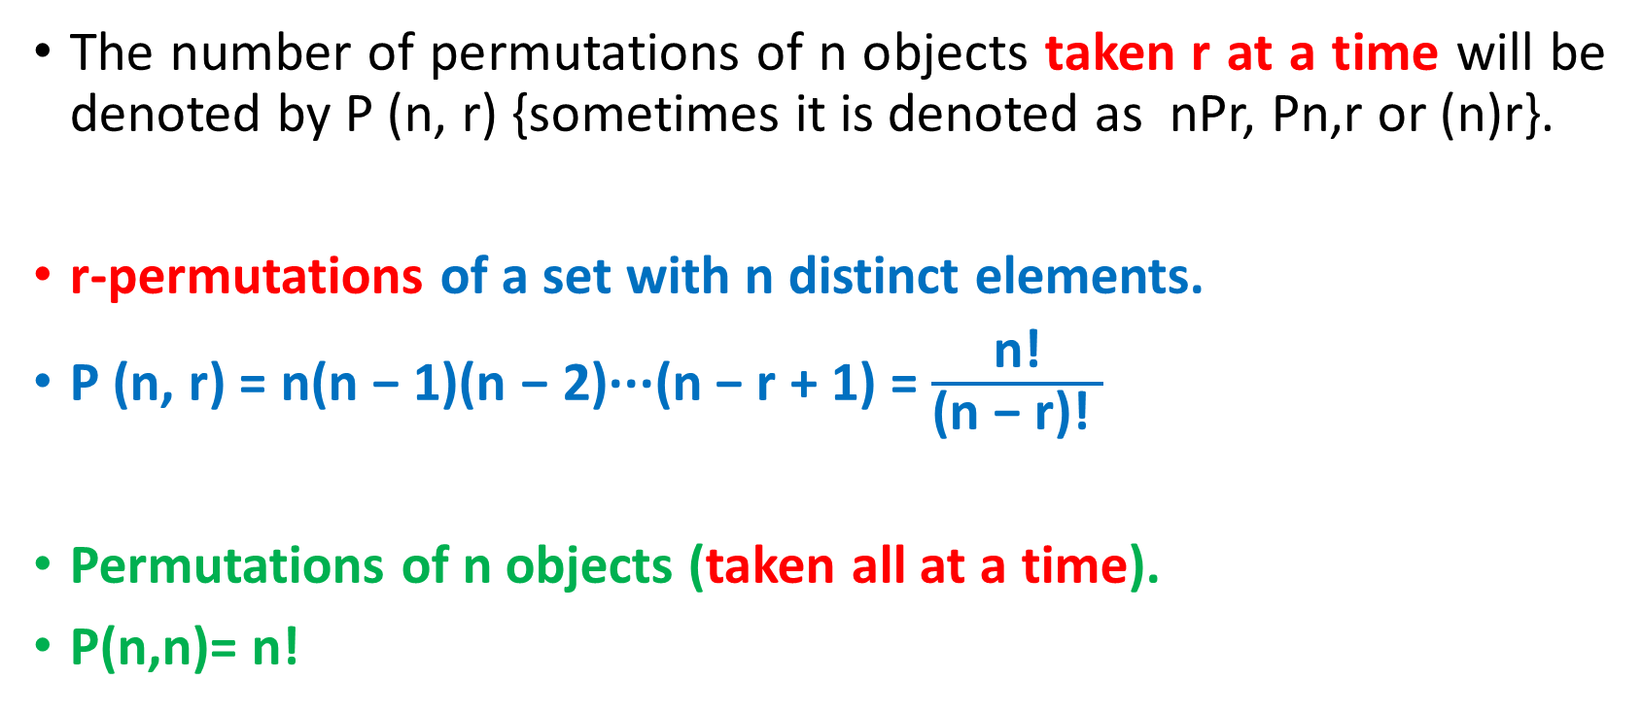
Permutation
The number of permutations of n objects taken r at a time will be denoted by P (n, r) {sometimes it is denoted as nPr, Pn,r or (n)r}.
r-permutations of a set with n distinct elements.
P (n, r) = n(n − 1)(n − 2)···(n − r + 1) = $\frac{\text{n}\text{!}}{\text{(}\text{n}\text{ − }\text{r}\text{)!} }$
Permutations of n objects (taken all at a time).
P(n,n)= n!

Slide 6
Example
Let S = {a, b, c}.
The 2-permutations of S are the ordered arrangements of 2 elements
a, b ; a, c ; b, a ; b, c ; c, a and c, b.
Consequently, there are six 2-permutations of this set with three elements.
By the product rule, it follows that P(3, 2) = 3 . 2 = 6.

Slide 7
EXAMPLE
Find the number of “three-letter words” using only the given six letters A, B, C, D, E, F, without repetition.
Solution
The ﬁrst letter can be chosen in 6 ways;
following this, the second letter can be chosen in 5 ways;
and, ﬁnally, the third letter can be chosen in 4 ways.
P(6,3) =6·5·4=120
There are 120 permutations of 6 objects taken 3 at a time.

Slide 8
Example
There are n! permutations of n objects (taken all at a time).
P(n,n)= n!
For example,
Permutations of the three letters A, B, C.
These are: ABC, ACB, BAC, BCA, CAB, CBA.
P(3,3)= 3!=6

Slide 9
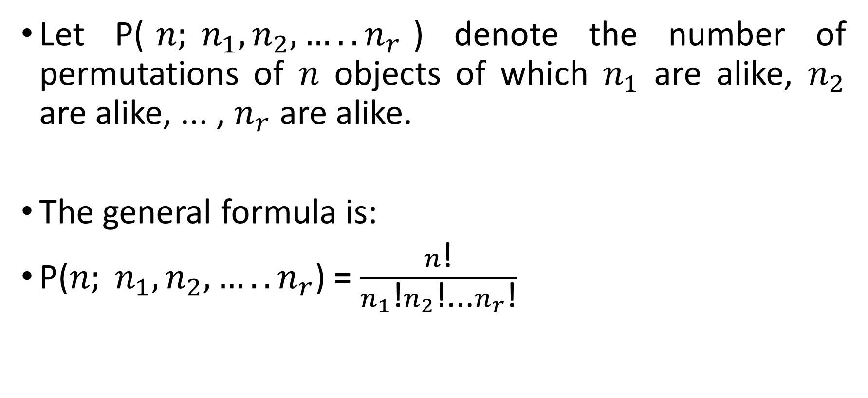
Permutations with Repetitions
Let P($n; n_{1},n_{2},{…..n}_{r}$) denote the number of permutations of $n$ objects of which $n_{1}$ are alike, $n_{2}$ are alike, ... , $n_{r}$ are alike.
The general formula is:
P($n; n_{1},n_{2},{…..n}_{r}$) = $\frac{n\text{!}}{n_{1}\text{!}n_{2}\text{!...}n_{r}\text{!}}$

Slide 10
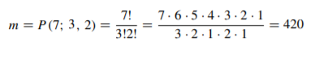
EXAMPLE
Find the number m of seven-letter words that can be formed using the letters of the word “BENZENE.”
We seek the number of permutations of 7 objects of which 3 are alike (the three E’s), and 2 are alike (the two N’s).

Slide 11
Ordered Samples
When we choose one element after another, say, r times, we call the choice an ordered sample of size r.
Example
To choose 3 cards one after the other from a 52-card deck (choice is ordered sample of size 3)
Two cases:
(1) Sampling with replacement
(2) Sampling without replacement

Slide 12
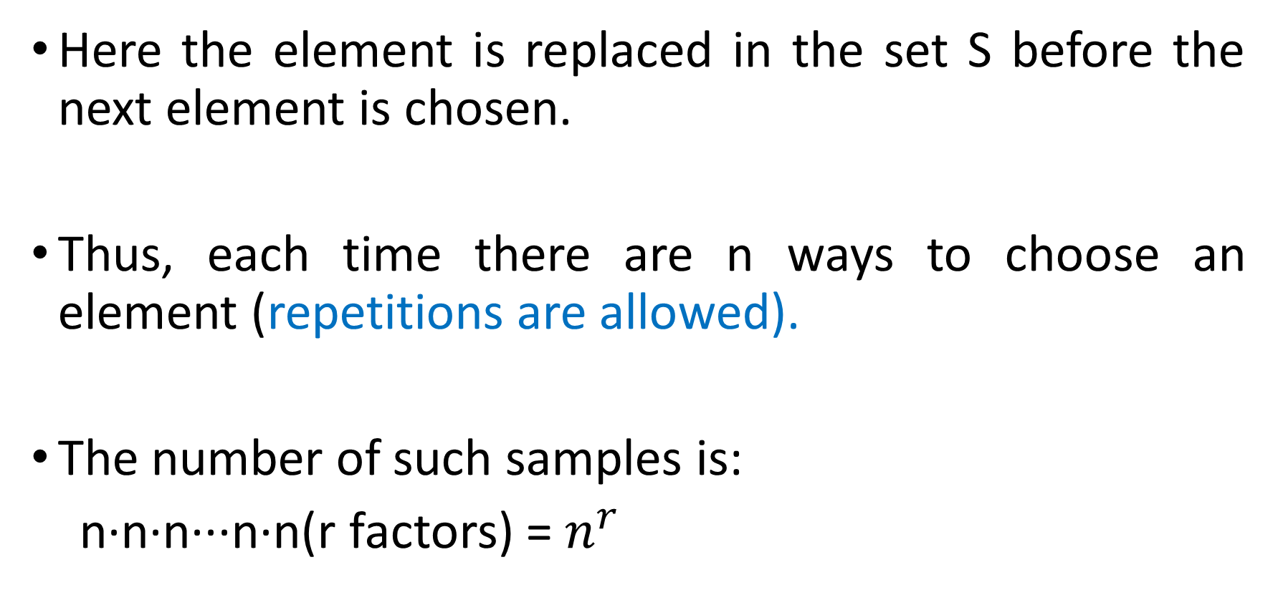
(1) Sampling with replacement
Here the element is replaced in the set S before the next element is chosen.
Thus, each time there are n ways to choose an element (repetitions are allowed).
The number of such samples is:
n·n·n···n·n(r factors) = $n^{r}$

Slide 13
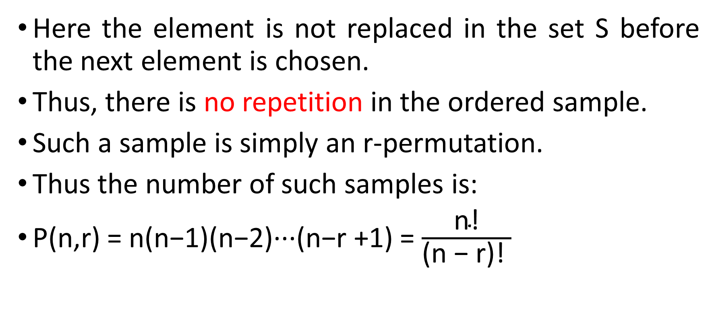
(2) Sampling without replacement
Here the element is not replaced in the set S before the next element is chosen.
Thus, there is no repetition in the ordered sample.
Such a sample is simply an r-permutation.
Thus the number of such samples is:
P(n,r) = n(n−1)(n−2)···(n−r +1) = $\frac{\text{n}\text{!}}{\text{(}\text{n}\text{ − }\text{r}\text{)!} }$

Slide 14
EXAMPLE
Three cards are chosen one after the other from a 52-card
deck. Find the number m of ways this can be done:
(a) with replacement;
(b) without replacement.
Solution
(a) Each card can be chosen in 52 ways. Thus m =52(52)(52) =140608.
(b) Here there is no replacement. Thus the ﬁrst card can be chosen in 52 ways, the second in 51 ways, and the third in 50 ways. Therefore:
m = P(52,3) =52(51)(50) =132600

Slide 15
Example
How many ways are there to select a first-prize winner, a second-prize winner, and a third-prize winner from 100 different people who have entered a contest?
P(100, 3) = 100·99·98 = 970,200.

Slide 16
Example
How many permutations of the letters ABCDEFGH contain the string ABC?
Solution:
Because the letters ABC must occur as a block,
we can find the answer by finding the number of permutations of six objects, namely, the block ABC and the individual letters D, E, F, G, and H.
Because these six objects can occur in any order, there are 6! = 720 permutations of the letters ABCDEFGH in which ABC occurs as a block.

Slide 17
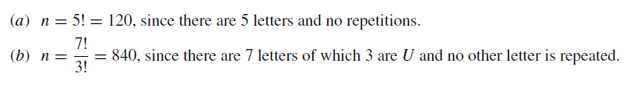
Example :
Find the number n of distinct permutations that can be formed from all the letters of each word:
(a) THOSE; (b) UNUSUAL; (c) SOCIOLOGICAL.

Slide 18
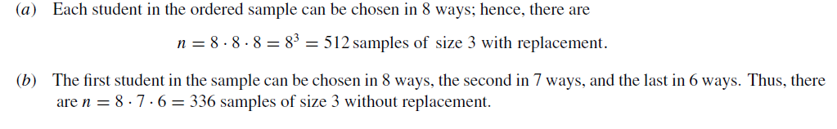
Examples
A class contains 8 students. Find the number n of samples of size 3:
(a)With replacement; (b)Without replacement.

Slide 19
Next Topic
Combinations

