Slide 1
Collections
BY k.a. Madhushika

Slide 2
What is Collection ?
2
A Collection is a class used to represent a set of similar data type items as a single unit.
Collections class is a member of the Java Collections Framework.
It can achieve all the operations that you perform on a data such as searching, sorting, insertion, manipulation, and deletion.

Slide 3
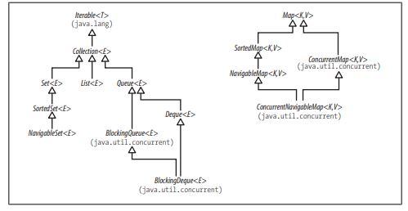
The main interfaces of the Java Collections Framework

Slide 4
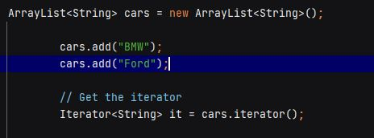

Iterable and Iterators
An Iterator is an object that can be used to loop through collections

Slide 5
Efficiency and the O-Notation
A good algorithm is economical in its use of two resources: time and space. Implementations of collections usually use space proportional to the size of the collection, but they can vary greatly in the time required for access and update, so that will be our primary concern.
The O-notation is a way of describing the performance of an algorithm in an abstract way, without the detail required to predict the precise performance of a particular program running on a particular machine.

Slide 6
Collections and Thread Safety
A thread is like a lightweight process, so a program simultaneously executing several threads can be thought of as a computer running several programs simultaneously, but with one important difference: different threads can simultaneously access the same memory locations and other system resources.
Multithread Programming :
1. the case of multicore and multiprocessor machines, is to share the work and get it done quicker .
2. two operations may take varying, perhaps unknown, amounts of time, and you do not want the response to one operation to await the completion of the other.

Slide 7
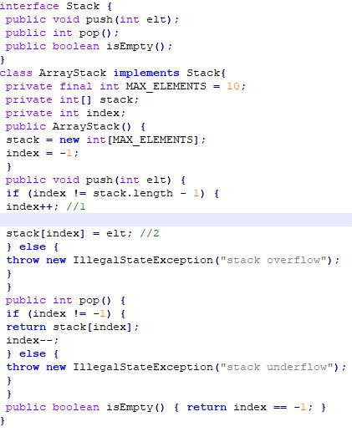
Different threads simultaneously accessing the same
memory location can produce unexpected results,
unless you take care to constrain their access.
The increasing importance of concurrent programming
during the lifetime of Java has led to a corresponding
emphasis in the collections library on flexible and
efficient concurrency policies
A non-thread-safe stack implementation

Slide 8
Synchronization and the Legacy Collections
Using synchronized to modify the declaration of the push method will guarantee that once a thread has started to execute it, all other threads are excluded from that method until the execution is done:
public synchronized void push(int elt) { ... }
This synchronized version of push is thread-safe;
in a multi-threaded environment, each thread behaves consistently with its behavior in a single-threaded environment.To safeguard the invariant and make ArrayStack as a whole thread-safe, the methods pop and isEmpty must also be synchronized on the same object.
The method isEmpty doesn’t write to shared data, so synchronizing it isn’t required to prevent a race condition,

Slide 9
Each thread may use a separate memory cache : writes by 1 thread may not be seen by another unless either they both take place within blocks synchronized on the same lock, or use volatile keyword.
Synchronization can be very expensive: forcing threads to queue up to enter the critical section one at a time slows down the overall execution of the program, and the overhead of administering locks can be very high if they are often contended.

Slide 10
Synchronized Collections and Fail-Fast Iterators
To provide maximum performance for single-threaded execution, the new collections provided no concurrency control at all.
In multithreaded environments, a thread which has obtained an iterator will usually continue to use it while other threads modify the original collection.
So iterator behavior has to be considered as an integral part of a collection's concurrency policy. The policy of the iterators for the Java 2 collections is to fail fast.
Stack threadSafe = new SynchronizedArrayStack(new ArrayStack()); To get thread safe stack

Slide 11
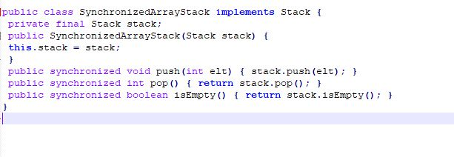
A synchronized wrapper for ArrayStack

Slide 12
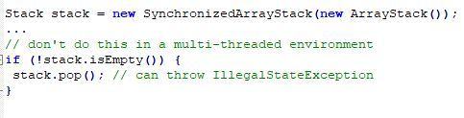
Using Synchronized Collections Safely Even a class like SynchronizedArrayStack, which has fully synchronized methods and is itself thread-safe, must still be used with care in a concurrent environment.
For synchronized collections (as for the legacy collections), this must be enforced with client-side locking:
synchronized(stack) { if (!stack.isEmpty()) { stack.pop(); }

Slide 13
Concurrent Collections
Several new Collection classes are added in Java 5 and Java 6 especially concurrent alternatives of standard synchronized ArrayList, Hashtable and synchronized HashMap collection classes.
java.util.concurrent package and misses a whole new set of functionality which can be utilized to build more scalable and high-performance Java application.
Eg : ConcurrentHashMap, BlockingQueue
If you need thread safety, the concurrent collections generally provide much better performance than synchronized collections

Slide 14
Difference between synchronized collection and concurrent collection
The main reason for this slowness is locking; synchronized collections locks the whole collection
e.g. whole Map or List while concurrent collection never locks the whole Map or List. They achieve thread-safety by using advanced and sophisticated techniques like lock stripping.

Slide 15
The Collection Interface
Adding Elements
boolean add(E e) // add the element e
boolean addAll(Collection c) // add the contents of c
Removing Elements
boolean remove(Object o) // remove the element o
void clear() // remove all elements
boolean removeAll(Collection c) // remove the elements in c
boolean retainAll(Collection c) // remove the elements *not* in c
Querying the Contents of a Collection
boolean contains(Object o) // true if o is present
boolean containsAll(Collection c) // true if all elements of c // are present in the collection
boolean isEmpty() // true if no elements are present
int size() // return the element count (or // Integer.MAX_VALUE if that is less)

Slide 16
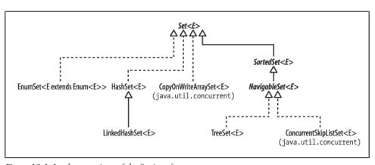
SETS

Slide 17
HashSet
Java HashSet class is used to create a collection that uses a hash table for storage. It inherits the AbstractSet
HashSet stores the elements by using a mechanism called hashing.
HashSet contains unique elements only.
HashSet allows null value.
HashSet class is non synchronized.
HashSet doesn't maintain the insertion order. Here, elements are inserted on the basis of their hashcode.
HashSet is the best approach for search operations.
The initial default capacity of HashSet is 16, and the load factor is 0.75.
class and implements Set interface.

Slide 18
Hash Set Cont..
A list can contain duplicate elements whereas Set contains unique elements only.
public class HashSet<E> extends AbstractSet<E> implements Set<E>, Cloneable, Serializable
Example Code:
https://github.com/madhushika-madhubhani/Krish_SE_Training/blob/main/java-basic-code-samples/java-fundamentals/src/main/java/com/madhushika/collection/HashSetExample.java

Slide 19
LinkedHashSet
Java LinkedHashSet class is a Hashtable and Linked list implementation of the set interface. It inherits HashSet class and implements Set interface.
contains unique elements only like HashSet.
provides all optional set operation and permits null elements.
The class is non synchronized.
class maintains insertion order.
public class LinkedHashSet<E> extends HashSet<E> implements Set<E>, Cloneable, Serializable

Slide 20
CopyOnWriteArraySet
A Set that uses an internal CopyOnWriteArrayList for all of its operations. Thus, it shares the same basic properties:
It is best suited for applications in which set sizes generally stay small, read-only operations vastly outnumber mutative operations,
and you need to prevent interference among threads during traversal.
It is thread-safe.
Mutative operations (add, set, remove, etc.) are expensive since they usually entail copying the entire underlying array.
Iterators do not support the mutative remove operation.
Traversal via iterators is fast and cannot encounter interference from other threads. Iterators rely on unchanging snapshots of the array
at the time the iterators were constructed.

Slide 21
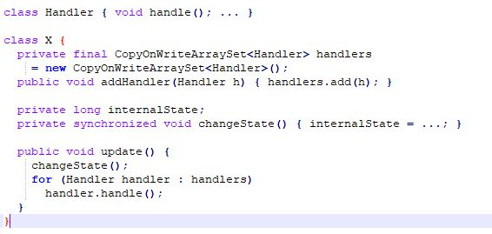

Slide 22
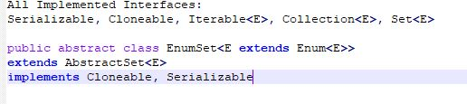
EnumSet
An enumSet is a Java Collections member, it is not synchronized. An enumSet is a high performing set implementation that works faster than the HashSet. All the elements in an enumSet must be of a single enumeration type that is specified when the set is created.

Slide 23
TreeSet
TreeSet class contains unique elements only like HashSet.
Access and retrieval times are quiet fast.
Doesn't allow null element.
Non synchronized.
Maintains ascending order.
Hashset gives better performance (faster) than Treeset for the operations like add, remove, contains, size etc. HashSet offers constant time cost while TreeSet offers log(n) time cost for such operations

Slide 24
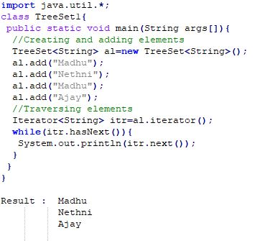

Slide 25
QUEUE
Java Queue interface orders the element in FIFO(First In First Out) manner. In FIFO, first element is removed first and last element is removed at last.
public interface Queue<E> extends Collection<E>
PriorityQueue class
The PriorityQueue class provides the facility of using queue. But it does not orders the elements in FIFO manner. It inherits AbstractQueue class.
public class PriorityQueue<E> extends AbstractQueue<E> implements Serializable

Slide 26
Java Deque Interface
Java Deque Interface is a linear collection that supports element insertion and removal at both ends. Deque is an acronym for "double ended queue".
public interface Deque<E> extends Queue<E>
ArrayDeque class
Unlike Queue, we can add or remove elements from both sides.
Null elements are not allowed in the ArrayDeque.
ArrayDeque is not thread safe, in the absence of external synchronization.
ArrayDeque has no capacity restrictions.
ArrayDeque is faster than LinkedList and Stack.

Slide 27
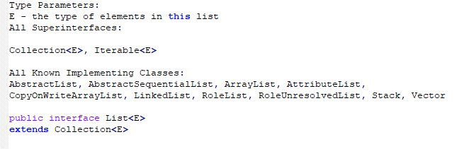
LIST
An ordered collection (also known as a sequence). The user of this interface has precise control over where in the list each element is inserted. The user can access elements by their integer index (position in the list), and search for elements in the list.

Slide 28
ArrayList
Can contain duplicate elements.
Maintains insertion order.
Non synchronized.
Allows random access because array works at the index basis.
In ArrayList, manipulation is little bit slower than the LinkedList in Java because a lot of shifting needs to occur if any element is removed from the array list.

Slide 29
LinkedList
Can contain duplicate elements.
Maintains insertion order.
Non synchronized.
In Java LinkedList class, manipulation is fast because no shifting needs to occur.
Java LinkedList class can be used as a list, stack or queue.

Slide 30
Java ListIterator Interface
ListIterator Interface is used to traverse the element in a backward and forward direction.
public interface ListIterator<E> extends Iterator<E>

Slide 31
Map Interface
A map contains values on the basis of key, i.e. key and value pair. Each key and value pair is known as an entry. A Map contains unique keys.
A Map is useful if you have to search, update or delete elements on the basis of a key.
HashMap
Contains values based on the key.
Contains only unique keys.
Java HashMap may have one null key and multiple null values.
Non synchronized.
Java HashMap maintains no order.
The initial default capacity of Java HashMap class is 16 with a load factor of 0.75.
public class HashMap<K,V> extends AbstractMap<K,V> implements Map<K,V>, Cloneable, Serializable

Slide 32
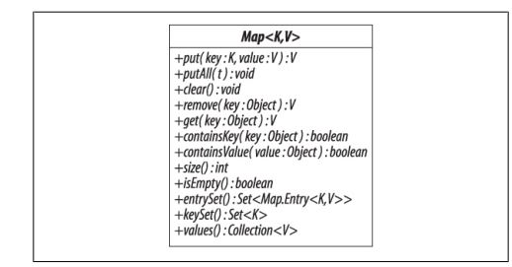

Slide 33
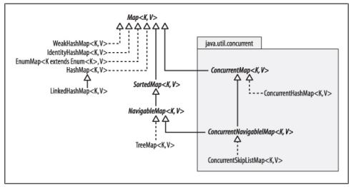
The structure of Map implementations in the Collections Framework

Slide 34
LinkedHashMap
public class LinkedHashMap<K,V> extends HashMap<K,V> implements Map<K,V>
Contains values based on the key.
Contains unique elements.
It may have one null key and multiple null values.
Non synchronized.
Maintains insertion order.
The initial default capacity of Java HashMap class is 16 with a load factor of 0.75.

Slide 35
TreeMap
Contains values based on the key. It implements the NavigableMap interface and extends AbstractMap class.
Contains only unique elements.
Cannot have a null key but can have multiple null values.
Non synchronized.
Java TreeMap maintains ascending order.
public class TreeMap<K,V> extends AbstractMap<K,V> implements NavigableMap<K,V>, Cloneable, Serializable

Slide 36
Hashtable
A Hashtable is an array of a list. Each list is known as a bucket. The position of the bucket is identified by calling the hashcode() method. A Hashtable contains values based on the key.
Contains unique elements.
Doesn't allow null key or value.
Synchronized.
The initial default capacity of Hashtable class is 11 whereas loadFactor is 0.75.
public class Hashtable<K,V> extends Dictionary<K,V> implements Map<K,V>, Cloneable, Serializable

Slide 37
HashMap is much faster and uses less memory than Hashtable as former is unsynchronized . Unsynchronized objects are often much better in performance in compare to synchronized object like Hashtable in single threaded environment.

Slide 38
Comparable interface
The Java Comparable interface, java. lang. Comparable , represents an object which can be compared to other objects.
For instance, numbers can be compared, strings can be compared using alphabetical comparison etc. Several of the built-in classes in Java implements the Java Comparable interface.
public int compareTo(Object obj): It is used to compare the current object with the specified object. It returns
    positive integer, if the current object is greater than the specified object.
    negative integer, if the current object is less than the specified object.
    zero, if the current object is equal to the specified object.

Slide 39
Comparator interface
Java Comparator interface is used to order the objects of a user-defined class. This interface is found in java. util package and contains 2 methods compare(Object obj1,Object obj2) and equals(Object element).

Slide 40
Comparator vs Comparable
The Comparable interface is a good choice when used for defining the default ordering or, in other words, if it's the main way of comparing objects.
Then, we must ask ourselves why use a Comparator if we already have Comparable?
There are several reasons why:
Sometimes, we can't modify the source code of the class whose objects we want to sort, thus making the use of Comparable impossible
Using Comparators allows us to avoid adding additional code to our domain classes
We can define multiple different comparison strategies which isn't possible when using Comparable

Slide 41
Vector
Vector is like the dynamic array which can grow or shrink its size. Unlike array, we can store n-number of elements in it as there is no size limit. It is a part of Java Collection framework since Java 1.2. It is found in the java.util package and implements the List interface, so we can use all the methods of List interface here.
      public class Vector<E>
      extends Object<E>
      implements List<E>, Cloneable, Serializable
Vector is synchronized.
Java Vector contains many legacy methods that are not the part of a collections framework.

Slide 42
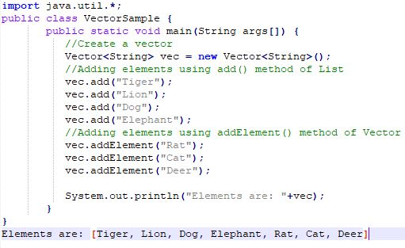

Slide 43
Java Stack
The stack is a linear data structure that is used to store the collection of objects. It is based on Last-In-First-Out (LIFO). Java collection framework provides many interfaces and classes to store the collection of objects. One of them is the Stack class that provides different operations such as push, pop, search, etc.
In Java, Stack is a class that falls under the Collection framework that extends the Vector class. It also implements interfaces List, Collection, Iterable, Cloneable, Serializable. It represents the LIFO stack of objects. Before using the Stack class, we must import the java.util package. The stack class arranged in the Collections framework hierarchy, as shown below.

Slide 44
Code samples
https://github.com/madhushika-madhubhani/Krish_SE_Training/tree/main/java-basic-code-samples/java-fundamentals/src/main/java/com/madhushika/collection
References
Java Generics and Collections – Maurice Naftalin & Philip Wadler

Slide 45
GENERICS
BY K.A.Madhushika

Slide 46
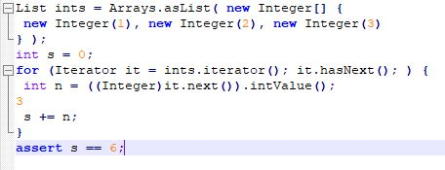
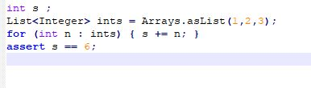
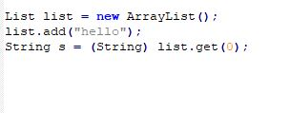
Introduction
The Java Generics programming is introduced in J2SE 5 to deal with type-safe objects.
It detects bugs at compile time.
Before generics with generics
compile time checking
can store any type of objects in the collection .
Need type casting :

Slide 47
It keeps things simple, in that generics do not add anything fundamentally new.
It keeps things small, in that there is exactly one implementation of List, not one version for each type.’
And it eases evolution, since the same library can be accessed in both non generic and generic forms.
Syntax to use generic collection
Class or Interface<Type>
Eg : ArrayList<String>

Slide 48
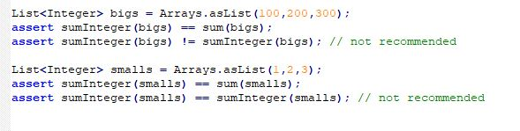
Boxing and Unboxing
With generics automatically inserts boxing and unboxing coercions where appropriate. If an expression e of type int appears where a value of type Integer is expected, boxing converts it to new Integer(e).
If an expression e of type Integer appears where a value of type int is expected, unboxing converts it to the expression e.intValue().
use equals rather than ==

Slide 49
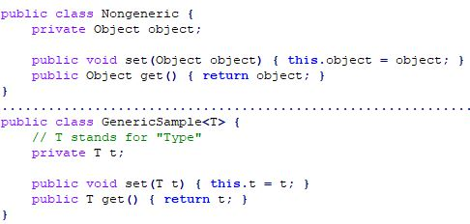
Generic Types
Generic class
A type variable can be any non-primitive type . any class type, any interface type, any array type, or even another type variable. This technique can be applied to create generic interface

Slide 50
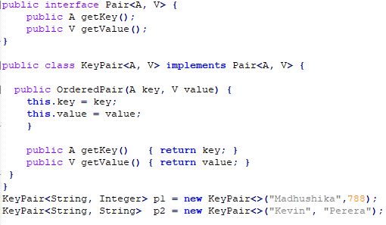
The diamond
Diamond<Integer> diamond =new Diamond<>();
Multiple type parameters
Parameterized Types
KeyPair<String, GenericSample<Integer>> p = new KeyPair<>("primes", new GenericSample<Integer>(...));

Slide 51
Type Parameter Naming Conventions
By convention, type parameter names are single, uppercase letters. Without this convention, it would be difficult to tell the difference between a type variable and an ordinary class or interface name.
The most commonly used type parameter names are:
E - Element (used extensively by the Java Collections Framework)
K - Key
N - Number
T - Type
V - Value
S,U,V etc. - 2nd, 3rd, 4th types

Slide 52
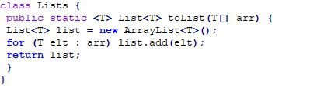
Generic Methods and Varargs
The static method toList accepts an array of type T[] and returns a list of type List<T>, and does so for any type T.
This is indicated by writing <T> at the beginning of the method signature, which declares T as a new type variable. A method which declares a type variable in this way is called a generic method.
The vararg feature permits a special, more convenient syntax for the case in which the last argument of a method is an array

Slide 53

Subtyping and Wildcards
Subtyping is a key feature of object-oriented languages such as Java. In Java, one type is a subtype of another if they are related by an extends or implements clause.
Eg:
Substitution Principle: a variable of a given type may be assigned a value of any subtype of that type, and a method with a parameter of a given type may be invoked with an argument of any subtype of that type.

Slide 54
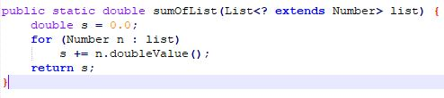
Wildcards with extends
The question mark is called a wildcard, since it stands for some type that is a subtype of E.
Upper bounded wildcards
Unbounded wildcards
If you are writing a method that can be implemented using functionality provided in the Object class.
When the code is using methods in the generic class that don't depend on the type parameter. For example, List.size or List.clear. In fact, Class<?> is so often used because most of the methods in Class<T> do not depend on T.

Slide 55
Lower Bounded Wildcards
A lower bounded wildcard is expressed using the wildcard character ('?'), following by the super keyword, followed by its lower bound: <? super A>.
public static void addNumbers(List<? super Integer> list) {
for (int i = 1; i <= 10; i++) {
list.add(i);
}
}

Slide 56
The Get and Put Principle
use an extends wildcard when you only get values out of a structure, use a super wildcard when you only put values into a structure, and don’t use a wildcard when you both get and put.

Slide 57
Wild card capture
When a generic method is invoked, the type parameter may be chosen to match the unknown type represented by a wildcard. It is called as wildcard capture.
If you try to use the first signature with a similar method body, it won’t work:
public static void reverse(List<?> list) {
List<Object> tmp = new ArrayList<Object>(list);
for (int i = 0; i < list.size(); i++) {
list.set(i, tmp.get(list.size()-i-1)); // compile-time error
}
}

Slide 58
If the compiler prints an error message containing this type, it is referred to as capture of ?. For instance, with Sun’s current
compiler, the incorrect version of reverse generates the following error message:
Capture.java:6: set(int,capture of ?) in java.util.List<capture of ?>
cannot be applied to (int,java.lang.Object)
list.set(i, tmp.get(list.size()-i-1));

Slide 59
quizzical phrase capture of ? in an error message, it will come from a wildcard type.
Even if there are two distinct wildcards, the compiler will print the type associated with each as capture of ?.
Bounded wildcards generate names that are even more long-winded, such as capture of ? extends Number.

Slide 60
Restrictions on Wildcards
An "in" variable is defined with an upper bounded wildcard, using the extends keyword.
An "out" variable is defined with a lower bounded wildcard, using the super keyword.
In the case where the "in" variable can be accessed using methods defined in the Object class,
use an unbounded wildcard.
In the case where the code needs to access the variable as both an "in" and an "out" variable, do not use a wildcard.

Slide 61
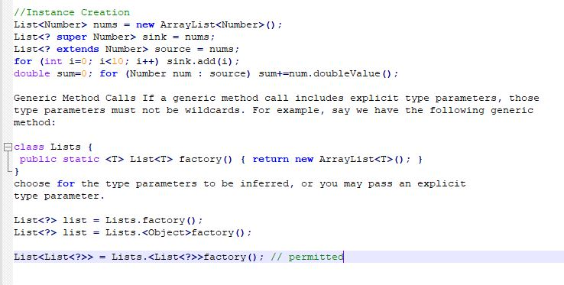

Slide 62
Wildcard Restrictions cont.
Supertypes When a class instance is created, it invokes the initializer for its supertype. Hence, any restriction that applies to instance creation must also apply to supertypes. In a class declaration, if the supertype or any superinterface has type parameters, these types must not be wildcards.
class NestedList extends ArrayList<List<?>> {...} // permitted

Slide 63
Type Erasure
Generics provided tighter type checks at compile time and to support generic programming.
Replace all type parameters in generic types with their bounds or Object if the type parameters are unbounded. The produced bytecode, therefore, contains only ordinary classes, interfaces, and methods.
Insert type casts if necessary to preserve type safety.
Generate bridge methods to preserve polymorphism in extended generic types.

Slide 64
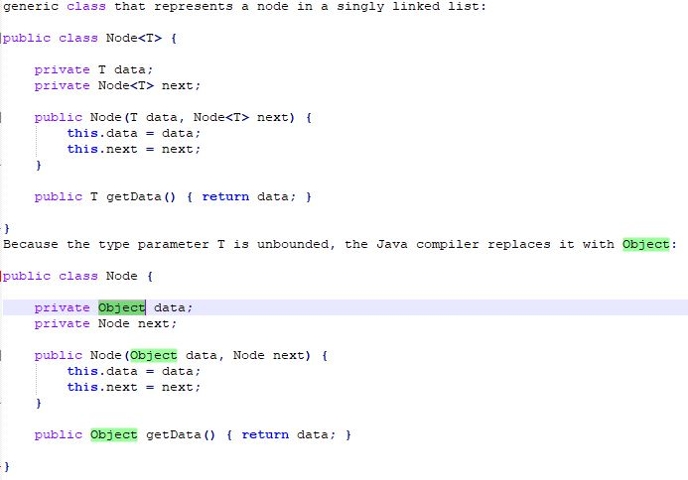

Slide 65
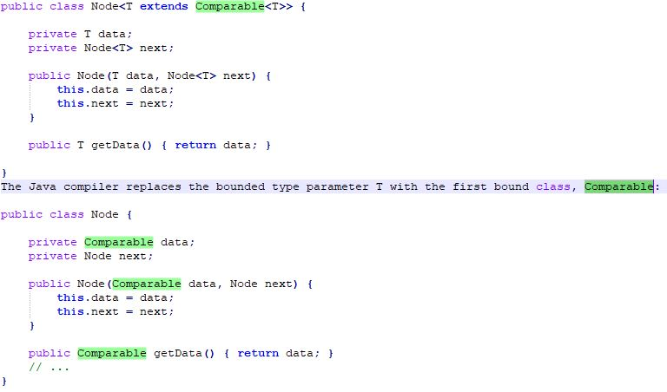

Slide 66
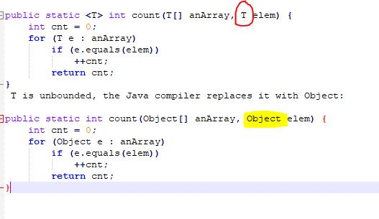
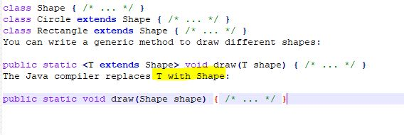
Erasure of Generic Methods

Slide 67
Bridges
In the case of a parameterized interface such as Comparable, this may cause additional methods to be inserted by the compiler; these additional methods are called bridges.
The bridge method is generated automatically by the compiler. Indeed, the compiled version of the code for both examples is essentially identical.

Slide 68
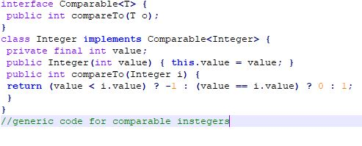
can see the bridge if apply the reflection.code that finds all methods with the name compareTo in the class Integer, using toGenericString to print the generic signature of a method
for (Method m : Integer.class.getMethods())
if (m.getName().equals("compareTo"))
System.out.println(m.toGenericString());

Slide 69
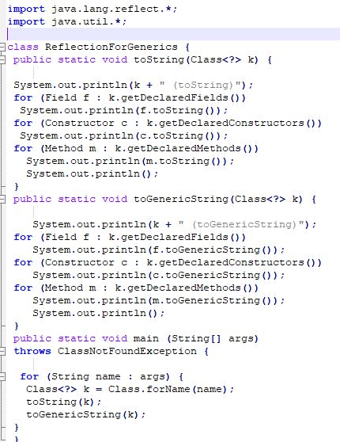
Reflection for Generics
Generics change the reflection library in two ways.
We have discussed generics for reflection, where
Java added a type parameter to the class Class

Slide 70
Non-Reifiable Types
A reifiable type is a type whose type information is fully available at runtime. This includes primitives, non-generic types, raw types, and invocations of unbound wildcards.
Non-reifiable types are types where information has been removed at compile-time by type erasure — invocations of generic types that are not defined as unbounded wildcards.
Type does not have all of its information available at runtime.

Slide 71
Heap Pollution
It occurs when a variable of a parameterized type refers to an object that is not of that parameterized type.
It occurs if the program performed some operation that gives rise to an unchecked warning at compile-time.
unchecked warning is generated if, either at compile-time or runtime.
If you compile sections of your code separately, it is difficult to detect the potential risk of heap pollution. If you ensure that your code compiles without warnings, then no heap pollution can occur.
All code compiles at a same time the compiler issued unchecked warnings.

Slide 72
Restrictions of Generics
Cannot Instantiate Generic Types with Primitive Types
Cannot Create Instances of Type Parameters
Cannot Declare Static Fields Whose Types are Type Parameters
Cannot Use Casts or instanceof With Parameterized Types
Cannot Create Arrays of Parameterized Types
Cannot Create, Catch, or Throw Objects of Parameterized Types
Cannot Overload a Method Where the Formal Parameter Types of Each Overload Erase to the Same Raw Type

Slide 73
THREADS
BY K.A.Madhushika

Slide 74
Multithreading
Multithreading in Java is a process of executing multiple threads simultaneously.
A thread is a lightweight sub-process, the smallest unit of processing. Multiprocessing and multithreading, both are used to achieve multitasking.
we use multithreading than multiprocessing because threads use a shared memory area. They don't allocate separate memory area so saves memory, and context-switching between the threads takes less time than process.

Slide 75
Advantages of Multithreading
It doesn't block the user because threads are independent and you can perform multiple operations at the same time.
It can perform many operations together, so it saves time.
Threads are independent, so it doesn't affect other threads if an exception occurs in a single thread.

Slide 76
2 ways to create a thread
1. Extend by thread Class
2. Implements runnable Interface
Thread class provide constructors and methods to create and perform operations on a thread.Thread class extends Object class and implements Runnable interface.

Slide 77
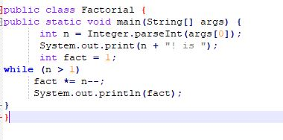
What is thread ?
A thread is an application task that is executed by a host computer. The notion of a task should be familiar to you even if the terminology is not. Suppose you have a Java program to compute the factorial of a given number :
Eg : Convert args[0] to an integer. Store that integer in a location called n. Print some text. Store 1 in a location called fact. Test if n is greater than 1. If it is, multiply the value stored in fact by the value stored in n and decrement n by 1. If it isn’t, print out the value stored in fact

Slide 78
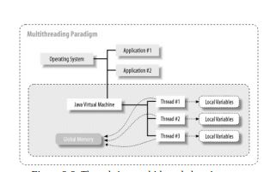
Threads in a multithreaded environment

Slide 79
Commonly used Constructors of thread class
    Thread()
    Thread(String name)
    Thread(Runnable r)
    Thread(Runnable r,String name)
    Thread(ThreadGroup group,Runnable target)
    Thread(ThreadGroup group, Runnable target, String name)
    Thread(ThreadGroup group, Runnable target, String name, long stackSize)
    Thread(ThreadGroup group, String name)

Slide 80
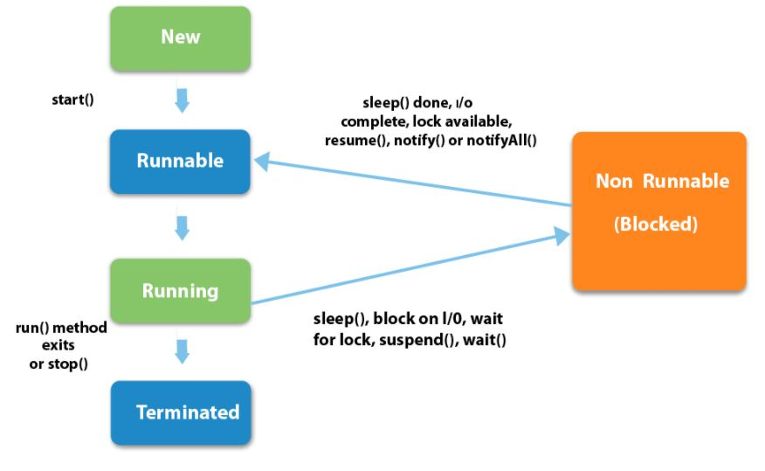
Life Cycle of a thread

Slide 81
Priority of a Thread
Each thread have a priority. Priorities are represented by a number between 1 and 10. In most cases, thread schedular schedules the threads according to their priority (known as preemptive scheduling). But it is not guaranteed because it depends on JVM specification that which scheduling it chooses.
3 constraints :
      public static int MIN_PRIORITY
      public static int NORM_PRIORITY
      public static int MAX_PRIORITY
There is nothing like default priority

Slide 82

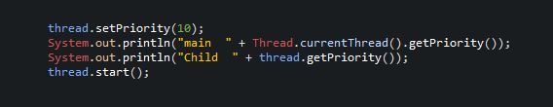
Main thread default priority value is 5.There after any thread you are creating it get inherited parent thread value. Always thread default priority is not 5.
thread.setPriority(11); //illegal argument because 11 is beyond the highest priority value

Slide 83
What happens 2 threads get same priority value?
Same behaviour. (not much significant )
Threads are not rank . There are 1 and 10 value .

Slide 84
Daemon Thread in Java
Daemon thread in java is a service provider thread that provides services to the user thread. Its life depend on the mercy of user threads i.e. when all the user threads dies, JVM terminates this thread automatically.
There are many java daemon threads running automatically e.g. gc, finalizer etc.
  It provides services to user threads for background supporting tasks. It has no role in life than to serve user threads.
  Its life depends on user threads.
  It is a low priority thread

Slide 85
Why JVM terminates the daemon thread if there is no user thread?
The purpose of the daemon thread is that it provides services to user thread for background supporting task.
If there is no user thread, JVM terminates the daemon thread if there is no user thread
Methods for daemon thread
    public void setDaemon(boolean status)
    public boolean isDaemon()

Slide 86
ThreadGroup
Java provides a convenient way to group multiple threads in a single object. In such way, we can suspend, resume or interrupt group of threads by a single method call.
Java thread group is implemented by java.lang.ThreadGroup class.
The thread group creates a tree in which every thread group except the initial thread group has a parent.
A thread is allowed to access information about its own thread group, but it cannot access the information about its thread group's parent thread group or any other thread groups.

Slide 87
Methods of ThreadGroup
checkAccess()
activeCount()
activeGroupCount()
enumerate(Thread[] list)
getMaxPriority()
isDaemon() . etc

Slide 88
Joining Threads
java.lang.Thread class provides the join() method which allows one thread to wait until another thread completes its execution. If t is a Thread object whose thread is currently executing, then t.join() will make sure that t is terminated before the next instruction is executed by the program.
If there are multiple threads calling the join() methods that means overloading on join allows the programmer to specify a waiting period.
join is dependent on the OS for timing, so you should not assume that join will wait exactly as long as you specify.

Slide 89
join(): It will put the current thread on wait until the thread on which it is called is dead. If thread is interrupted then it will throw InterruptedException.
public void join()
join(long millis) :It will put the current thread on wait until the thread on which it is called is dead or wait for specified time (milliseconds).
public synchronized void join(long millis)
join(long millis, int nanos): It will put the current thread on wait until the thread on which it is called is dead or wait for specified time (milliseconds + nanos).
public void join(long millis, int nanos)

Slide 90
yield():
Eg:
Suppose there are three threads t1, t2, and t3. Thread t1 gets the processor and starts its execution and thread t2 and t3 are in Ready/Runnable state.
Completion time for thread t1 is 5 hour and completion time for t2 is 5 minutes. Since t1 will complete its execution after 5 hours, t2 has to wait for 5 hours to just finish 5 minutes job. In such scenarios where one thread is taking too much time to complete its execution, we need a way to prevent execution of a thread in between if something important is pending. yeild() helps us in doing so.

Slide 91
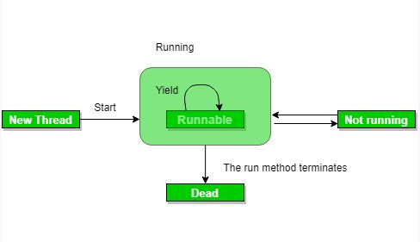
It means thread is not doing anything particularly important and if any other threads or processes need to be run, they should run. Otherwise, the current thread will continue to run.
When thread call s yield method, it gives hint to the thread scheduler that it is ready to pause its execution. Thread scheduler is free to ignore this hint.
If any thread executes yield method , thread scheduler checks if there is any thread with same or high priority than this thread. If processor finds any thread with higher or same priority then it will move the current thread to Ready/Runnable state and give processor to other thread and if not – current thread will keep executing.

Slide 92
Output may vary in machine to machine but chances of execution of yield() thread first is higher than the other thread because main thread is always pausing its execution and giving chance to child thread(with same priority).

Slide 93
Thread Notification
Wait and Notify
void wait() Waits for a condition to occur. This method must be called from within a synchronized method or block.
void wait(long timeout)
if the notification has not occurred in timeout milliseconds, it returns anyway. This method must be called from a synchronized method or block.
void wait(long timeout, int nanos)
if the notification has not occurred in timeout milliseconds and nanos nanoseconds, it returns anyway. This method must be called from a synchronized method or block. Note that, just like the sleep() method, implementations of this method do not actually support nanosecond resolution

Slide 94
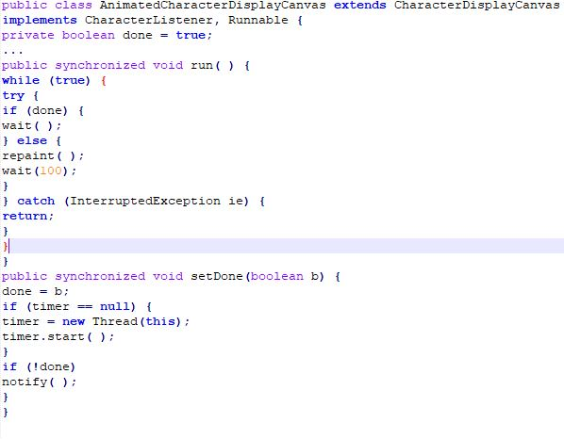
void notify()
Notifies a thread that is waiting that the condition has occurred. This method must be called from within a synchronized method or block
.

Slide 95
Synchronization
Synchronization in java is the capability to control the access of multiple threads to any shared resource
The synchronization is mainly used to
          To prevent thread interference.
          To prevent consistency problem.
Synchronization Types
Process Synchronization
Thread Synchronization

Slide 96
Thread Synchronization
Mutual Exclusive
  Synchronized method.
  Synchronized block.
  static synchronization.
Cooperation (Inter-thread communication in java)

Slide 97
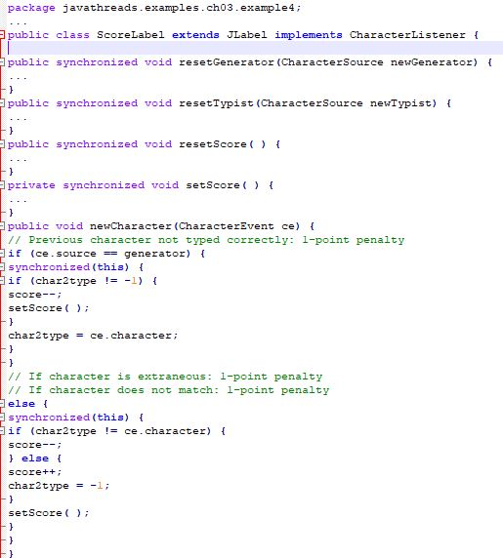
Synchronized Blocks
It is possible for the synchronized keyword to lock a block
of code within a method. It is also possible for the
synchronized keyword to specify the object whose lock is
grabbed instead of using the lock of the object that
contains the method.

Slide 98
Synchronized block vs Synchronized method
Synchronized block generally reduce the scope of lock.
Synchronized block provide granular control over lock
Synchronized block can throw throw java.lang .NullPointerException
In case of synchronized method, lock is acquired by thread when it enter method and released when it leaves method, either normally or by throwing Exception.

Slide 99
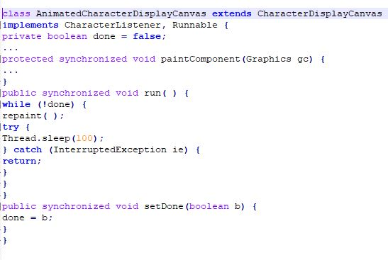
DeadLock
Deadlock in java is a part of multithreading. Deadlock can occur in a situation when a thread is waiting for an object lock, that is acquired by another thread and second thread is waiting for an object lock that is acquired by first thread. Since, both threads are waiting for each other to release the lock, the condition is called deadlock.

Slide 100
Code sample : https://github.com/madhushika-madhubhani/Krish_SE_Training/tree/main/ThreadIntro
References :
Java Threads, 3rd Edition Scott Oaks Henry Wong

