Slide 1
Computational Models of Decision Making
Peter Grabowski ’13
Professor Matthew Botvinick and Alec Solway
March 6th 2011

Slide 2
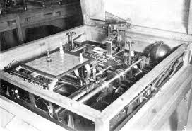
Original Motivation
http://nathanbauman.com/seoulhero/nfblog/?p=317

Slide 3
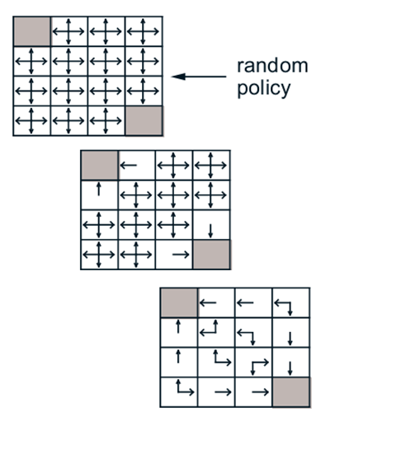
Map States to Actions
Sutton and Barto, 1998

Slide 4
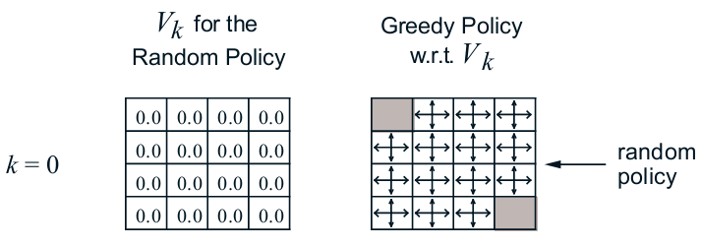
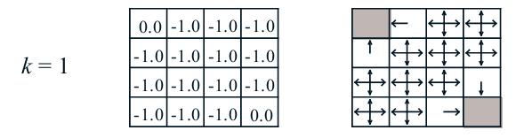
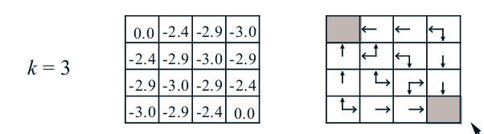
Map States to Values
Sutton and Barto, 1998

Slide 5
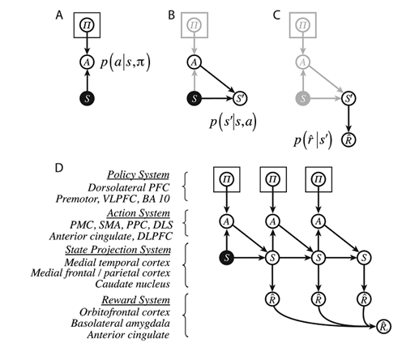
Model Based Learning
Sutton and Barto, 1998

Slide 6

Model Based

Slide 7
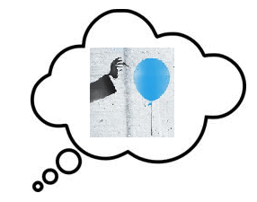
Model Based

Slide 8

Model Based

Slide 9

Model Based

Slide 10
Model Based

Slide 11
Model Free

Slide 12
Model Free

Slide 13
Model Free

Slide 14
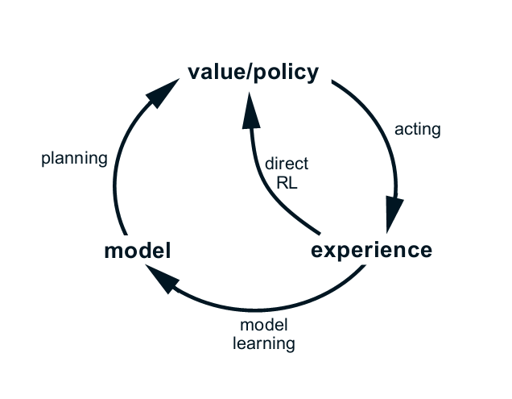
Model Free Vs. Model Based
Sutton and Barto, 1998

Slide 15
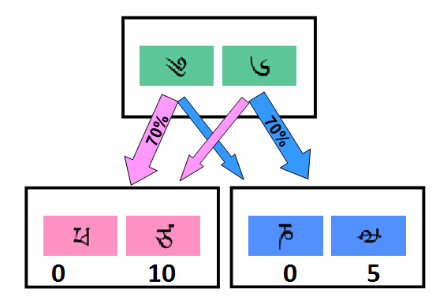
Daw’s Study
Daw et al, 2011

Slide 16
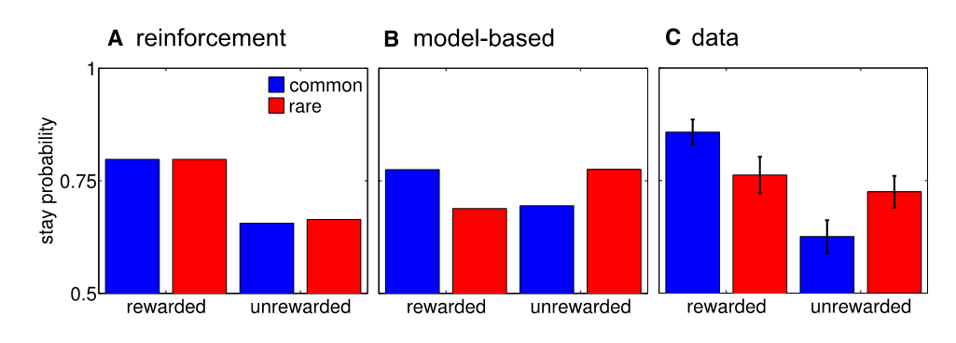
Daw’s Study
Daw et al, 2011

Slide 17
Current State
Machine Learning, Sutton and Barto 1998
Model-Based Influences on Humans’ Choices and Striatal Prediction Errors, Daw et al 2011
Goal-Directed Decision Making as Probabilistic Inference:A Computational Framework and Potential Neural Correlates, Solway and Botvinick 2012
Preliminary Data Analysis

Slide 18
To Do Next
Two Weeks
Increase familiarity with SARSA (model based learning) and hybrid algorithms
Continue writing code to construct models
Tweak code to optimize models
Four Weeks
Determine contribution of model-free and model-based agents
Analyze correlation with reaction times
Long Term
Use reaction times as constraints to build more accurate computational models
Examine distribution of reaction using drift diffusion models to determine which of many model-based learning algorithms the subject used

Slide 19
Success Criteria
Model accurately and consistently predicts actual subject’s patterns of decision making
Correlation found between model-based decision making and reaction time
New model, with RT’s as constraint
Use of drift diffusion model to predict specific learning algorithm

Slide 20
Conclusion: Reinforcement Learning
Sutton and Barto, 1998

Slide 21
Conclusion :Model Based

Slide 22
Conclusion: Model Free

Slide 23
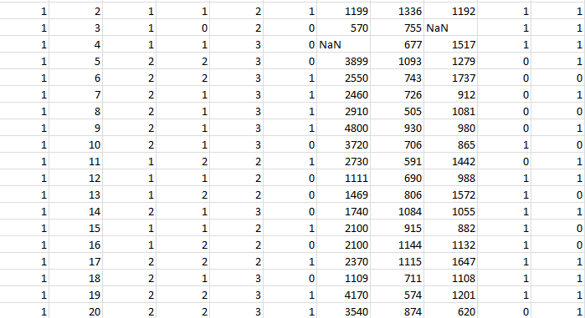
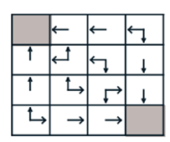
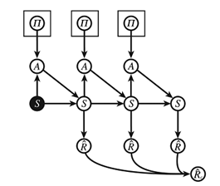
Conclusion: Daw’s Study

Slide 24
References
Daw, Nathaniel D., Samuel J. Gershman, Ben Seymour, Peter Dayan, and Raymond J. Dolan. "Model-Based Influences on Humans' Choices and Striatal Prediction Errors." Neuron 69.6 (2011): 1204-215.
Botvinick, Matthew and Solway, Alec. "Goal-Directed Decision Making as Probabilistic Inference: A Computational Framework and Potential Neural Correlates." Psychological Review 119.1 (2012): 120-54.
Sutton, R.S., and A.G. Barto. "Reinforcement Learning: An Introduction." IEEE Transactions on Neural Networks 9.5 (1998): 1054.

