Slide 1
Nexthikes IT Solution
Project Name: Bengaluru House Price Analysis
Presented by: Madhusmita Puhan

Slide 2
Top 20 Locations by Avg Price per Sqft
Chart: Horizontal bar chart
Insight: Suragajakkanahalli has the highest average price per square foot, followed by Gandhi Bazar and Ashok Nagar.
Interpretation: These are premium residential areas with significantly higher pricing.

Slide 3
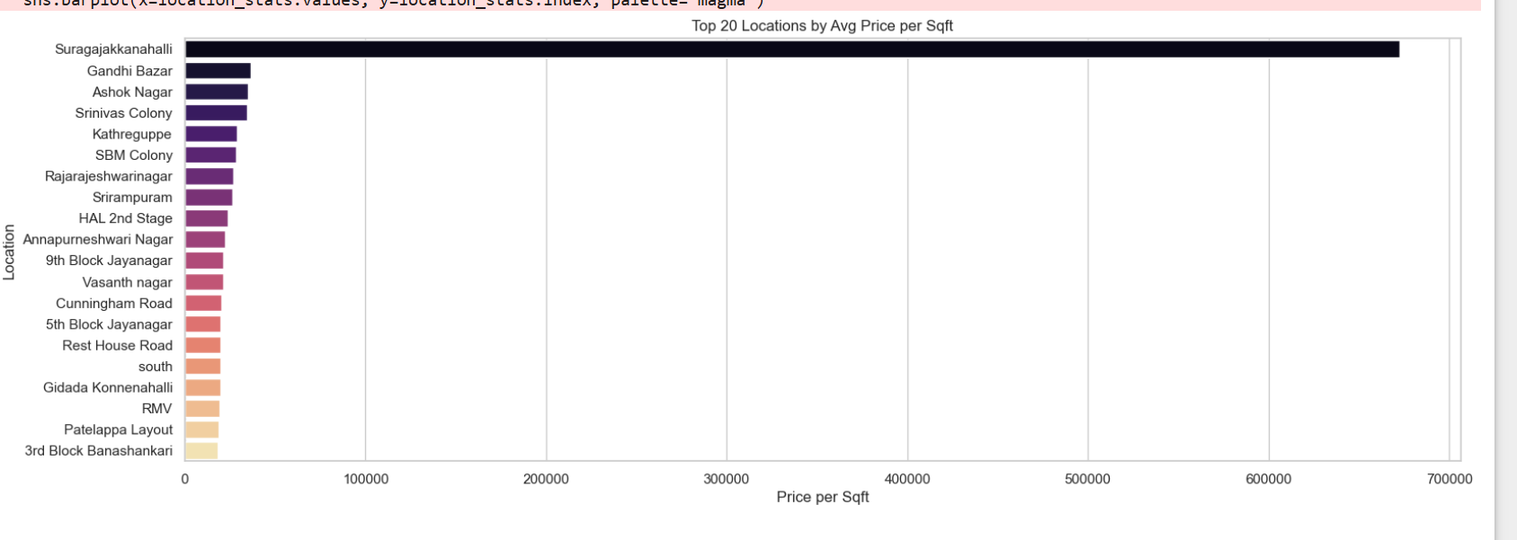

Slide 4
Correlation Heatmap
Chart: Heatmap showing correlation coefficients
Insight: Strong positive correlation between total_sqft and price (0.79), moderate between bath and price (0.51).
Conclusion: Larger homes and more bathrooms tend to increase the price.

Slide 5
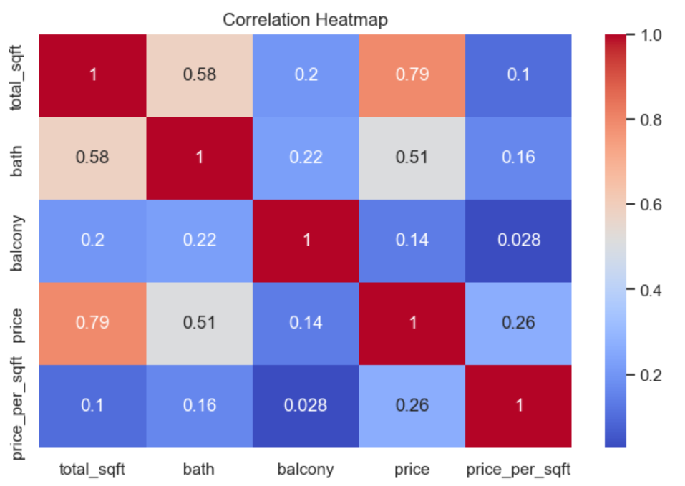

Slide 6
Distribution of Area Types
Chart: Pie chart
Insight: Most listings are Super Built-up Area (71.2%), followed by Built-up and Plot Area.
Conclusion: Super Built-up is the most common listing type in the dataset.

Slide 7
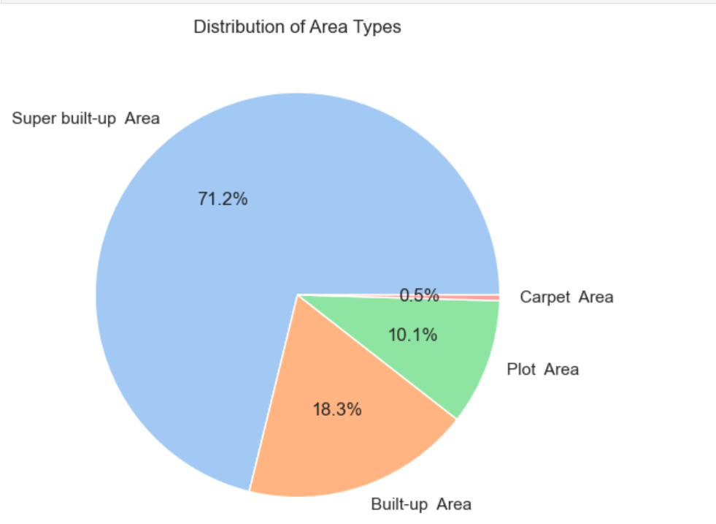

Slide 8
Boxplot - Price per Sqft
Chart: Boxplot
Insight: The plot reveals extreme outliers with very high price per sqft.
Conclusion: Outliers may represent luxury homes or data entry errors and should be treated before modeling.

Slide 9
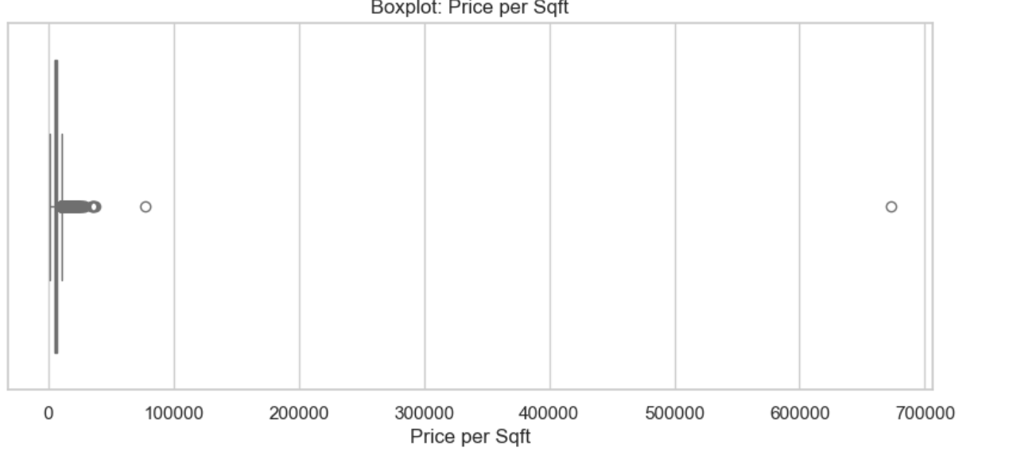

Slide 10
Additional Insights from Project
The dataset required heavy data cleaning — especially handling missing values and non-standardized size entries (e.g., '2 BHK' vs. '2 Bedroom').
Location data was cleaned and grouped to reduce unique values.
Outliers were removed from both price and size columns to make trends clearer.
Additional visualizations like scatter plots, histograms, and value counts supported better understanding.

Slide 11
More Visuals
Note: More graphs and visuals are included in the project notebook/code submission but are not shown here due to space.

Slide 12
Thank You

