Slide 1
Introduction
Name: Madhusmita Puhan
Organization: NextHikes IT Solutions
Topic: Dataset Analysis and Processing Workflow

Slide 2
Working with Dataset 1
Read Dataset 1 using pd.read_csv()
Check dimensions using .shape
View data types using .dtypes
Generate summary using .info() and .describe()
Handle missing values (e.g., fillna, dropna)
Drop unnecessary columns (e.g., drop(['col1', 'col2'], axis=1))
Visualize using Seaborn/Matplotlib (e.g., histograms, pairplots)

Slide 3
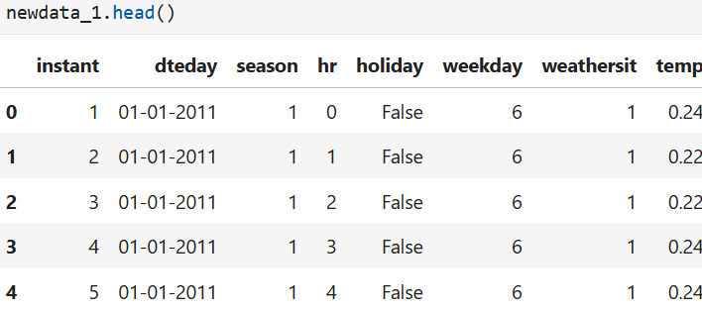

Slide 4
Working with Dataset 2
Read Dataset 2 using pd.read_csv()
Repeat steps from Dataset 1:
Dimensions
Data types
Summary
Missing values
Drop columns
Visualize

Slide 5
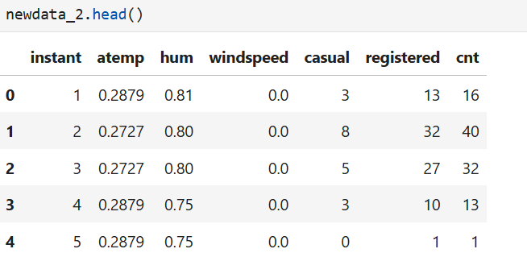

Slide 6
Merge Dataset 1 and 2
Merge datasets using pd.merge() or pd.concat()
Check merged dataset dimensions
Check data types
Summary statistics
Treat missing values again if any
Visualize merged data

Slide 7
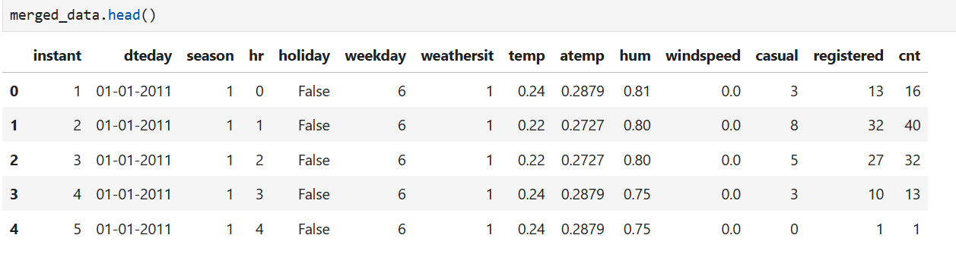

Slide 8
Working with Dataset 3
Read Dataset 3 using pd.read_csv()
Check shape and dimensions
Inspect data types
Summary statistics
Handle missing data
Drop unnecessary columns
Visualize key trends

Slide 9
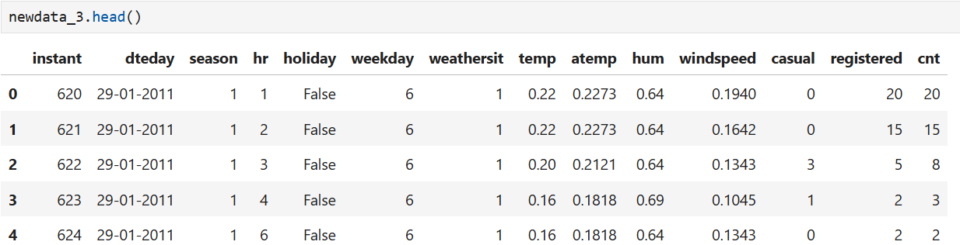

Slide 10
Final Merged Dataset (Dataset1 + Dataset2 + Dataset3)
Merge Dataset 3 with previously merged data
Use pd.concat()
Check dataset dimensions
.shape
View data types
.dtypes
Generate summary
.info() and .describe()
Handle missing values
e.g., df.fillna(), df.dropna()
Visualize
Use bar plots, histograms, boxplots to inspect distribution

Slide 11
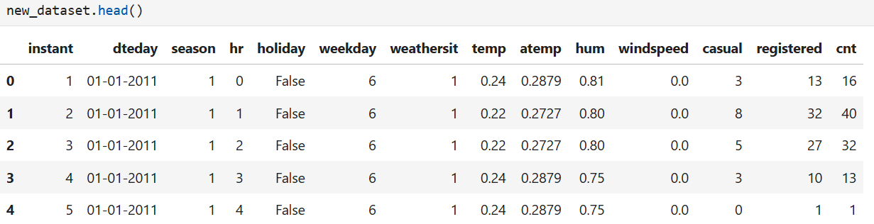

Slide 12
Outliers, Skewness, and Kurtosis
Detect outliers using:
Boxplot (sns.boxplot()), Z-score
Measure Skewness
df.skew()
Indicates asymmetry of distribution
Measure Kurtosis
df.kurtosis()
Indicates tail heaviness
Visualizations
Histogram with KDE
Boxplots per variable

Slide 13
Correlation in the Dataset
Compute correlation matrix
df.corr()
Visualize with heatmap
sns.heatmap(df.corr(), annot=True, cmap='coolwarm')
Identify highly correlated features
Useful for feature selection or multicollinearity diagnosis
Discuss observations:
correlations
Potential redundant features

Slide 14
Thank You

