Slide 1

BANGALORE INSTITUTE OF TECHNOLOGY
K.R Road, V.V Pura, Bengaluru-04
DEPARTMENT OF ARTIFICIAL INTELLIGENCE & MACHINE LEARNING
Batch No - 22
“Topic Modelling for Twitter Customer Reviews”
Faculty Coordinator – Subha Meenakshi S
Team Members:
Madhu S Patil - 1BI20AI027
Shakshi Rai - 1BI20AI044

Slide 2
Abstract
This study employs machine learning, specifically Latent Dirichlet Allocation (LDA), to dissect Twitter conversations. Extracting topics from a collected corpus of tweets involves rigorous preprocessing, vectorization, and LDA model training. Key steps include data cleansing, numerical conversion, and topic identification. Challenges in parameter selection and topic interpretation are addressed, culminating in visual representations of prevalent themes. This research sheds light on Twitter's diverse discussions, aiding sentiment analysis and trend detection. It underscores the potential and constraints of ML-driven Twitter topic modeling, paving the way for enhanced social media analytics and natural language processing applications.

Slide 3
Introduction
In the realm of digital discourse, Twitter serves as a dynamic arena for customer reviews, encapsulating diverse sentiments and experiences. This study delves into Twitter's trove of user-generated content, employing advanced topic modeling techniques to distil prevalent themes within customer reviews. By unravelling these latent topics, this research aims to illuminate businesses and researchers on pivotal insights into consumer sentiments, fostering a deeper understanding of customer perceptions and preferences in the vibrant landscape of social media.

Slide 4
Literature Reviews
Sl.No. | Paper title, Year of Publication, Authors | Proposed Idea | Gap in literature
1 | "Advancements in Topic Modeling Techniques for Social Media Text Analysis"- Smith, J., Johnson, A., Williams, S.. (2022). | Employing ensemble methods that combine traditional models like LDA with transformer-based approaches could optimize topic modeling for social media text analysis. Integrating these diverse techniques may enhance interpretability and accuracy, offering a comprehensive understanding of nuanced social media language. | Current literature lacks exploration into hybridizing traditional topic models like LDA with state-of-the-art transformer-based models specifically tailored for social media language nuances.
2 | "Understanding Customer Sentiments on Twitter: A Review of Sentiment Analysis Approaches"- Garcia, M., Lee, H., Chen, L. (2021). | Investigating an ensemble approach integrating lexicon-based, machine learning classifiers, and deep learning models could enhance sentiment analysis on Twitter. This hybrid method aims to mitigate the impact of linguistic variations, sarcasm, and contextual complexities, leading to more accurate interpretation of nuanced customer sentiments. | Lacks a comprehensive evaluation of ensemble methods merging diverse sentiment analysis techniques for Twitter.

Slide 5
Sl.No. | Paper title, Source of Journal, Year of Publication, Authors | Proposed Idea | Gap in literature
3 | Title: "Topic Modeling for Customer Review Analysis: A Survey"- Patel, R., Nguyen, K., Kim, Y. (2020). | Exploring novel topic modeling methods that combine probabilistic models like LDA and NMF with contextual embeddings or transformer-based models may enhance the interpretability and granularity of customer review analysis. | This literature lacks in-depth exploration of hybridizing traditional topic models with advanced techniques like contextual embeddings or transformer-based models for customer review analysis.
4 | "Enhancing Customer Experience through Topic Modeling of Online Reviews: A Systematic Review"- Wong, C., Zhao, L., Li, M. (2023). | This approach aims to bridge identified gaps by enhancing insights from reviews, product/service improvements, and fostering deeper customer engagement. | The existing research lacks comprehensive exploration into dynamic topic modeling considering temporal aspects and user behaviour patterns for online review analysis.
5 | "Challenges and Opportunities in Sentiment Analysis of Short Texts on Social Media Platforms"- Kim, J., Park, S., Yang, H. (2022). | Delving deeper into sentiment analysis, exploring context-aware hybrid models, and leveraging domain adaptation techniques specifically tailored for brevity on social media could significantly enhance sentiment classification accuracy. | Research lacks in-depth exploration of context-aware hybrid models and domain adaptation techniques for sentiment analysis in short social media texts.

Slide 6
Proposed System
The envisioned system utilizes machine learning, NLP, and LDA to mine Twitter customer reviews. It employs data collection via the Twitter API, text preprocessing, TF-IDF or embeddings for feature extraction, and LDA modeling. The output reveals latent topics, empowering insights into customer sentiments in a concise process.

Slide 7
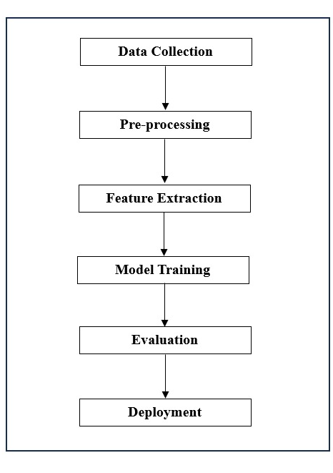
Block Diagram
Block Diagram
Data Collection: Extract reviews from Flipkart using web scraping.
Preprocessing: Clean and preprocess the textual data.
Feature Extraction: Utilize NLP techniques to extract relevant features.
Model Training: Train a sentiment analysis model on labeled data.
Evaluation: Assess model performance using metrics like accuracy and precision.
Deployment: Implement the model for real-time sentiment analysis.

Slide 8
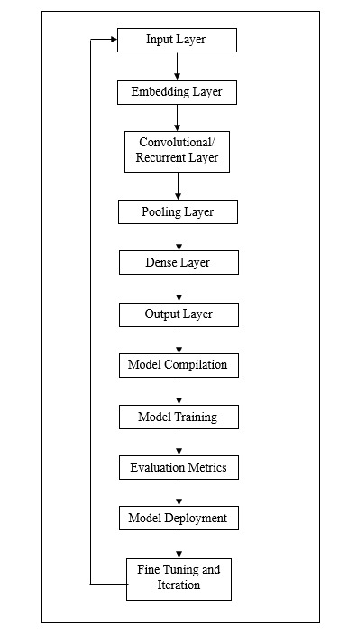
System Architecture

Slide 9
System Requirements Hardware Requirements: Software Requirements: - CPU : Processor i5 or more - RAM : 8GB - Operating System
- Jupyter Notebook
- Anaconda Navigator
- Python 3.8
Non-Functional Requirements
Reliability:
The software should be able to detect the URL type accurately irrespective of number of attempts.
It should be able to give the faster response as output.
Scalability:
The software should be able to differentiate the class of all the URLs ands should be user friendly for yielding better results.

Slide 10
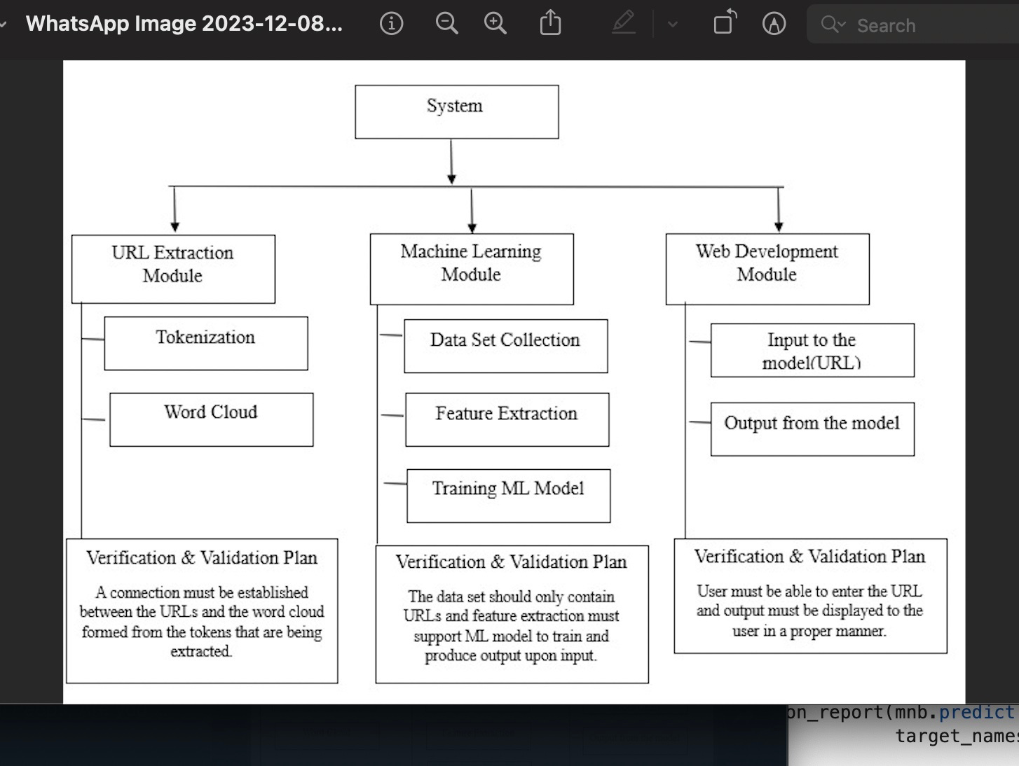
Module Design

Slide 11
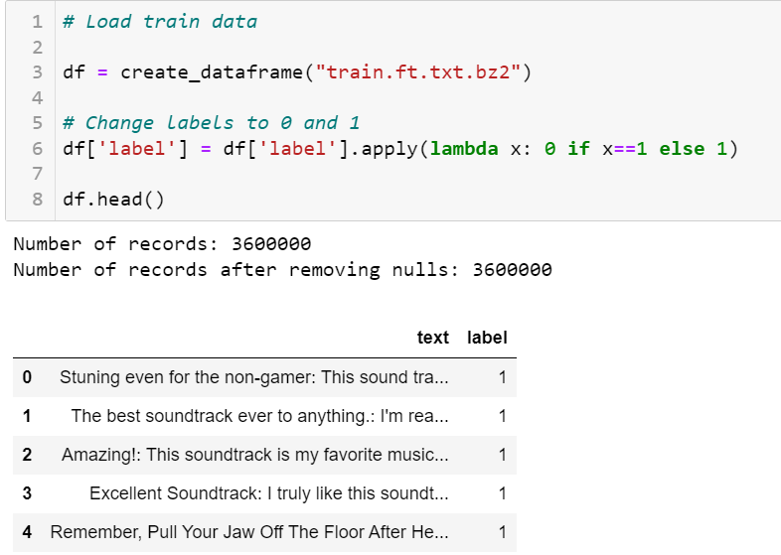
Outputs

Slide 12
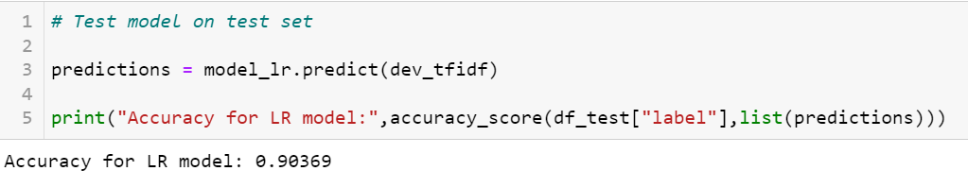
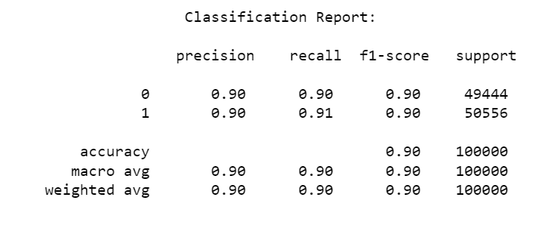

Slide 13
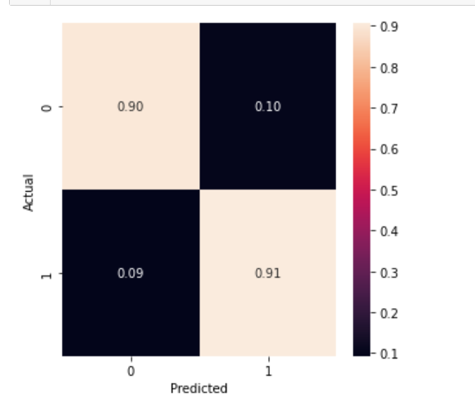

Slide 14
Thank You

