Slide 1
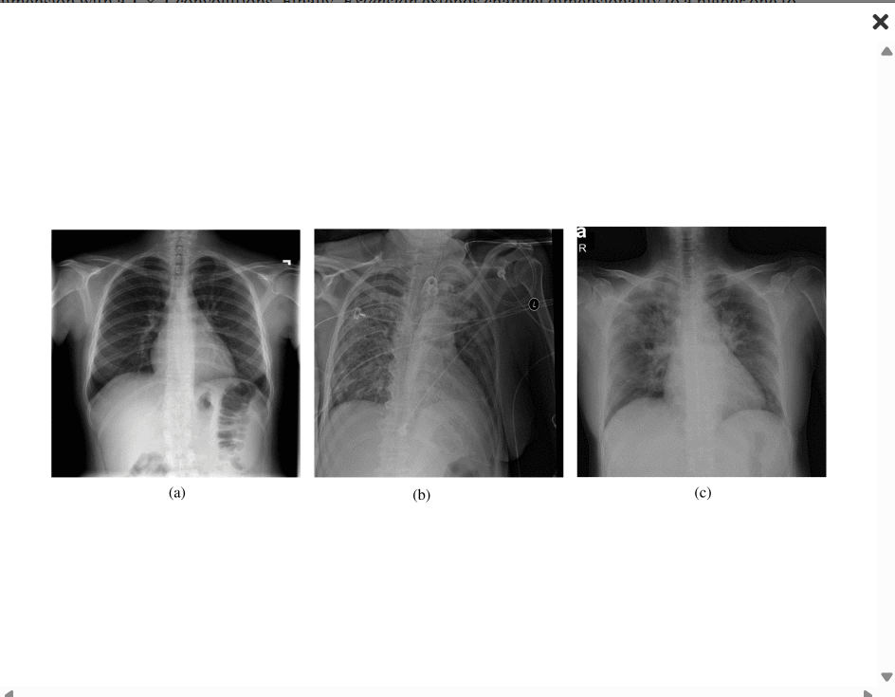
MINI PROJECT
NEURAL NETWORKS & DEEP LEARNING
EDL-COVID: Ensemble Deep Learning for COVID-19 Case Detection From Chest X-Ray Images
Source: https://ieeexplore.ieee.org/document/9350186
Madhu Sravani Bolisetti
700754871

Slide 2
Motivation
The COVID-19 pandemic exposed critical limitations in traditional diagnostic infrastructure.
RT-PCR testing, while accurate, faced scalability issues due to reagent shortages and delayed turnaround times.
Chest X-rays are widely available and cost-effective, making them suitable for rapid diagnosis, especially in underserved areas.
Manual interpretation requires radiological expertise, leading to bottlenecks and potential misdiagnoses.
Deep learning can augment diagnostic workflows by automating feature detection and improving decision-making speed.
A reliable, AI-based system could reduce the burden on healthcare systems during surges.

Slide 3
Problem Statement
COVID-Net is a promising model but limited by training data imbalance and sensitivity variability across classes.
Single-model predictions are vulnerable to noise, leading to inconsistencies in real-world settings.
Misclassification between COVID-19 and Pneumonia is common due to overlapping visual features in CXR.
Lack of model interpretability and generalization creates trust issues in clinical adoption.
Goal: Overcome these limitations with an ensemble approach that amplifies model strengths and suppresses individual weaknesses.

Slide 4
Objective
Design EDL-COVID, a snapshot ensemble framework built upon COVID-Net backbone.
Generate diverse model checkpoints via cosine annealing during a single training cycle.
Implement Weighted Averaging Ensembling (WAE) based on per-class sensitivity scores to balance predictions.
Evaluate performance on the COVIDx dataset with metrics: Accuracy, Sensitivity, PPV, and ROC.
Deliver a highly sensitive COVID-19 detection model capable of generalizing across clinical scenarios.

Slide 5
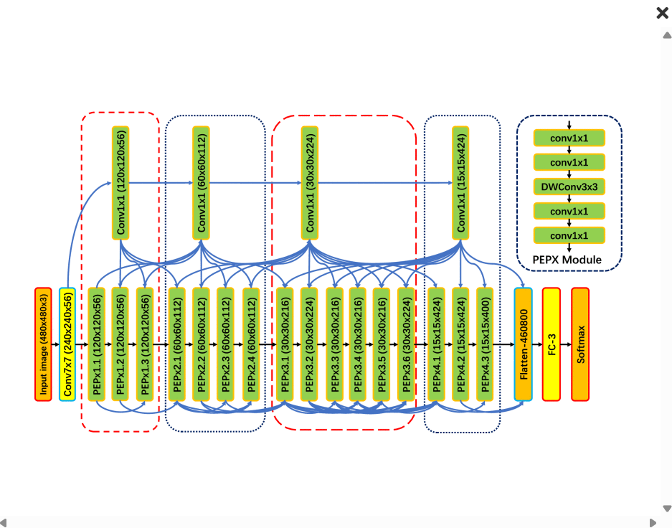
Methodology
Dataset: COVIDx - 15,477 CXR images across Normal, Pneumonia, and COVID-19 categories.
Architecture: COVID-Net using lightweight, interpretable design with PEPX modules and DWConv layers.
Training: One full training session using cosine annealing to sample models from different optimization points.
Ensemble: Combine snapshot outputs using WAE where each model's vote is scaled by its class-wise sensitivity.
Tools: TensorFlow 2.0, cuDNN 7.6, NVIDIA Tesla T4 GPU, Python 3.6 for reproducibility.
Evaluation: Accuracy, Sensitivity, PPV, ROC Curve, and Confusion Matrix for clinical reliability.

Slide 6
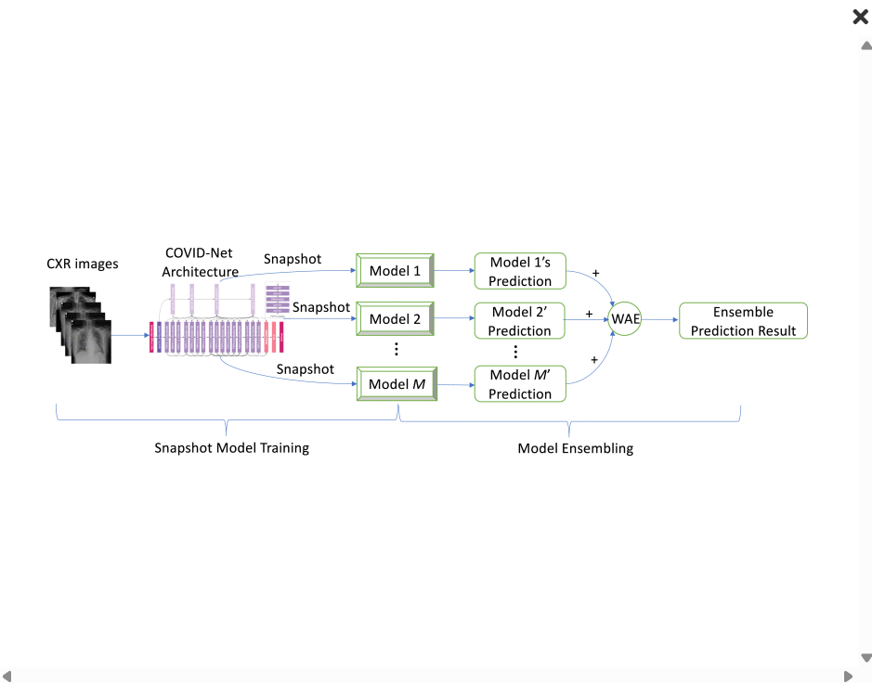

Slide 7
RESULTS
EDL-COVID outperforms single-model COVID-Net in all evaluation metrics.
Accuracy: 95.0% (vs 93.3% baseline), demonstrating overall reliability.
Sensitivity: 96% for COVID-19 - critical in minimizing false negatives in healthcare.
PPV: 94.1% - indicating strong confidence in positive predictions.
ROC-AUC: >0.98 across classes, confirming excellent model discrimination.
Only 4 out of 100 COVID-19 cases misclassified in test set.
Execution efficiency: Scales linearly with input size, supporting batch inference for hospitals.

Slide 8
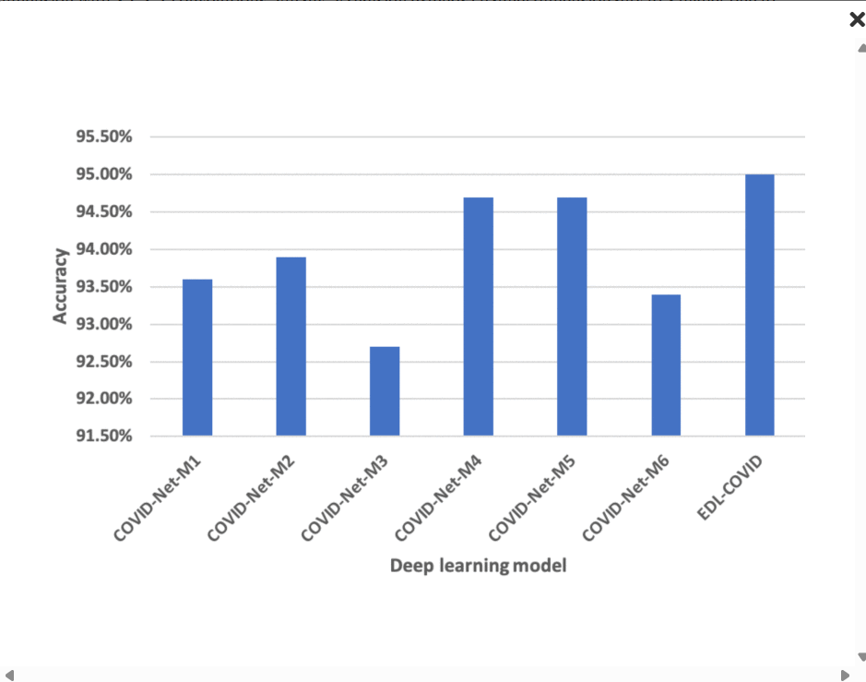
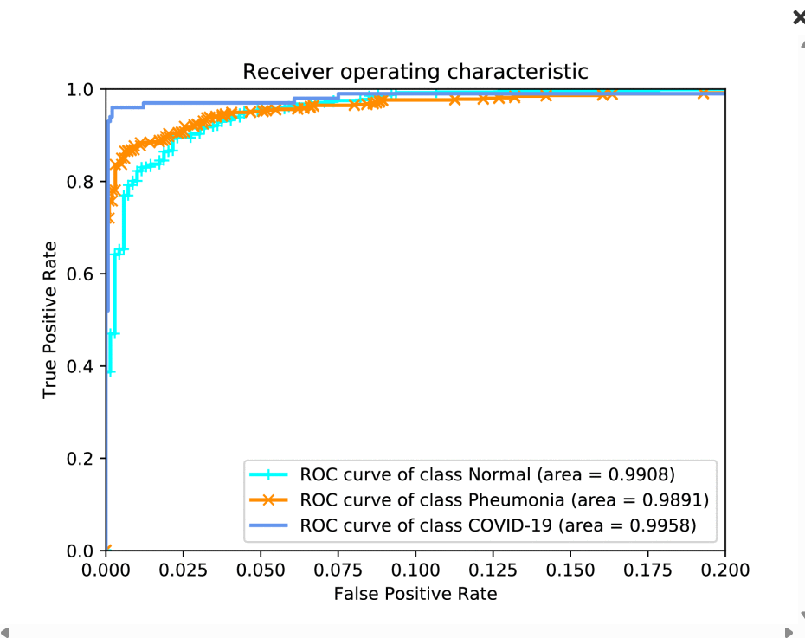
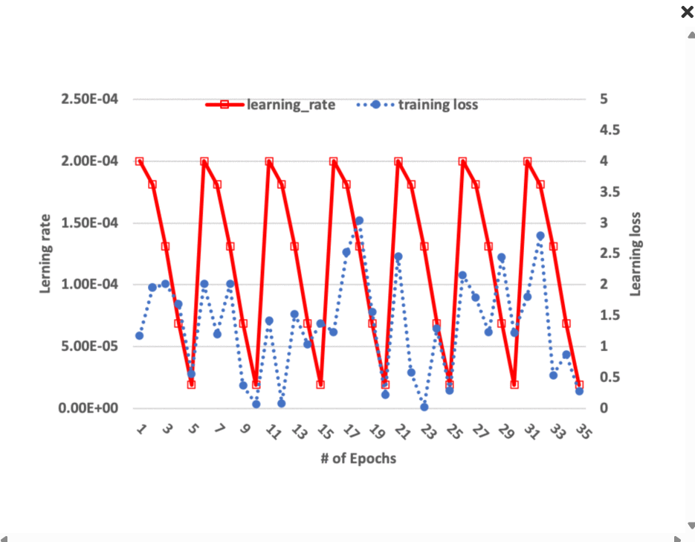

Slide 9
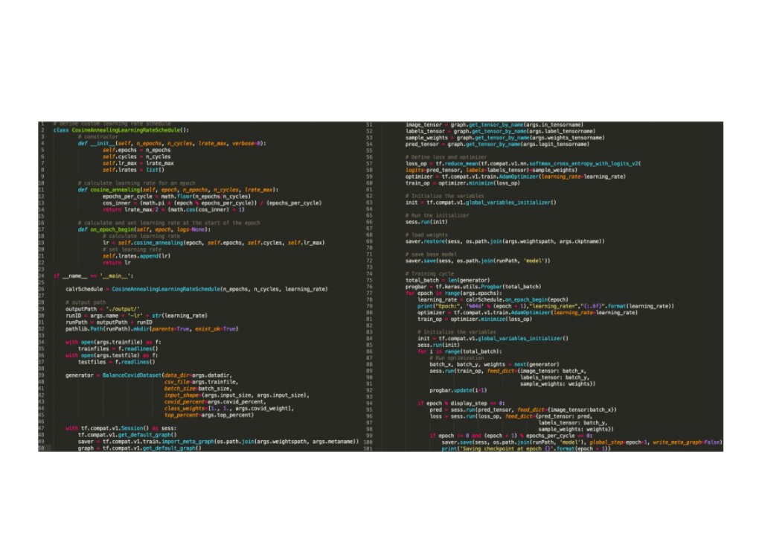

Slide 10
FUTURE SCOPE
Expand training with multi-center, real-world datasets to improve generalization.
Integrate EDL-COVID into hospital systems with real-time CXR interpretation via PACS.
Implement explainability tools like Grad-CAM to visualize model decisions and improve clinician trust.
Combine CXR images with clinical metadata (e.g., symptoms, RT-PCR) using multimodal deep learning.
Extend the ensemble framework to identify other pulmonary diseases or future pandemic viruses.
Evaluate model performance in diverse clinical environments through prospective studies.

Slide 11
CONCLUSION
EDL-COVID successfully integrates snapshot ensembling with sensitivity-based weighting.
It addresses overfitting, class imbalance, and improves prediction confidence.
The framework can be expanded to integrate attention mechanisms or Grad-CAM for better interpretability.
Can be deployed as a decision-support system for radiologists or in triage settings.
Future work includes validation on larger, multi-center datasets and real-time deployment feasibility.
EDL-COVID sets a precedent for rapid AI innovation in healthcare diagnostics.

Slide 12
REFERENCES
2020, [online] Available: https://github.com/lindawangg/COVID-Net/blob/master/docs/COVIDx.md.
M. Abdel-Basset, V. Chang, H. Hawash, R. K. Chakrabortty and M. Ryan, "FSS-2019-nCov: A deep learning architecture for semi-supervised few-shot segmentation of covid-19 infection" in Knowl.-Based Syst., vol. 212, 2021.
M. Z. Alom, M. Rahman, M. S. Nasrin, T. M. Taha and V. K. Asari, "COVID_MTNet: Covid-19 detection with multi-task deep learning approaches", 2020.
A. Borghesi and R. Maroldi, "COVID-19 outbreak in italy: Experimental chest x-ray scoring system for quantifying and monitoring disease progression", La Radiologia Med., vol. 125, no. 5, pp. 509–513, 2020.

