Slide 1
Module 5
Operational Amplifier

Slide 2
Contents
Introduction
OPAMP Symbol
Internal block diagram
Open-loop configuration
Common mode rejection ratio
OPAMP equivalent circuit
OPAMP characteristics
Closed-loop configuration

Slide 3
Contents
Inverting Amplifier
Non-inverting Amplifier
Summing Amplifier Difference Amplifier
Differentiator
Integrator
Tutorials

Slide 4
Reference book
OPAMPS and Linear Integrated Circuits
by Ramakanth Gayakwad

Slide 5
Introduction
Operational Amplifier (OPAMP) is a very high gain amplifier fabricated on Integrated Circuit (IC)
Finds application in
  Audio amplifier
  Signal generator
  Signal filters
  Biomedical Instrumentation
    And numerous other applications

Slide 6
Introduction
Advantages of OPAMP over transistor amplifier
  Less power consumption
  Costs less
  More compact
  More reliable
  Higher gain can be obtained
  Easy design

Slide 7
OPAMP terminals
+V_{CC}
Non inverting input
+
Output
Inverting input
–
–V_{EE}

Slide 8
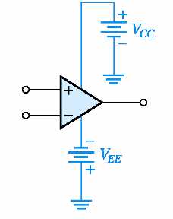
OPAMP terminals

Slide 9
OPAMP terminals
If input is applied to non inverting input terminal, then output will be in-phase with input
If input is applied to inverting input terminal, then output will be 180 degrees out of phase with input
If inputs are applied to both terminals, then output will be proportional to difference between the two inputs

Slide 10
OPAMP terminals
Two DC power supplies (dual) are required
Magnitudes of both may be same
The other terminal of both power supplies are connected to common ground
All input and output voltages are measured with reference to the common ground

Slide 11
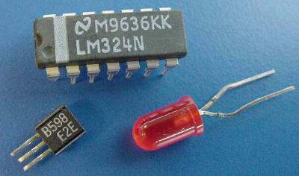
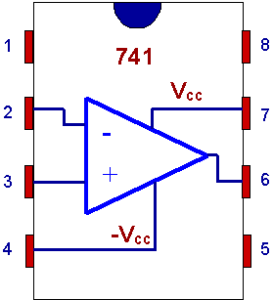
OPAMP terminals
Integrated Circuit

Slide 12
Internal Block Diagram
Differential
Amplifier
Stage
Intermediate
Stage
Level
Shifter
Stage
Output
Stage
Four stages can be identified –
Input stage or differential amplifier stage can amplify difference between two input signals; Input resistance is very high; Draws zero current from the input sources

Slide 13
Internal Block Diagram
Intermediate stage (or stages) use direct coupling; provide very high gain
Level shifter stage shifts the dc level of output voltage to zero (can be adjusted manually using two additional terminals)
Output stage is a power amplifier stage; has very small output resistance; so output voltage is the same, no matter what is the value of load resistance connected to the output terminal

Slide 14
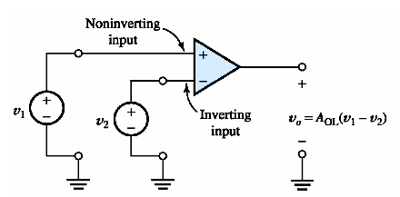
Open-loop configuration
If v₁ = 0, then v_{o} = –A_{OL}v₂ Inverting amplifier
If v₂ = 0, then v_{o} = A_{OL}v₁ Non inverting amp

Slide 15
Open-loop configuration
A_{OL} is the open-loop voltage gain of OPAMP
Its value is very high
Typical value is 0.5 million
So, even if input is in micro volts, output will be in volts
But output voltage cannot cross the value of power supply V_{CC}
So, if input is in milli volts, output reaches saturation value V_{sat} = V_{CC} (or V_{EE})

Slide 16
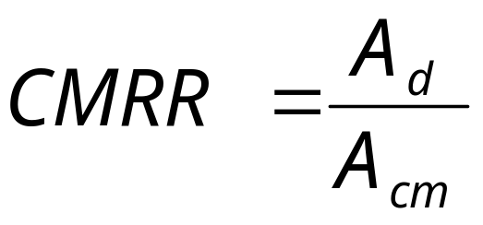
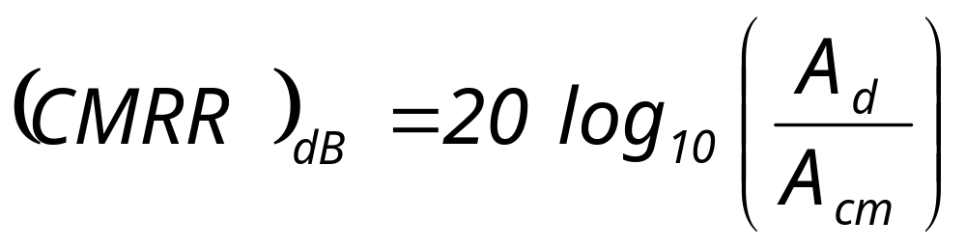
Op-Amp Parameters
Common-mode rejection ratio
  It is a measure of the ability of Op-Amp to reject the signals common to both input terminals (noise)
  Defined as

Slide 17
Problems
An OPAMP has differential voltage gain of 100,000 and CMRR of 60 dB. If non inverting input voltage is 150 μV and inverting input voltage is 140 μV, calculate the output voltage of OPAMP
Ans: 1.01 V
For an OPAMP, when v1 is 0.5 mV and v2 is –0.5 mV, output voltage is 8 V. For the same OPAMP, when v1 = v2 = 1 mV, output voltage is 12 mV. Calculate the CMRR of the OPAMP
Ans: 56.48 dB

Slide 18
OPAMP equivalent circuit
Practical OPAMP
R_{i}
+
–
R_{o}
A_{OL}v_{id}
v_{o}
v_{i1}
v_{i2}

Slide 19
OPAMP equivalent circuit
Ideal OPAMP
+
–
A_{OL}v_{id}
v_{o}
v_{i1}
v_{i2}

Slide 20
OPAMP Characteristics
Ideal OPAMP
  Infinite differential mode gain
  Zero common mode gain
  Infinite CMRR
  Infinite input resistance
  Zero output resistance
  Infinite bandwidth
  Infinite slew rate

Slide 21
OPAMP Characteristics
Differential mode gain A_{d}
  It is the factor by which the difference between the two input signals is amplified by the OPAMP
Common mode gain A_{cm}
  It is the factor by which the common mode input voltage is amplified by the OPAMP
Common mode rejection ratio CMRR
  Is the ratio of A_{d} to A_{cm} expressed in decibels

Slide 22
OPAMP Characteristics
Input resistance R_{i}
  It is the equivalent resistance measured between the two input terminals of OPAMP
Output resistance R_{o}
  It is equivalent resistance measured between output terminal and ground
Bandwidth
  It is the range of frequency over which the gain of OPAMP is almost constant

Slide 23
OPAMP Characteristics
Output offset voltage V_{oo}
  It is the output voltage when both input voltages are zero
  Denoted as V_{oo}
Input offset voltage V_{io}
  It is the differential input voltage that must be applied at the input terminals in order to make output voltage equal to zero
  V_{io} = |v₁ – v₂| for v_{o} = 0

Slide 24
OPAMP Characteristics
Input offset current I_{io}
  It is the difference between the currents in the input terminals when both input voltages are zero
  I_{io} = | I₁ – I₂ | when v₁ = v₂ = 0
Input bias current I_{ib}
  It is the average of the currents in the input terminals when both input voltages are zero
  I_{ib} = (I₁ + I₂) / 2 when v₁ = v₂ = 0

Slide 25
OPAMP Characteristics
Slew rate SR
  It is the maximum rate of change of output voltage with respect to time
  Slew rate has to be very high if OPAMP has to operate efficiently at high frequencies

Slide 26
OPAMP Characteristics
Practical characteristics of 741C OPAMP
  Differential mode gain is 200,000
  CMRR is 90 dB
  Input resistance is 2 MΩ
  Output resistance is 75 Ω
  Unity-gain Bandwidth is 1 MHz
  Slew rate is 0.5 V / μs
  Output offset voltage is 1 mV
  Input offset current is 20 nA
  Input bias current is 80 nA

Slide 27
Closed-loop configurations
Open-loop voltage gain of OPAMP is very high; such high gain is not required in most applications
In order to reduce gain, a part of output signal is fed back to the inverting input terminal (called negative feedback)
Many other OPAMP characteristics are improvised with this

Slide 28
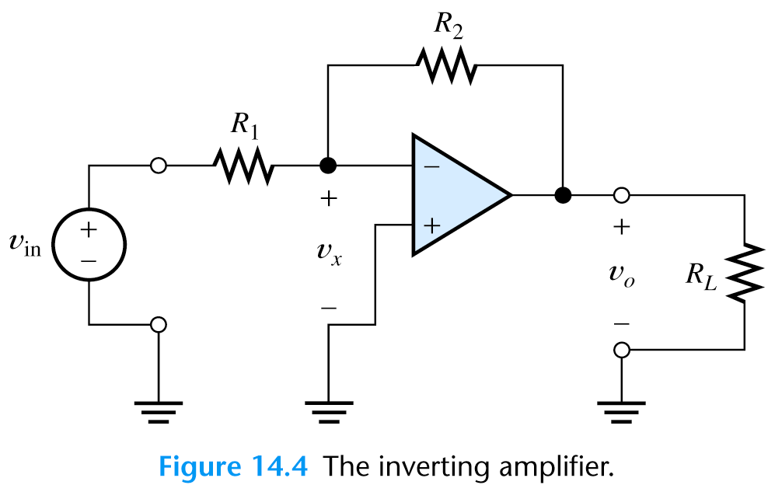
Inverting Amplifier
R_{F}

Slide 29
Inverting Amplifier
Input is applied to inverting terminal
Non inverting is grounded
Feedback is given to inverting terminal through resistor R_{F}
Assuming v_{o} is less than V_{CC}
since A_{d} is very high, v_{id} should be very small; v_{id} taken as almost zero
Current entering OPAMP input terminal is almost zero

Slide 30
Inverting Amplifier
i₂
R_{F}
i₁
0
+
0 V
–
Virtual ground

Slide 31
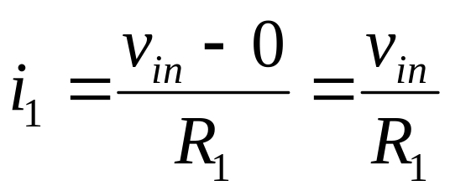
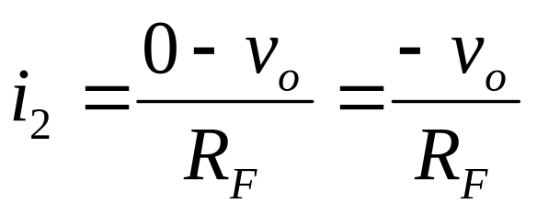
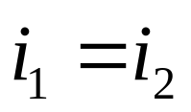
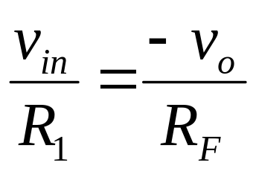
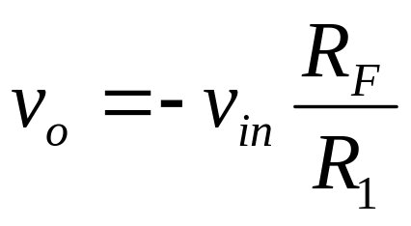
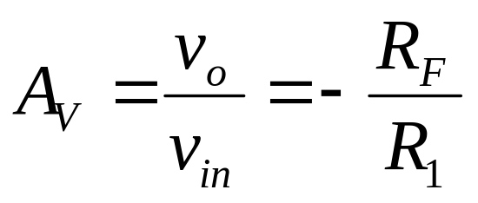
Inverting Amplifier

Slide 32
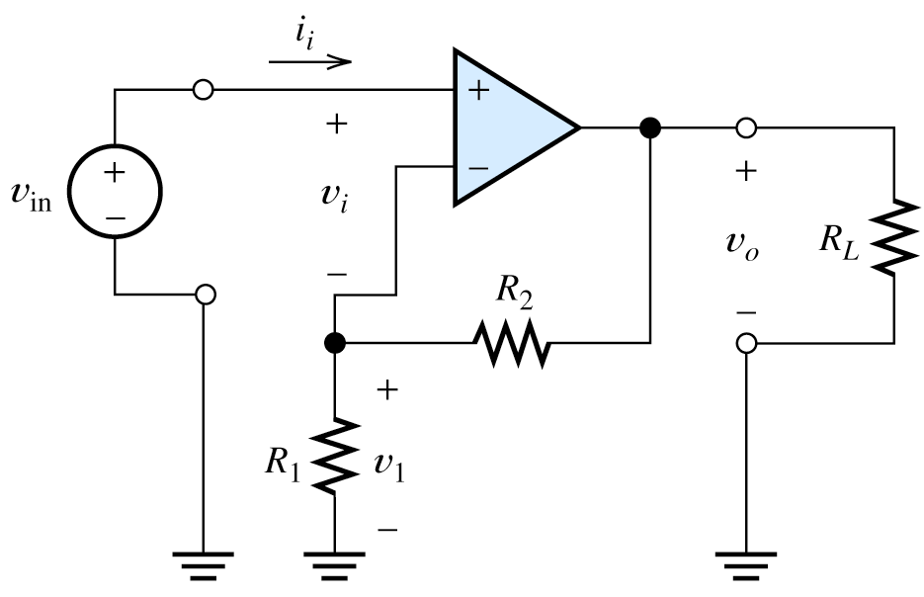
Non Inverting Amplifier
R_{F}

Slide 33
Non Inverting Amplifier
Input is applied to non inverting terminal
Feedback is given to inverting terminal
Output voltage will be in-phase with input voltage
Here again, the following assumptions are made
  Since A_{d} is very high, v_{id} should be very small; v_{id} taken as almost zero
  Current entering OPAMP input terminal is almost zero

Slide 34
Non Inverting Amplifier
v₁
v₂
R_{F}
i₂
i₁

Slide 35
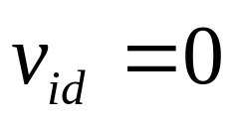
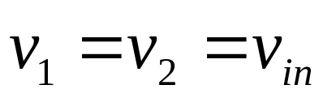
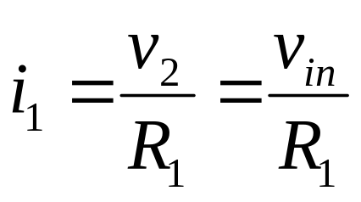
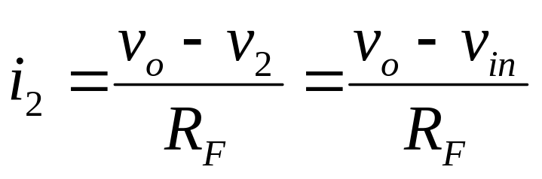
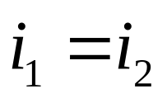
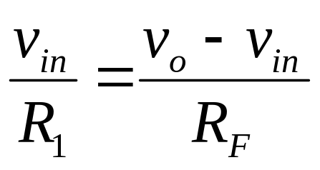
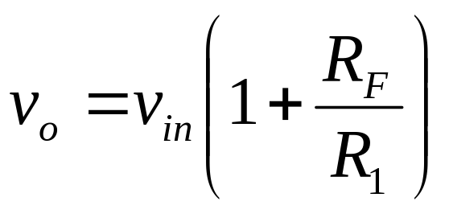
Non Inverting Amplifier

Slide 36
Problems
For an inverting amplifier using OPAMP, R₁=1K, R_{F}=100K, v_{in}=0.1sin(ωt). Find v_{o}.
Ans: –10sin(ωt)
For a non inverting amplifier, R₁=10K, R_{F}=100K. Calculate v_{o} if v_{i} = 25 mV dc.
Ans: 275 mV dc
An ac signal of rms value 2 mV needs to be amplified to 1.024 V rms, 180 degree phase shifted. Design a suitable amplifier choosing R₁=1.2K
Ans: Inv amplifier with R_{F}=614.4K

Slide 37
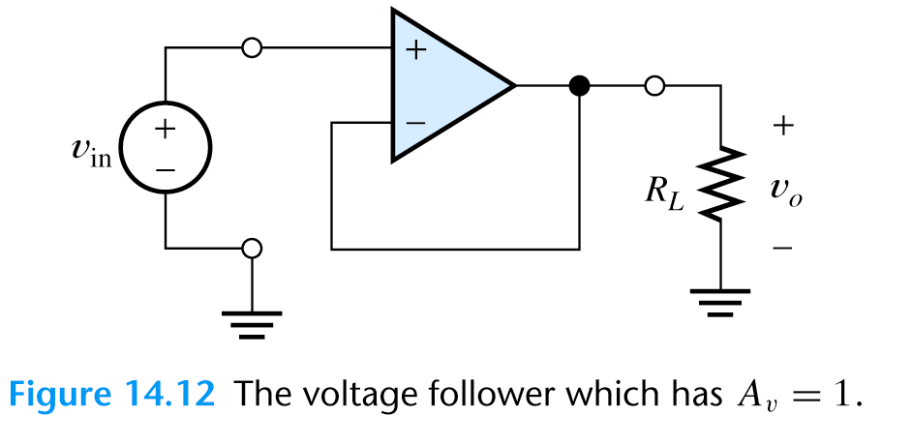
Voltage Follower
Special case of non inverting amplifier where R_{F}=0
Voltage gain is unity. v_{o} = v_{in}
Has very high input resistance and very low output resistance; Used as buffer for impedance matching

Slide 38
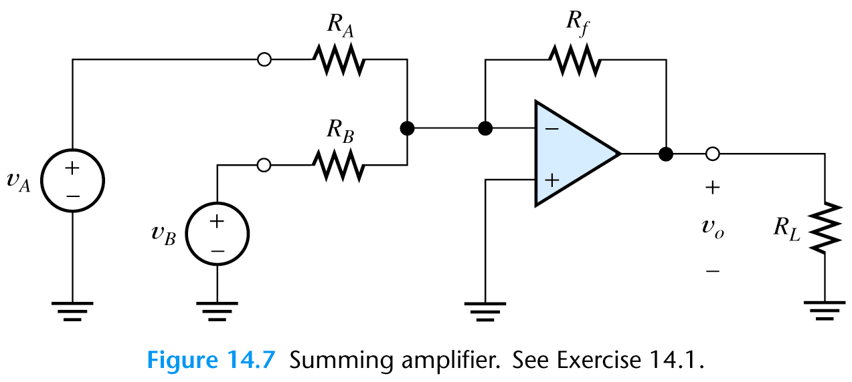
Summing Amplifier (Adder)
i_{F}
i_{A}
i_{B}

Slide 39
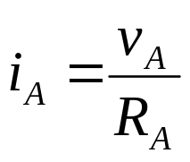
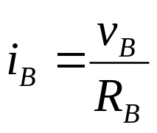
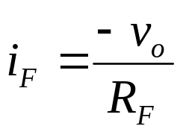
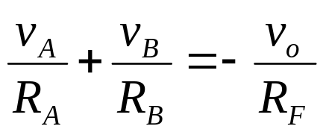

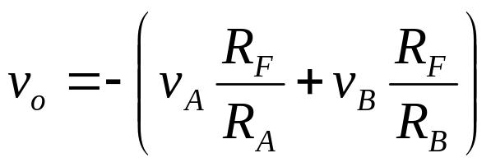

Summing Amplifier (Adder)
If R_{A}=R_{B}=R_{F}, then

Slide 40
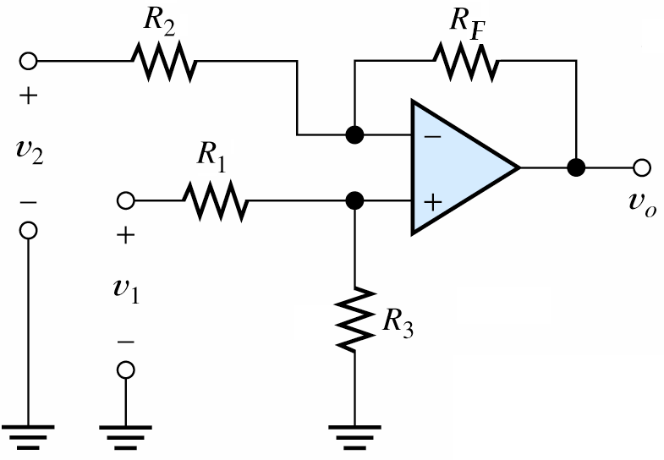
Difference Amplifier (Subtractor)

Slide 41
Difference Amplifier (Subtractor)
The circuit is analyzed using superposition theorem
Consider only v₁ to be present; v₂=0
Now derive expression for output voltage v_{o1}
Next consider only v₂ to be present; v₁=0
Derive expression for output voltage v₀₂
Actual output voltage v_{o} = v_{o1}+v_{o2}

Slide 42
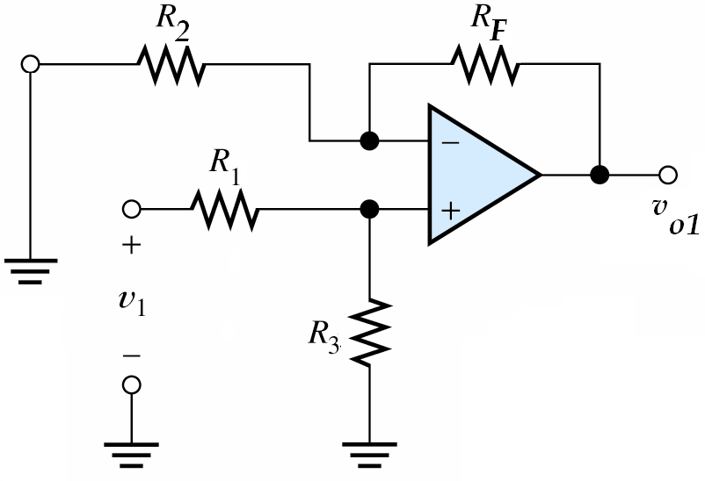
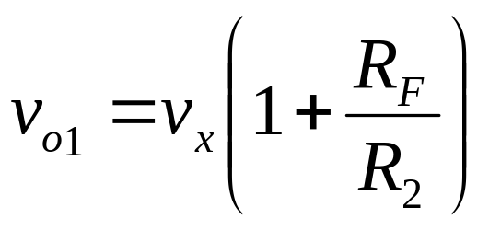
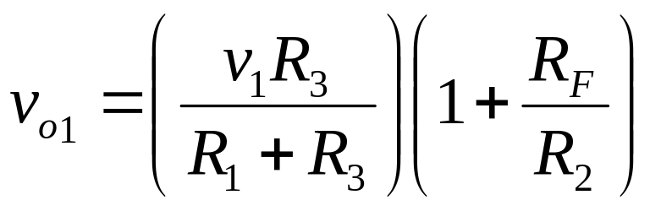
Difference Amplifier (Subtractor)
v_{x}

Slide 43
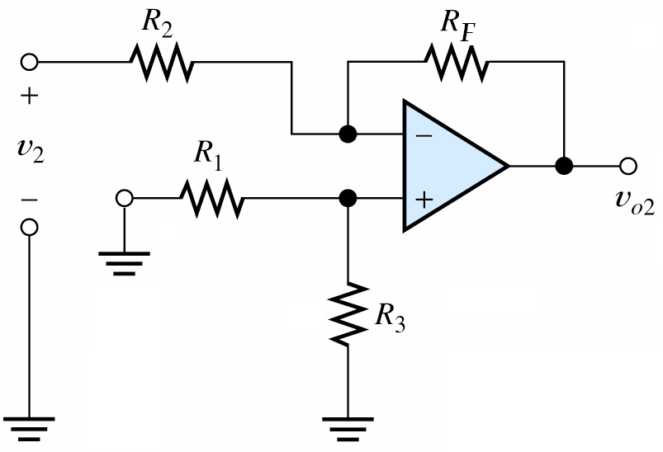
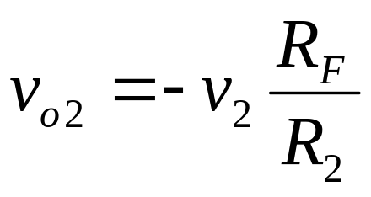
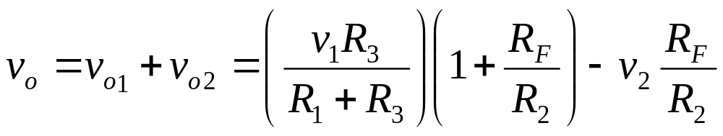
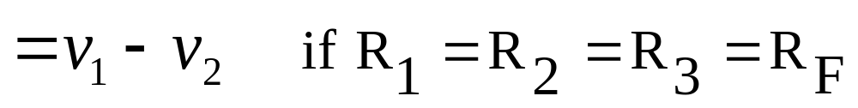
Difference Amplifier (Subtractor)

Slide 44
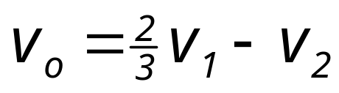
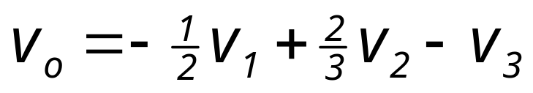
Problems
Design an OPAMP circuit such that output is given by v_{o}=–(0.5v₁+0.75v₂) where v₁ and v₂ are input voltages. Choose R_{F}=10K
Design an OPAMP subtractor to have output given by Choose R_{F}=R₂=1K
Design an OPAMP adder/subtractor to get output voltage

Slide 45
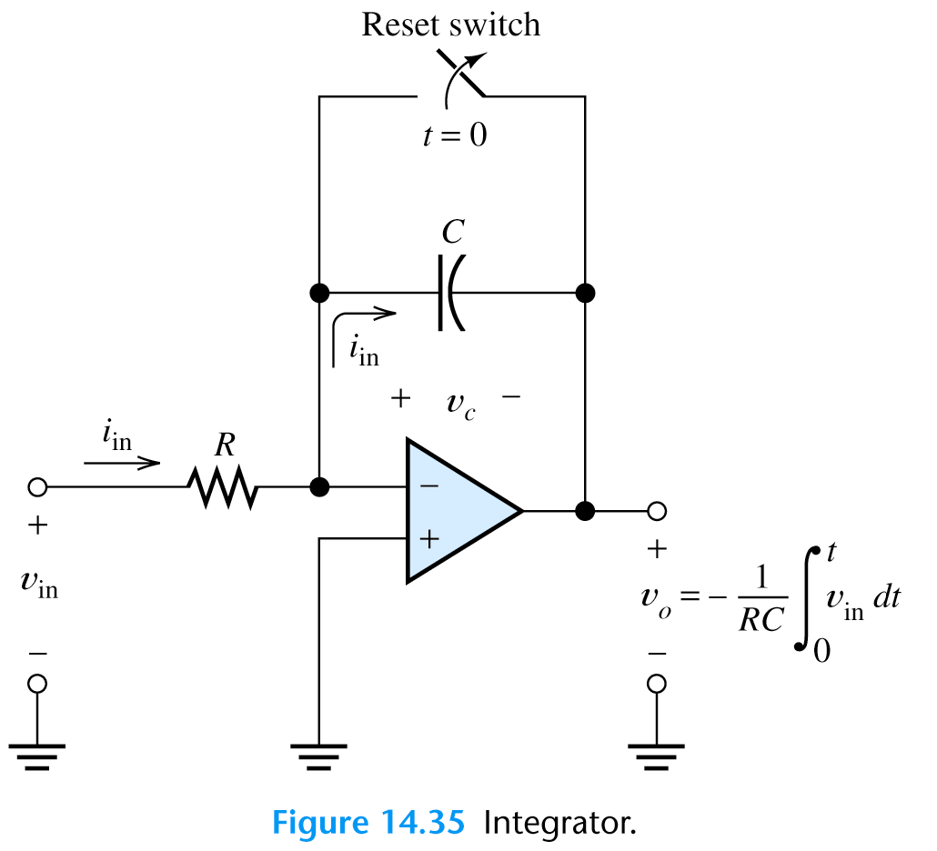
Integrator

Slide 46
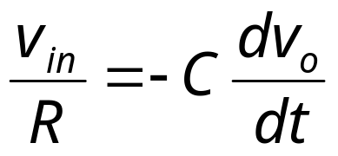
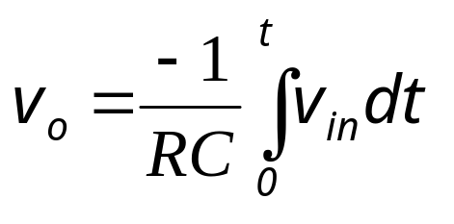
Integrator
Integrator is a circuit whose output is proportional to (negative) integral of the input signal with respect to time
Feedback is given through capacitor to inverting terminal
Since same current flows through R and C,

Slide 47
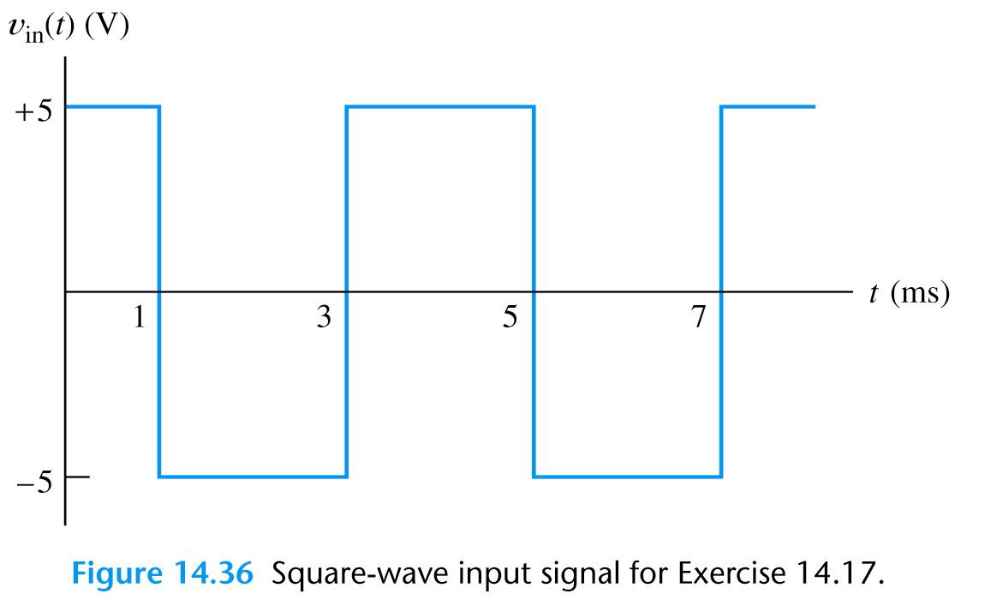
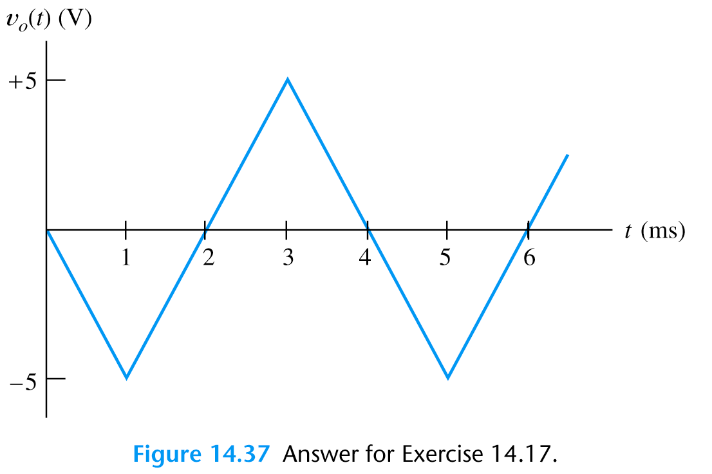
Integrator

Slide 48
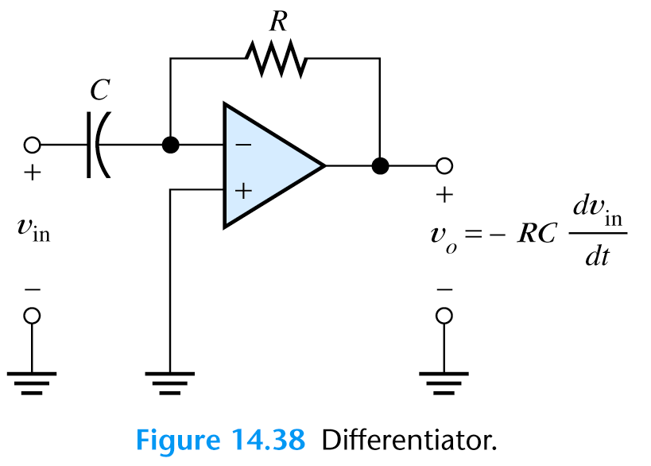
Differentiator

Slide 49
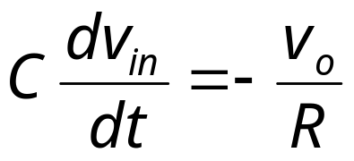
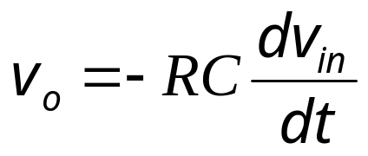
Differentiator
Differentiator is circuit whose output is proportional to (negative) differential of input voltage with respect to time
Input is given through capacitor, feedback given through resistor to inv terminal
Since current through R and C are same,

Slide 50
End of Module 4

