Slide 1
VOICE-BOX
Speak. Compete. Improve.
PROJECT by: Madhusudan Nagar & ritik thakur
SUPERVISOR: Janet m’am

Slide 2
Project overview
VOICEBOX is a real-time multiplayer web app
Players take turns speaking on random topics
Each player records for 20 seconds
AI scores based on grammar, fluency, and sentiment
Winner is declared based on the highest score

Slide 3
TECHNOLOGIES USED
FRONTEND
REACT
VITE
BACKEND
Node.Js
Express
Socket.IO
REAL-TIME COMMUNICATION
Socket.IO
SCORING AND SPEECH RECOGNITION
TextBlob NLP (Python)
Whisper (Python)

Slide 4
How it works
Player joins via web browser
System waits for 4 players
Random topic is shown
Players take 20s turns to record
Audio sent to server > Python > Whisper > TextBlob
Scores are shown and winner is declared

Slide 5
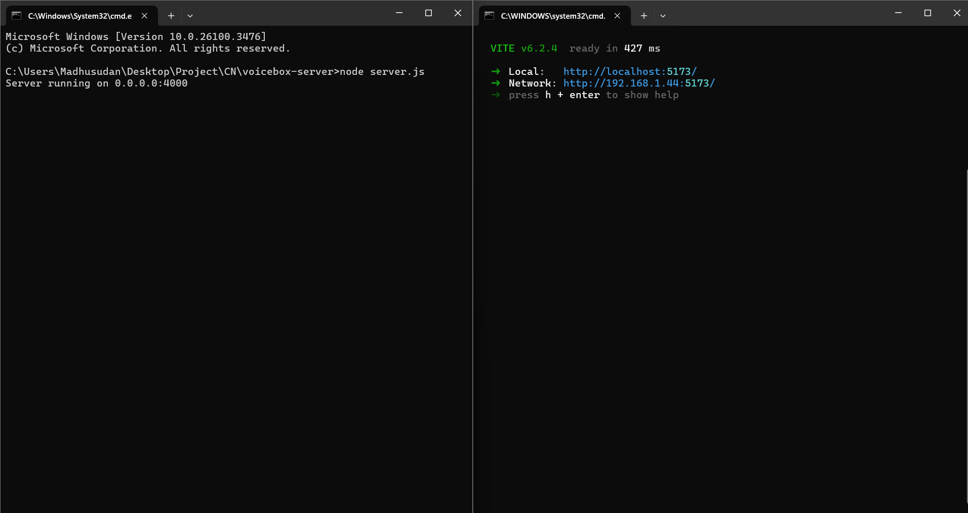
Serving and running
Starting the server on 0.0.0.0:4000 (port 4000)
Configuring Vite to serve on the local IP address for devices connected to the same Wi-Fi

Slide 6
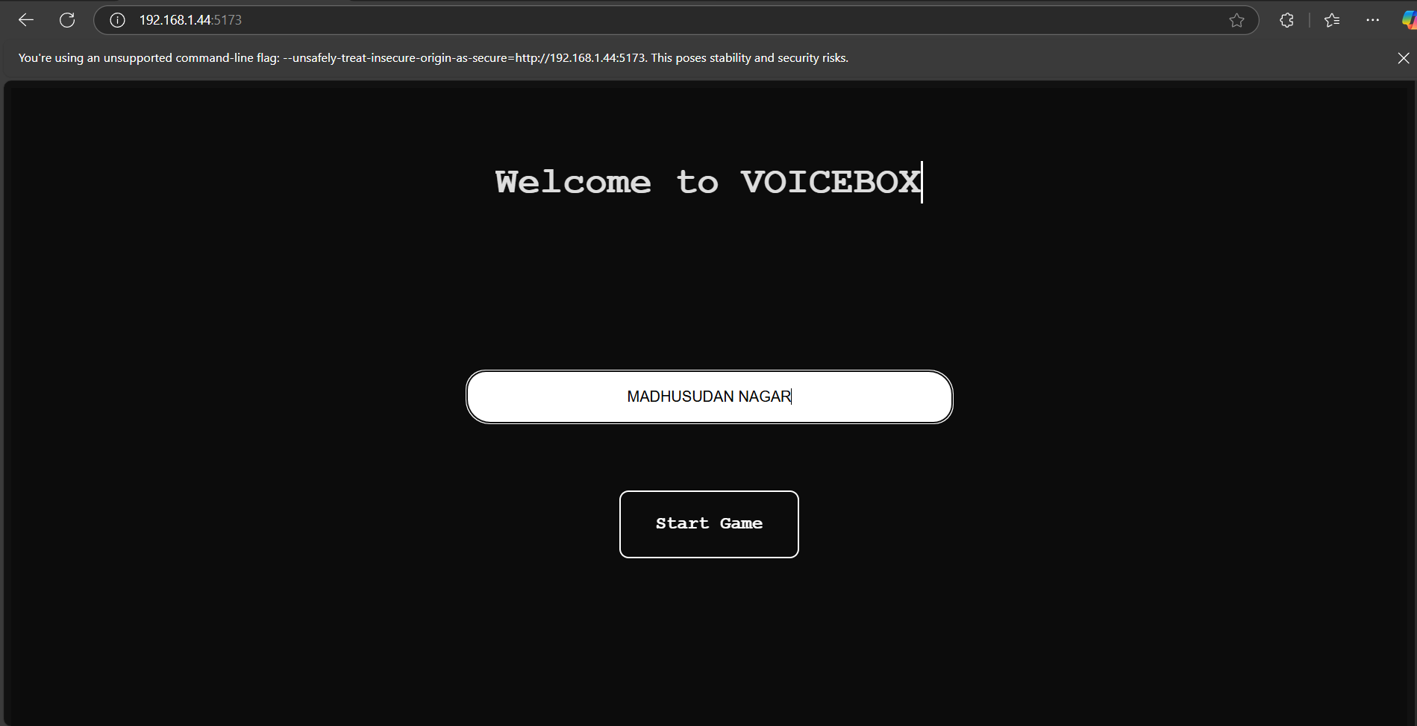
WELCOME
Open 192.168.1.44:5173 in a browser to connect to the game lobby
USING 192.168.1.44:5173 IN THE BROWSER TO CONNECT TO THE GAME LOBBY.
ENTER YOUR PLAYER NAME.

Slide 7
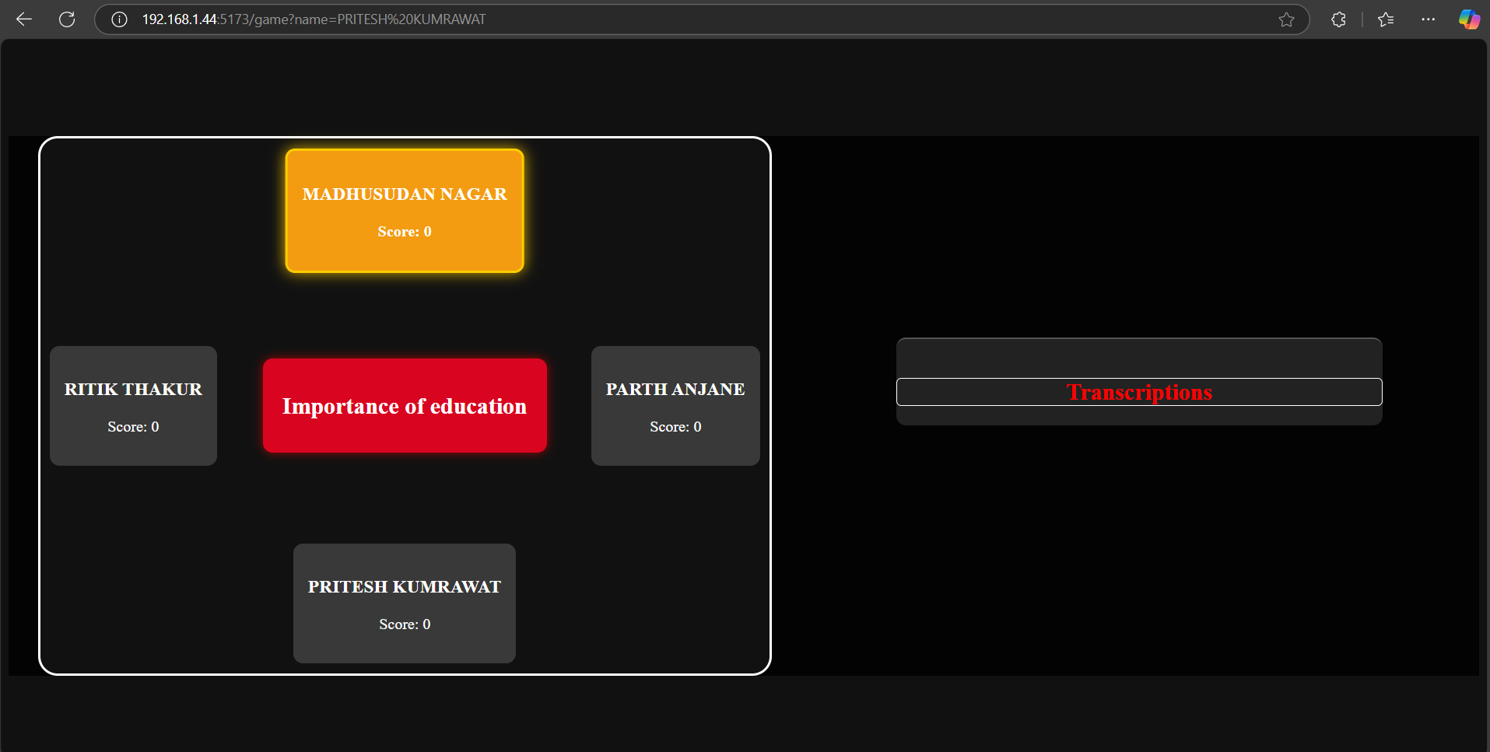
GAME LOBBY
All connected players take turns speaking on the topic displayed in the center.

Slide 8
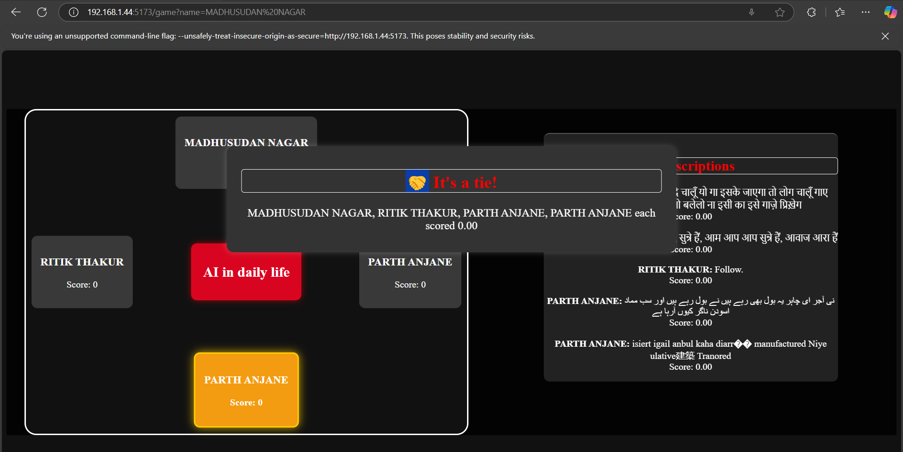
SCORE CALCULATION
TRANSCIPTS OF EACH PLAYER IS SHOWN ON THE RIGHT.
EACH TRANSCRIPT IS EVALUATED AND SCORED BY WHISPER(AI).

Slide 9
WINNER DECLARATION
WINNER IS DECLARED WITH THE HIGHEST SCORE.

Slide 10
Future Enhancements
Better AI scoring with grammar models
Leaderboard and historical stats
Mobile responsiveness
Multiplayer matchmaking and chat

Slide 11
THANK YOU

