Slide 1
Finger Biometric
-- Neural networks

Slide 2
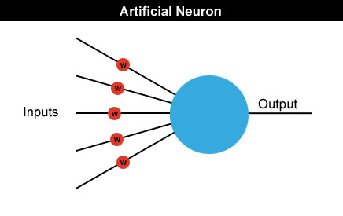
Neural networks
Neural networks are made up of many artificial neurons.
Each input into the neuron has its own weight associated with it illustrated by the red circle.
A weight is simply a floating point number and it's these we adjust when we eventually come to train the network.

Slide 3
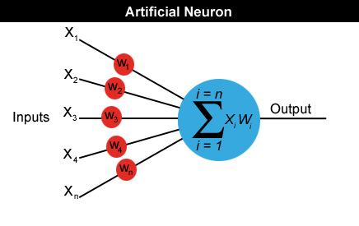
Neural networks
A neuron can have any number of inputs from one to n, where n is the total number of inputs.
The inputs may be represented therefore as x1, x2, x3… xn.
And the corresponding weights for the inputs as w1, w2, w3… wn.
Output a = x1w1+x2w2+x3w3... +xnwn

Slide 4
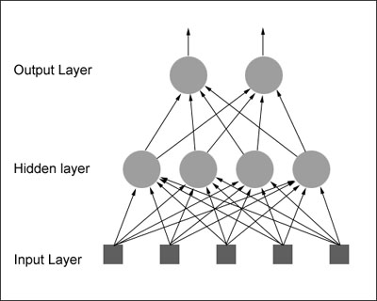
How do we actually use an artificial neuron?
Feedforward network: The neurons in each layer feed their output forward to the next layer until we get the final output from the neural network.
There can be any number of hidden layers within a feedforward network.
The number of neurons can be completely arbitrary.

Slide 5

Neural Networks by an Example
let's design a neural network that will detect the number '4'.
Given a panel made up of a grid of lights which can be either on or off, we want our neural net to let us know whenever it thinks it sees the character '4'.
The panel is eight cells square and looks like this:
the neural net will have 64 inputs, each one representing a particular cell in the panel and a hidden layer consisting of a number of neurons (more on this later) all feeding their output into just one neuron in the output layer

Slide 6
Neural Networks by an Example
initialize the neural net with random weights
feed it a series of inputs which represent, in this example, the different panel configurations
For each configuration we check to see what its output is and adjust the weights accordingly so that whenever it sees something looking like a number 4 it outputs a 1 and for everything else it outputs a zero.
More: http://www.doc.ic.ac.uk/~nd/surprise_96/journal/vol4/cs11/report.html

Slide 7
Multi-Layer Perceptron (MLP)

Slide 8
x₁
x_{n}
We will introduce the MLP and the backpropagation algorithm which is used to train it
MLP used to describe any general feedforward (no recurrent connections) network
However, we will concentrate on nets with units arranged in layers

Slide 9
x₁
x_{n}
Different books refer to the above as either 4 layer (no. of layers of neurons) or 3 layer (no. of layers of adaptive weights). We will follow the latter convention
1st question:
what do the extra layers gain you? Start with looking at what a single layer can’t do

Slide 10
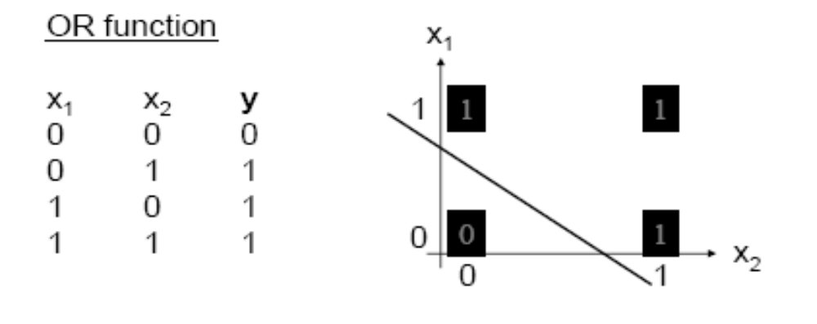
Perceptron Learning Theorem
Recap: A perceptron (threshold unit) can learn anything that it can represent (i.e. anything separable with a hyperplane)

Slide 11
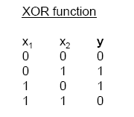
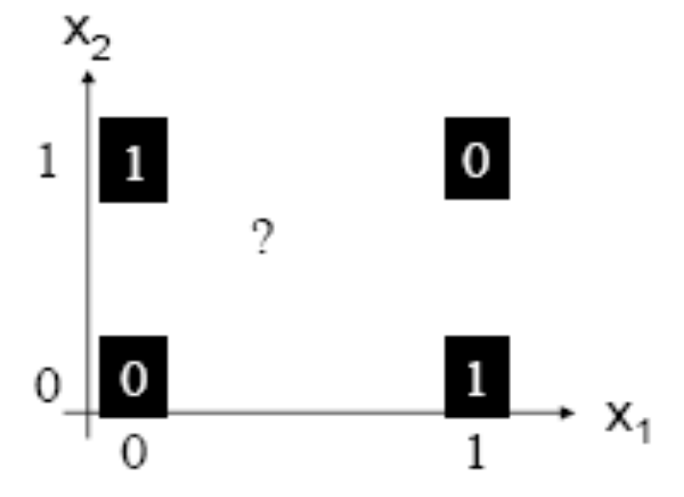
The Exclusive OR problem
A Perceptron cannot represent Exclusive OR since it is not linearly separable.

Slide 12
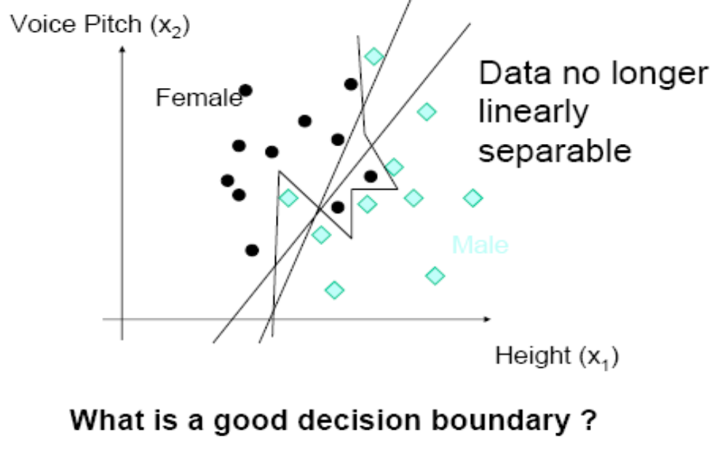

Slide 13
Minsky & Papert (1969) offered solution to XOR problem by
combining perceptron unit responses using a second layer of
Units. Piecewise linear classification using an MLP with
threshold (perceptron) units
+1
1
3
2
+1

Slide 14
Three-layer networks
x₁
x₂
Input
Output
x_{n}
Hidden layers

Slide 15
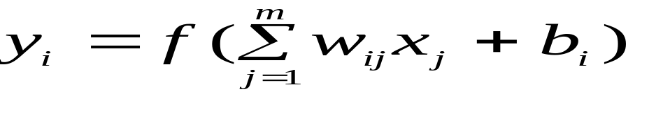
Properties of architecture
No connections within a layer
Each unit is a perceptron

Slide 16
Properties of architecture
No connections within a layer
No direct connections between input and output layers
Each unit is a perceptron

Slide 17
Properties of architecture
No connections within a layer
No direct connections between input and output layers
Fully connected between layers
Each unit is a perceptron

Slide 18
Properties of architecture
No connections within a layer
No direct connections between input and output layers
Fully connected between layers
Often more than 3 layers
Number of output units need not equal number of input units
Number of hidden units per layer can be more or less than
input or output units
Each unit is a perceptron
Often include bias as an extra weight

Slide 19
What do each of the layers do?
3rd layer can generate arbitrarily complex boundaries
1st layer draws linear boundaries
2nd layer combines the boundaries

Slide 20
Backpropagation learning algorithm ‘BP’
Solution to credit assignment problem in MLP. Rumelhart, Hinton and Williams (1986) (though actually invented earlier in a PhD thesis relating to economics)
BP has two phases:
Forward pass phase: computes ‘functional signal’, feed forward
propagation of input pattern signals through network
Backward pass phase: computes ‘error signal’, propagates
the error backwards through network starting at output units
(where the error is the difference between actual and desired
output values)

Slide 21
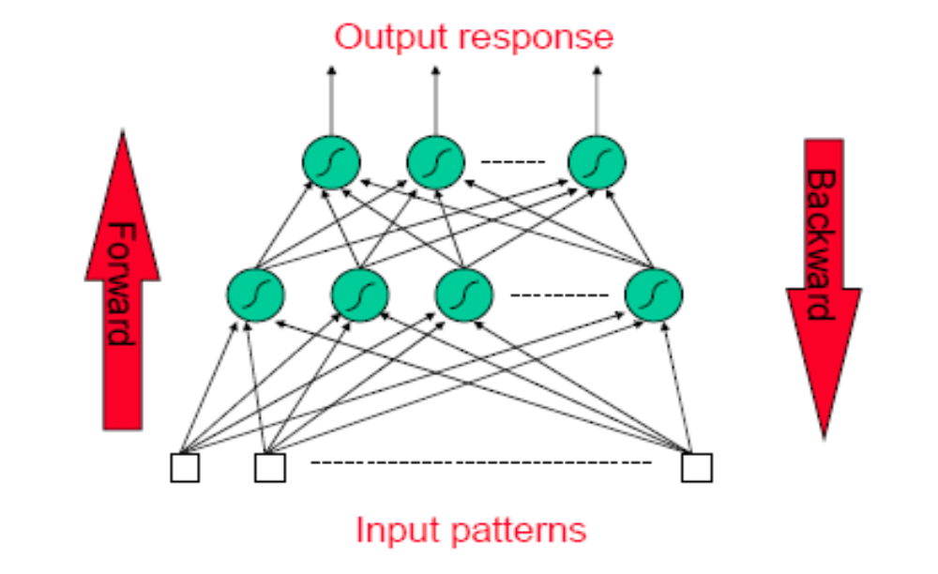
Conceptually: Forward Activity -
Backward Error

Slide 22
Forward Propagation of Activity
Step 1: Initialise weights at random, choose a learning rate η
Until network is trained:
For each training example i.e. input pattern and target output(s):
Step 2: Do forward pass through net (with fixed weights) to produce output(s)
  i.e., in Forward Direction, layer by layer:
    Inputs applied
    Multiplied by weights
    Summed
    ‘Squashed’ by sigmoid activation function
    Output passed to each neuron in next layer
  Repeat above until network output(s) produced

Slide 23
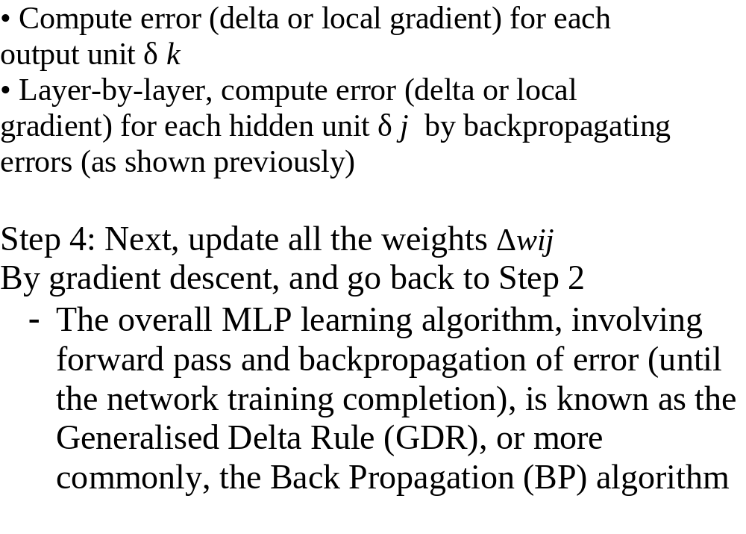
Step 3. Back-propagation of error

Slide 24
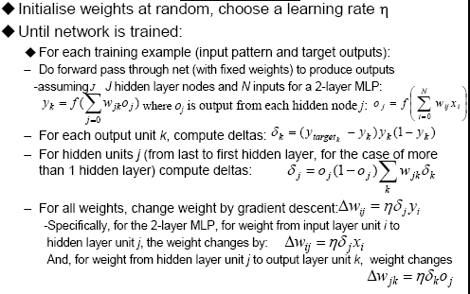
‘Back-prop’ algorithm summary
(with Maths!) (Not Examinable)

Slide 25
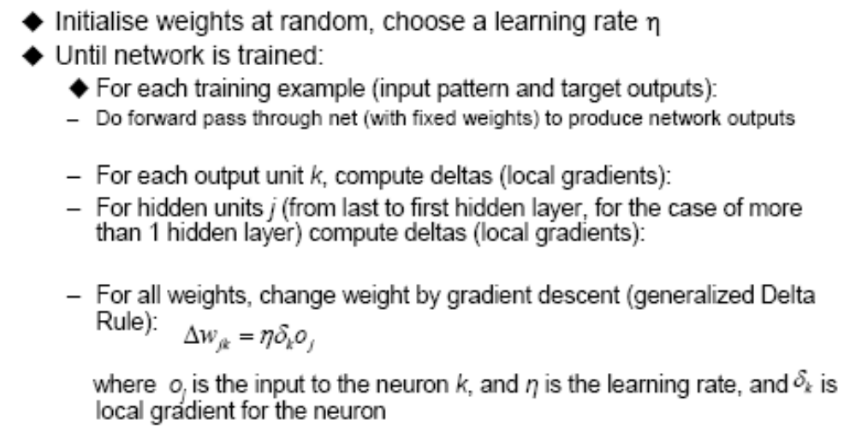
‘Back-prop’ algorithm summary (with NO Maths!)

Slide 26
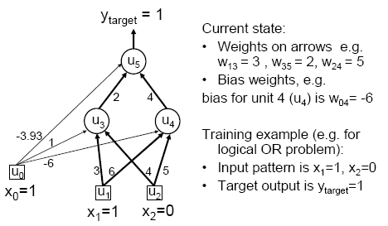
MLP/BP: A worked example

Slide 27
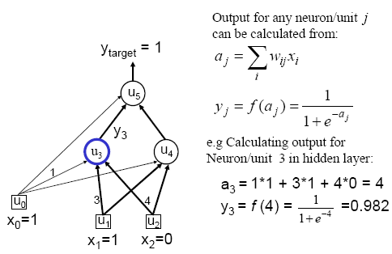
Worked example: Forward Pass

Slide 28
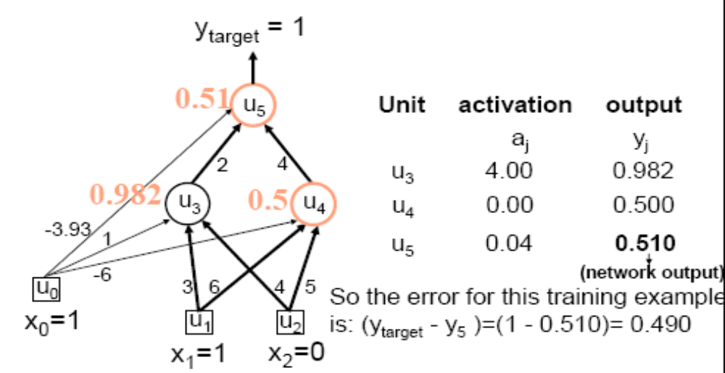
Worked example: Forward Pass

Slide 29
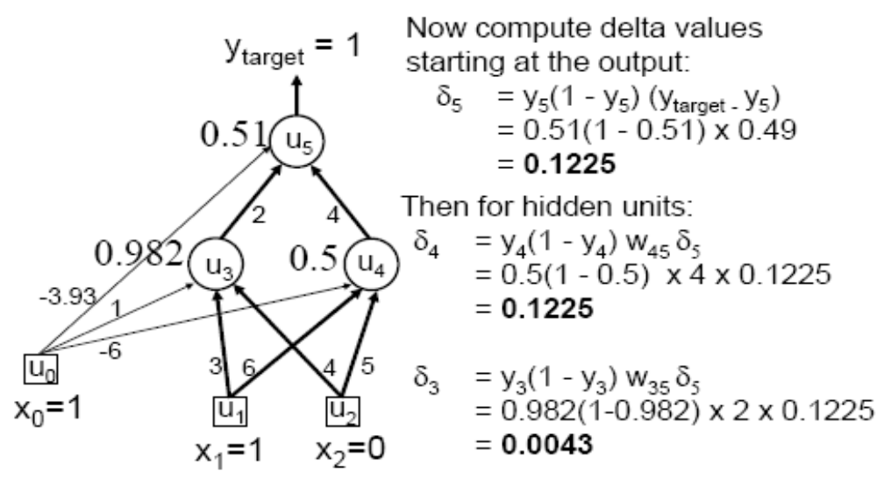
Worked example: Backward Pass

Slide 30
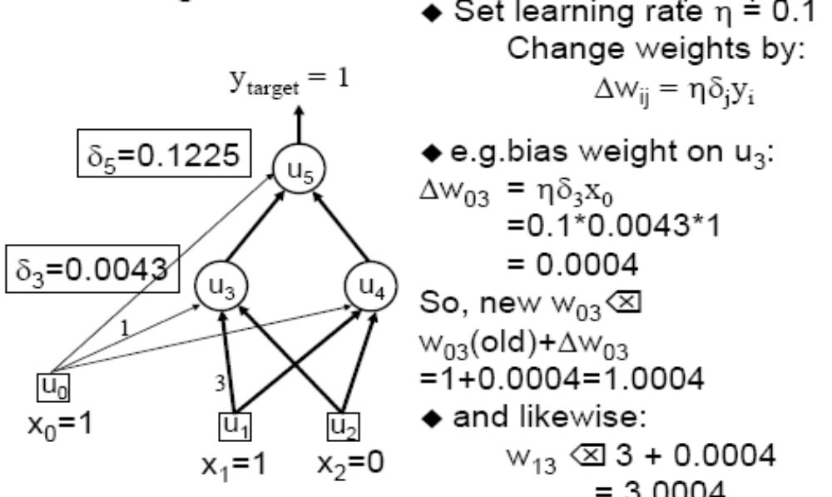
Worked example: Update Weights
Using Generalized Delta Rule (BP)

Slide 31
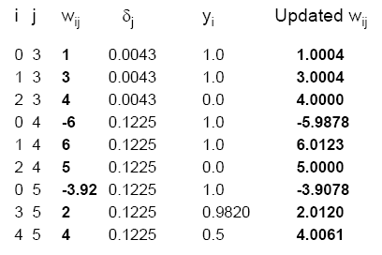
Similarly for the all weights wij:

Slide 32
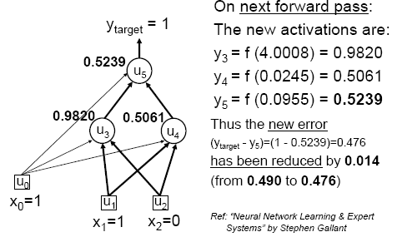
Verification that it works

Slide 33
Training
This was a single iteration of back-prop
Training requires many iterations with many training examples or epochs (one epoch is entire presentation of complete training set)
It can be slow !
Note that computation in MLP is local (with respect to each neuron)
Parallel computation implementation is also possible

Slide 34
Training and testing data
How many examples ?
  The more the merrier !
Disjoint training and testing data sets
  learn from training data but evaluate performance (generalization ability) on unseen test data
Aim: minimize error on test data

