Slide 1
Java Memory Model
Version 1.0

Slide 2


AGENDA
Introduction
Heap
PermGen
Thread
Interaction with Hardware Memory
New In Java 8
* Delete This Page Before Circulation

Slide 3
Introduction
Java Memory Model (JMM) defines various types of ‘Memory Area' used by JVM for various purposes
It specifies how and when different threads can see values written to shared variables by other threads
It also defines interaction of JMM with internal Memory Hardware

Slide 4
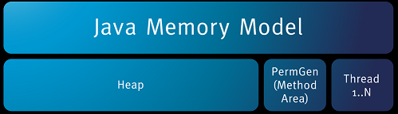
Memory Areas
JMM makes use of THREE memory areas:
Heap
Permgen
Thread

Slide 5
Heap Space
Java Heap space is used by java runtime to allocate memory to Objects and JRE classes.
Whenever we create any object, it’s always created in the Heap space.
Any object created in the heap space has global access and can be referenced from anywhere of the application
Garbage Collection runs on the heap memory to free the memory used by objects that doesn’t have any reference.

Slide 6
Heap Space (contd.)
Heap Space is further divided into two generations/ areas namely:
Young Generation – This pool is further divided into following areas:
Eden Space: The pool from which memory is initially allocated for most objects
Survivor Space: The pool containing objects that have survived the (minor) garbage collection of the Eden space
Old Generation (aka Tenured Generation) - The pool containing objects that have existed for some time in the survivor space

Slide 7
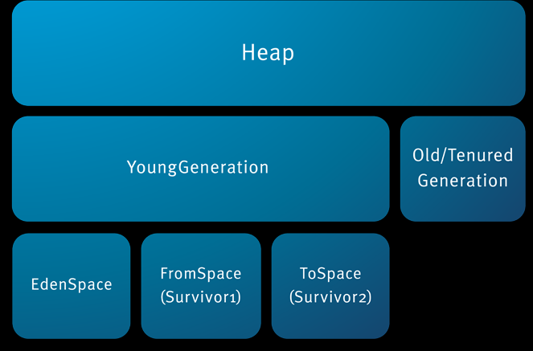
Pictorial View of Java Heap

Slide 8
More About Young Generation
Most of the newly created objects are located in the Eden memory space.
When Eden space is filled with objects, Minor GC is performed and all the survivor objects are moved to one of the survivor spaces.
Minor GC also checks the survivor objects and move them to the other survivor space. So at a time, one of the survivor space is always empty.
Objects that are survived after many cycles of GC, are moved to the Old generation memory space. Usually it’s done by setting a threshold for the age of the young generation objects before they become eligible to promote to Old generation.

Slide 9
More About Old Generation
Old Generation memory contains the objects that are long lived and survived after many rounds of Minor GC.
Usually garbage collection is performed in Old Generation memory when it’s full.
Old Generation Garbage Collection is called Major GC and usually takes longer time.

Slide 10
Heap Space | Interesting Points
You can increase or change size of Java Heap space by using JVM command line option -Xms, -Xmx and -Xmn
You can use either JConsole or Runtime.maxMemory(), Runtime.totalMemory(), Runtime.freeMemory() to query about Heap size programmatic in Java
You can use command "jmap" to take Heap dump in Java and "jhat" to analyze that heap dump.
Don’t panic when you get java.lang.OutOfMemoryError, sometimes its just matter of increasing heap size. Do check for ‘memory leaks’ in your application by using various profilers such as Jprofiler, YourKit etc

Slide 11
‘Perm’ region
Perm space is used to keep information for loaded classes
It is also used for few other advanced features like String Pool(for highly optimized string equality testing).
As your application(number of classes) will grow this space shall get filled quickly
Since the garbage collection on this Space is not much effective to clean up as required, you quickly get Out of Memory : perm gen space error. After then, no application shall run on that machine effectively even after having a huge empty JVM.

Slide 12
‘Thread’ (aka Stack Memory)
Thread memory is used for execution of a thread.
They contain method specific values that are short-lived and references to other objects in the heap that are getting referred from the method.
Stack memory is always referenced in LIFO (Last-In-First-Out) order.
Whenever a method is invoked, a new block is created in the stack memory for the method to hold local primitive values and reference to other objects in the method.

Slide 13
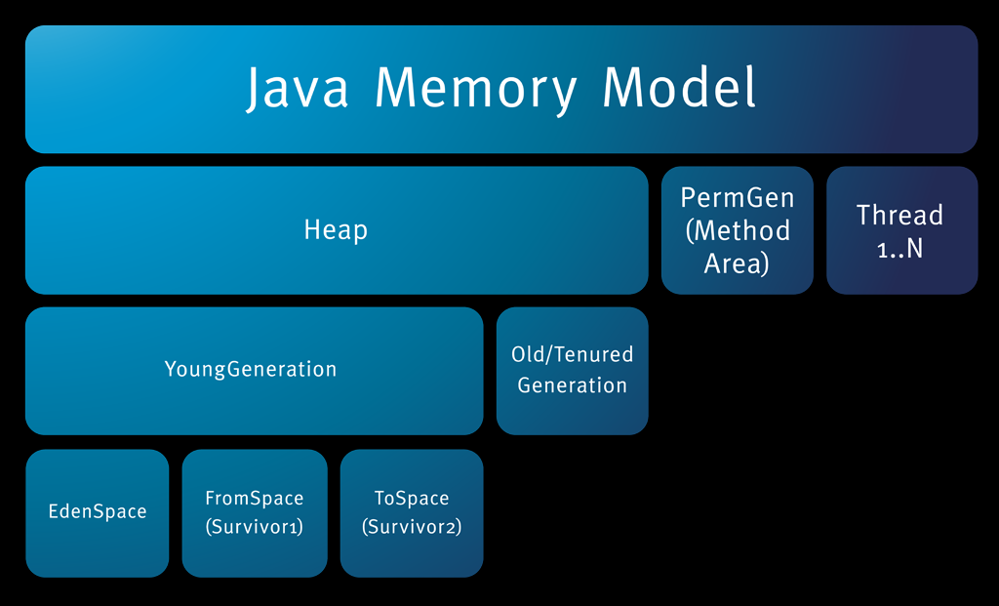
Java Memory Model | Full View

Slide 14
JMM and Interation With Hardware Memory
02

Slide 15
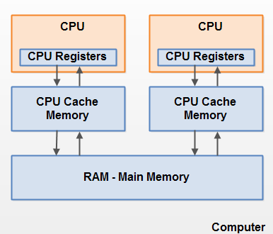
Computer Hardware Architecture - Glimpse
A computer often has 2 or more CPUs in it
Each CPU contains a set of registers which are essentially in-CPU memory.
Each CPU may also have a CPU cache memory layer.
A computer also contains a main memory area (RAM). All CPUs can access the main memory.

Slide 16
Speed of various memory types
CPU can access CPU-registers much faster than it can access main memory.
CPU cache memory layer speed is somewhere in between the speed of the internal registers and main memory

Slide 17
Data Flow in Registers, Cache and Main Memory
Typically, when a CPU needs to access main memory it will read part of main memory into its CPU cache.
It may even read part of the cache into its internal registers and then perform operations on it.
When the CPU needs to write the result back to main memory it will flush the value from its internal register to the cache memory, and at some point flush the value back to main memory.
The values stored in the cache memory is typically flushed back to main memory when the CPU needs to store something else in the cache memory. The CPU cache can have data written to part of its memory at a time, and flush part of its memory at a time.

Slide 18
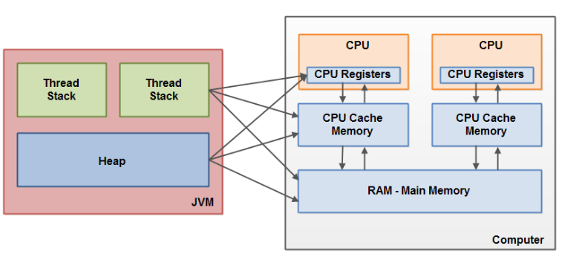
Bridging The Gap Between The Java Memory Model And The Hardware Memory Architecture
Explained in next slide …

Slide 19
Bridging Explained
The hardware memory architecture does not distinguish between thread stacks and heap.
On the hardware, both the thread stack and the heap are located in main memory.
Parts of the thread stacks and heap may sometimes be present in CPU caches and in internal CPU registers
When objects and variables can be stored in various different memory areas in the computer, certain problems may occur. The two main problems are:
Visibility of thread updates (writes) to shared variables.
Race conditions when reading, checking and writing shared variables

Slide 20
Visibility of Shared Objects
“Imagine that the shared object is initially stored in main memory. A thread running on CPU one then reads the shared object into its CPU cache. There it makes a change to the shared object. As long as the CPU cache has not been flushed back to main memory, the changed version of the shared object is not visible to threads running on other CPUs. This way each thread may end up with its own copy of the shared object, each copy sitting in a different CPU cache.”
If two or more threads are sharing an object, without the proper use of either volatile declarations or synchronization, updates to the shared object made by one thread may not be visible to other threads.
To solve this ‘visibility’ problem you use ‘volatile’ keyword

Slide 21
Race Conditions
“Imagine if thread A reads the variable count of a shared object into its CPU cache. Imagine too, that thread B does the same, but into a different CPU cache. Now thread A adds one to count, and thread B does the same. Now var1 has been incremented two times, once in each CPU cache. Since, the two increments have been carried out concurrently without proper synchronization. Regardless of which of thread A and B that writes its updated version of count back to main memory, the updated value will only be 1 higher than the original value, despite the two increments.”
If two or more threads share an object, and more than one thread updates variables in that shared object,race conditions may occur..
To solve this ‘race-condition’ problem, you must do proper ‘synchronization’

Slide 22
Changes in JMM in Java 8
Permanent Generation (PermGen) space has been completed removed in JAVA 8 and replaced with Metaspace
PermGen space situation
This memory space is completely removed.
The PermSize and MaxPermSize JVM arguments are ignored and a warning is issued if present at start-up.
Metaspace memory allocation model
Most allocations for the class metadata are now allocated out of native memory.
The classes that were used to describe class metadata have been removed.

