Slide 1
SOCIALLY RELEVANT PROJECT(IT7513)
ENVIRONMENTAL WEBSITE WITH PREDICTION MODELS.
DONE BY
AJAY.B(2018506010)
ABHINAV SHEKAR.S(2018506002)
NABEEL MOHAMED SHERIFF(2018506068)

Slide 2
PROBLEM STATEMENT
The project deals about the various prediction models using Machine Learning algorithms. The prediction model entities to be analysed are listed as follows: i)Rainfall prediction ii)Flood prediction iii)Stock prediction
2

Slide 3

Rainfall prediction
(i)Accurate prediction of rainfall (precipitation) is `challenging due to the complexity of meteorological phenomena.
(ii)Rainfall is caused by a variety of meteorological conditions and the mathematical model for it is nonlinear.
(iii)Weather forecasting methods based on neural networks (NNs) which are implemented on general-purpose computers,have been investigated intensively in recent years.

Slide 4
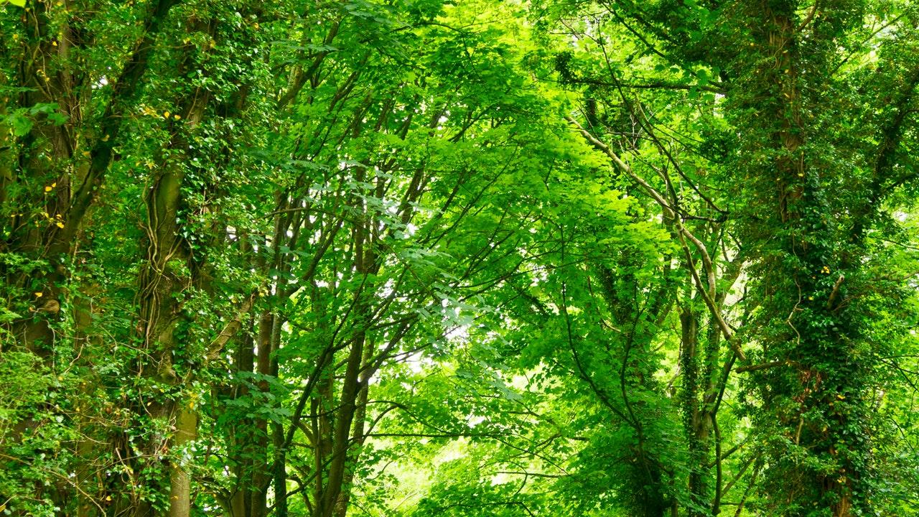
Flood Prediction
(i)Floods may only last few hours and can cause considerable damage and a possible threat to life.
(ii)Flood prediction requires quantitative knowledge about infiltration and runoff dynamics, which is generally gained at the local scale.
(iii)When scaling up local measurements to the catchment scale, account needs to be taken off the catchment’s organization (connectivity and patchiness). Our study showed that the peak discharge can be significantly reduced if the succession and connectivity of land use are well planned.
4

Slide 5
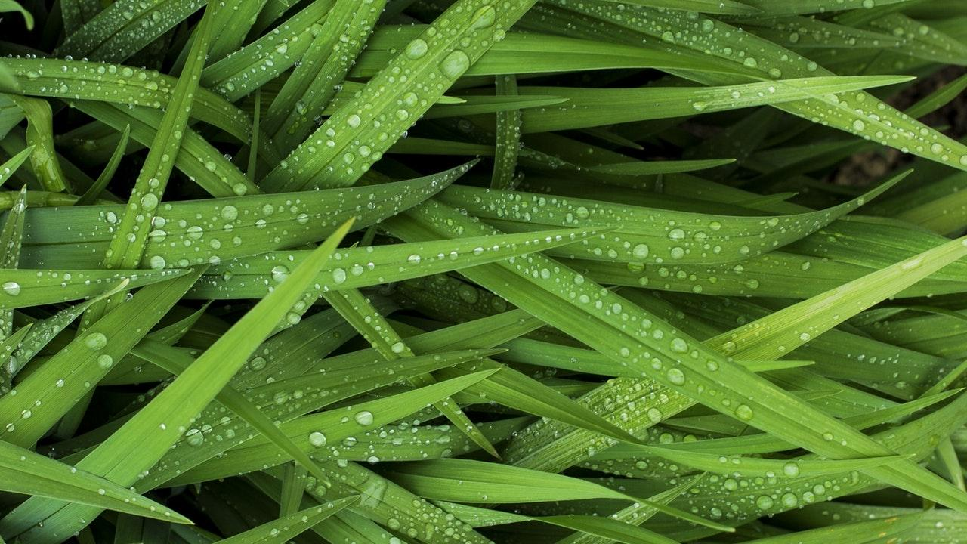
Stock Prediction
(i)Predicting how the stock market will perform is one of the most difficult things to do.
(ii)There are so many factors involved in the prediction – physical factors vs. physiological, rational and irrational behaviour, etc.
(iii) All these aspects combine to make share prices volatile and very difficult to predict with a high degree of accuracy.
(iv)Machine learning techniques have the potential to unearth patterns and insights we didn’t see before, and these can be used to make unerringly accurate predictions.
5

Slide 6
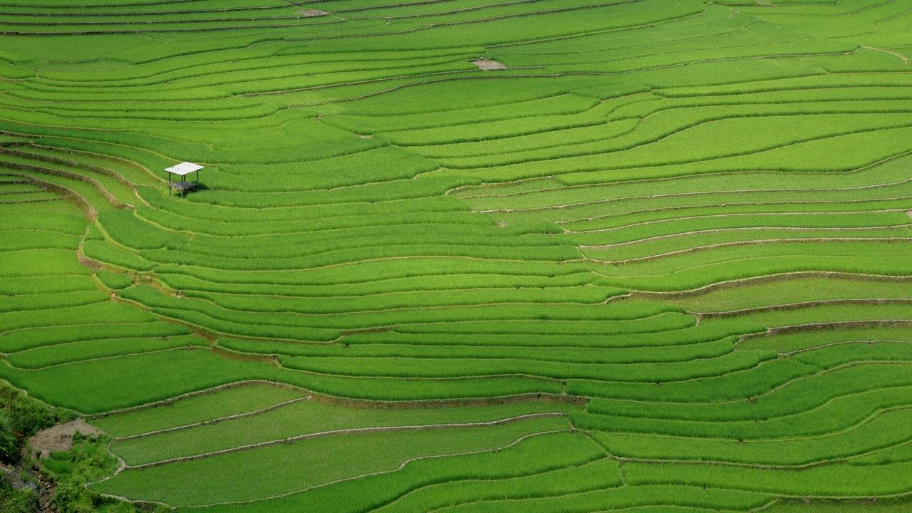
REFERENCE PAPER ANALYSIS
https://github.com/ajai-cr7/Srp/tree/master/ResearchPapers
6

Slide 7
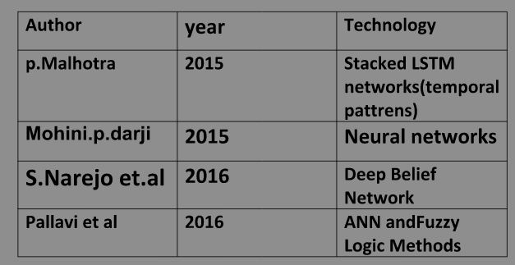
LITERATURE VIEW
7

Slide 8
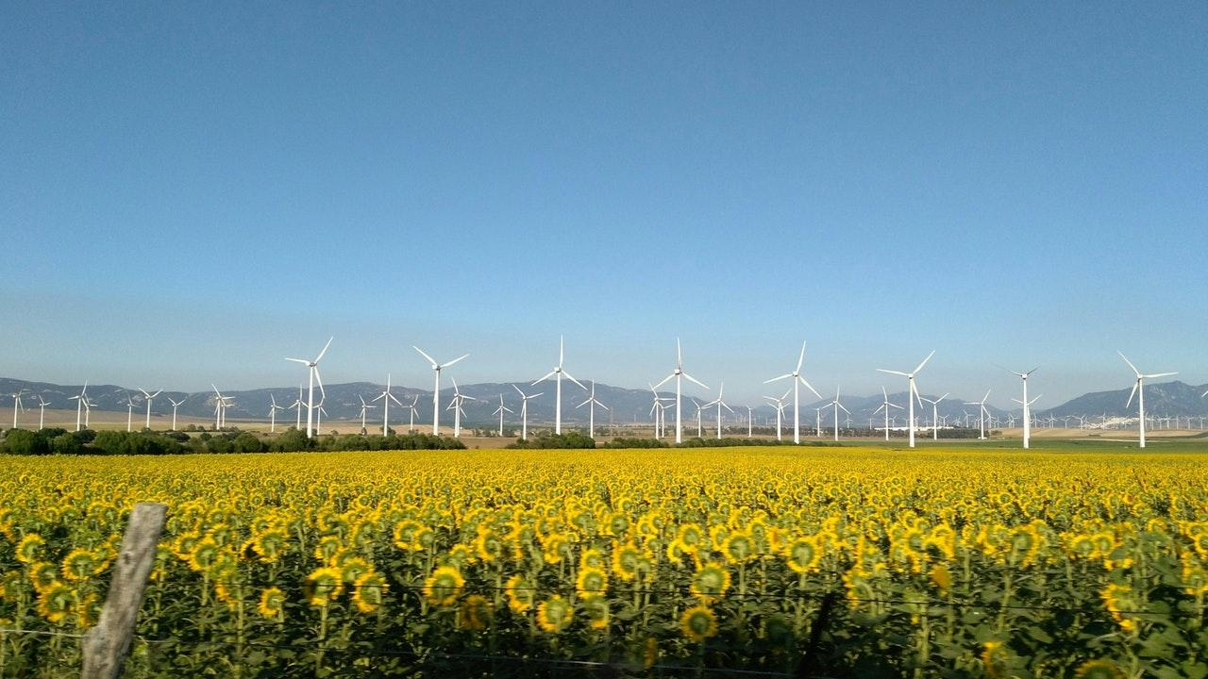
PROPOSAL
Our idea is to project the environmental websites with various prediction models.
The main feature of this project is the combination of materialistic and natural environment scenarios consisting of the rainfall prediction, flood prediction and stock prediction.
The stock prediction is included in the materialistic means of environment.
This website makes us to access these three things which is unique in the common world.
The propsal of this project has been analysed with various reference papers and implemented in our own fasion.
8

Slide 9
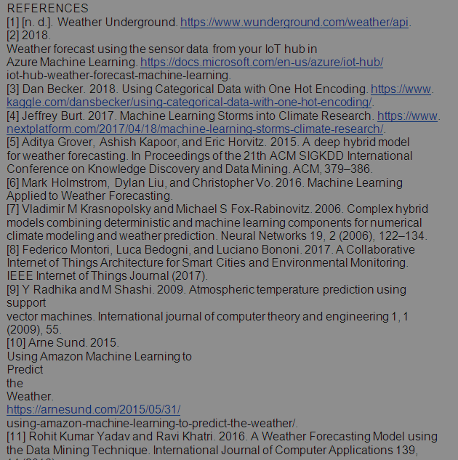
REFERENCES:
References
9

Slide 10
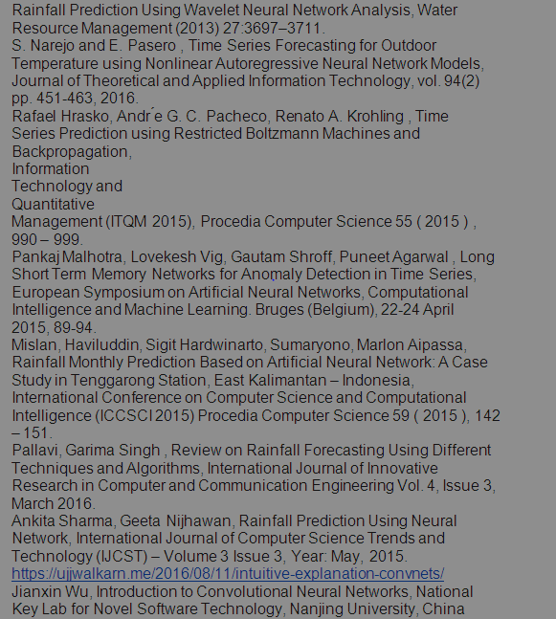
10

Slide 11
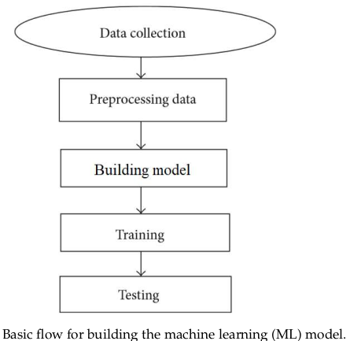
ARCHITECTURE DIAGRAMS
11

Slide 12
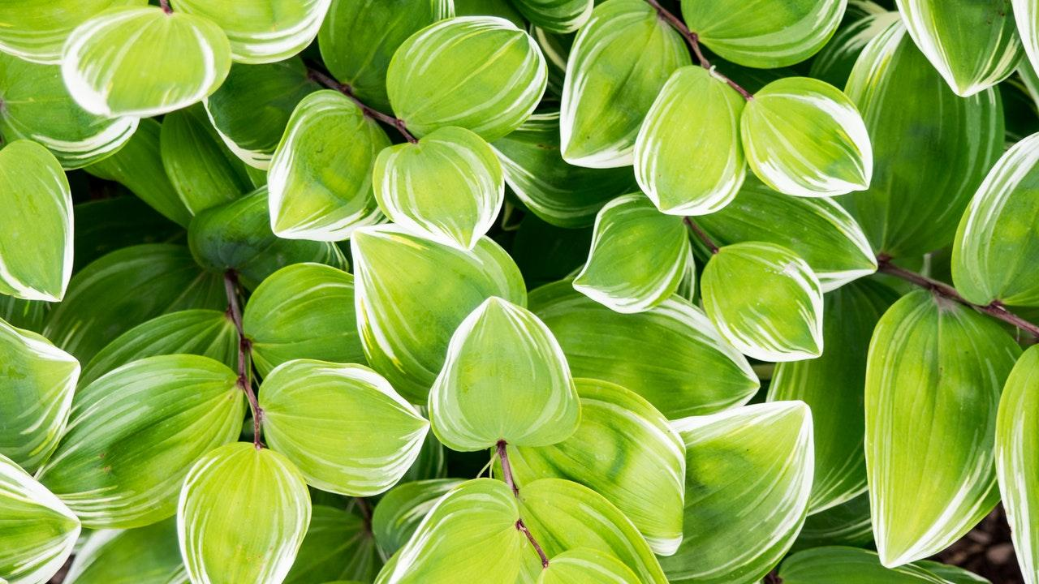
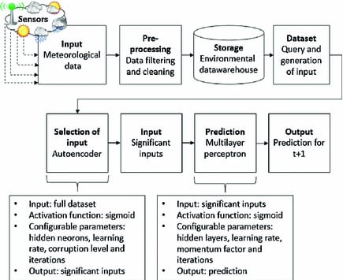
Rainfall prediction:
12

Slide 13
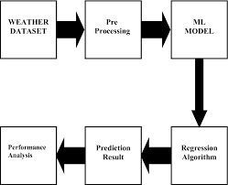
Weather prediction:
13

Slide 14
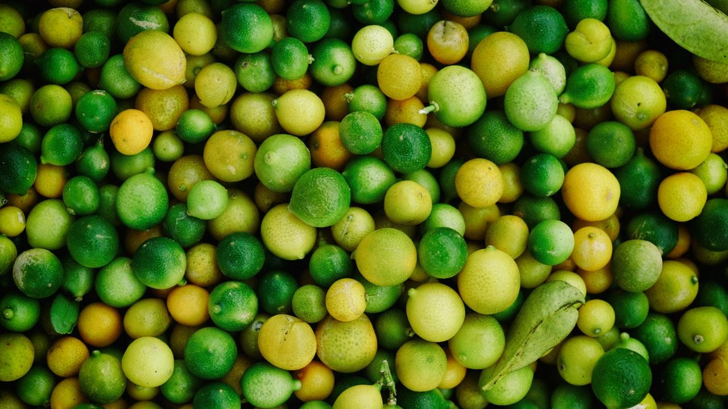
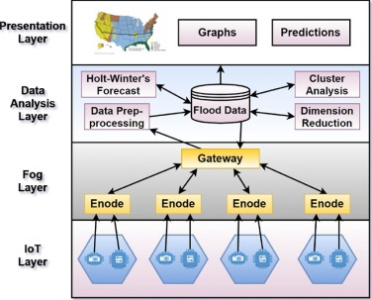
Flood prediction:
14

Slide 15
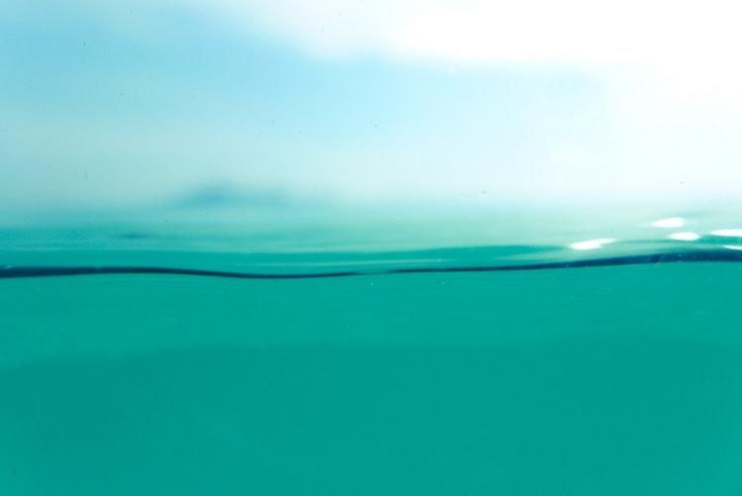
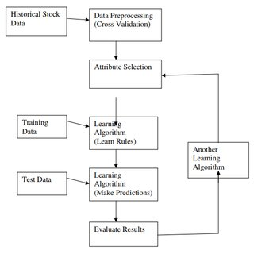
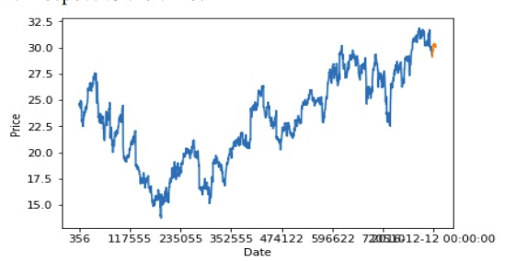
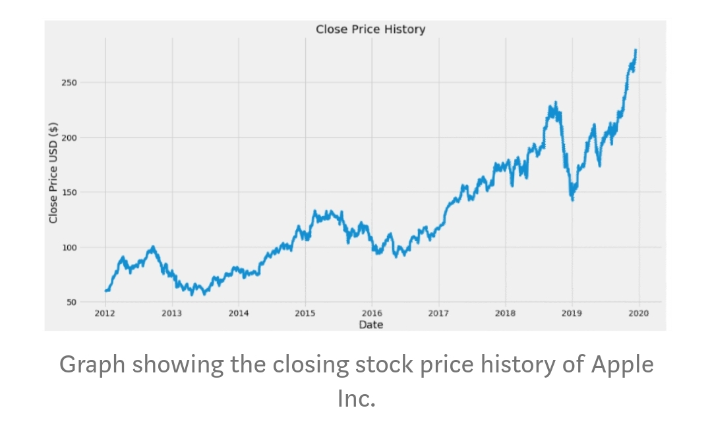
Stock prediction
15

Slide 16
Our planet’s alarm is going off, and it is time to wake up and take action! – Leonardo DiCaprio
16

Slide 17
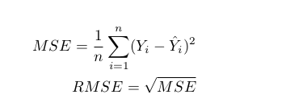
DRAWBACKS IN CURRENT PAPERS
Rainfall :
-----------
=>High RMSE (Root Mean Square Error) and MAPE (Mean Absolute Percentage error)errors so that future months are less reliable for Meteorological purposes.
=>No model for light rain scenarios !
17

Slide 18
Flood:
--------
=>There is no model for spatial flood prediction , that is predicting the floods in certain areas, that weren’t affected before
Stock:
--------
=>The existing system fails when there are rare outcomes or predictors,
=>The existing system does not perform well when there is a change in the operating environment.
=> It doesn‟t focus on external events in the environment, like news events or social media.
18

Slide 19
Weather :
------------
=>Results varies from obtained from temperature and humidity sensors and weather station data , because existing models considers only specific parameters to all areas, just like an generalised model , but an parameter in one city might also affects other cities too , like considering the atmospheric moisture !
19

Slide 20
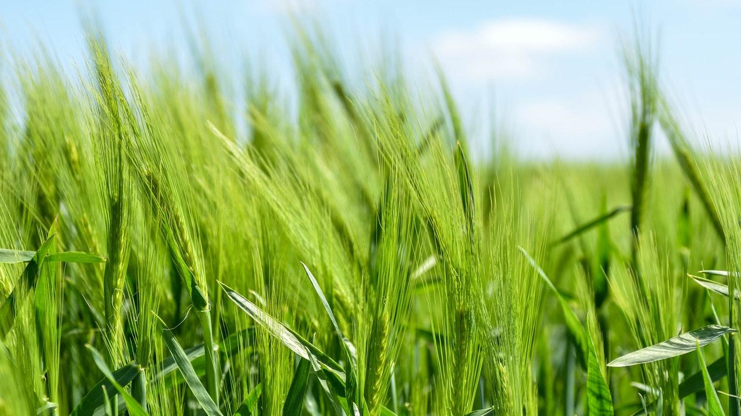
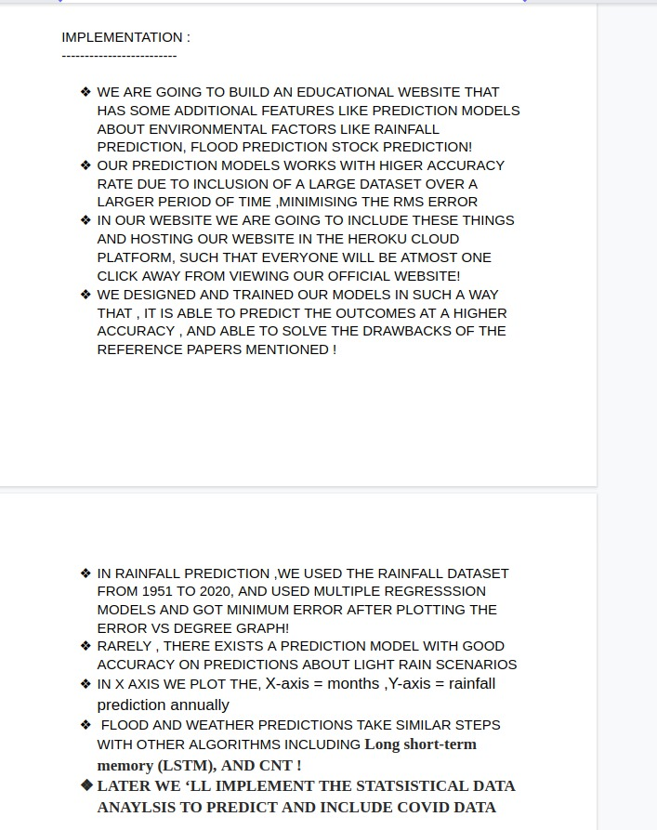
20

Slide 21
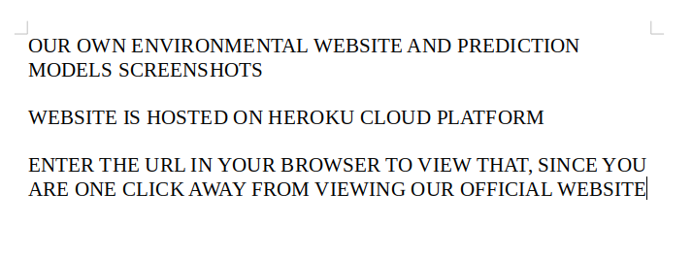
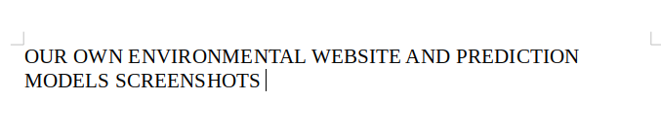

Slide 22
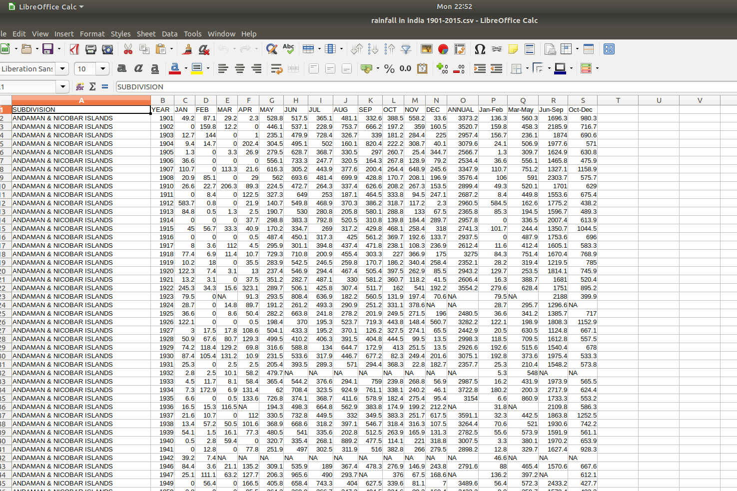

Slide 23
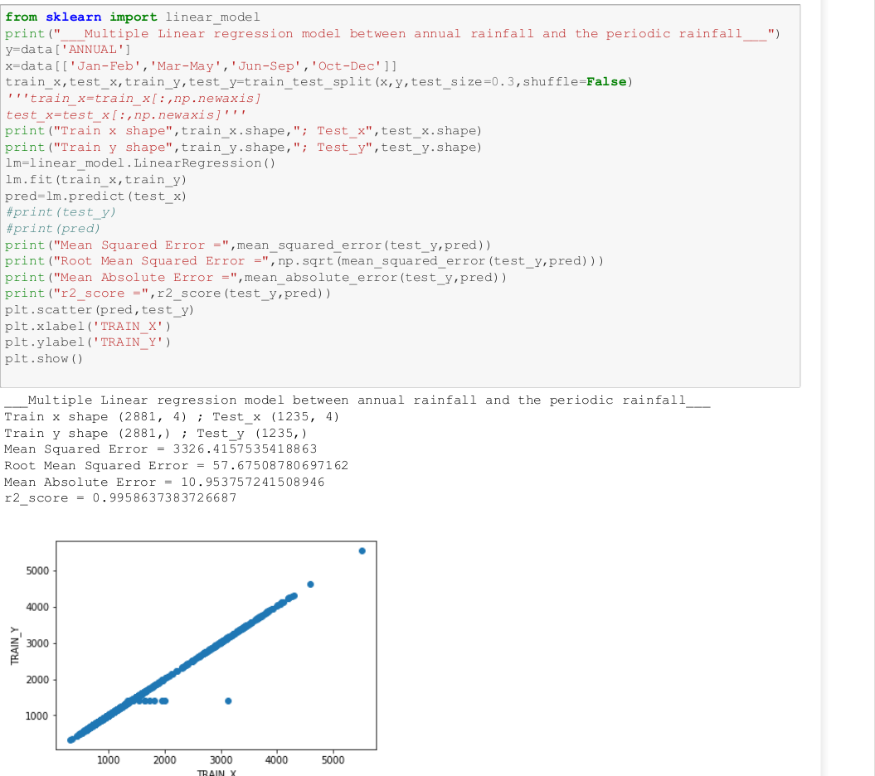

Slide 24
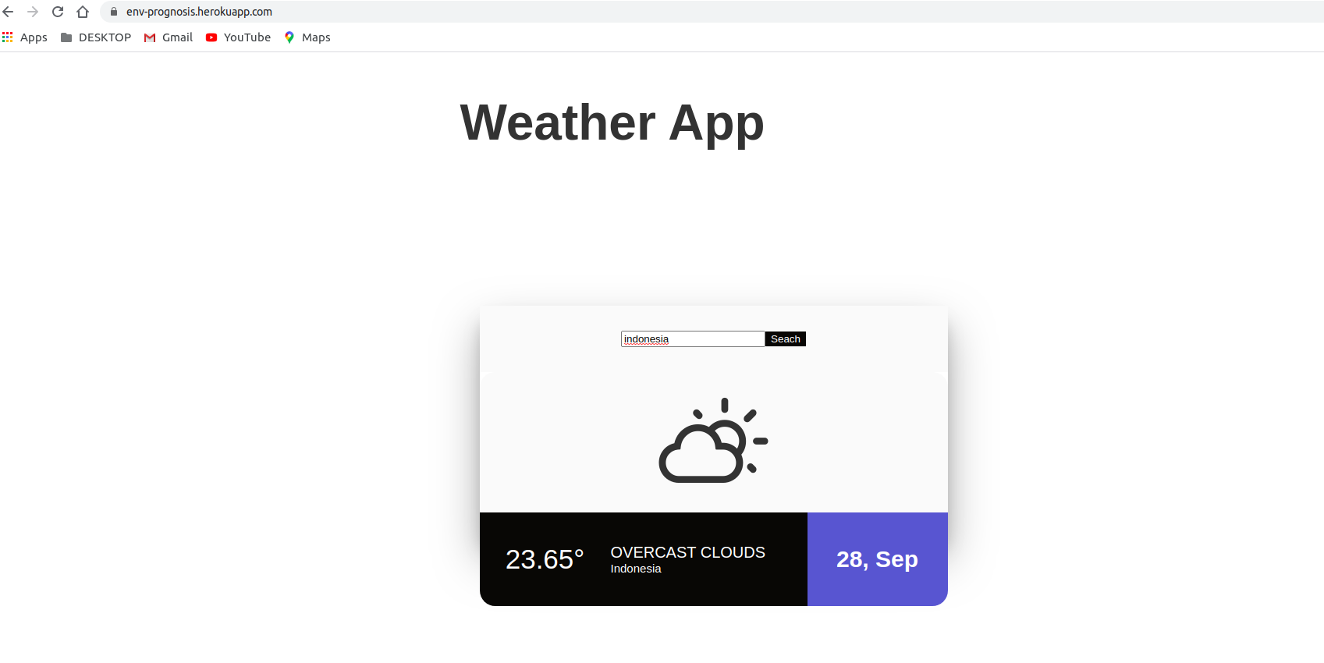

Slide 25
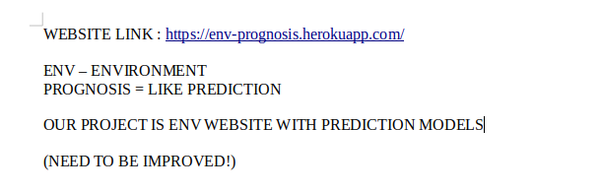
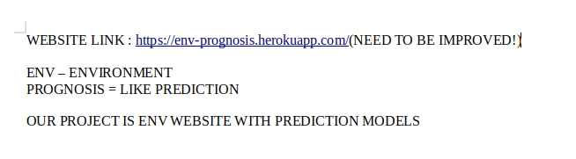

Slide 26
Thank you
26

