Slide 1
Maharaja Institute of Technology Thandavapura
Approved by AICTE, New Delhi | Affiliated to VTU, Belagavi | Dept. of CSE (Artificial Intelligence and Machine Learning)
Online Voting System
Using Face Recognition & Liveness Detection
MINI PROJECT REPORT
Team Members
Project Guide
• Bhanu Prakash BC — 4MN23CI008
Prof. Sandhya R.
• Madhushree KR — 4MN23CI024
Department of CSE, MIT Thandavapura
• Priyanka HB — 4MN23CI033
• Madhusudhan S — 4MN24CI403
Academic Year 2025–2026 | SecureVote Project | Version 1.0

Slide 2
INTRODUCTION
02
The Shift to Digital Voting:
Voting is rapidly evolving toward digital, remote, and accessible platforms worldwide.
Traditional paper-based systems face scalability, accessibility, and tampering challenges.
The Security Concern:
Without physical verification, ensuring the right person casts a vote becomes critical.
Impersonation, proxy voting, and ballot manipulation threaten election integrity.
The AI Opportunity:
Facial biometrics offer a powerful tool for non-intrusive, accurate voter identification.
Liveness detection adds a crucial anti-spoofing layer beyond basic face matching.
Our Solution Direction:
Authenticate the voter. Verify live presence. Protect the vote with blockchain.
SecureVote | Online Voting System | MIT Thandavapura | CSE (AI & ML)

Slide 3
PROBLEM STATEMENT
03
01. Voter Impersonation
Difficulty in reliably verifying that the person casting the vote is the legitimate registered voter.
Traditional systems lack biometric verification, making impersonation straightforward.
02. Facial Spoofing
Conventional face recognition can verify facial identity but cannot confirm live physical presence.
Attackers can bypass systems using printed photos, recorded videos, or 3D masks.
03. Vote Integrity & Double Voting
Online voting requires robust protection against duplicate voting attempts.
Vote records must be immutable — unauthorized modification of ballots must be impossible.
04. Lack of Transparency
Voters and auditors need verifiable evidence that votes were counted correctly and not altered.
SecureVote | Online Voting System | MIT Thandavapura | CSE (AI & ML)

Slide 4
OBJECTIVES
04
01. Secure Voter Authentication
Implement multi-factor authentication using Email OTP and facial recognition (SFace + YuNet).
Ensure only legitimate, pre-registered voters gain access to the ballot.
02. Liveness-Based Spoofing Prevention
Verify that the authenticated face belongs to a live, physically present voter.
Detect and reject photo, video replay, and deepfake presentation attacks.
03. Secure & Verifiable Voting
Prevent duplicate voting through blockchain-based immutable vote tracking.
Maintain a tamper-evident SHA-256 blockchain ledger for all cast votes.
04. Administrative Transparency
Provide a real-time admin dashboard with blockchain explorer and voter management.
Enable election administrators to manage elections, candidates, and voter whitelists.
SecureVote | Online Voting System | MIT Thandavapura | CSE (AI & ML)

Slide 5
SYSTEM ARCHITECTURE
05
Web Frontend
HTML5 / CSS / JavaScript
→
Flask Backend
Python App Server
→
SQLite Database
database.db
Security & Verification Stack
Email OTP
(SMTP / Dev Console)
OpenCV YuNet
Face Detection
SFace Model
Face Recognition
Liveness Engine
Movement Analysis
Blockchain Ledger
SHA-256 Blockchain | Genesis Block → Vote Block 1 → Vote Block 2 → ... → Vote Block N
Each block: voter_id_hash + candidate_id + timestamp + previous_hash + nonce (Proof-of-Work)
Key Technical Specs
✦ Face Matching: SFace Cosine Similarity ≥ 0.363 threshold
✦ Liveness: Multi-frame variance analysis (var_x or var_y > 0.5 px)
✦ OTP: 6-digit, 5-minute expiry, single-use (replay prevention)
✦ Blockchain: SHA-256 hash, difficulty=2 (Proof-of-Work nonce mining)
SecureVote | Online Voting System | MIT Thandavapura | CSE (AI & ML)

Slide 6
RESEARCH GAP & PROPOSED IMPROVEMENT
06
Base Paper: 'VOTUM: Secure and Transparent E-Voting System' (Springer, 2024)
Limitations of Existing VOTUM System:
• No dedicated liveness detection — susceptible to photo/video replay attacks
• Does not prevent face-registration duplication across multiple accounts
• No CSV-based voter whitelist import for controlled election access
• Limited admin tooling — no blockchain explorer or real-time voter status
Our Proposed Improvements:
• Integrated OpenCV YuNet + SFace for high-accuracy face detection & recognition
• Multi-frame liveness analysis: natural movement variance across video frames
• Cosine similarity-based duplicate face registration detection
• SHA-256 Blockchain with Proof-of-Work (difficulty=2) for immutable vote storage
• Full admin portal: dashboard, blockchain explorer, election management
• CSV voter whitelist import for controlled, verifiable election access lists
SecureVote | Online Voting System | MIT Thandavapura | CSE (AI & ML)

Slide 7
METHODOLOGY & VOTING WORKFLOW
07
Phase 1 — Registration
Voter enters: Name, Email, Voter ID, Date of Birth → Webcam captures live photo → YuNet detects face → SFace extracts feature vector → Duplicate face check → Profile + encoding saved to SQLite DB
Phase 2 — Login & OTP Verification
Voter enters: Voter ID + Email → System generates 6-digit OTP (expires in 5 min) → OTP sent via SMTP email (or printed to console in Dev mode) → Voter submits OTP → DB validates OTP, marks as used (single-use, no replay)
Phase 3 — Biometric & Liveness Check
Webcam streams multiple live video frames → Frames sent to Flask backend → Liveness engine checks natural movement variance (var_x or var_y > 0.5) across frames → SFace compares live frame encoding vs. registered encoding (cosine ≥ 0.363)
Phase 4 — Blockchain Voting & Receipt
Voter selects candidate on ballot → Flask checks has_voted flag → New blockchain block mined: SHA-256(voter_id_hash + candidate + timestamp + prev_hash + nonce) → has_voted = 1 set in DB → Immutable block hash receipt displayed to voter
SecureVote | Online Voting System | MIT Thandavapura | CSE (AI & ML)

Slide 8
TECHNOLOGY STACK & IMPLEMENTATION
08
Backend
Flask 3.1.1 (Python)
Face AI
OpenCV 4.11 + YuNet + SFace
REST APIs, session management, routing, SMTP email, background scheduling (APScheduler)
Real-time face detection (YuNet ONNX), 128D feature extraction (SFace ONNX), cosine similarity matching
Liveness
Multi-frame Movement Analysis
Database
SQLite 3 (database.db)
Captures 10+ webcam frames, calculates face center variance across frames, threshold: var > 0.5 pixels
5 tables: voters, otps, elections, candidates, votes, allowed_voters. WAL journal mode.
Blockchain
Custom SHA-256 + PoW
Frontend
HTML5 + Vanilla CSS + JavaScript
Pure Python blockchain, difficulty=2 PoW mining, SHA-256 hashing, voter ID anonymized via hash
Webcam API (getUserMedia), real-time canvas capture, OTP form, dynamic ballot UI, results charts
SecureVote | Online Voting System | MIT Thandavapura | CSE (AI & ML)

Slide 9
DATABASE SCHEMA (SQLite)
09
Table Name
Key Columns
voters
id, name, email, voter_id (UNIQUE), date_of_birth, face_encoding (BLOB), face_image_path, has_voted (0/1), registered_at
otps
id, email, otp, created_at, expires_at, used (0/1)
elections
id, title, description, is_active (0/1), results_visible (0/1), voting_start, voting_end, created_at
candidates
id, name, party, symbol, photo, election_id (FK → elections.id)
votes
id, voter_id, election_id (FK → elections.id), block_hash, voted_at
allowed_voters
id, voter_name, voter_id (UNIQUE), imported_at
SecureVote | Online Voting System | MIT Thandavapura | CSE (AI & ML)

Slide 10
BLOCKCHAIN SECURITY MODEL
10
Each vote is recorded as an immutable SHA-256 cryptographic block:
Genesis Block
Vote Block #1
Vote Block #2
Vote Block N
Message: SecureVote Init
Prev: 0000...0000
Nonce: Mining complete
voter_id_hash: SHA256(...)
candidate_id: 3
Timestamp: epoch
voter_id_hash: SHA256(...)
candidate_id: 1
Timestamp: epoch
voter_id_hash: SHA256(...)
candidate_id: 2
Timestamp: epoch
→
→
→
Tamper-Proof Guarantee:
• If any vote data is altered, the SHA-256 hash of that block changes completely.
• Changed hash breaks chain linkage — every subsequent block becomes invalid instantly.
• Proof-of-Work nonce mining ensures computational cost to forge any block.
• Voter identity protected: only SHA-256(voter_id) stored — never the actual ID.
• Admin cannot delete or modify past votes — blockchain is append-only by design.
SecureVote | Online Voting System | MIT Thandavapura | CSE (AI & ML)

Slide 11
ADMIN PORTAL & SYSTEM FEATURES
11
Admin Dashboard
Blockchain Explorer
✦ Real-time voter turnout counter
✦ Interactive block visualizer
✦ Total ballots cast tracking
✦ Block index, hash, data payload
✦ Active election status monitor
✦ Chain validity verification
✦ One-click voting toggle (open/close)
✦ Vote count tally per candidate
Election Management
Voter Registry
✦ Create/edit elections & candidates
✦ View all registered voters
✦ Set voting start/end time windows
✦ Check has_voted status per voter
✦ Auto-notify voters when voting opens
✦ Import voter whitelist via CSV
✦ Export results CSV
✦ Remove/reset test voter records
SecureVote | Online Voting System | MIT Thandavapura | CSE (AI & ML)

Slide 12
EXPECTED RESULTS
12
01. Secure Voter Authentication
02. Effective Liveness Detection
✦ Successful multi-factor verification using OTP + facial recognition
✦ Accurate detection of live voter vs. static photo/video replay
✦ Only pre-registered, authenticated users access the ballot
✦ Natural movement variance > 0.5 px threshold prevents spoofing
✦ Zero false positives on face match at cosine threshold ≥ 0.363
✦ Multi-frame capture (10+ frames) ensures robust liveness score
03. Duplicate Voting Prevention
04. Secure & Verifiable Voting
✦ Blockchain has_voted flag prevents any second vote from same voter
✦ All votes stored as immutable SHA-256 blockchain blocks with PoW
✦ Cosine similarity check during registration blocks duplicate face enrollment
✦ Any tampering attempt immediately breaks chain hash linkage
✦ Admin dashboard shows voting status of every registered voter in real-time
✦ Public blockchain explorer allows transparent vote count verification
SecureVote | Online Voting System | MIT Thandavapura | CSE (AI & ML)

Slide 13
FUTURE WORK
13
01. Advanced Deepfake & Presentation-Attack Detection
Integrate 3D depth sensing, texture analysis, and passive liveness (IR sensors).
Train dedicated anti-spoofing classifiers to defend against AI-generated deepfakes.
02. Scalable Cloud & Mobile Deployment
Deploy on Google Cloud / AWS with containerized Flask (Docker / Kubernetes).
Develop native Android/iOS applications for broader voter accessibility.
03. End-to-End Verifiable Voting (E2E-V)
Allow voters to independently verify their vote was counted without revealing identity.
Implement cryptographic zero-knowledge proofs for privacy-preserving ballot verification.
04. Decentralized Blockchain (Ethereum / Hyperledger Fabric)
Replace in-memory blockchain with a distributed ledger for production-grade tamper resistance.
Enable multi-party consensus validation — no single admin can control the election chain.
05. Multi-Language & Accessibility Support
Add regional language support and accessibility features for disabled voters.
SecureVote | Online Voting System | MIT Thandavapura | CSE (AI & ML)

Slide 14
CONCLUSION
14
Multi-Factor
Authentication
AI Anti-Spoofing
Blockchain
Integrity
Admin
Transparency
Email OTP + Face
Recognition + Liveness
YuNet Detection +
SFace + Movement Var.
SHA-256 PoW
Immutable Vote Ledger
Real-time Dashboard +
Blockchain Explorer
Summary & Impact
✦ SecureVote addresses core vulnerabilities in traditional online voting systems.
✦ Combines state-of-the-art AI face recognition (OpenCV YuNet + SFace) with multi-factor authentication.
✦ Liveness detection effectively prevents photo, video, and deepfake presentation attacks.
✦ SHA-256 blockchain with Proof-of-Work provides an immutable, transparent, tamper-evident vote ledger.
✦ Comprehensive admin portal ensures election transparency, management, and accountability.
✦ The system demonstrates that secure, AI-powered, blockchain-backed online voting is achievable today.
SecureVote — Authenticate. Verify. Protect. Vote.
SecureVote | Online Voting System | MIT Thandavapura | CSE (AI & ML)

Slide 15
REFERENCES
15
[1] A. B. Carter and D. E. Johnson, "Secure Voting Systems: A Review of Biometrics," Journal of Cybersecurity and Digital Forensics, vol. 11, no. 3, pp. 145–159, 2023.
[2] VOTUM: Secure and Transparent E-Voting System — Springer Nature Link (2024). Base paper for this project.
[3] OpenCV Zoo — Face Detection (YuNet) and Face Recognition (SFace) ONNX Models. github.com/opencv/opencv_zoo.
[4] Flask Documentation (v3.1.1) — Pallets Projects. flask.palletsprojects.com.
[5] S. Nakamoto, "Bitcoin: A Peer-to-Peer Electronic Cash System," 2008. (Blockchain PoW concept basis)
[6] SQLite Documentation — sqlite.org. WAL journal mode, row_factory pattern.
[7] APScheduler — Advanced Python Scheduler for background job execution. apscheduler.readthedocs.io.
[8] Python-PPTX Documentation — Report generation. python-pptx.readthedocs.io.
SecureVote | Online Voting System | MIT Thandavapura | CSE (AI & ML)

Slide 16
Original Presentation
Slide Screenshots — Full PPT Visual Record
The following slides show screenshot captures of each original presentation slide
13 Slides Total — as referenced from: online voting system.pptx
SecureVote | Online Voting System Report | MIT Thandavapura

Slide 17
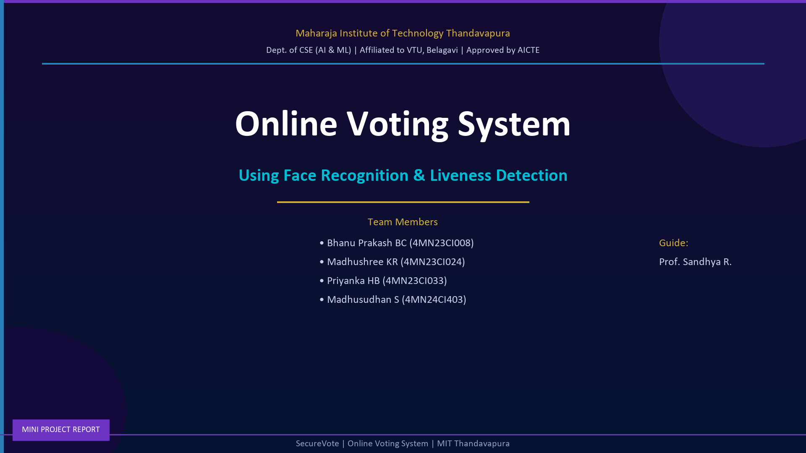
S01
PPT Screenshot — Slide 1: Title / Cover — Project Overview & Team
Screenshot 1 of 11 | Online Voting System | MIT Thandavapura

Slide 18
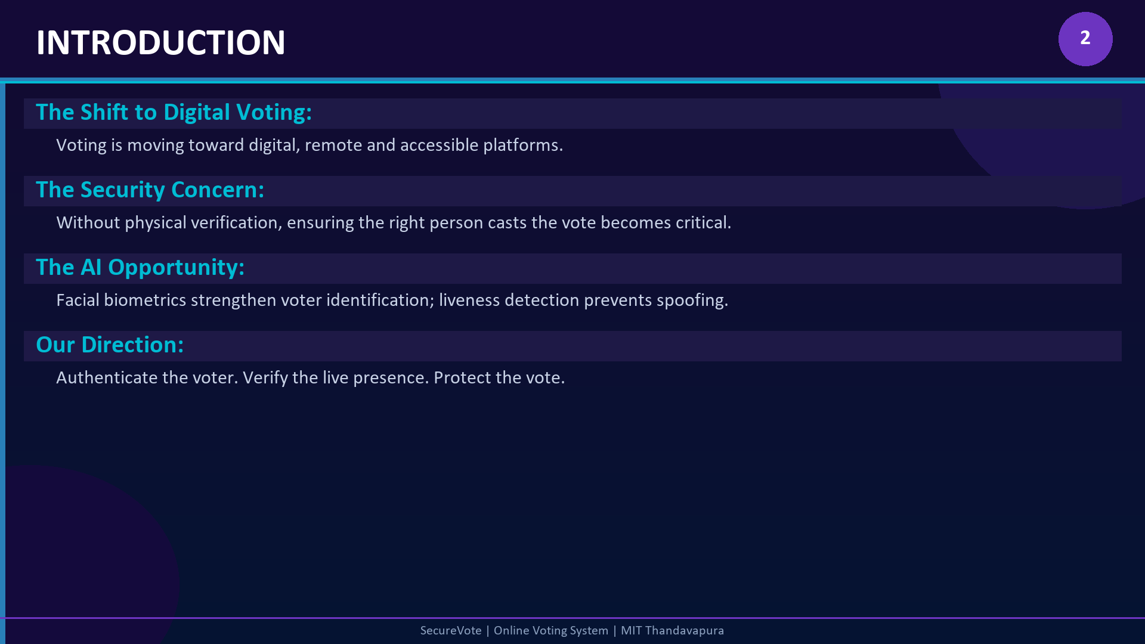
S02
PPT Screenshot — Slide 2: Introduction — Digital Voting Landscape
Screenshot 2 of 11 | Online Voting System | MIT Thandavapura

Slide 19
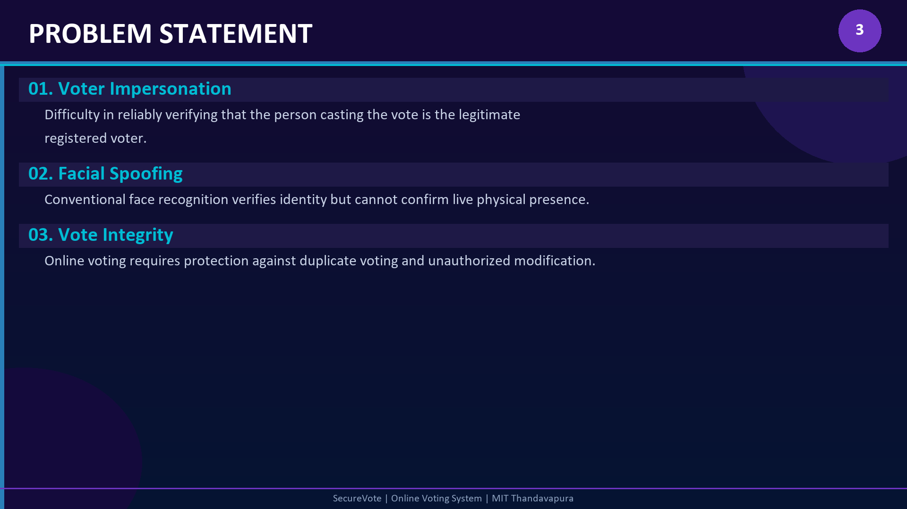
S03
PPT Screenshot — Slide 3: Problem Statement — Core Challenges
Screenshot 3 of 11 | Online Voting System | MIT Thandavapura

Slide 20
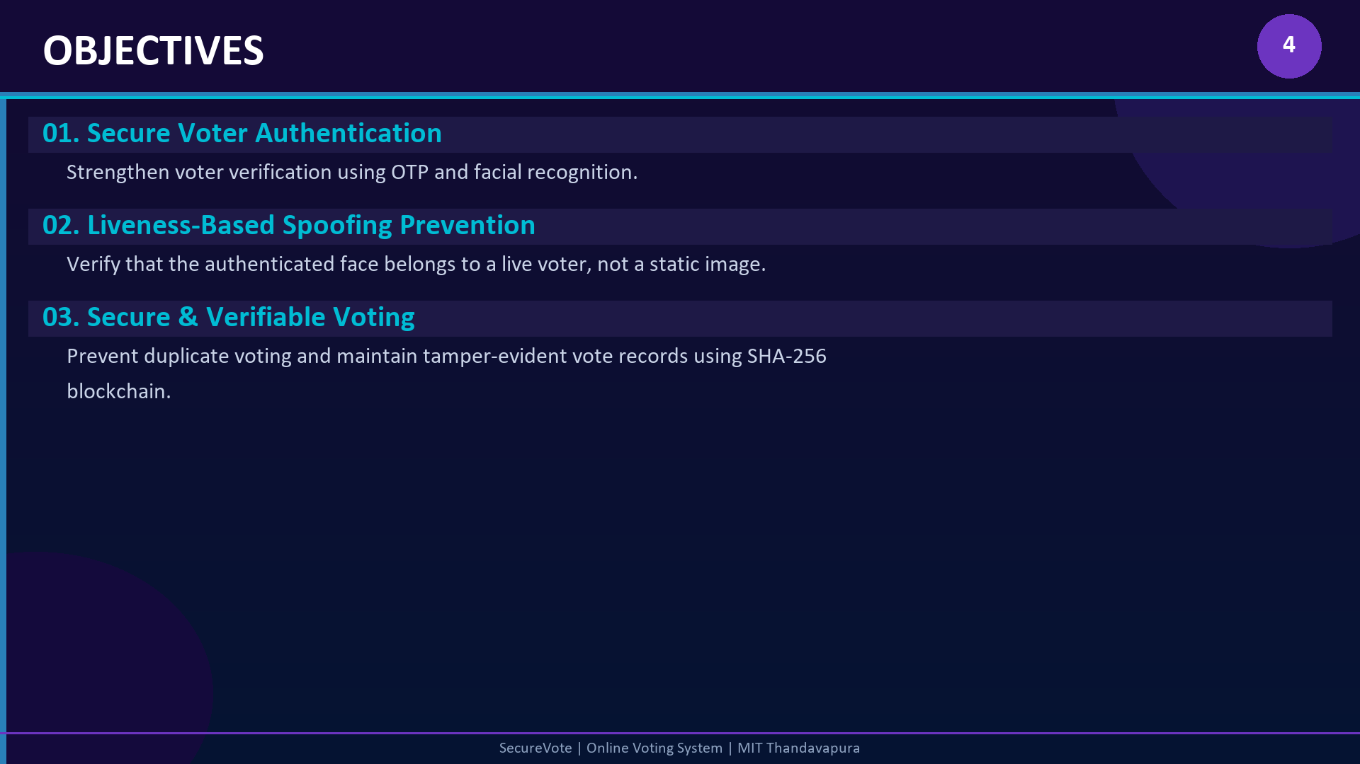
S04
PPT Screenshot — Slide 4: Objectives — Project Goals
Screenshot 4 of 11 | Online Voting System | MIT Thandavapura

Slide 21
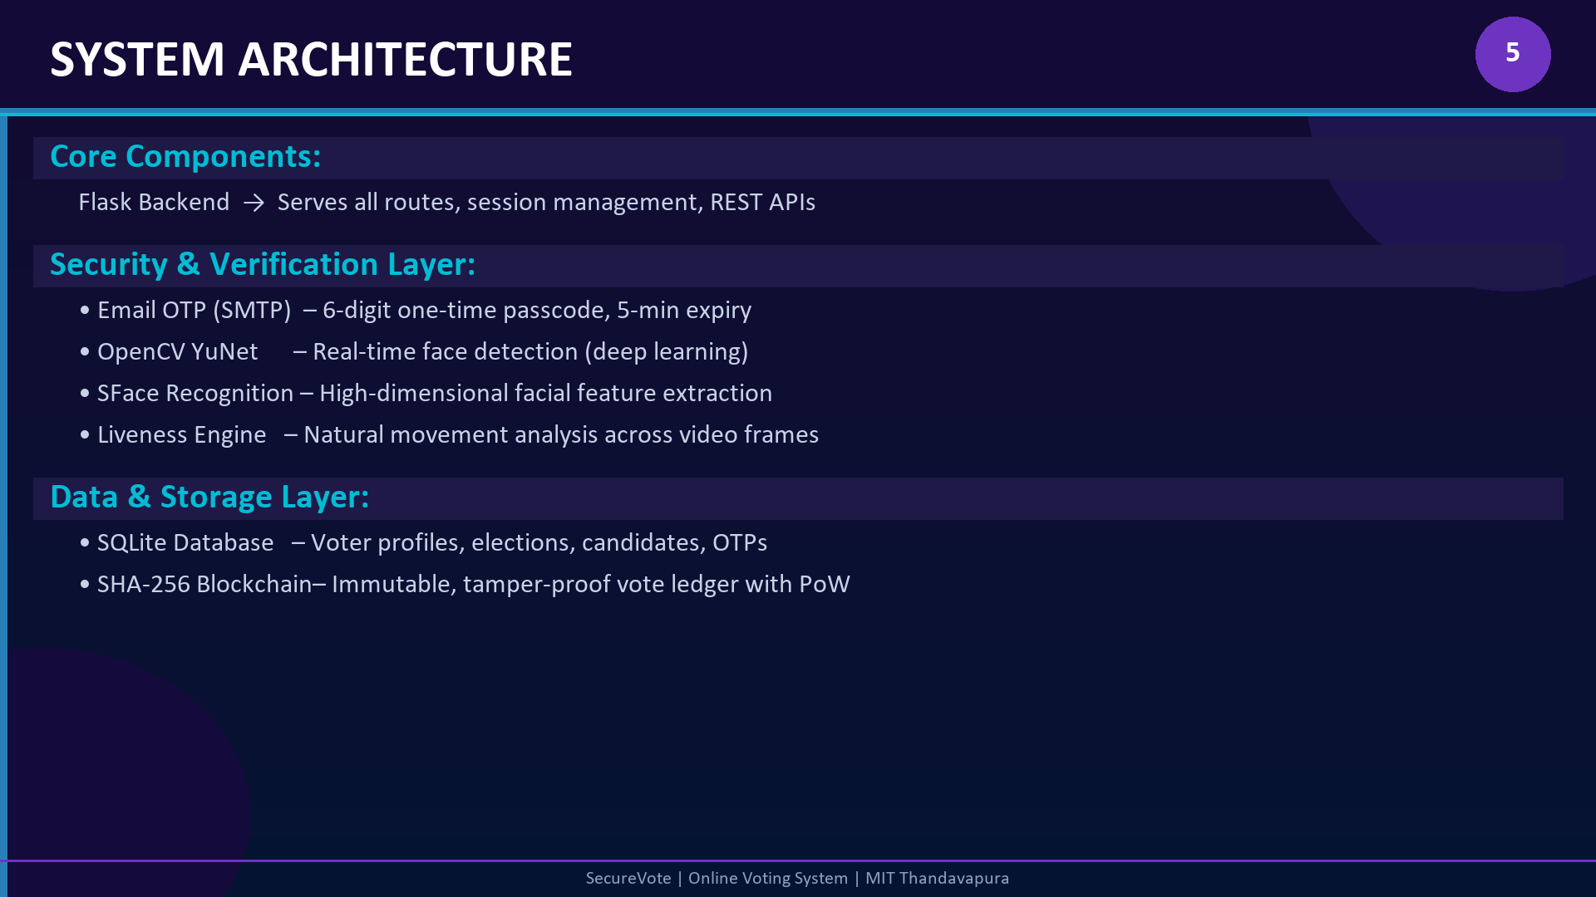
S05
PPT Screenshot — Slide 5: System Architecture Diagram
Screenshot 5 of 11 | Online Voting System | MIT Thandavapura

Slide 22
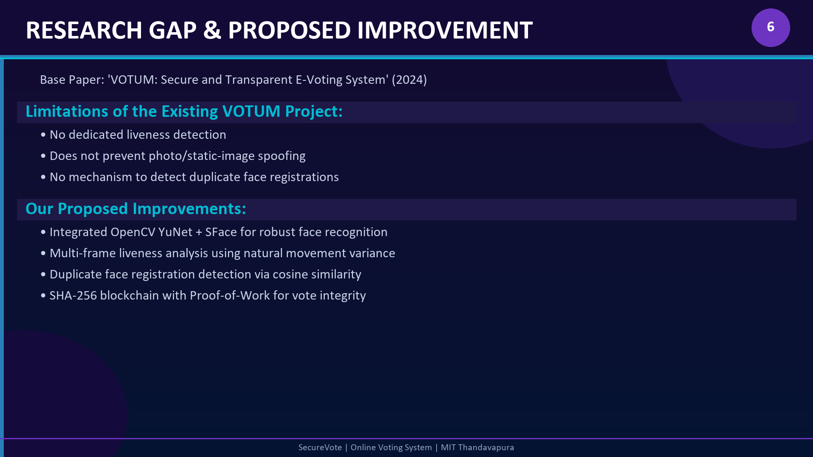
S06
PPT Screenshot — Slide 6: Research Gap & Proposed Improvements
Screenshot 6 of 11 | Online Voting System | MIT Thandavapura

Slide 23
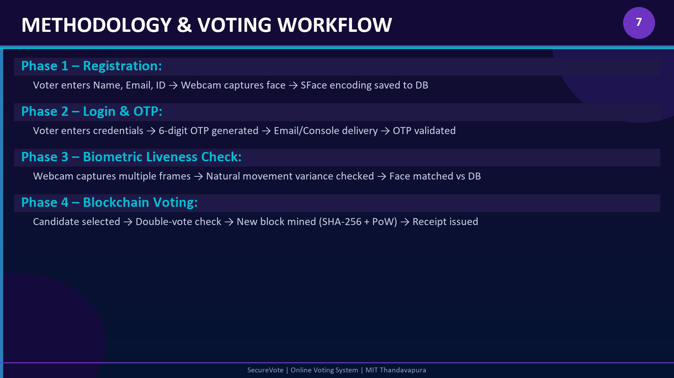
S07
PPT Screenshot — Slide 7: Methodology — 4-Phase Voting Workflow
Screenshot 7 of 11 | Online Voting System | MIT Thandavapura

Slide 24
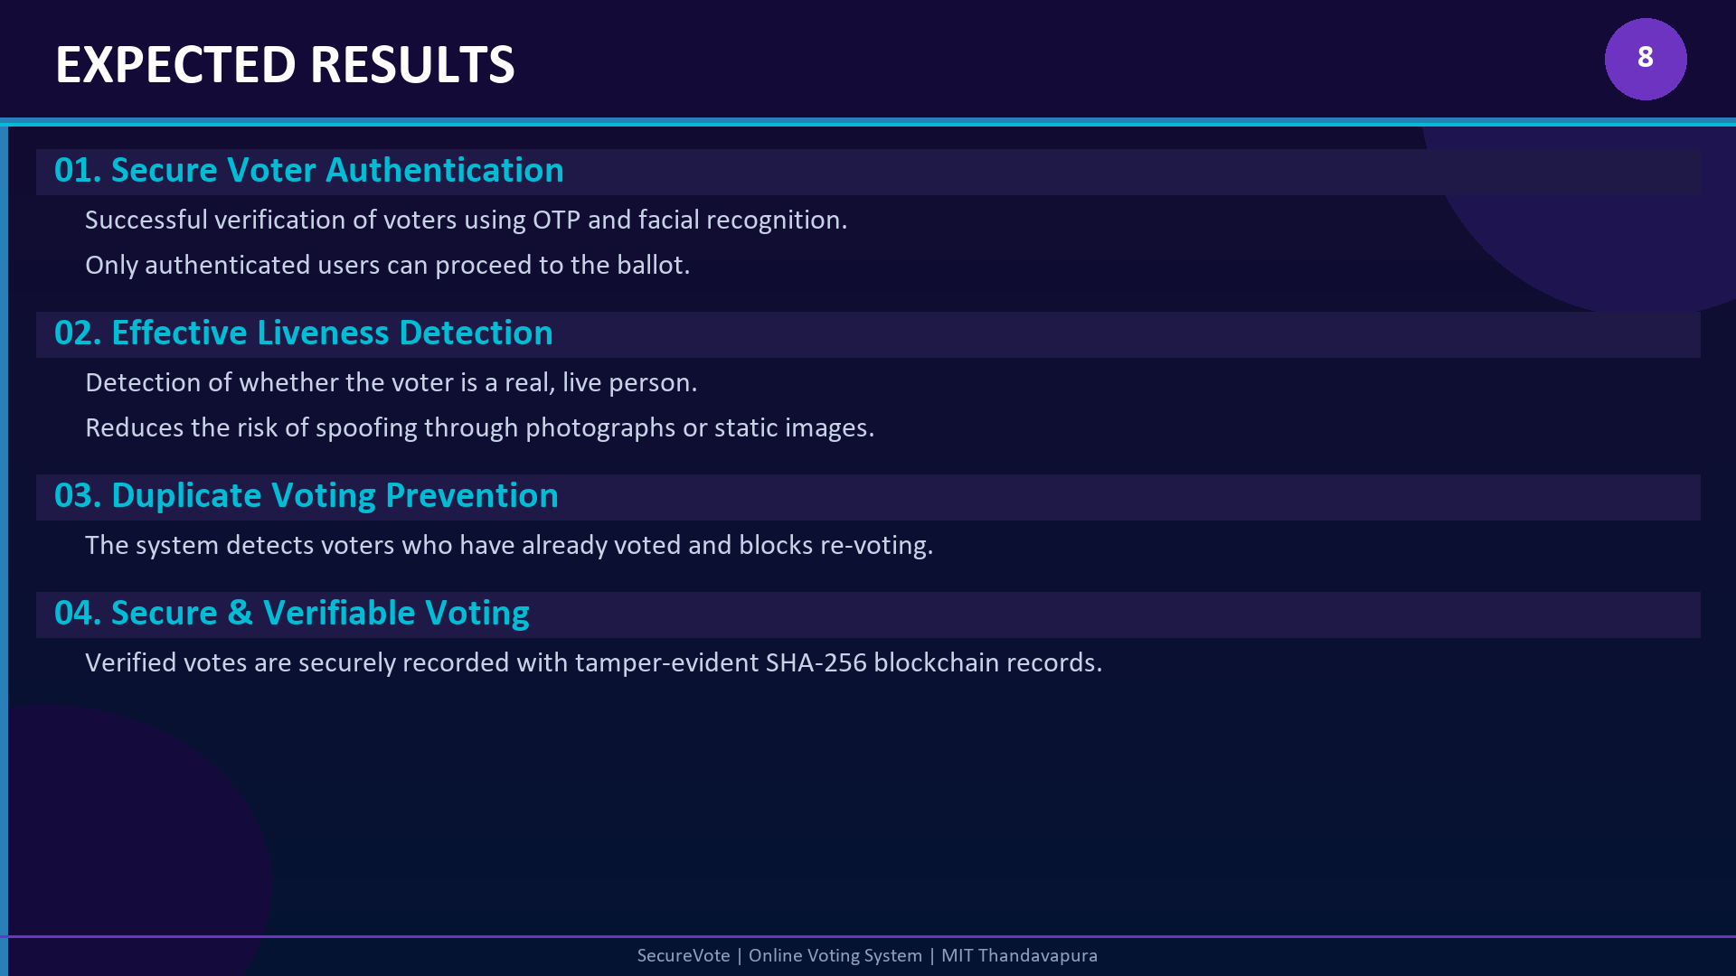
S08
PPT Screenshot — Slide 8: Expected Results — Outcome 1 & 2
Screenshot 8 of 11 | Online Voting System | MIT Thandavapura

Slide 25
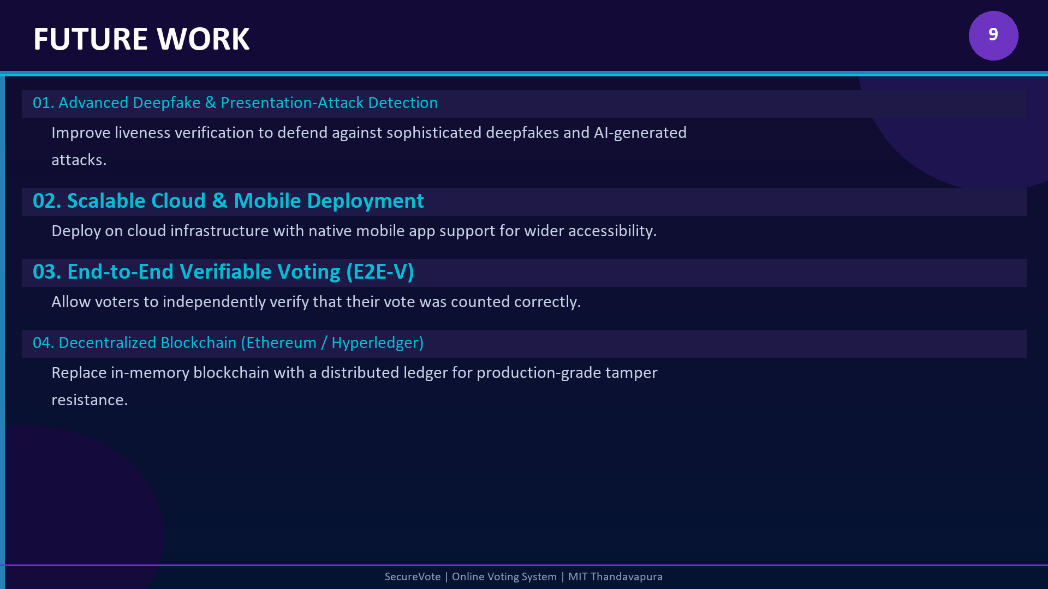
S09
PPT Screenshot — Slide 9: Expected Results — Outcome 3
Screenshot 9 of 11 | Online Voting System | MIT Thandavapura

Slide 26
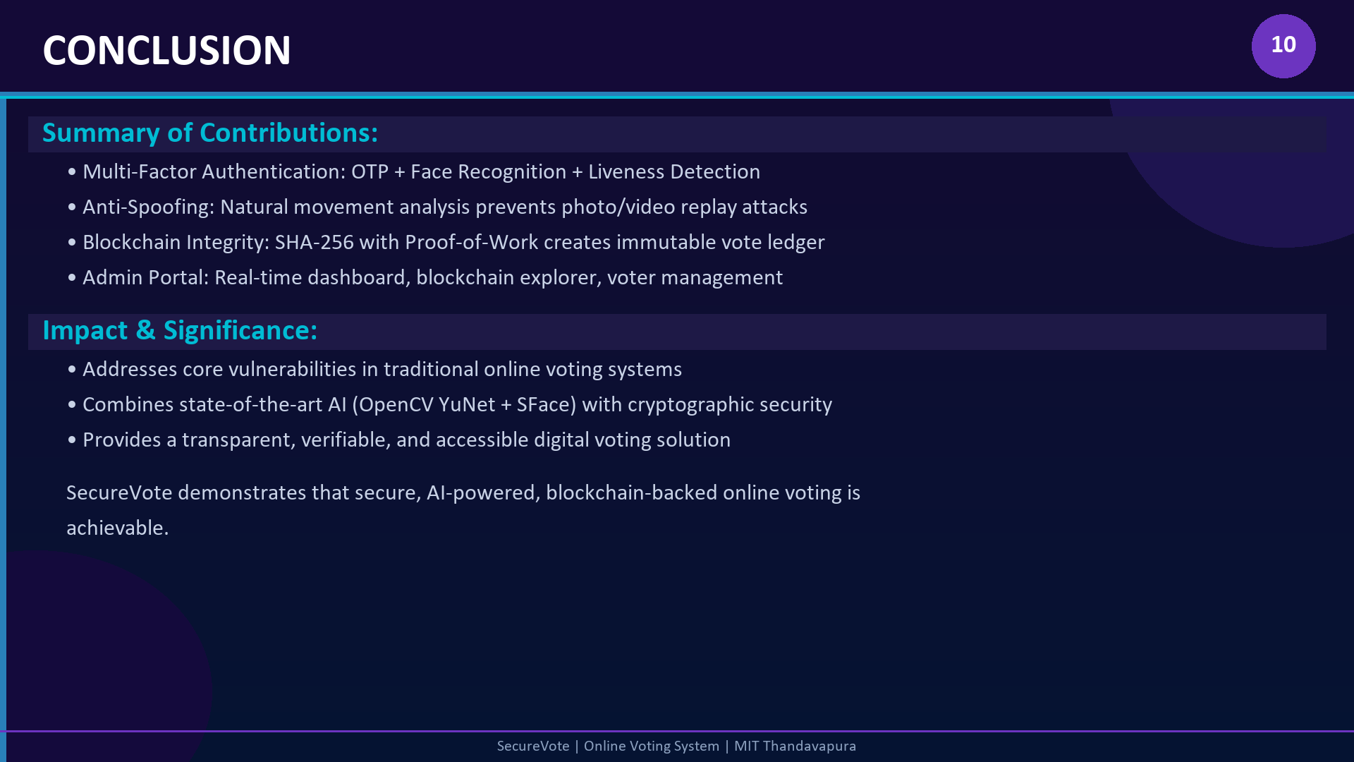
S10
PPT Screenshot — Slide 10: Expected Results — Outcome 4
Screenshot 10 of 11 | Online Voting System | MIT Thandavapura

Slide 27
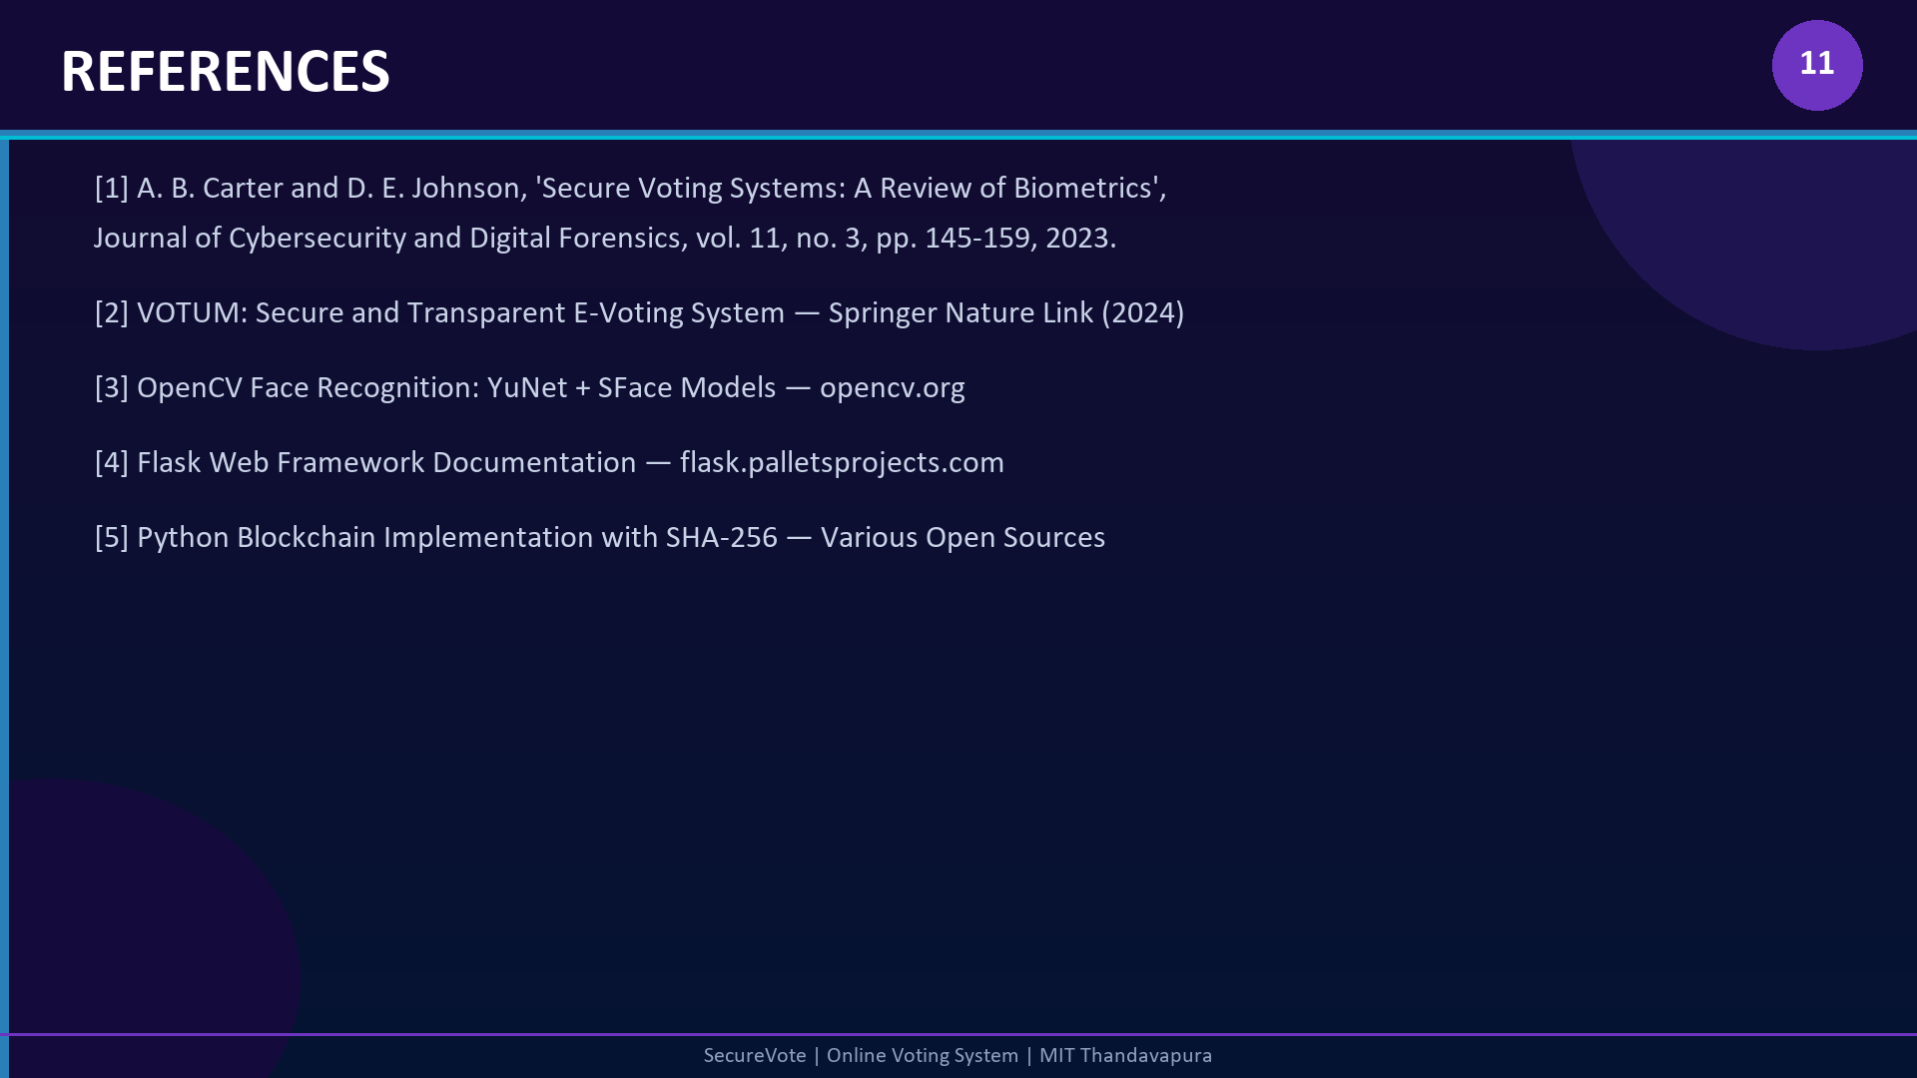
S11
PPT Screenshot — Slide 11: Future Work — Enhancements
Screenshot 11 of 11 | Online Voting System | MIT Thandavapura

