Slide 1
Decawords
Bigyan Karki
Madhu Sujan Paudel

Slide 2
About the Program
This Program lets the user play a game.
The user gets 10 jumbled word that he must solve.
A file containing all the words is used to generate a random word and the word is jumbled.
Then the answer entered by the user is used to check if it correct or not.
Points are scored accordingly.

Slide 3
Rules for the Program
The user needs to use all the words.
Correct answer = +10
Incorrect word = -10
The user can also ask for help which will provide user with the first and last alphabet of the correct word.
The user gets a message based on how well they perform.

Slide 4
How it is solved
We ask the user to input their name first which we use in our final output to add a personal touch to the game.
We use a file that we use to get words and jumble it up.
We ask the user to solve it.
We have used two different classes to put it into manageable portions.

Slide 5
Pseudo Code
Public Static void main(String[] args){
Int points = 0
for( int i = 0; i < 10; i++) {
String word = random_word()
String shuffled_word = Shufflestring.shuffle(word)
System.out.print(“shuffled_word”);
System.out.print(“Enter the guess”);
String guessed_word = keyboard.nextLine()
if(guessed_word == word) { points += 10
}
else{
points -= 10
}
}

Slide 6
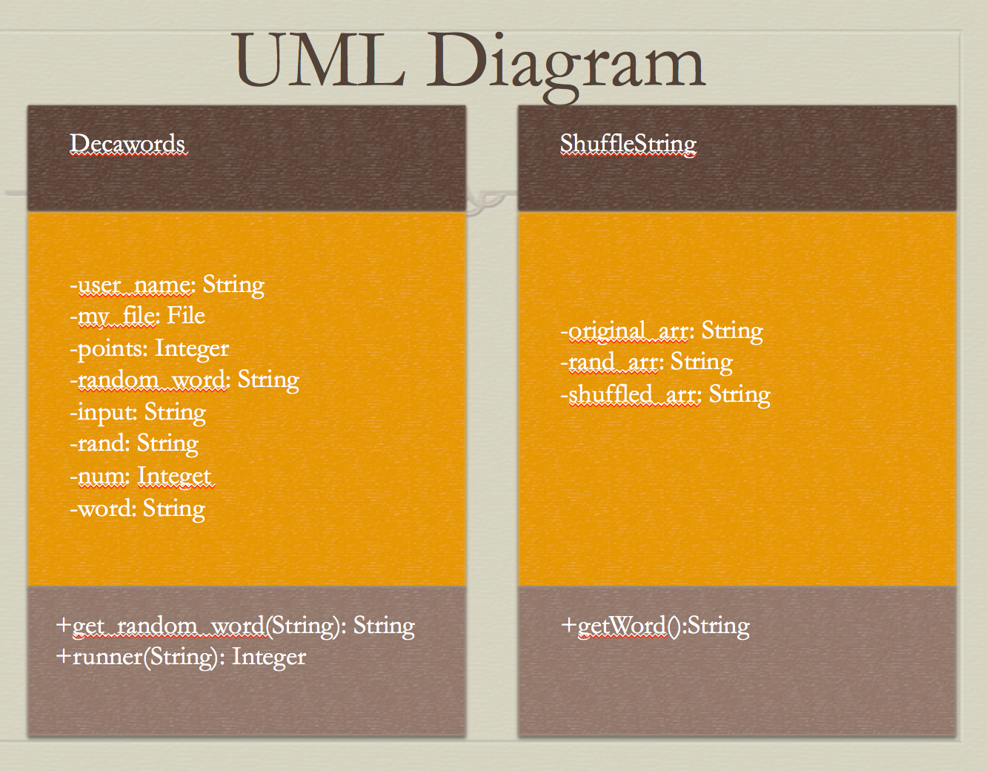

Slide 7
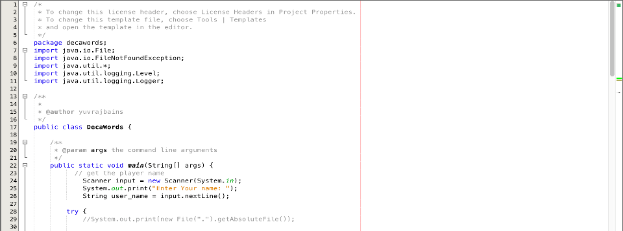
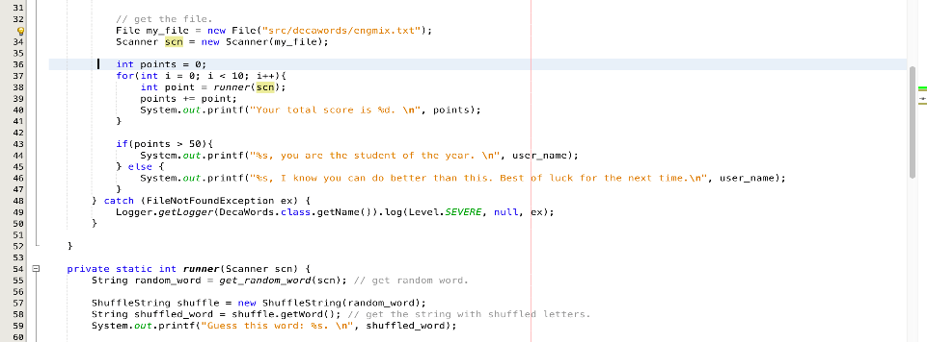

Slide 8
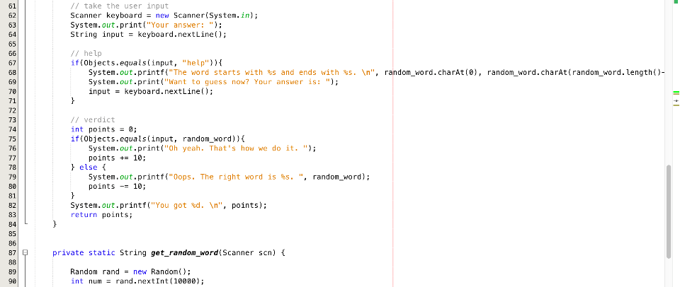
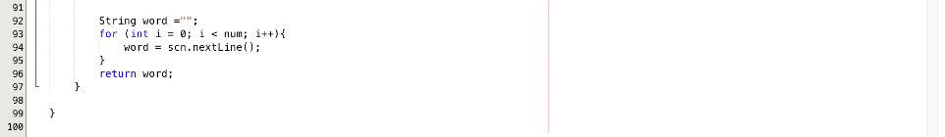

Slide 9
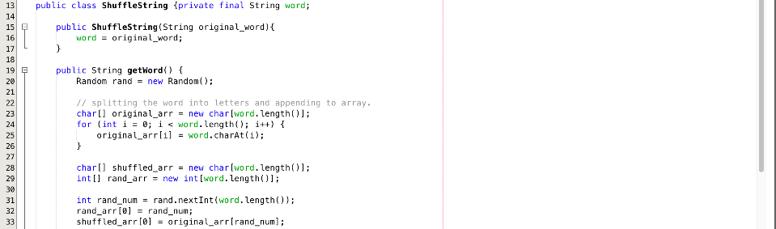
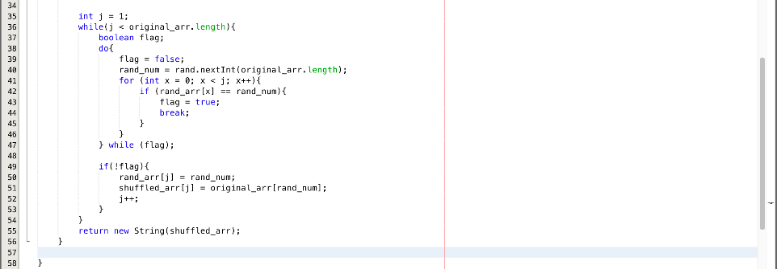
Shuffle the string and assign arrays

Slide 10
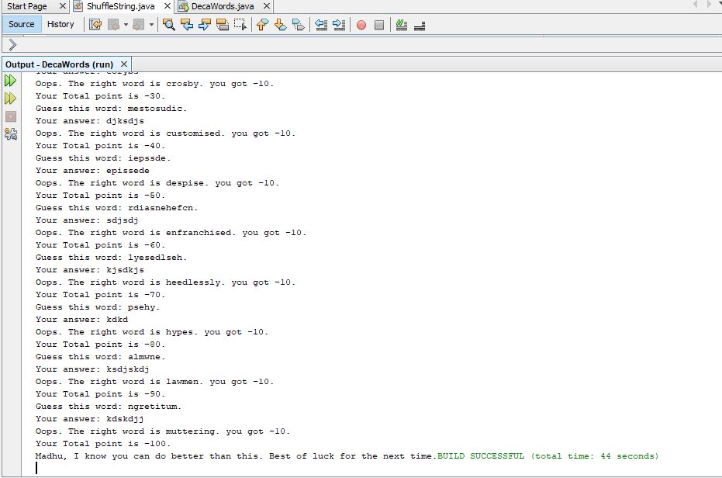
Sample Output

Slide 11
Thank You!

