Slide 1
NAME:Madhumitha K REGISTER NUMBER:2422k1744 NM ID:asbru5h2422k1744 DEPARTMENT:B.Sc.Computer science COLLEGE/UNIVERSITY:Adharsh Vidhyalaya College Of Arts And Science For Women/Bharathiar University

Slide 2
INTRACTIVE DIGITAL PORTFOLIO USING FRONT AND WEB DEVELOPMENT

Slide 3
AGENDA:
Problem statement
Project Overview
End users
Tools And Technologies
Portfolio Design And Layout
Features And Functionality
Results And screenshots
Conclusion

Slide 4
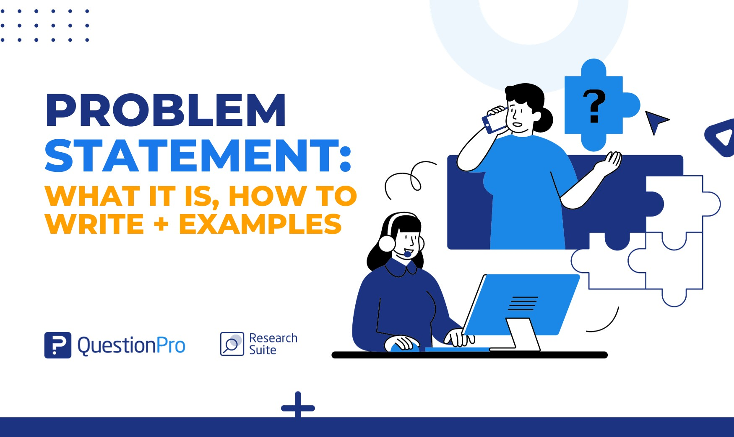
1. Problem statement
A problem statement explains the challenges you face with your work, which can affect your operations, launching new products, or improving existing ones. It shows the gap between the current state and the desired state of a process, product, or service

Slide 5
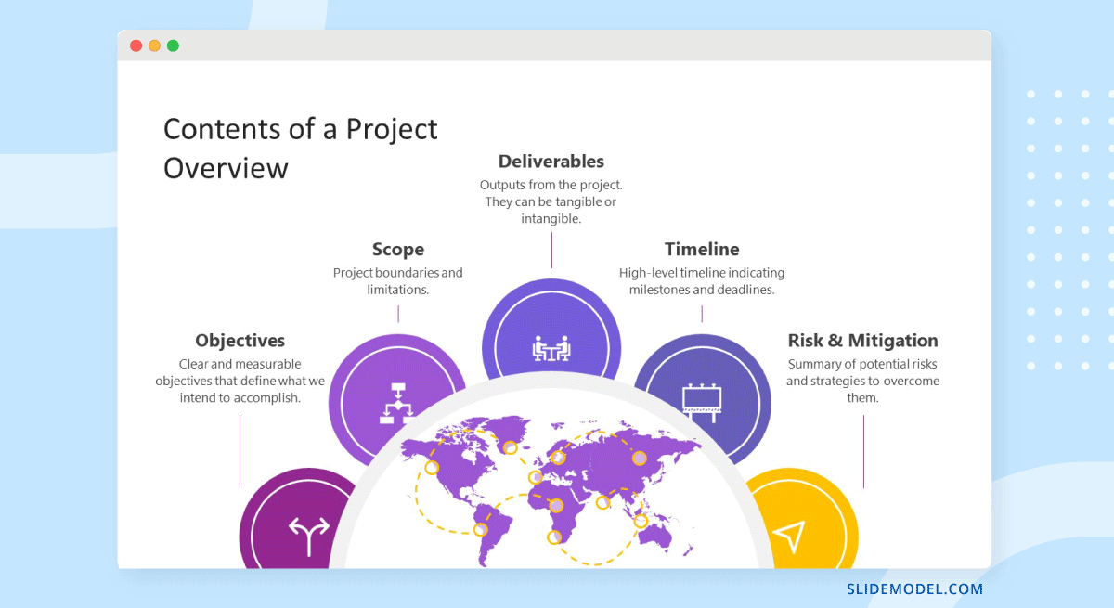
2.Project overview
If you're a project manager or are responsible for leading a team through a project, it may be helpful to create a project overview. A project overview outlines the important details of your project, such as its goals and potential risks. Knowing more about project overviews and how to create one can help you stay organized and work more efficiently.

Slide 6
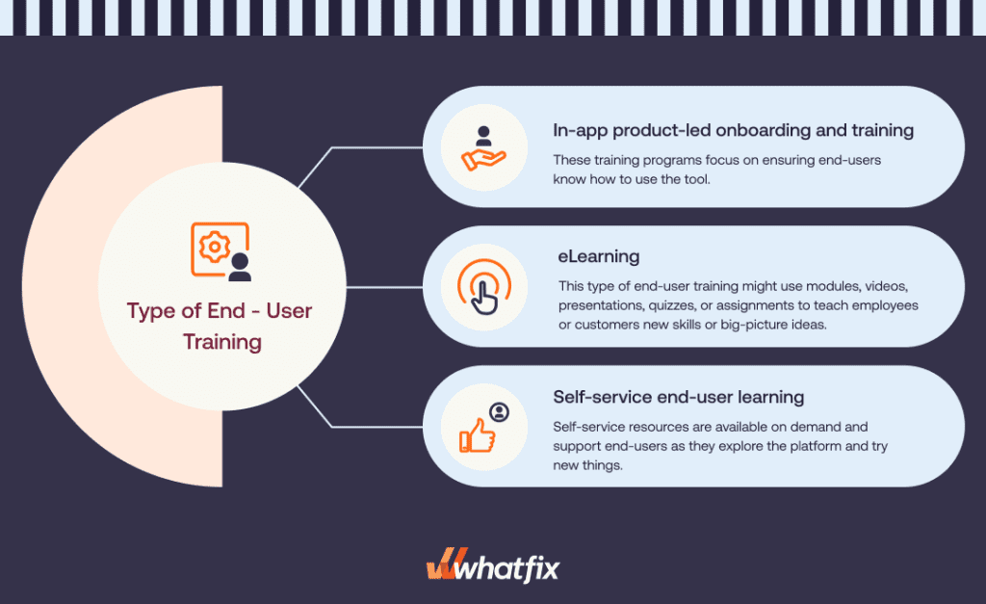
3.End users
The term "end user" refers to the consumer of a good or service, often one who has some innate know-how that is unique to consumers.
In a literal sense, the term is used to distinguish the person who purchases and uses the good or service from individuals who are involved in the stages of its design, development, and production

Slide 7

4.Tools And Technologies
Data Science has been playing a vital role in almost every industry today, whether you call it for making business decisions or planning, or future forecasting. It all falls under the technology and trends that we're going forward with. We're running in a world full of the digital era, and we've got a lot of data all over, and we are using different tools and techniques to make it resourceful for different purposes. If you'd talk about any popular technology, it would be "Data Science" only.

Slide 8

5.Portfolio Design And Layout
A portfolio is a place to show off who you are, your style, and serve as an introduction to potential clients or employers. Make it personal. By using language and a tone that feels like you and a photo or video that shows your personality, you can start to establish a connection online with those who visit your portfolio.

Slide 9
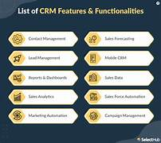
6.Features And Functionality
Features and functionality are both important aspects of a product or service, but they serve different purposes. Features refer to specific characteristics or capabilities that a product offers, such as a camera on a smartphone or a touch screen on a tablet. Functionality, on the other hand, refers to how well those features work together to provide a seamless user experience. While features may attract customers to a product, it is the functionality that ultimately determines its usability and effectiveness. In essence, features are what a product has, while functionality is how well it works

Slide 10
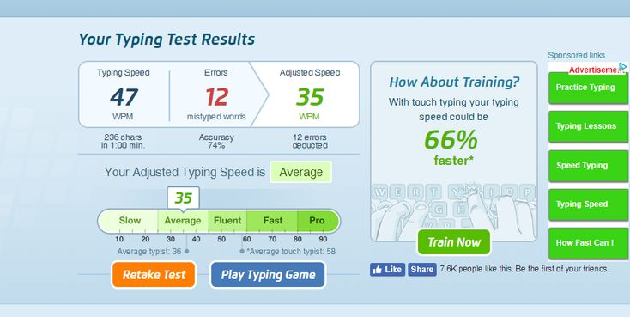
7.Results And Screenshot
A screenshot is an image of the exact thing displayed on the screen of your device. It captures everything visible, from applications to notifications, preserving the visual arrangement and details. This image serves as a record of what was shown useful for sharing, troubleshooting, or documenting. Screenshots provide a static representation of the screen, distinct from dynamic screen recordings

Slide 11
8.Conclusion
A digital portfolio is like an online scrapbook that showcases your skills in action, your experience, and your expertise through real-life examples. By looking at this scrapbook, your future employer or client can get a feel of what you bring to the table and who you are as a professional.

