Slide 1
DDoS Detection and Alleviation in IoT Network using SDN
TEAM 4 Madhuvanthi Mohan Vijayamala & Aravind Pothuri

Slide 2
Motivation
Several compromised IoT devices across a network can be used to render a target server inactive leading to a Denial of Service situation
The number of IoT devices are constantly growing
DDoS attacks in IoT networks are hence a formidable challenge
The lack of resources and reduced capacity of IoT devices/network are taken advantage of

Slide 3
Proposed Solution
Software Defined Networking (SDN) architecture based solution for an IoT network
Network controlling plane and the forwarding plane have clear boundaries
Easily programmable
The control is centralized and hence a global view of the network topology is available
The model can handle TCP flood, UDP flood, Ping flood attacks
The proposed solution is based on network characteristics and resource traits of an IoT network
The solution has been implemented on a simulated network architecture on Mininet

Slide 4
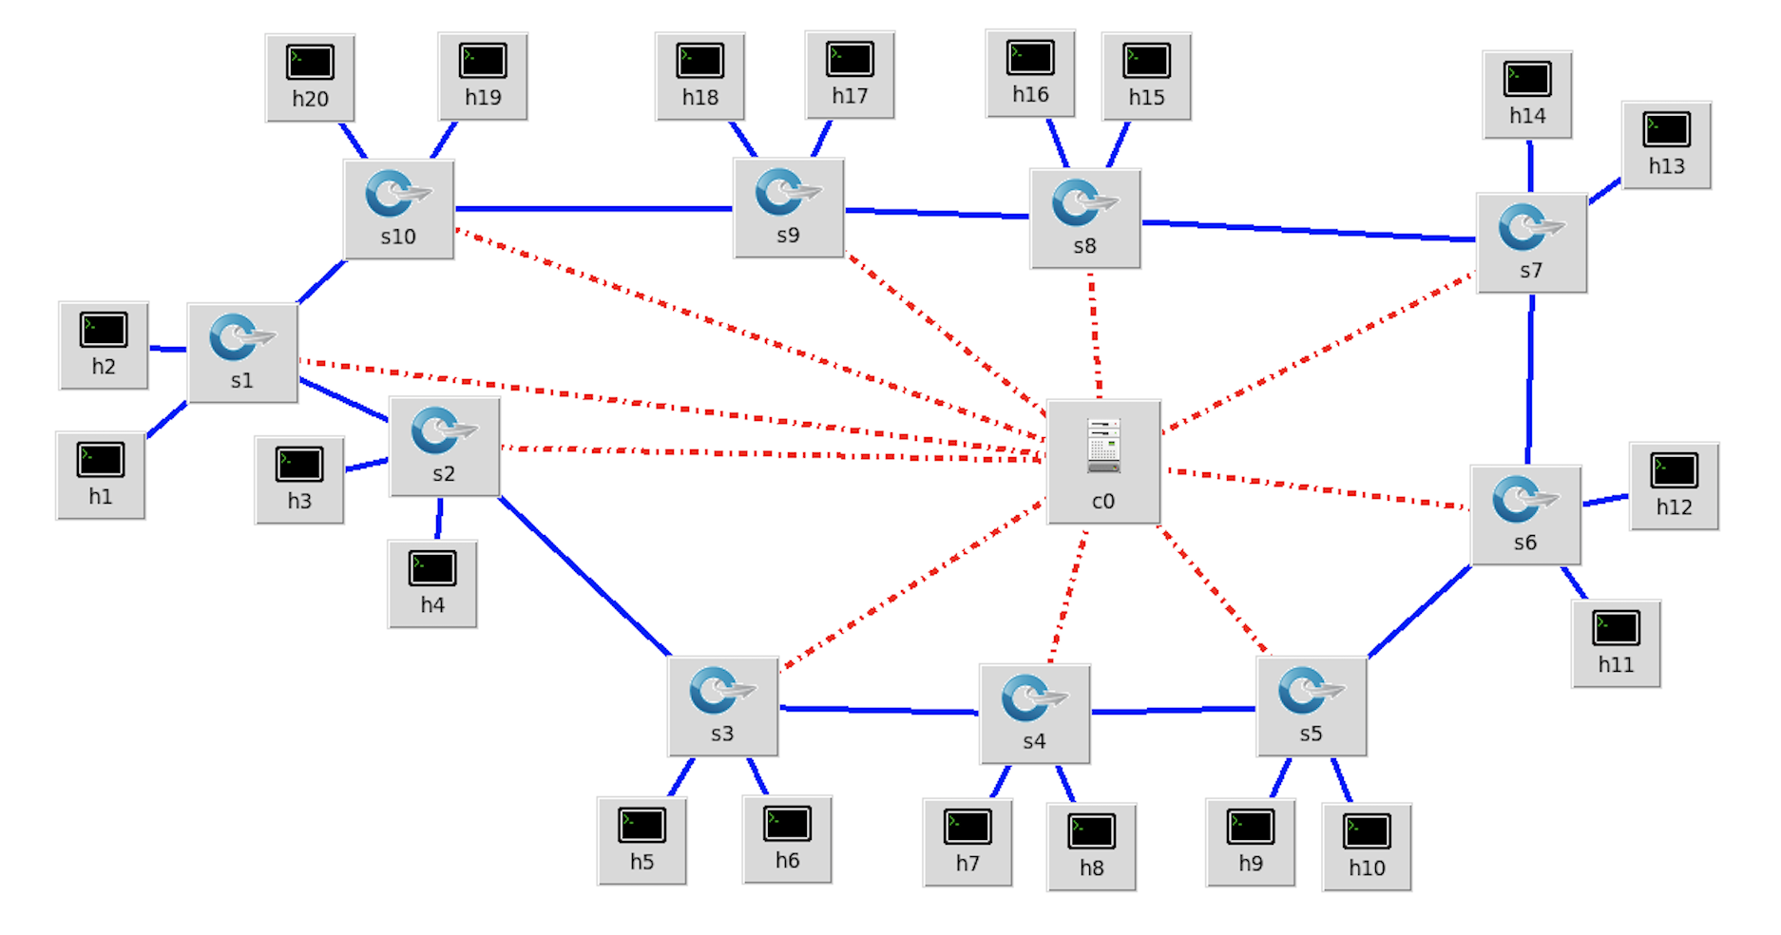
Simulated Network

Slide 5
Simulated Network
Developed a simulated IoT network on Mininet 2.2.2
19 hosts, 1 data server, 10 switches, 1 controller
Each of the switches (s1 to s10) emulate an IoT network
They are OpenFlow1.3 enabled switches
Each of the hosts (h1 to h19) emulate IoT devices in the network
Host h20 emulates IoT data server
Can be an MQTT broker, CoAP server, HTTP Server
All the connected IoT networks are managed by an SDN controller (c0)
An Ryu SDN Controller

Slide 6
IoT Traffic Model
Periodic Traffic
Static monitoring applications that update state of an object every pre-calculated period
Eg: Battery monitor of smart locks
Random Traffic
Dynamic applications that trigger an event without any particular frequency
Eg: Events generated by wearables
Underlying traffic is TCP (to access web servers) or UDP (wireless sensors)

Slide 7
Simulated IoT Network’s Traffic Model
Periodic TCP Traffic - Simulated by an MQTT broker on h20, an MQTT publisher that publishes data every 60 seconds on h1 and MQTT subscribers on h2, h3, h4, h5
Random TCP Traffic - Simulated by an MQTT broker on h20, an MQTT publisher that publishes data every 60 to 120 seconds on h6 and several MQTT subscribers on h7, h8, h9, h10
Periodic UDP Traffic - Simulated by an UDP server on h20, a UDP client on h11 that sends bursts of data every 60 seconds
Random UDP Traffic - Simulated by an UDP server on h20, a UDP client on h12 that sends bursts of data every 60 to 120 seconds

Slide 8
System Design - Parameters Involved
The objective of a DDoS attack is to exhaust resources and hence the processing capacity of each of the main components of an IoT network has to be considered.
These are application and environment dependent:
SWITCH_ THRESHOLD
The number of Packet_In messages that are allowed from a switch in a particular time period
Does not change
PORT_THRESHOLD
The number of Packet_In messages that are allowed from a port of a switch in a particular time period
Might change
PORT_THRESHOLD < SWITCH_THRESHOLD and SUM(PORT_THRESHOLD) = SWITCH_THRESHOLD

Slide 9
System Design - Parameters involved
3. IP_THRESHOLD
The number of Packet_In messages that are allowed from an IP/MAC address in a particular time period
Does not change
IP_THRESHOLD < SWITCH_THRESHOLD

Slide 10
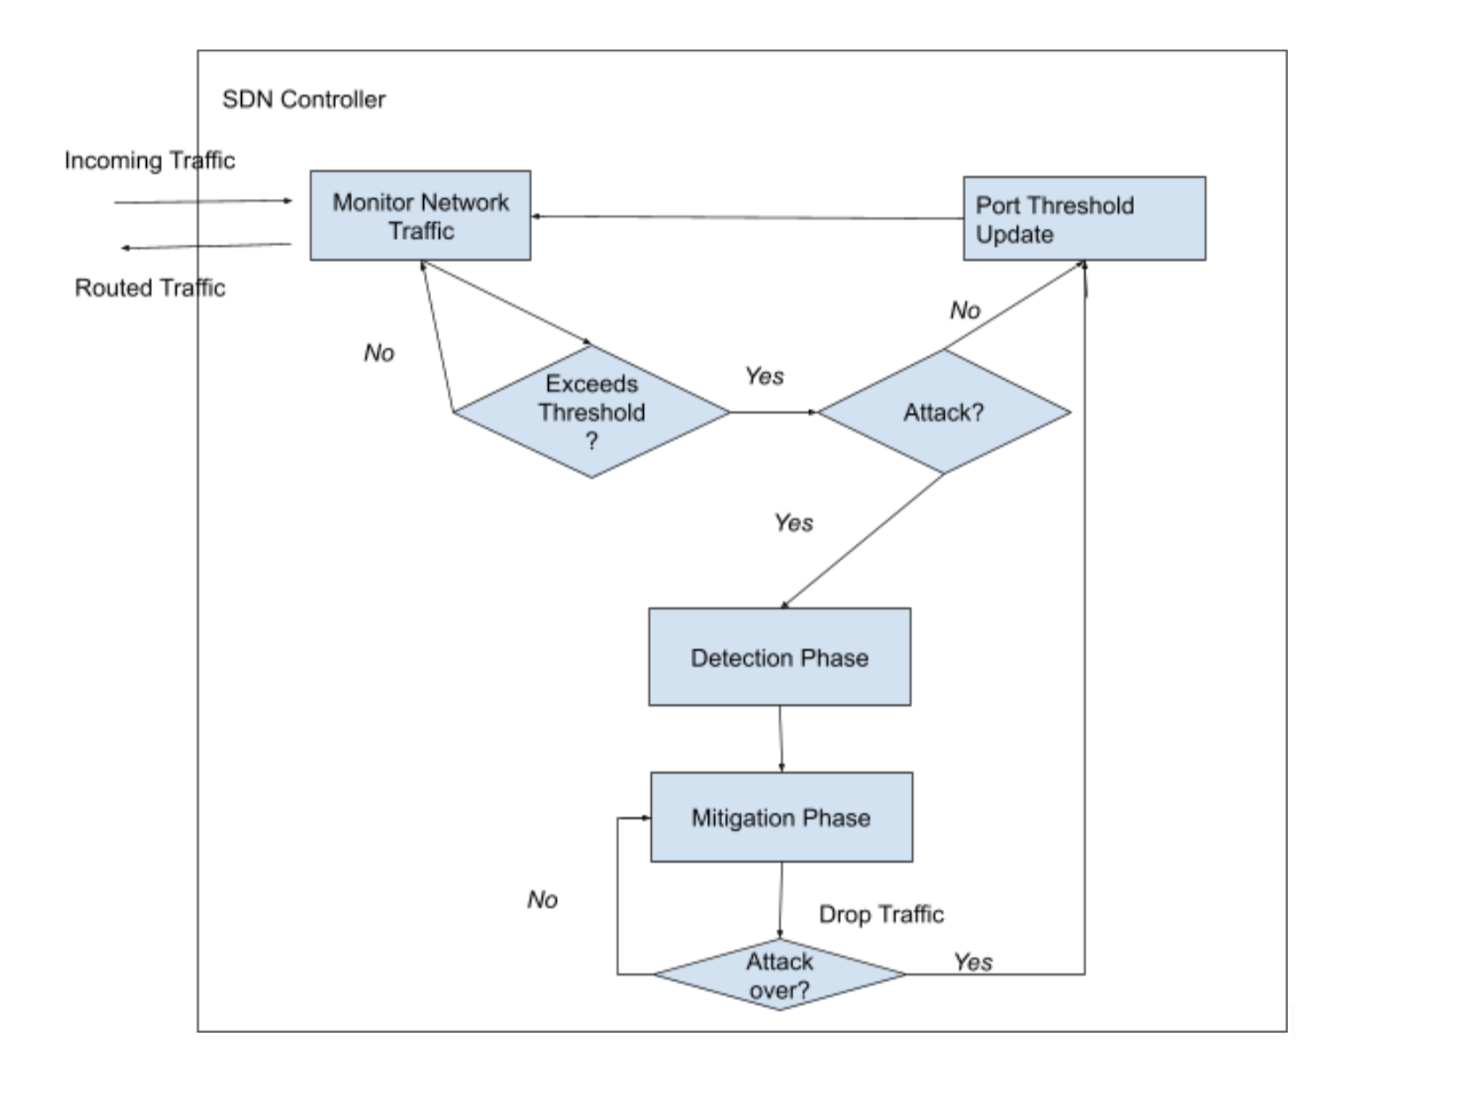
System Design
Monitor Traffic
Detection Phase
Port Threshold Update
Mitigation Phase

Slide 11
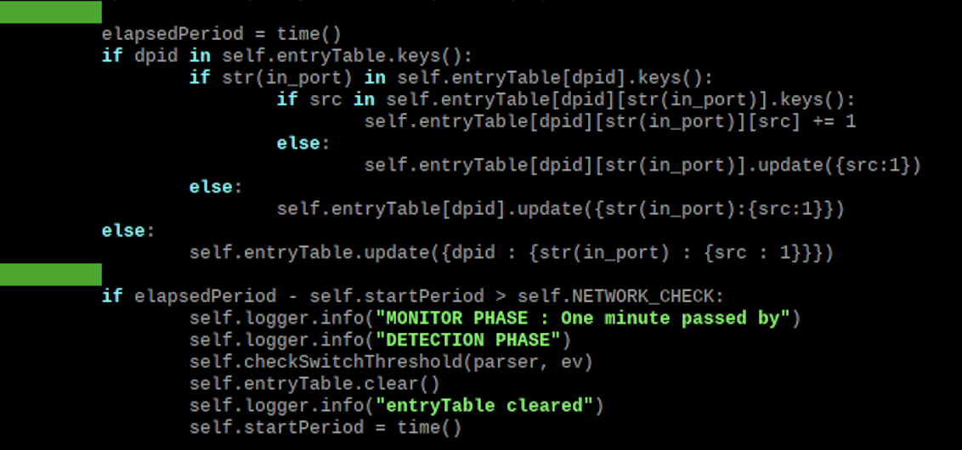
System Design
Monitor Traffic
Every incoming Packet_In message is routed to the controller
The number per switch, per port and per host is monitored every 60 seconds and then control transfers to Detection Phase

Slide 12
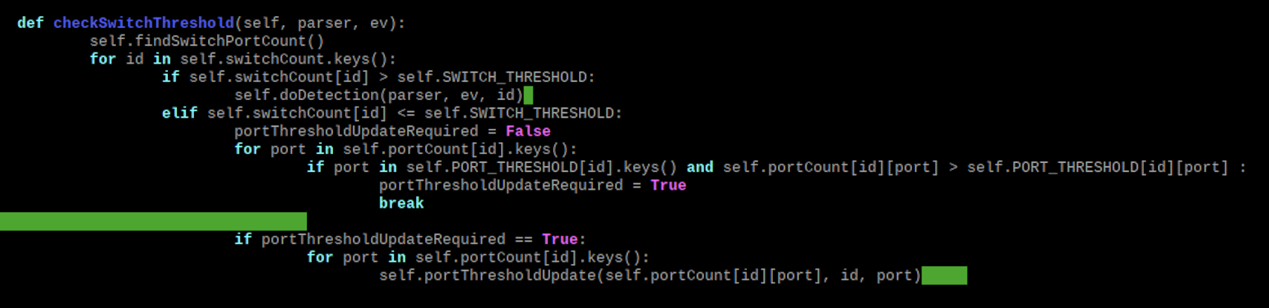
System Design
2. Detection Phase
The total number of Packet_In messages for every switch is compared with the SWITCH_THRESHOLD
If it exceeds, the presence of DDoS attack is confirmed and control transfers to Mitigation Phase
If it does not exceed, the number of Packet_In messages for every port per switch is compared with the corresponding PORT_THRESHOLD. If it exceeds (due to an oncoming DDoS or just normal traffic burst), then control transfers to Port Threshold Update, otherwise traffic is allowed as such

Slide 13
System Design
3. Port Threshold Update
The threshold is updated for each of the ports such that they do not exceed SWITCH_THRESHOLD
4. Mitigation Phase
Control reaches here only when there is a DDoS attack
The number of Packet_In messages for each host of the suspicious switch is compared with the IP_THRESHOLD and those that exceed are blocked
Blocking the host is achieved by adding an entry to the flow table of the switch to drop packets from the compromised host. This flow table entry is set to be valid for an extremely short period after which it is deleted from the flow table automatically
The control transfers to Port Threshold Update to reset the threshold values to the initial values

Slide 14
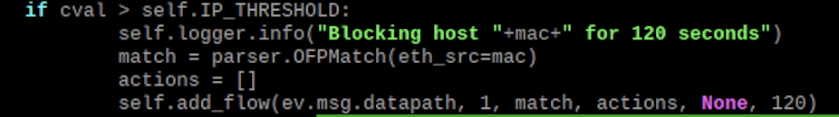
System Design
Port Threshold Update
Mitigation Phase

Slide 15
Code
Python script to implement a custom ryu manager SDN controller
Python scripts to implement MQTT broker, subscribers and publisher (random and periodic)
Python scripts to Implement UDP server and client (random and periodic)

Slide 16
Project Demo
https://drive.google.com/file/d/1KPSmh1lR3eWLwN94FwX5ICbYsx7LNp6b/view?usp=sharing

Slide 17
References
Wang,S.;Gomez,K.; Sithamparanathan, K.; Asghar, M.R.; Russello, G.; Zanna, P. Mitigating DDoS Attacks in SDN-Based IoT Networks Leveraging Secure Control and Data Plane Algorithm. Appl. Sci. 2021, 11, 929. https://doi.org/ 10.3390/app11030929
Azka Wani, S Revathi, DDoS Detection and Alleviation in IoT using SDN (SDIoT-DDoS-DA), 2020
https://ryu.readthedocs.io/en/latest/ofproto_v1_4_ref.html
https://inside-openflow.com/2016/07/21/ryu-api-dissecting-simple-switch/

Slide 18
Thank You

