Slide 1
Class-bias on the Titanic

Slide 2
Outline
Introduction: History and Timeline
Problem Statement
Data Analysis Process
Findings

Slide 3
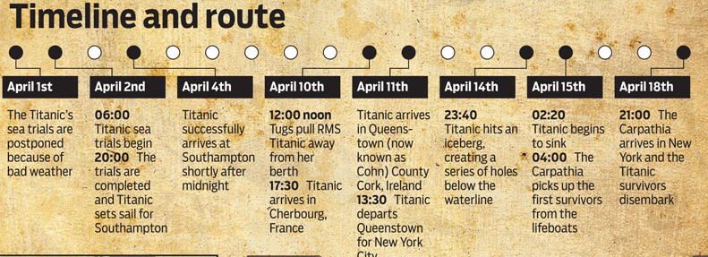
Timeline
On April 14, 1912, at 11:40PM, the Titanic struck a submerged iceberg in the north Atlantic
The ship took 2 hours and 40 minutes to be completely submerged
There were 20 lifeboats on board, though the ship was equipped to carry as many as 64
31.6% of the passengers and crew survived
53.4% could have survived if lifeboats had been filled to capacity
From http://www.titanicfacts.net/
Notes:
Lifeboats
The full complement of 64 was reduced to 20 for cosmetic reasons. At the time this was actually 10% over the legal limit, as boats were meant to ferry passengers back and forth between the sinking vessel and rescue vessel. Each boat has a capacity to carry 65 people.
The Californian:
http://www.historyonthenet.com/the-titanic-the-californian/
Titanic’s radio operator was busy clearing a backlog of passenger messages to Cape Race Newfoundland. When Evan’s message that The Californian was stopped for the night interrupted his messages, he told The Californian to ‘Shut up!’.
Evans when to sleep at 23:35. Despite multiple attempts to raise the titanic with morse signal lamps. No reply.
Reports show The Californian may have been just 6-10 miles from the Titanic, yet did not respond to signal rockets.

Slide 4
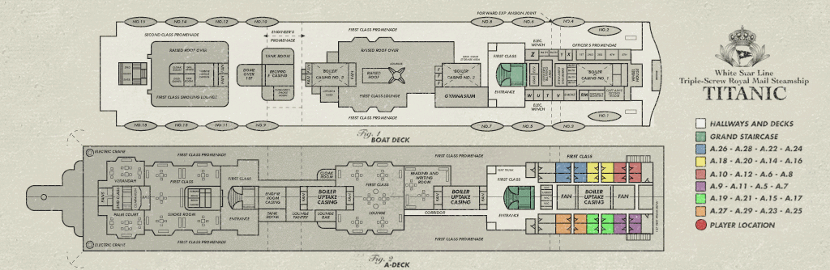
Problem Statement
Was there a cultural bias that determined access to lifeboats? Did certain classes, in particular the wealthy, have more members who survived the incident?
Given the passenger class, age, sex and point of origin, was there a higher probability to survive?

Slide 5
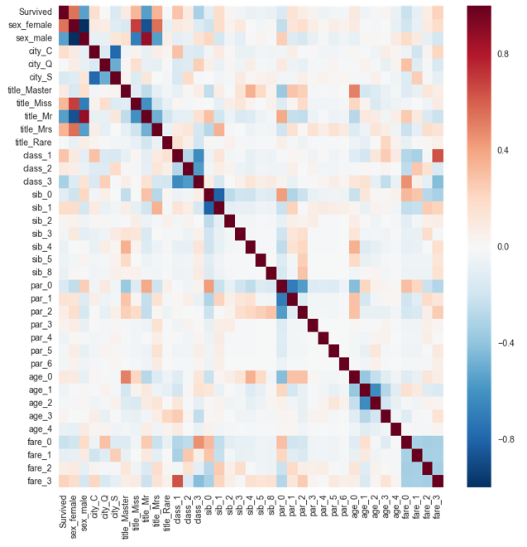
Important Factors
Once it was determined that the ship was lost, the captain issued the order to abandon ship and “load the women and children first.”
Lifeboats were only accessible from the boat deck.
Three Passenger Classes were mixed between decks, with First and Second Class in the top 4 decks.

Slide 6
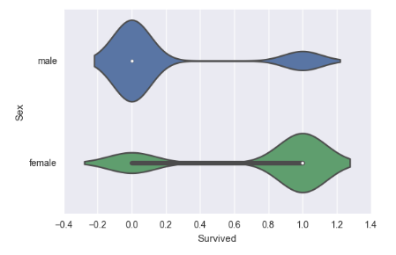
Data Analysis: Gender
Women survived in greater numbers than men.
Gender

Slide 7
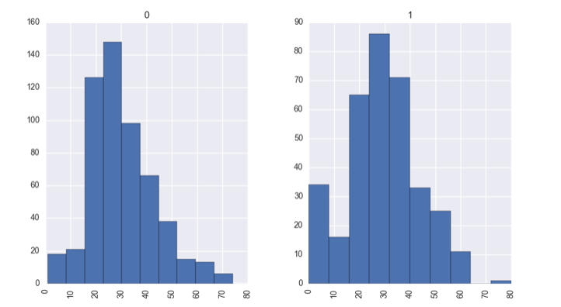
Data Analysis: Age
While nearly every young child survived, the actual age of the survivors did not tend to rely on age above the age of 20.
Deceased
Survived
Age
Age

Slide 8
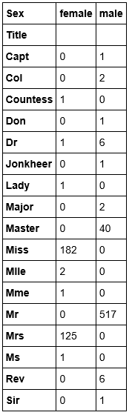
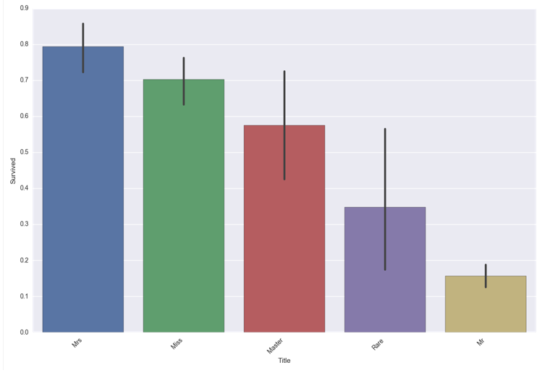
Data Analysis: Age from Title
Record keeping for White Star company
Unusual titles
Women and young people tended to survive.
Average ages:
Mrs: 34 Miss:23 Master:7 Rare:45 Mr: 31

Slide 9
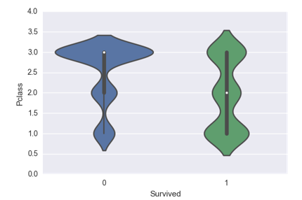
Data Analysis: Class
The distribution of those who survived by class is relatively uniform.
The distribution of those who died is heavily weighted on 3rd class passengers
Deceased
Survived

Slide 10
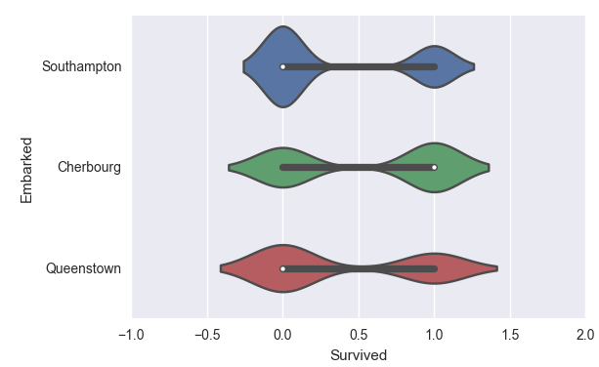
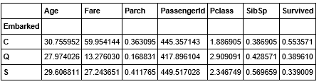
Data Analysis: Embarkation City
Passengers from Cherbourg:
Tended to be in 1st or 2nd Class
Many were traveling as a family

Slide 11
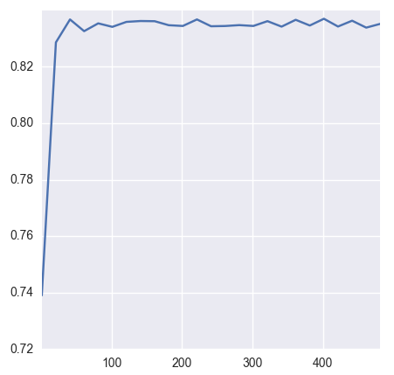
Data Analysis Approach: Accuracy Scores and Cross-Validation
Challenges:
Since there was not much data I chose a Random Forest classifier
Multiple classifiers
Random Forest – 83%
Cross-validated with ROC AUC
K-Nearest Neighbors – 83%
Cross-validated with Kfolds and Gridsearch

Slide 12
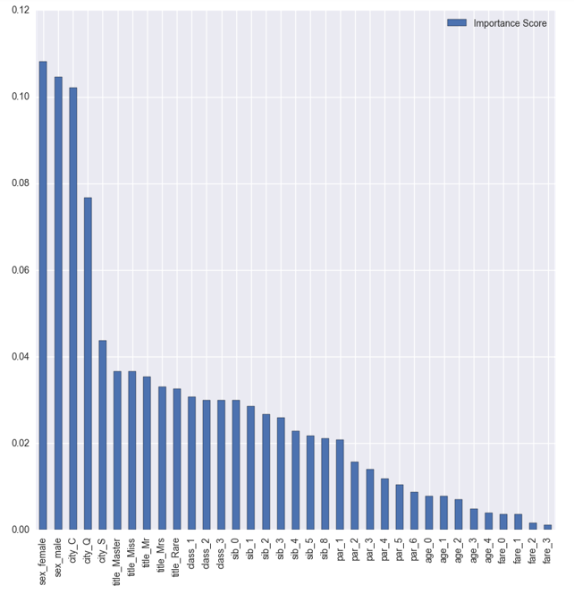
Findings
Passengers from Cherbourg:
Tended to be in 1st or 2nd Class
Many were traveling as a family

