Slide 1

Meterrific: Adding Smart Functionality to Traditional Parking Meters
By: Shiv Chopra, Blake Heard, Madison Hester, Michael Knudson, Raj Patel, Andrew Trimper
Date: January 16, 2019
Notes:
l

Slide 2
Introduction
The main goal of Meterrific is to develop a smart add-on for existing parking meters
Why?
Address main points or issues with urban street parking
Minimize time spent and gas wasted looking for parking
Minimize stress associated with city parking
How?
Use sensors to identify spot availability
Relay information to users
Navigate to open parking spots near destination
Re-route users if selected spot becomes unavailable
The team is requesting $164.20 in funding to develop the prototype
Notes:
Madison

Slide 3
Qualitative Goals
Target population: people driving in heavily populated cities with street parking and associated parking meters
Parking Meter
Protects processing unit from the environment
Keeps track of overall status and sends status to a cloud database
Mobile App
Navigates user to the closest parking spot near specified destination
Receives meter status from cloud database and re-routes user as necessary in real time
User can pay for the meter through the app
Notes:
Shiv

Slide 4
Design Approach: Hardware
Attachment to existing parking meter
Interchangeable connection point
Customizable part between connection point and parking meter
Electronics Housing
Protects electronics from environmental factors
Waterproof
Impact resistance
Smallest possible size and mass
Custom 3D-printed component cutouts
Waterproof Shell
Notes:
Andrew

Slide 5
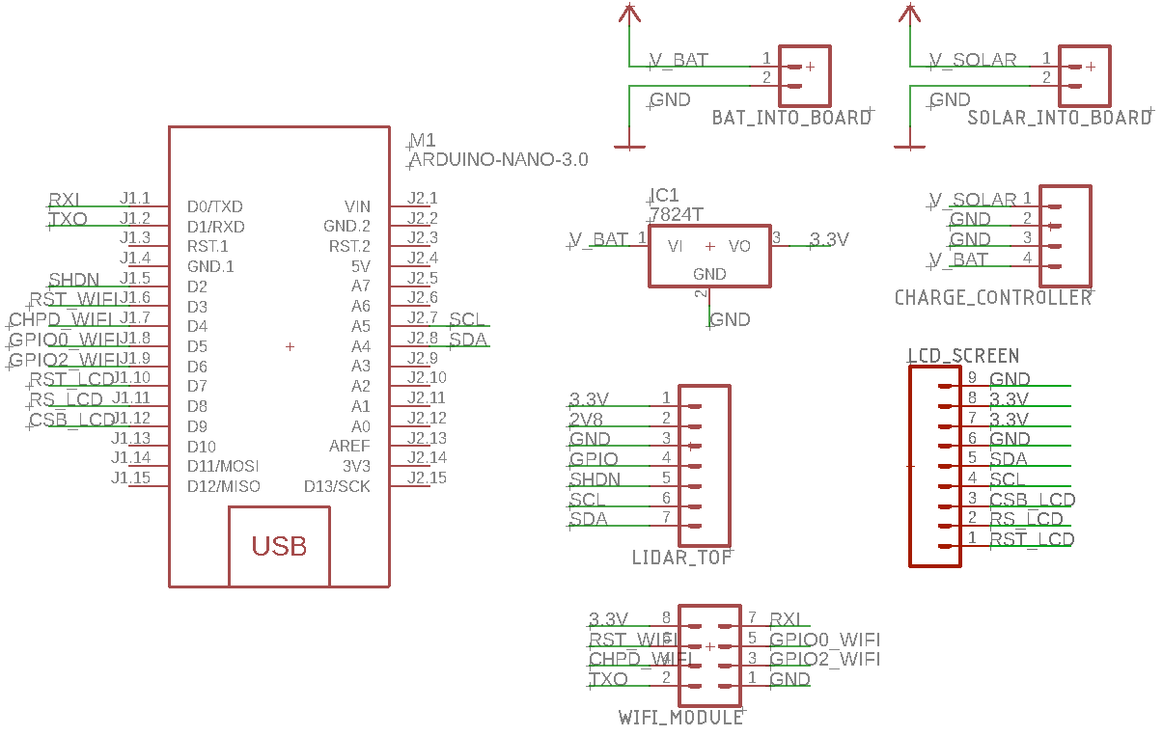
Design Approach: Electrical
Single printed circuit board (PCB)
LCD screen, LIDAR, solar panel, sit off-board
Central microprocessor handles interactions and logic
Wi-Fi module deals with sending data to cloud
Microprocessor
Requires: I2C Interface, SPI Interface
Prototype with Arduino Nano
Final product uses Atmega328p
Power
3.7V lithium polymer battery
Use external voltage regulators
Use decoupling capacitors
Notes:
Andrew

Slide 6
Quantitative Specs
Resting current draw | ~30mA
Active current draw | ~300mA
Time active (wifi) | < 0.1%
Battery life | 1700 mAh for 300 to 500 cycles
Usage time per battery charge | ~52hrs
Dimensions | 6 in x 3 in x 2 in
Cost per unit | $82.10
* Dimensions and cost per unit based on preliminary research. Both are expected to decrease in final product
Notes:
Michael
passive current draws- led, chip
active - wifi

Slide 7
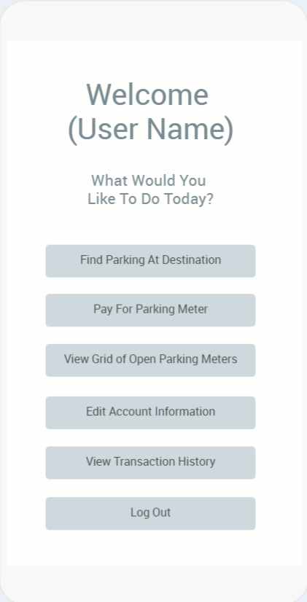
Design Approach: Software
Parking Meter Add-on Firmware
Keeping tabs on spot availability
Power management
Sending status to database
Cloud Database
Retrieving and handling of meter status data
Mobile App
Integration of Pre-existing Maps and Navigation API
Retrieving and handling of meter status data
Notes:
Andrew

Slide 8
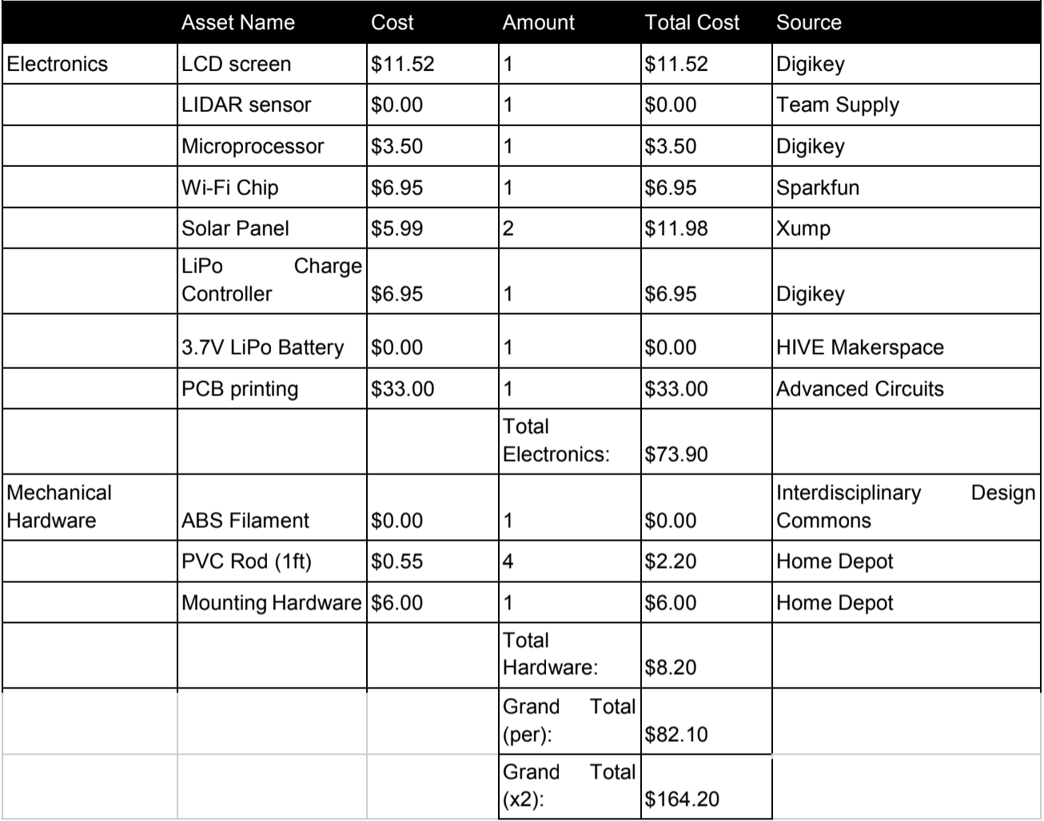
Current Status
Moving to production stage
Any usability, feasibility, or efficiency discoveries will lead to changes in final design
Finalizing parts requirements and placing orders
Notes:
Blake

Slide 9
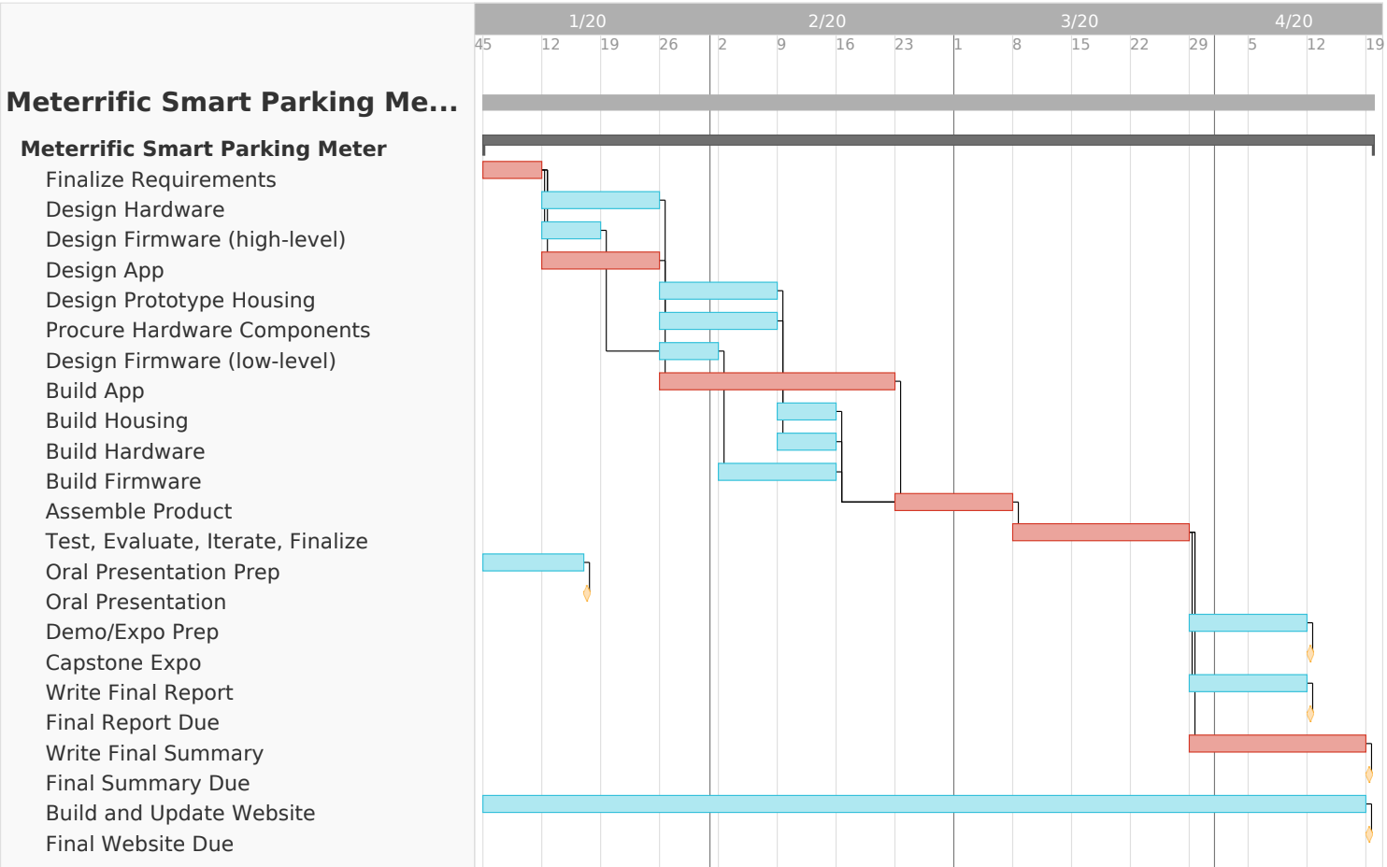
Schedule and Next Steps
Notes:
Raj

Slide 10
Questions?

