Slide 1
Assessing Vulnerability in Conflict Area X
Mahmoud (Madi) Diab
MAIR Candidate
Class of 2022
PAI 789 Advanced Policy Analysis
Prof. Peter J. Wilcoxen
Maxwell School
Syracuse University

Slide 2
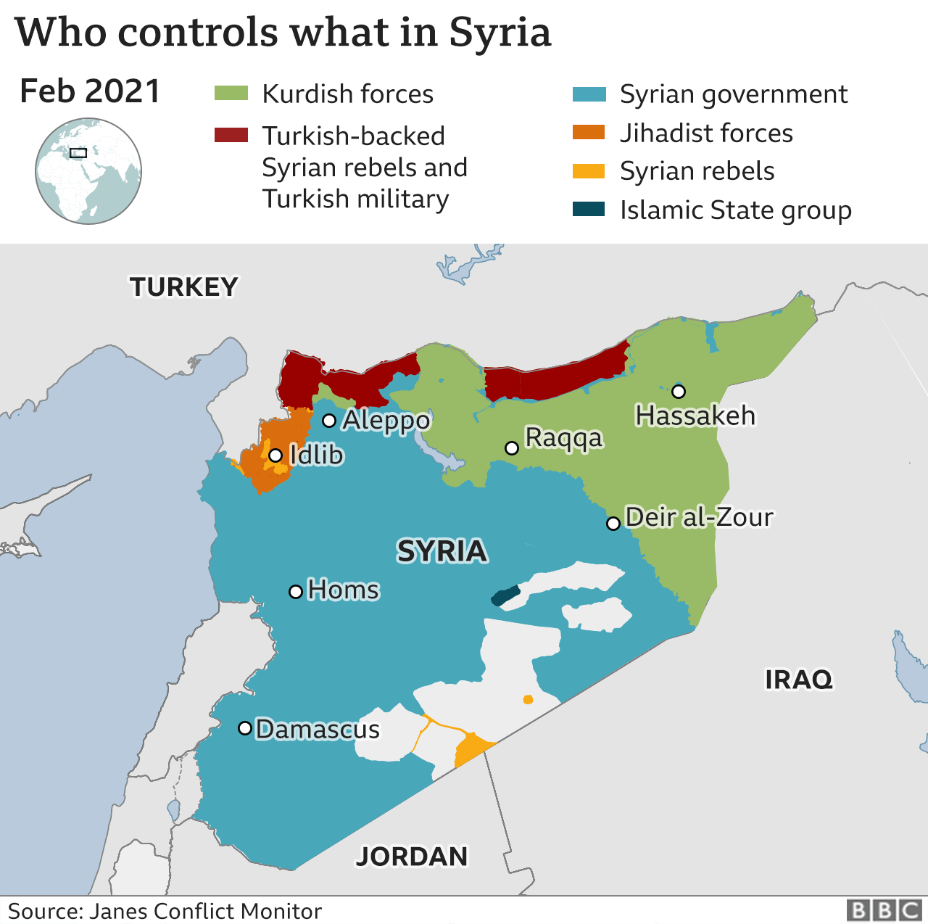
Motivated by the Syrian Conflict:
Status quo: last statistical survey 2013
Problem: contested sovereignty
Project:
Design & launch a vulnerability survey and
monitoring dashboard.
Tools:
Python; QGIS (& potentially Tableau Public)
The Data:
- Experimental randomized CDC data to model
the survey, run the analysis & project the
platform.
- Fictional country X.
Targeted indicators:

Slide 3
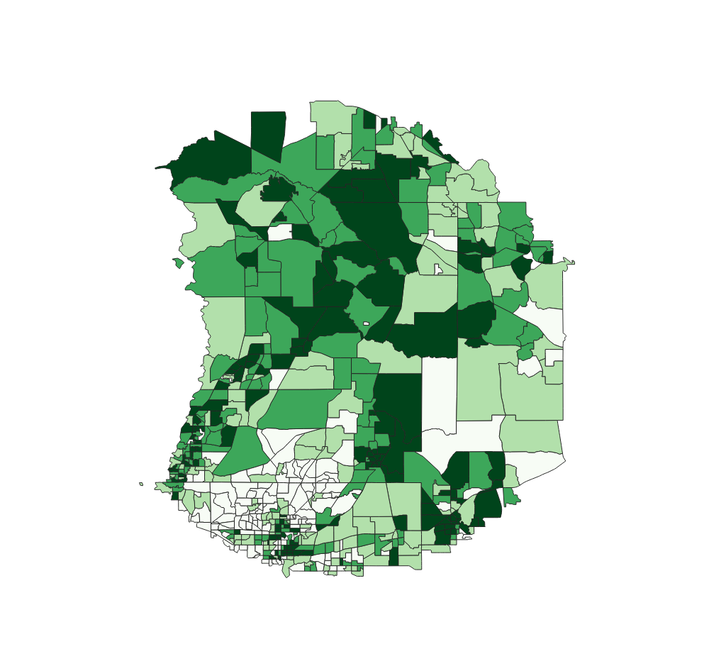
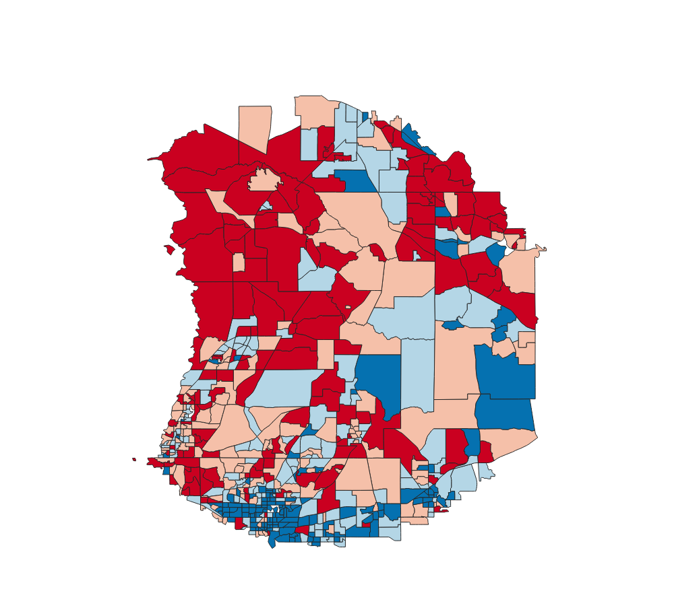
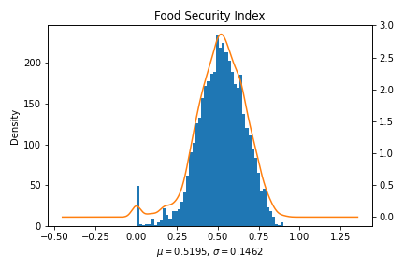
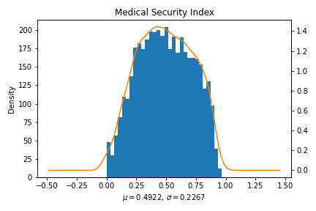
Food Security
Index
In
Country X
Medical Security Index
In
Country X

Slide 4
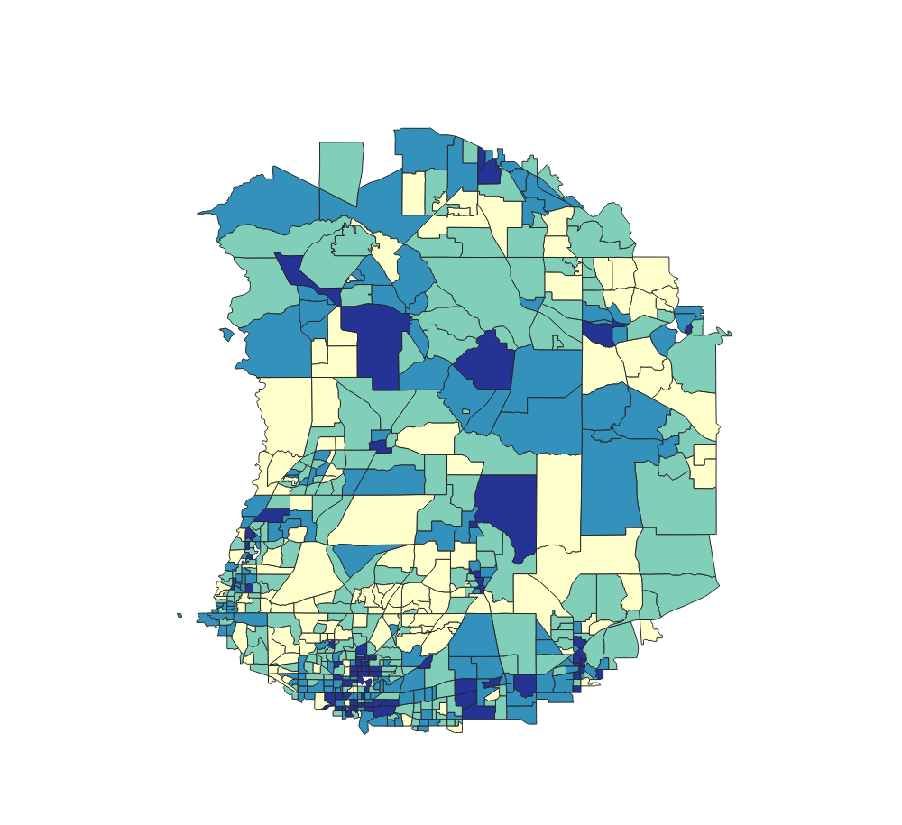
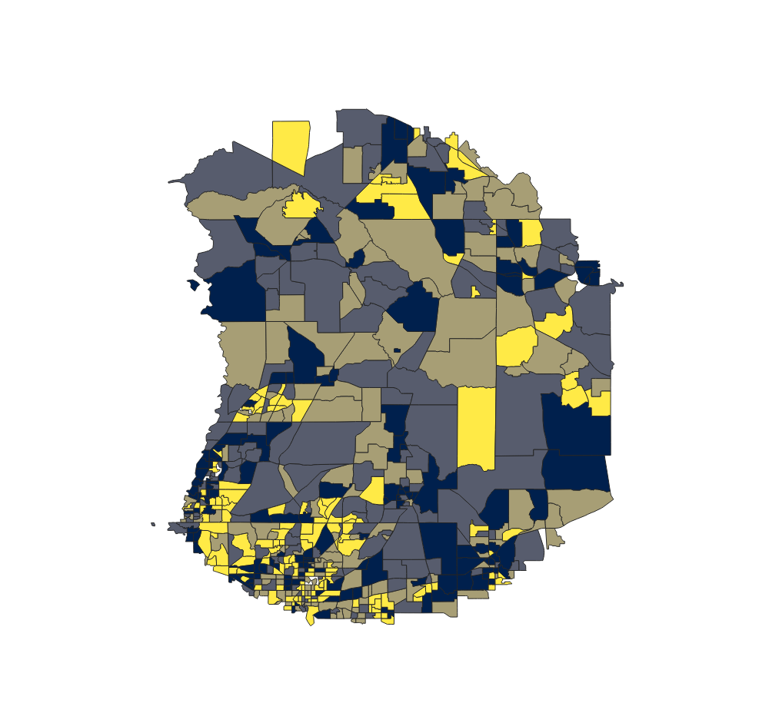
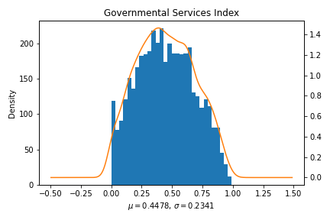
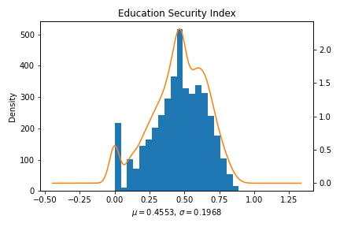
Governmental Services Index
In
Country X
Education Security Index
In
Country X

Slide 5
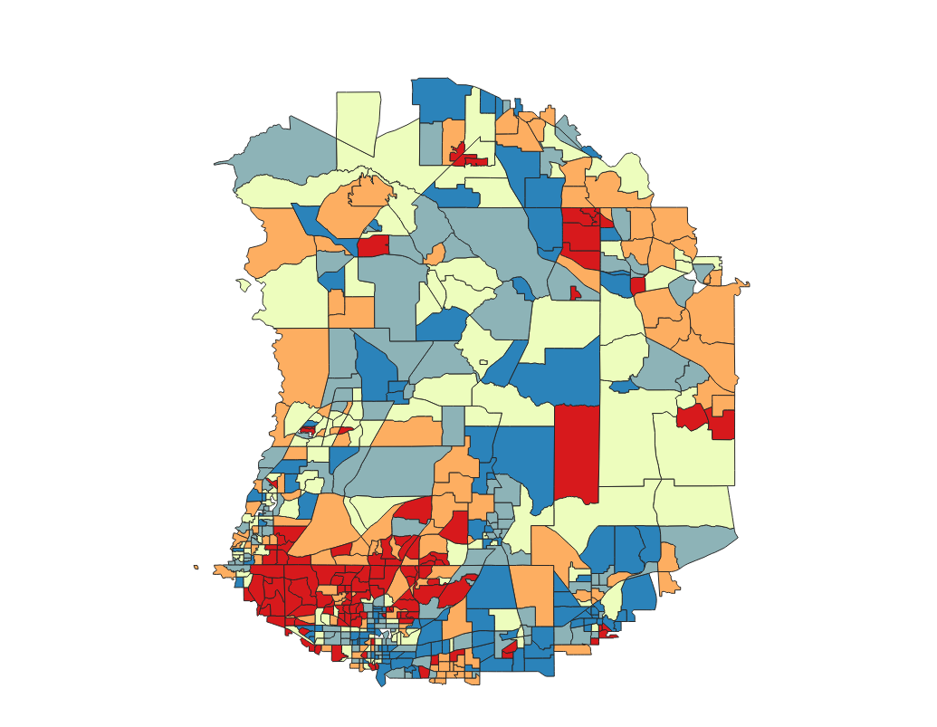
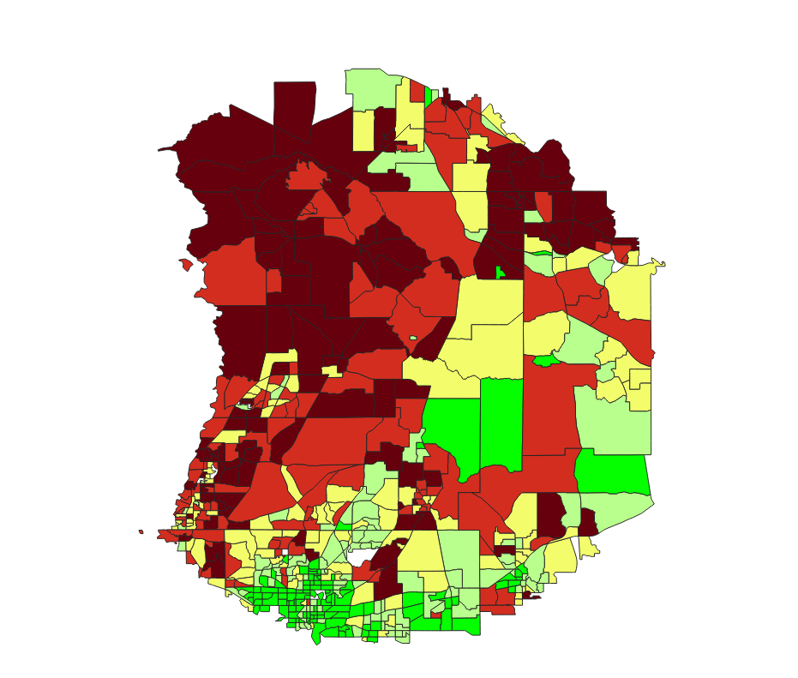
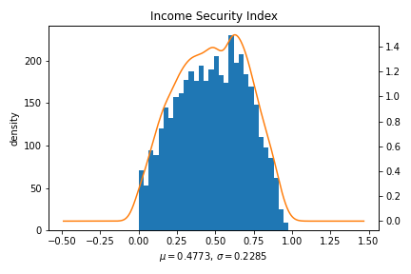
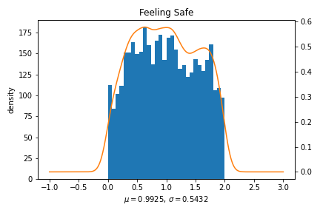
Income
Security
Feeling
Safe

Slide 6
Work in progress…
Check my repository for more:
https://github.com/madiab01/PAI-789-Madi-Project
Thank you ☺
Questions are welcome!

