Slide 1
Web Crawling ‘Final’ {
Topic.html
Content.css
[Ptt Stocks]
<B11902154 陳柏霖>
}
Programming Language

Slide 2
Table Of ‘Contents’ {
01
02
03
Topic.html
Content.css
Introduction
Process
<Target Webpage Data>
<Problem>
<Method and Result>
Other Results and Potential Problems
< The Remaining of this project >
}
Programming Language

Slide 3
01 {
[Introduction]
Topic.html
Content.css
< The Overview of this project >
}
Programming Language

Slide 4
Target Webpage < /1 PTTSTOCKS> {
Topic.html
Content.css
< Used to obtain the most popular target stocks from the posts>
}
Target Webpage < /2 TWSE> {
< Used to obtain the target stocks’ price>
}
Programming Language

Slide 5
Target Webpage < /1 PTTSTOCKS>; {
Topic.html
Content.css
‘Obtain The Articles info whose title starts with ”標的”’
<p The data I crawled includes Title, Content, Comment_tag, Comment_Content, from 1/01 to 5/21>
</p>
}
Programming Language

Slide 6
Target Webpage < /2 TWSE>; {
Topic.html
Content.css
‘Obtain all the price data of the target stocks within the time span’
<p As for my case, I get the price data from January to May>
</p>
}
Programming Language

Slide 7
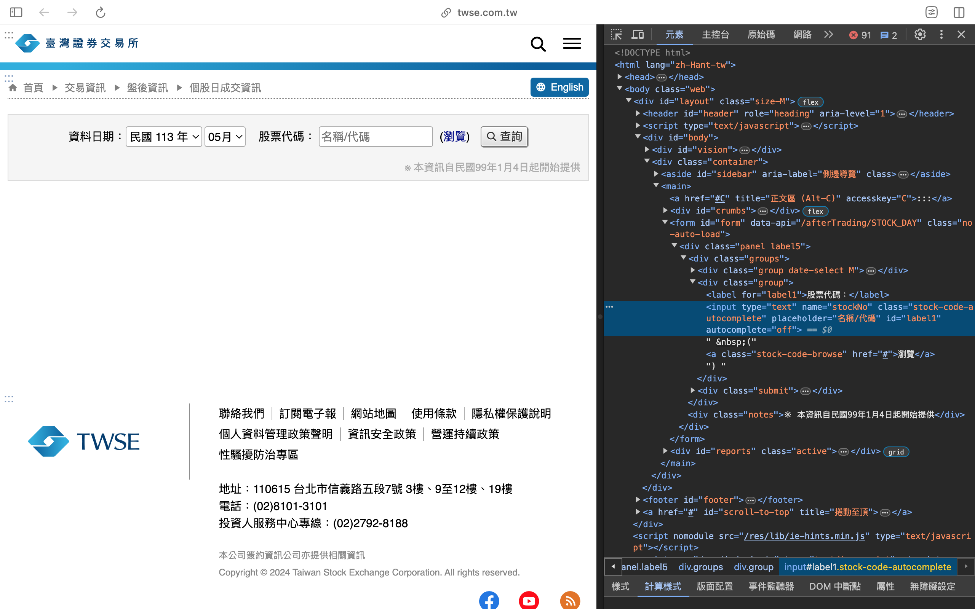
Structure {
Topic.html
Content.css
}
Programming Language

Slide 8
02 {
[Process]
Topic.html
Content.css
<Target Webpage Data>
<Problem>
<Result and Data>
}
Programming Language

Slide 9
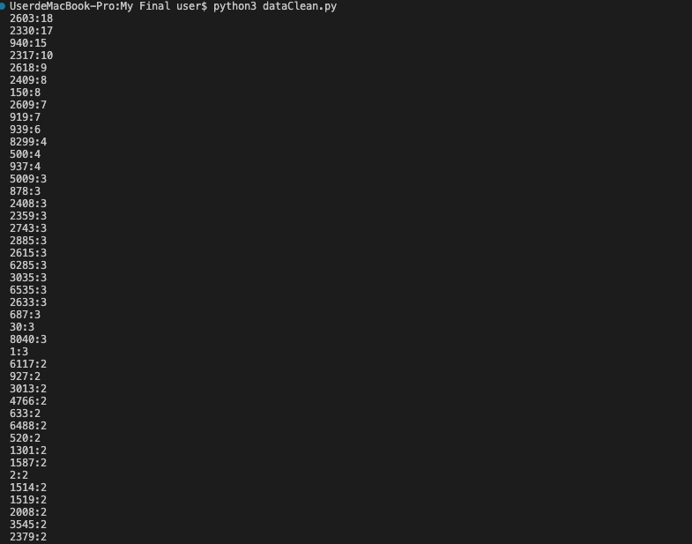
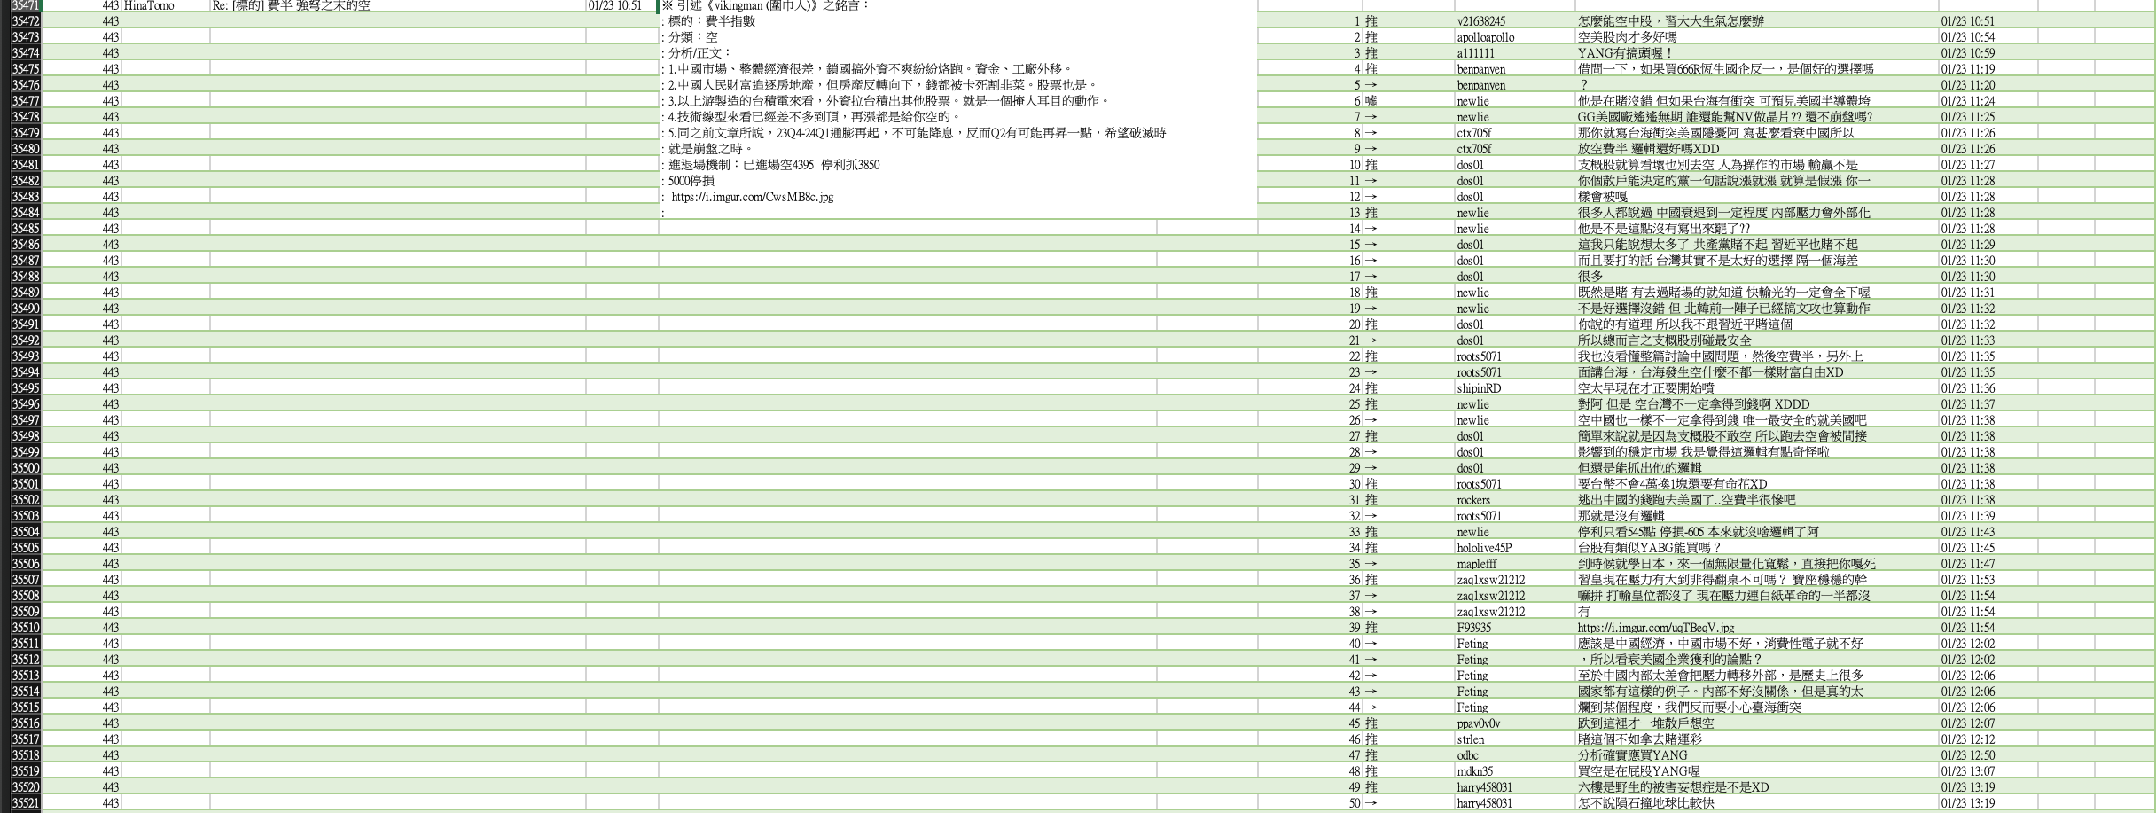
Data of PTT STOCKS: {
Topic.html
Content.css
There are total 492 posts to handle with, and I picked the 5 most mentioned posts.
}
Programming Language

Slide 10
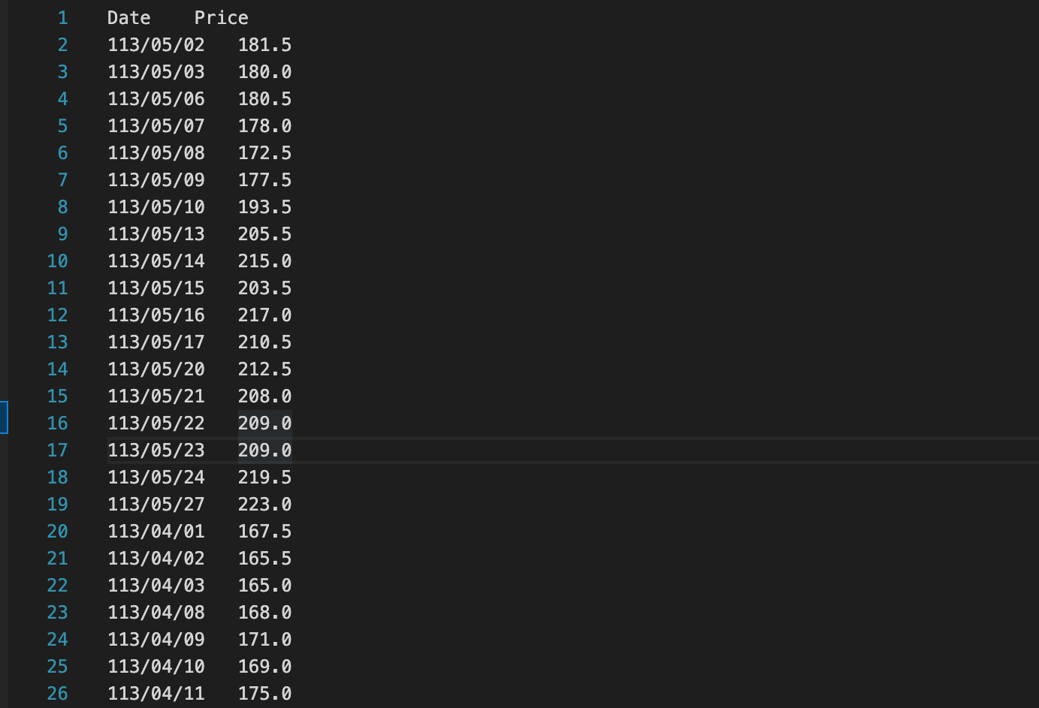
Data of TWSE: {
Topic.html
Content.css
After I picked the 5 most mentioned stocks from PTT STOCKS, I used Selenium to automatically obtain the wanted price data during Jan to May.
}
Programming Language

Slide 11
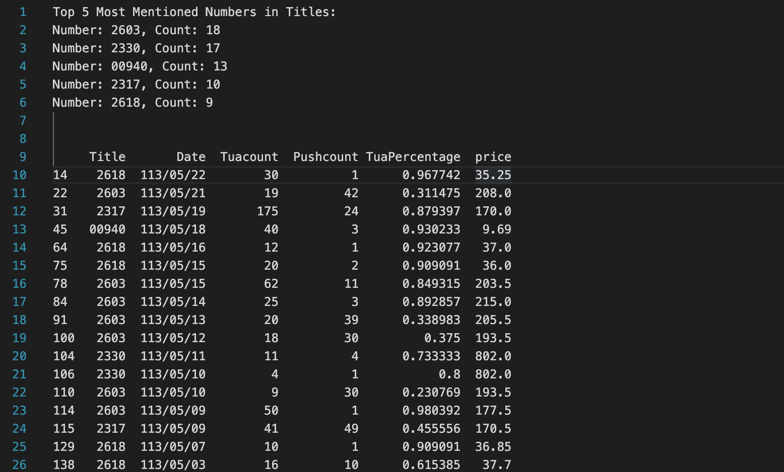
Combine the data together...{
Topic.html
Content.css
}
Programming Language

Slide 12
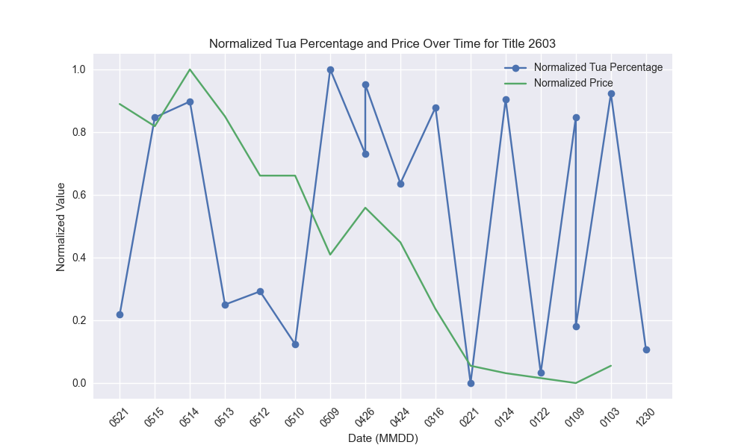
Problems Encountered{
Topic.html
Content.css
01
The Usage of “TuaPercentage”
02
Plot the “TuaPercentage” with Price -> Normalize, Long/Short
03
Use Sentiment Analysis to check whether the comments agree with post
Solution
Use LLM to analyze the Comments
}
Programming Language

Slide 13
Method and Result {
Topic.html
Content.css
<The solution to solve the previously mentioned problems and its result>
}
Programming Language

Slide 14
Solution: Large Language Model {
Topic.html
Content.css
Platform and Model:
< DaVinci(from MediaTek), using GPT-4-Turbo-8k >
Prompt:
< The following data is the comments of a post, analyze that are these comments agree the post? And give it a score from 1~10. 10 means the comments agree>
Feedback:
}
< Analyze based on the aspects. >
Programming Language

Slide 15
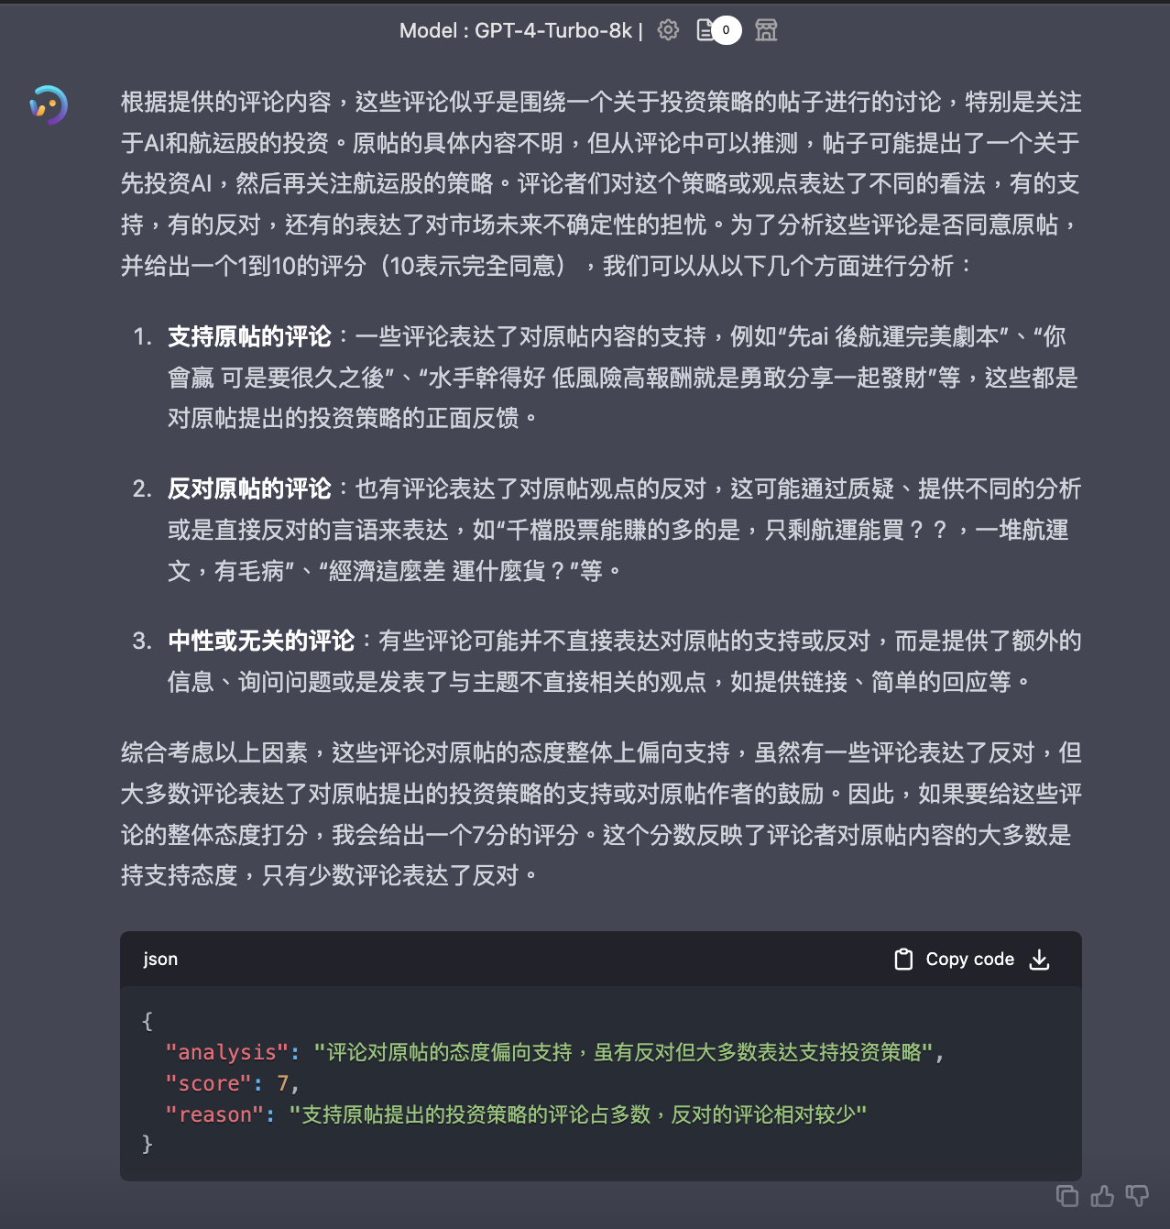

Slide 16
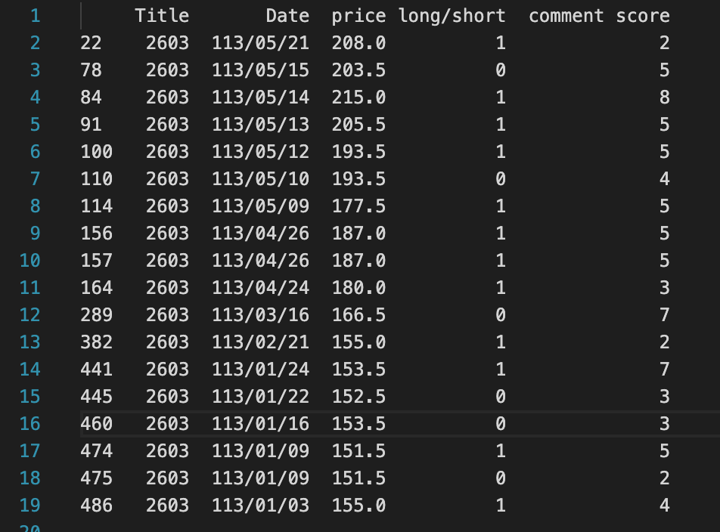

Slide 17
03 {
[Other Results and Potential Problems]
Topic.html
Content.css
< The Remaining of this project >
}
Programming Language

Slide 18
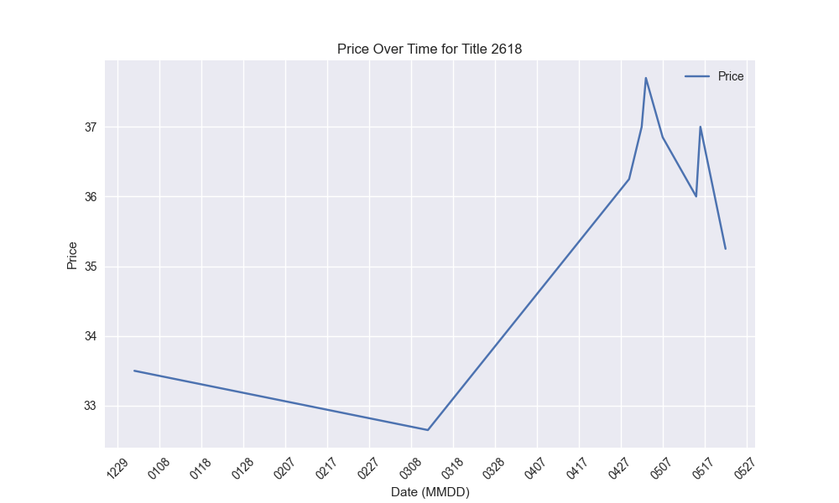
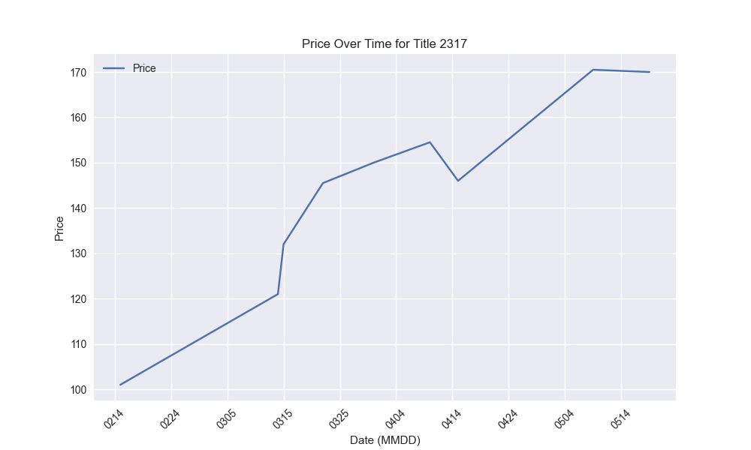
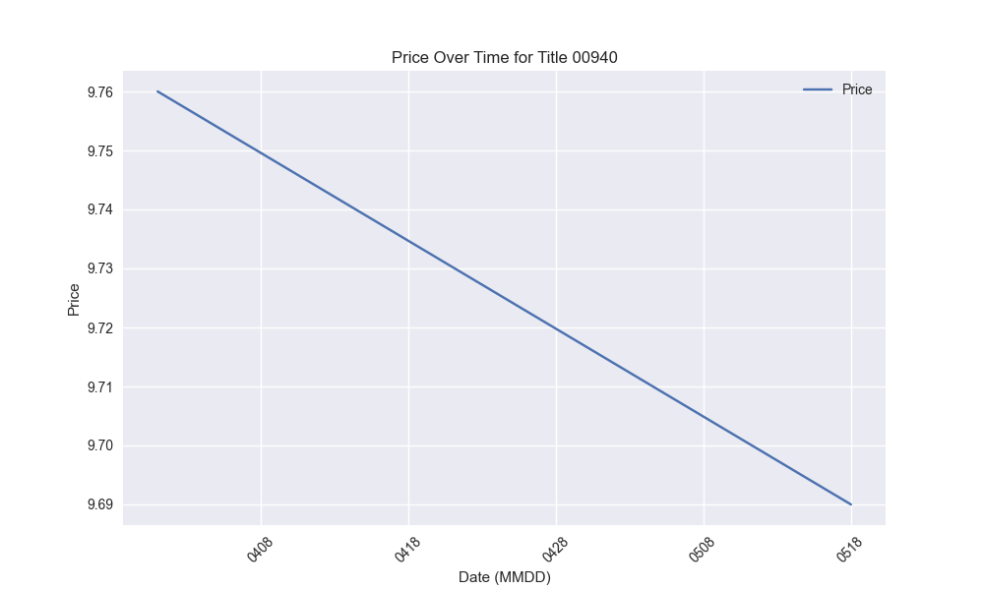
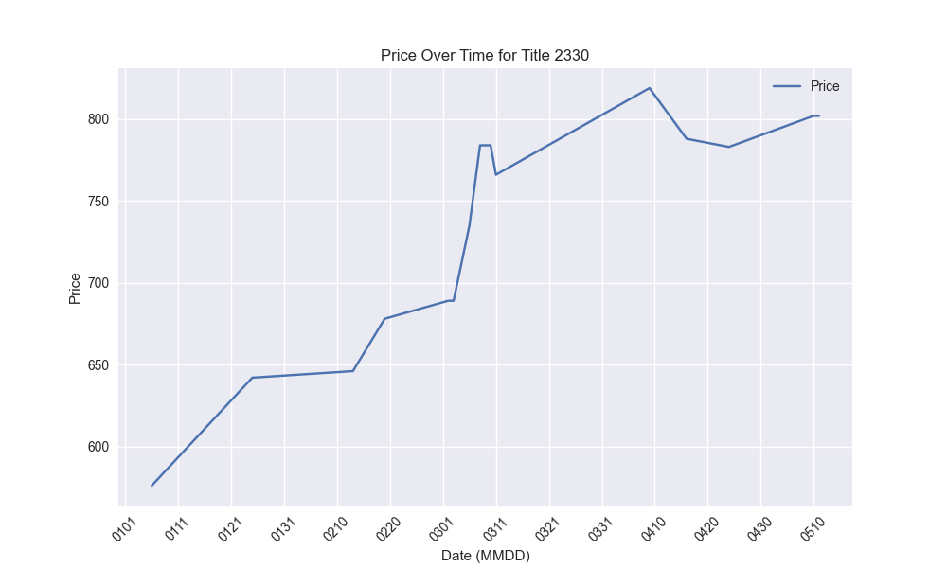
The Plot Graph of Price{
Topic.html
Content.css
2330 台積電
00940元大臺灣價值高息ETF基金
< 自一月漲幅 39.2%>
< 自四月跌幅 3.1%>
2317 鴻海
2618 長榮航
< 自二月漲幅 68.3%>
< 自一月漲幅 5.2%>
}
Programming Language

Slide 19
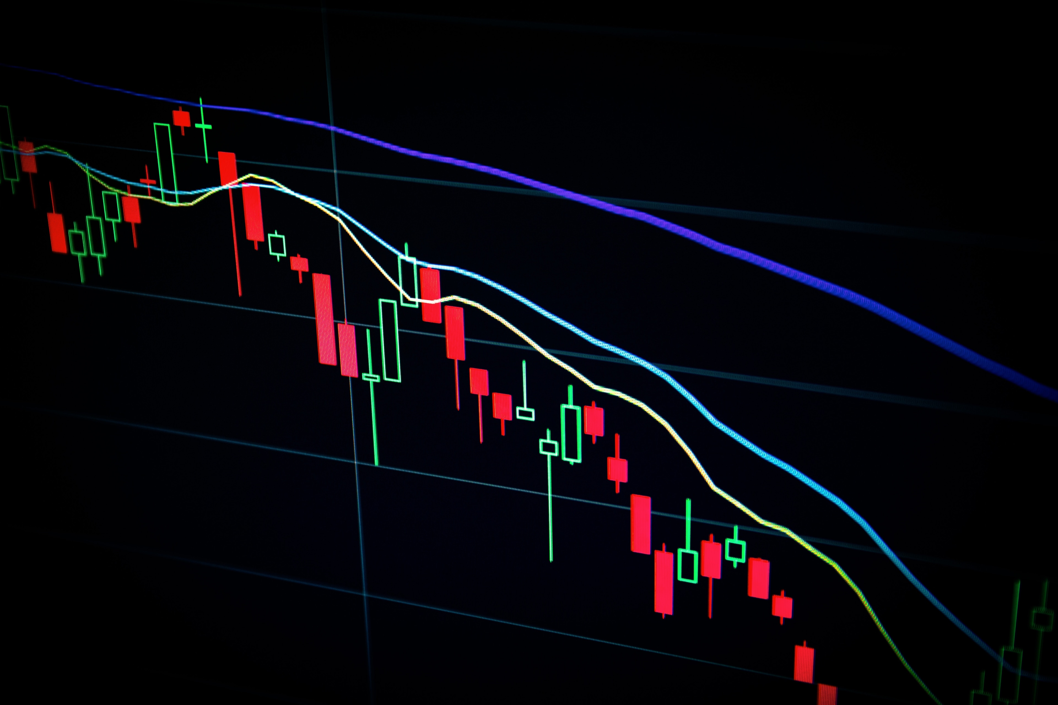
Potential Problem & Prospects{
Topic.html
Content.css
- The comments & LLM
- The analysis of the data
}
Programming Language

Slide 20
Thank { You;
Topic.html
Content.css
}
Programming Language

