Slide 1
Assignment for rec.foundation
Christine neiman
Student#0294083

Slide 2
The price is right
Location : https://www.goldencarers.com>games
Utility: Reminscing and cognitive exercise.
Description: borrowed items on a table.

Slide 3
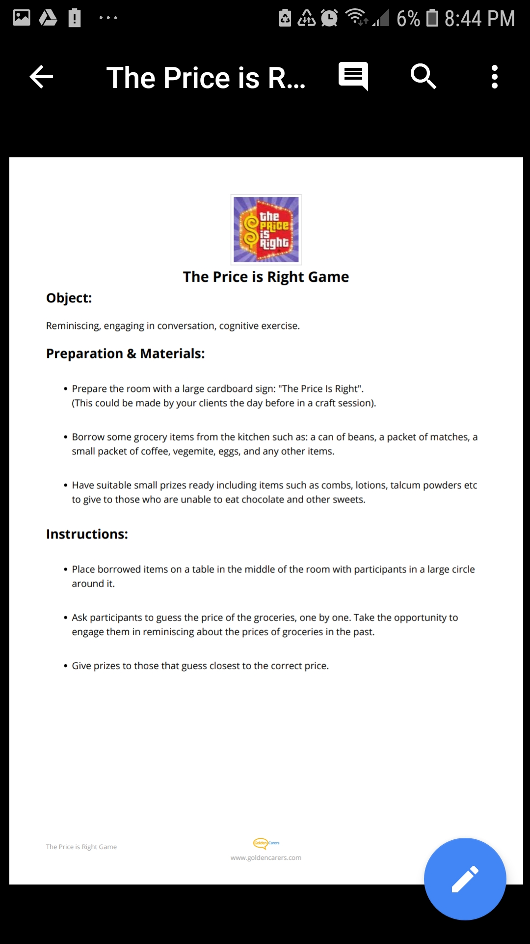

The price is right game

Slide 4
Recycled dream spring tree
Location: https://www.golden cares.com>games
Utility: hand exercise and cognitive skills

Slide 5
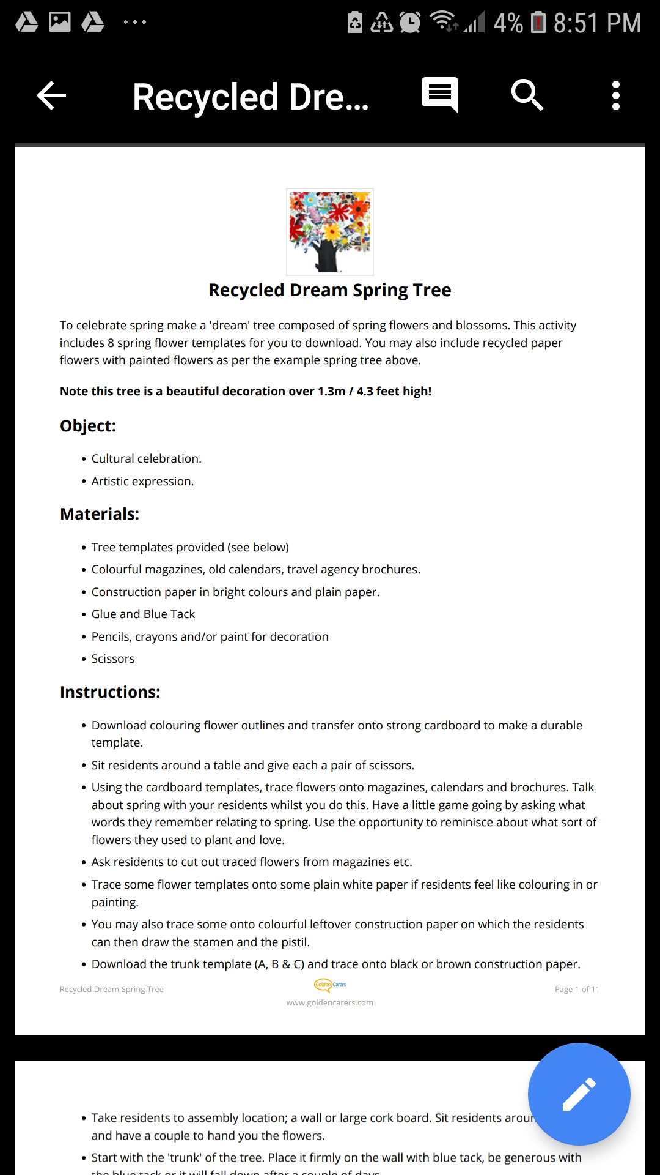

Recycled dream spring tree

Slide 6
School Days reminiscing game
Locations: www.golden carers.com>games
Utility improve dexterity

Slide 7
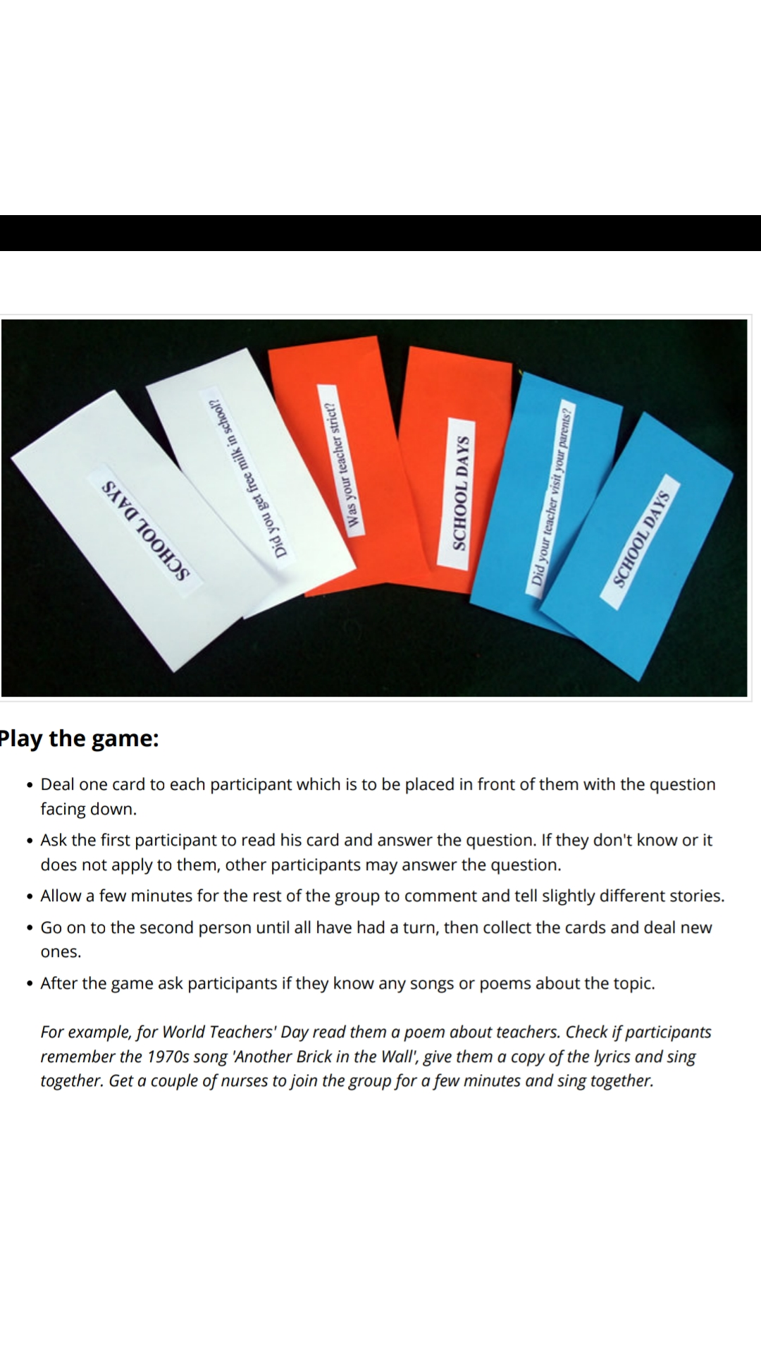

School Days

