Slide 1

Full Stack Web Development Internship
Student Name: Madiha Azam
USN: 3PD22CG048
Company: Jspiders
Duration: 5-6 months
College: Poojya Doddappa Appa College of Engineering.

Slide 2

About Jspiders
Company Overview
Jspiders is a leading IT training and development company specializing in Java technologies and web development. They provide industry-standard training programs and real-world project experience to students and professionals.
Internship Details
Domain: full stack Web Development
Mode: Offline
Focus: Full-stack development using Java ecosystem

Slide 3

Internship Objectives
Master Core Technologies
Learn Advanced Frameworks
Full-Stack Integration
Develop proficiency in SQL, HTML, CSS, JavaScript, and Core Java for building robust web applications
Understand how frontend and backend technologies work together to create complete web solutions
Gain hands-on experience with Spring Framework and Hibernate for enterprise-level application development

Slide 4
Technologies Stack
SQL
HTML & CSS
JavaScript
Database management and query language for data persistence and retrieval operations
Structural markup and styling languages for creating responsive user interfaces
Client-side scripting for interactive web applications and dynamic content
Core Java
Spring Framework
Hibernate
Object-oriented programming fundamentals and essential Java concepts
Inversion of Control, dependency injection, and Spring MVC for web development
Object-Relational Mapping for seamless database integration and persistence

Slide 5
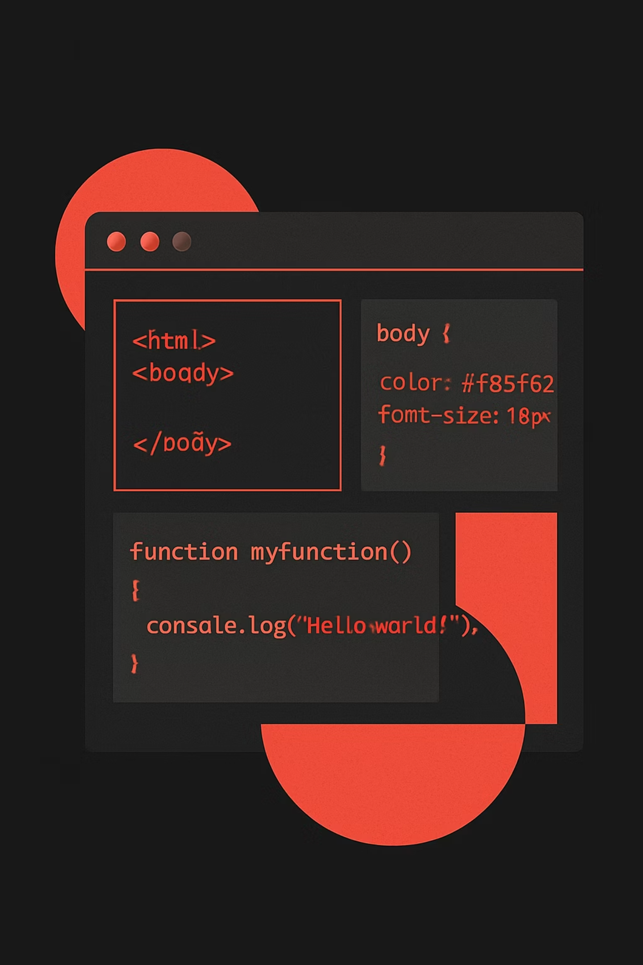
Core Technologies: Frontend
HTML & CSS Foundation
JavaScript Enhancements
Created semantic HTML structures and styled interfaces using CSS. Learned responsive design principles to ensure applications work across devices.
Implemented client-side functionality including form validation, DOM manipulation, and dynamic content updates.
Event handling and DOM traversal
Form validation and error handling
Asynchronous programming concepts
Basic AJAX for server communication
Div-based layouts and semantic markup
CSS selectors, box model, and positioning
Flexbox and Grid for modern layouts
Media queries for responsive design

Slide 6
Core Java Concepts
1
2
Object-Oriented Programming
Data Structures
Implemented classes, objects, inheritance, polymorphism, and encapsulation in real projects
Worked with collections framework including ArrayList, HashMap, and TreeSet for efficient data handling
3
4
Exception Handling
File I/O Operations
Implemented try-catch blocks and custom exceptions for robust error management
Developed skills in reading from and writing to files for data persistence

Slide 7
Spring Frameworks
Spring Framework
Learned dependency injection and Inversion of Control principles. Developed Spring MVC applications with proper controller, service, and repository layer separation.
@Component, @Primary, @Configuration annotations
@Autowired for dependency injection
Spring MVC for web layer
View resolution and request mapping

Slide 8
Work Done & Tasks Completed
01
02
03
Database Design
Frontend Development
Backend Implementation
Created ER diagrams and implemented database schema using SQL with proper normalization and constraints
Built responsive user interfaces integrating HTML, CSS, and JavaScript with dynamic content loading
Developed RESTful controllers, service layers, and repository interfaces using Spring Framework
04
05
Data Integration
Testing & Debugging
Connected frontend with backend through AJAX calls and implemented Hibernate for database operations
Performed unit testing, identified bugs, and optimized application performance

Slide 9
Project Architecture
Book My Ticket
Project Overview - What does the application do? (e.g., allows users to book tickets for events, movies, transportation, etc.)
Key Features - What are the main functionalities? (e.g., user registration, ticket search, booking, payment, cancellation, etc.)
Architecture - How is it structured? (e.g., MVC pattern, layers used, etc.)
Technologies Used - Beyond Spring Boot, what else? (e.g., Spring Data JPA, MySQL, Thymeleaf, REST APIs, etc.)
Database Schema - What are the main entities? (e.g., User, Event, Ticket, Booking, Payment, etc.)

Slide 10
Results & Outcomes
Full-Stack Project
Collaboration Skills
Technical Proficiency
Successfully developed a complete web application from frontend design to backend implementation with database integration
Worked effectively in team environment, participated in code reviews, and followed version control practices
Achieved hands-on expertise in all technologies of Java full-stack development ecosystem

